Slide 1
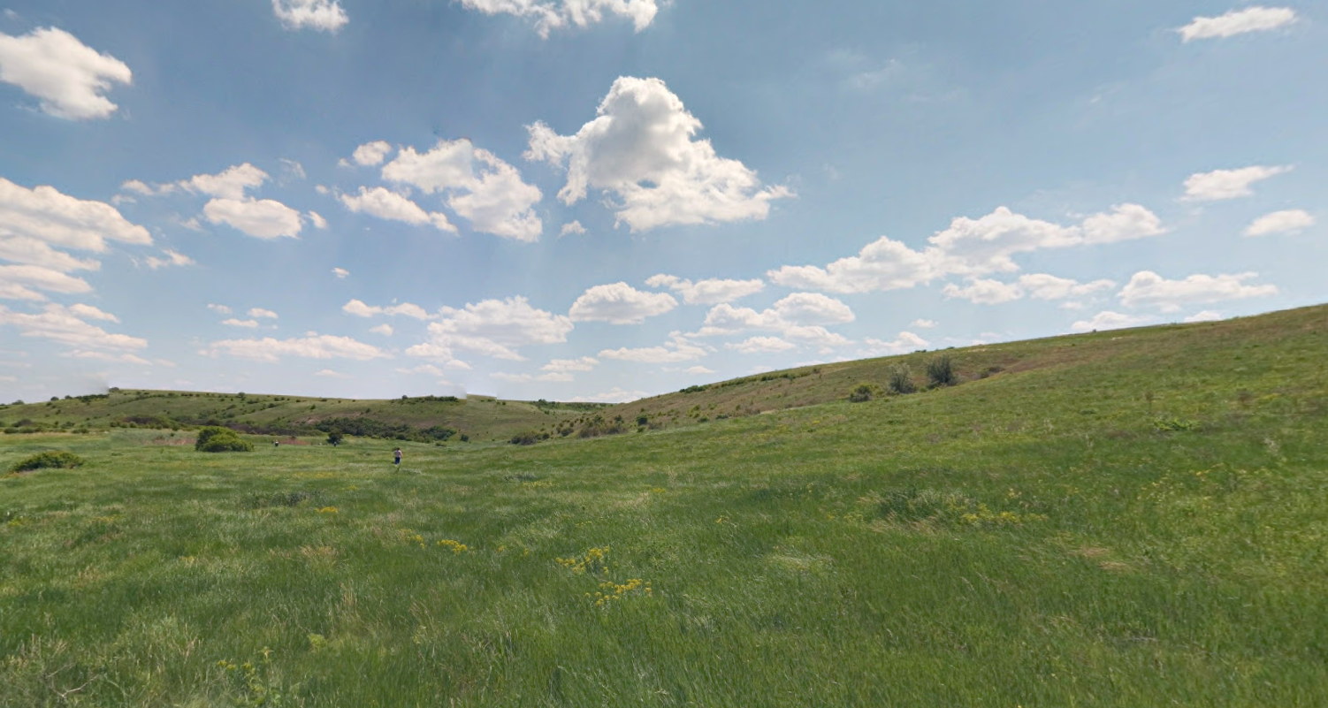
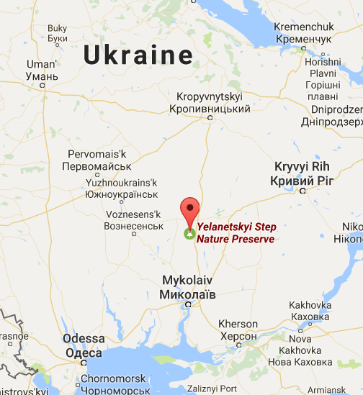
Yelanetsky steppe
Prepared by Troyeshchyna Gymnasium
Katya Tarasenko, Kyiv, Ukraine

Slide 2
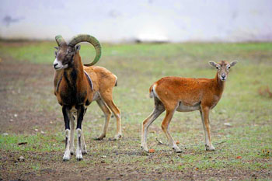
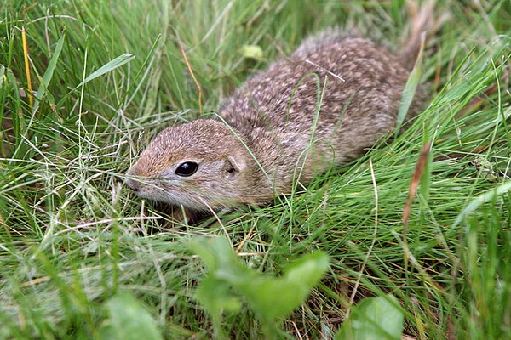
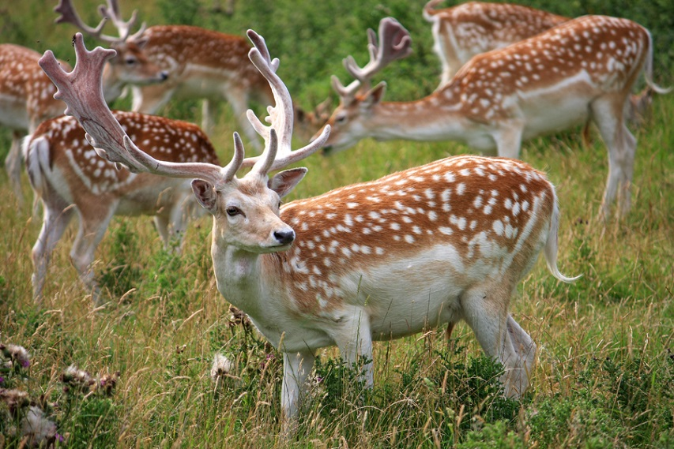
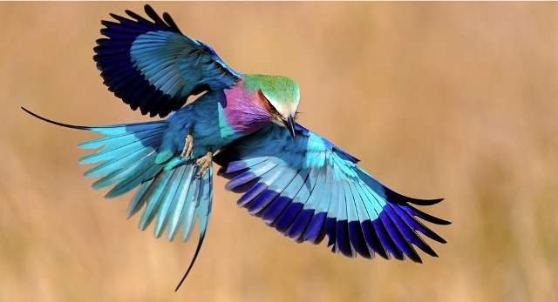
Animals of yelanetsky steppe
Mouflons
Rodents
Fallow deer
Roller

Slide 3
The Yelanetsky Steppe is the nature reserve in the Mykolayiv region of Ukraine.

Slide 4
This Yelanetsky Steppe Reserve was established in 1996.
The Yelanetsky Steppe possesses plants listed in the Green Book. It also protects more than 150 species of the steppe animals also registered in the Red Book of Ukraine and the European Red List.

Slide 5
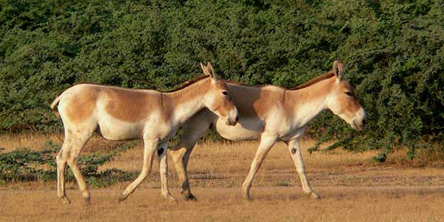
Originally (since 1978) there was a mini-zoo so called Protected area "Roza" - the animals were imported from Askania Nova. Since 1982, the protected area was promoted to a landscape protected area and since 1996, it is the Nature Reserve "Yelanetskaya steppe". The mini-zoo worked all the time, till it has grown into Safari-park in the frame of Nature Reserve. Despite its more than thirty years of history, the Safari-Park (and also Reserve) is de facto unknown and unheeded place, because no decent road goes here. Currently, there is one large (about 70 ha) enclosure of bisons, kulans, sika deer, fallow deer and mouflons.
Bisons
Kulans

Slide 6
information sources
http://en.discovermykolaiv.com.ua
http://exploreua.com
http://tic.mk.ua
https://uk.wikipedia.org/wiki/

