Slide 1
Reserve Askania-Nova
Troyeschyna Gymnasium
Kyiv
Ukraine
Authors:
Maxim Sergeyev
Marina Bradul
Miroslava Tsinkovska

Slide 2
Askania-Nova
Biosphere reserve Askania-Nova is the world famous national Park of Ukraine, the only European area of fescue-feather grass steppes, which has never been touched by a plow. There is a zoo, a collection of birds and animals from almost every country of the world. Wild animals live in the wild. Most of the territory is a beautiful Botanical Park with numerous artificial lakes and ponds.

Slide 3
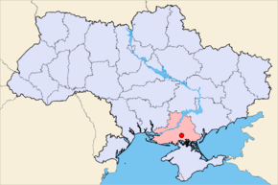
Location
It is located near the town Askania Nova Chaplinsky district, Kherson region (whence the name and former Reserve - "Heron").

Slide 4
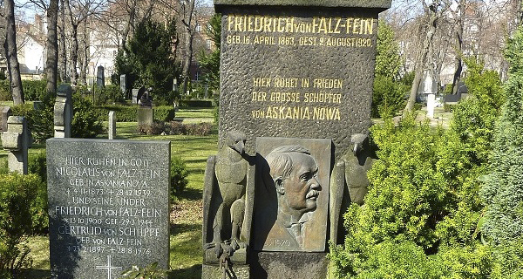
History
The reserve was established in 1874 by Frederick Faltz-Fein. At first the young Faltz-Fein aimed to preserve wildlife - in 1874 the 11-year old boy erected enclosures for animals. In 1887 he created a botanical garden.
In 1898 Faltz-Fein announced Private Reserve.

Slide 5
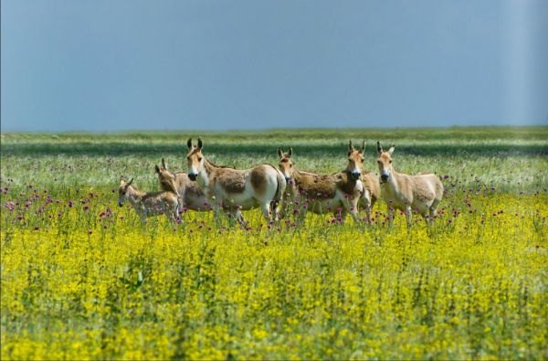
Tasks of Askania-Nova
Askania-Nova was created to preserve and study the nature virgin steppe and acclimate and explore the greatest possible number of species of animals and plants that had economic importance. In Askania there is a scientific prairie station, zoo-technical station of breeding farms, fitotehnichna station and some research institutions.
It has 12 departments (including the botanical gardens and protected steppe and zoological park), 9 laboratories, Science Museum; is an experimental farm and 4 factories livestock breeding.

Slide 6
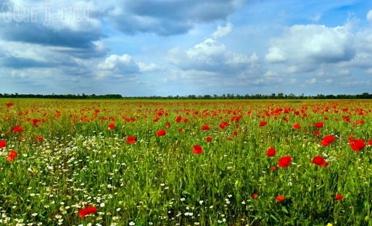
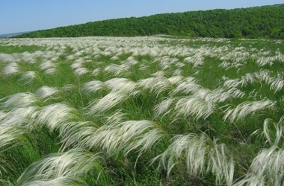
Weather
In the spring, the silver waves of the feather-grass gently gleam in the sun, dark flesh gives the fescue, the red poppies glow brightly, attracting seductive hyacinths in blue and purple tones, the chamomiles gently white.
The wild steppe is a peculiar oasis - a dendrological park, which includes a botanical park, a forest-steppe zone with oak forests and a new park.

Slide 7
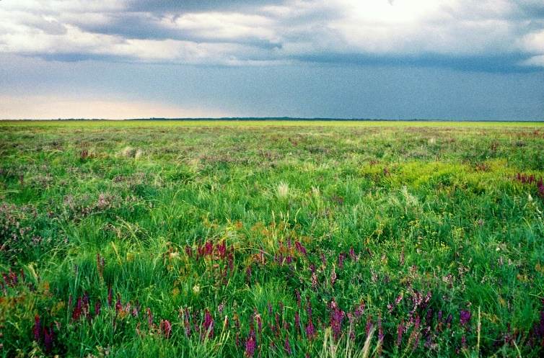
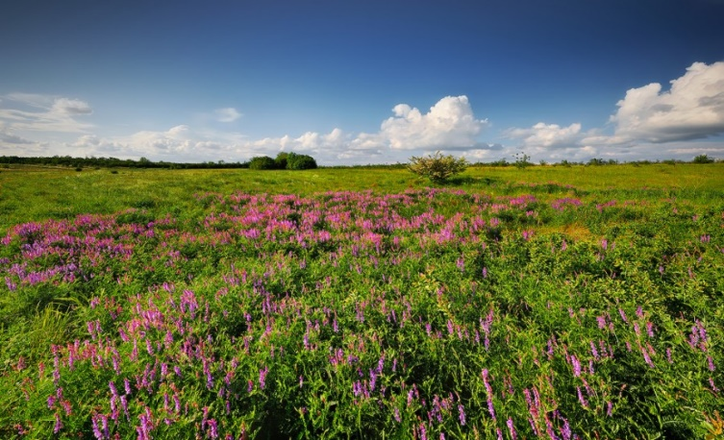
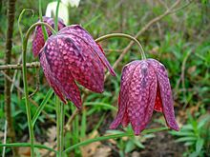
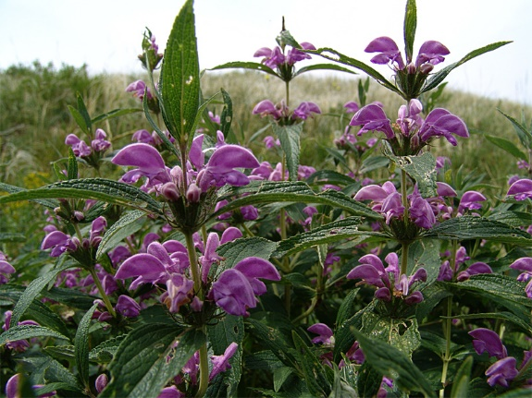
Rare plants
1. Astragalus Henning
2. Astragalus bent
3. Cornflower Taliyeva
4. Eremohone tough
5. Groundsel Dnieper
6. Zaliznyak hybrid
7. Zaliznyak Scythian
8. Zirkoplidnyk chastuhovyy
9. Orchis ridkokvitkovyy
10. Caragana Scythian
11. Feather hairy
12. Lessing feather
13. Priazovskaya feather
14. Ukrainian feather
15. Lamkokolosnyk Sitnikov
16. Lyonok Bieberstein
17. lythraceae chebretselystyy
18. Elatine Hungarian
19. Grouse small
20. Sitnik kulyastoplodyy
21. Tulip Scythian
22. Tulip Schrenk
23. Ferule east
24. Onions Regel
25. Bow Scythian
26. Sorrel Ukrainian

Slide 8
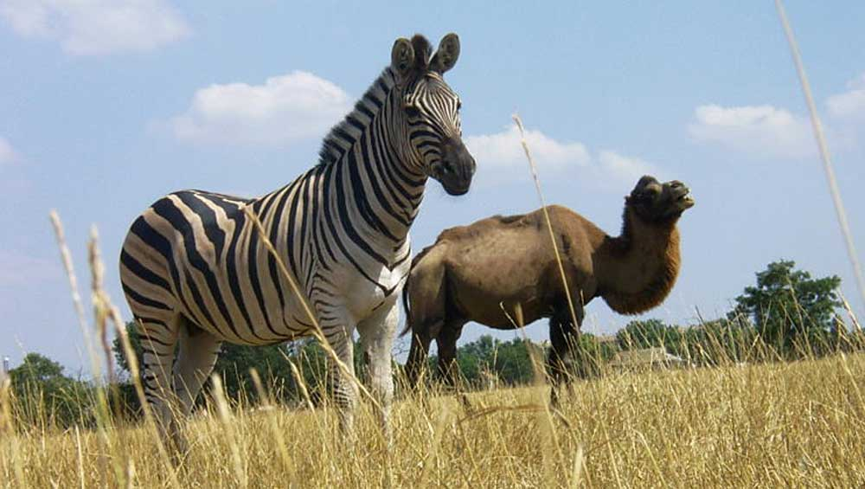
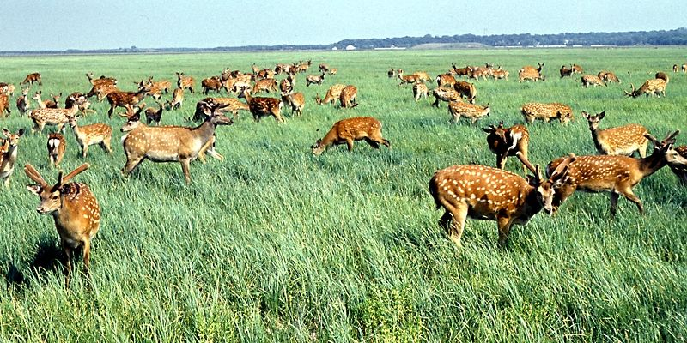
Animals
In vast enclosures of the zoo area of 30 sq km a lot of animals live in semi-free conditions. Numerous zebras and antelopes, bison and Buffalo, deer and wild horses live there, in total more than 1000 animals and 40 hybrid forms. These "guests" of Askania steppe feel themselves home in spacious enclosures.
Here you can find several species of antelope (Indian, African, American), wild goats and sheep, Asian bulls, Przewalski's horses, zebras, bison, various deer, llamas, guanacos and others.
A large and rare collection of waterfowl breeds live in artificial ponds. There you can see graceful swans, wild geese, various ducks; there are all kinds of ostriches, pheasants and numerous small tropical ornamental birds.

Slide 9
The materials are taken from:
https://uk.wikipedia.org/wiki
http://gdz4you.com/prezentacii/
prezentaciya-na-temu-askania-nova.html
https://ua.igotoworld.com/ru
http://uateka.com/ru/article/geography/

