Slide 1
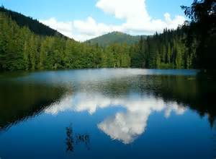
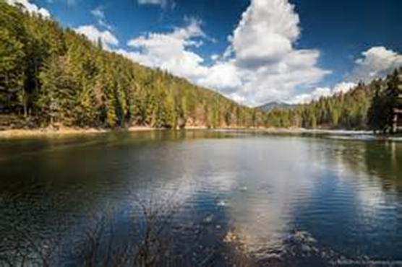
Troyeschyna Gymnasium Kyiv Ukraine
Autors :
K.Petrenko
Y.Lipkevich
Lake Synevyr
Natural wonders of Ukraine

Slide 2
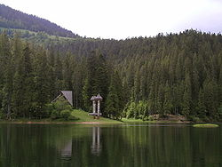
About this lake
Lake Synevyr – is the largest lake in the Carpathian Mountains of Ukraine.

Slide 3
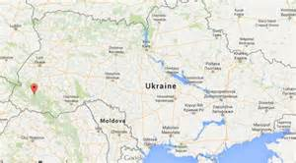
Where is it?
It is located in Mizhhiria Raion, Zakarpattia Oblast, not far from the village of Synevyr Poliana.

Slide 4
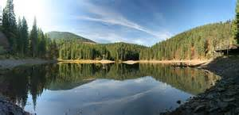
The forest around the lake
The forest around the lake is believed to be 140 to 160 years old. There is a very small island in the middle of the lake with an area of a few square meters which is called the Sea Eye (Morske Oko). The island has been flooded for some time.

Slide 5
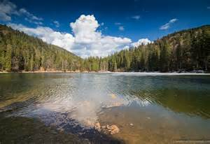
A legend
A legend states that the lake appeared (2,485 moons ago) out of the tears of one of count's daughters Syn, because her love, the Verkhovynian cowboy Vir, was killed by the order of the count, her father.

Slide 6
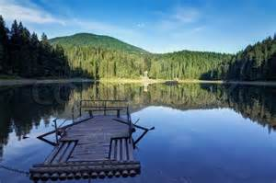
About the park
Swimming, camping, and fishing at that lake is prohibited. All the services that the park offers cost around $1 (₴ 5, 2008). There is a scenic path around the lake, which is rather round. Along the path park guests will find a few gazebos and a "rest house". There is also a horse-back riding service that takes customers on a trail ride around the lake.

Slide 7
Welcome to Synevyr!

Slide 8
Materials
All these materials are from the website Wikipedia

