Slide 1
Connecting seas
KA229 - School Exchange Partnerships
Nr: 2019-1-RO01-KA229-063231_1

Slide 2
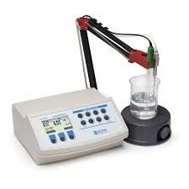
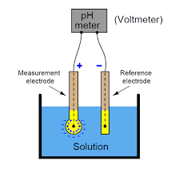
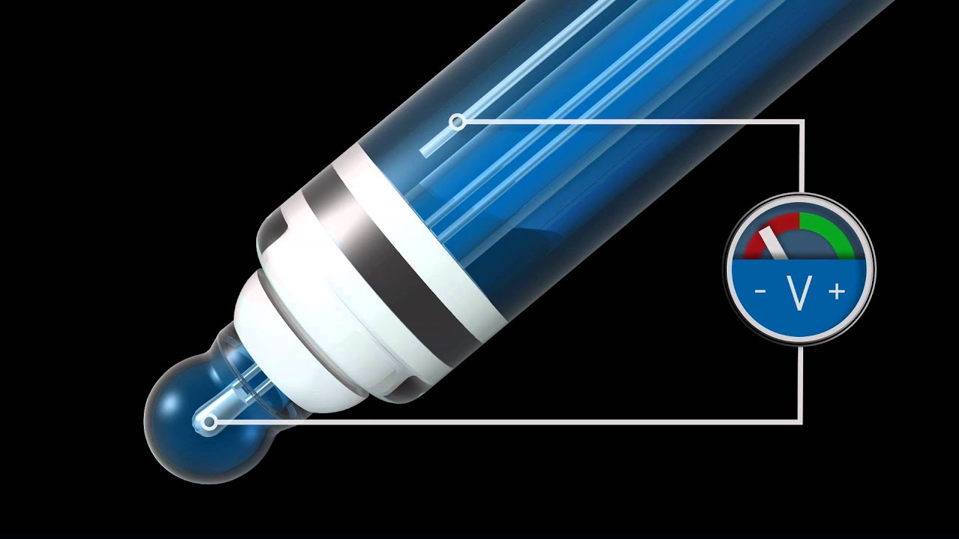
2. The electrometric method with a potentiometer (pH meter)
The potential difference between a glass electrode and a reference electrode (saturated calomel-KCl), introduced into the water sample, varies linearly with the pH of the water sample.

Slide 3
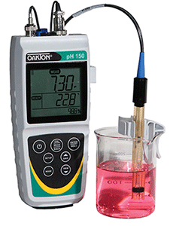
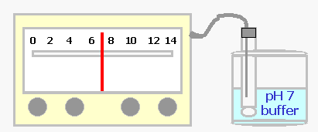
2. The electrometric method with a potentiometer (pH meter)
• insert the electrode into the water sample
• the pH value is read on the pH meter scale
• the operation is repeated two more times
• the final value is the average pH range of the all 3 determined values

Slide 4
LABORATORY TASK # 1
Determine the pH value of your water sample, and write the
value on your worksheet, through the:
Colorimetric Method
Electrometric method
Sample No. | The source of the water sample | pH Value (Colorimetric Method) | pH Value (Electrometric Method) | Standard water pH ​​ | Remarks
1 | Atlantic Ocean |  |  | 6.5-9
2 | Adriatic Sea |  |  | 6.5-9
3 | Black Sea |  |  | 6.5-9
4 | Fresh water |  |  | 6.5-8.5

Slide 5
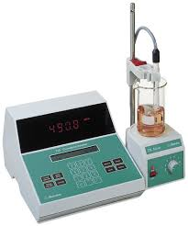
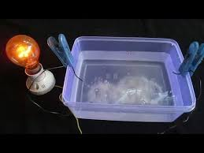
Determination of water electric conductivity
The conductivity reflects the salt content of the water
The electrical conductivity of the water depends on the content of electrolytes and their strength.
The electric conductivity of the water is measured in the laboratory with a device called conductometer.
The electrical conductivity has as Siemens unit of measure per meter, S ∙ m-1 and its sub-multiples.

Slide 6
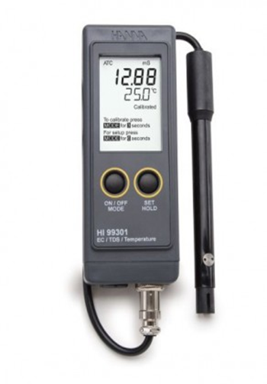
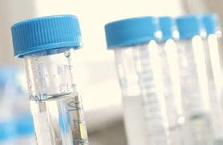
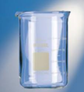
Necessary lab equipment and reagents
water sample conductometer Berzelius beaker
Procedure
• calibrate the device with distilled water
• insert the electrode into the water sample
• read the determined value

Slide 7
LABORATORY TASK # 2
Determine the electric conductivity of your water sample,
and write the value on your worksheet.
Sample No. | The source of the water sample | Conductivity, µS/cm | Standard Conductivity ​​of water µS/cm | Remarks
1 | Atlantic ocean |  | ˃ 2500
2 | Adriatic sea |  | ˃2500
3 | Black sea |  | ˃2500
4 | Fresh water |  | ≤2500

Slide 8
Thank you for your attention!

