Slide 1
Connecting seas
KA229 - School Exchange Partnerships
Nr: 2019-1-RO01-KA229-063231_1

Slide 2
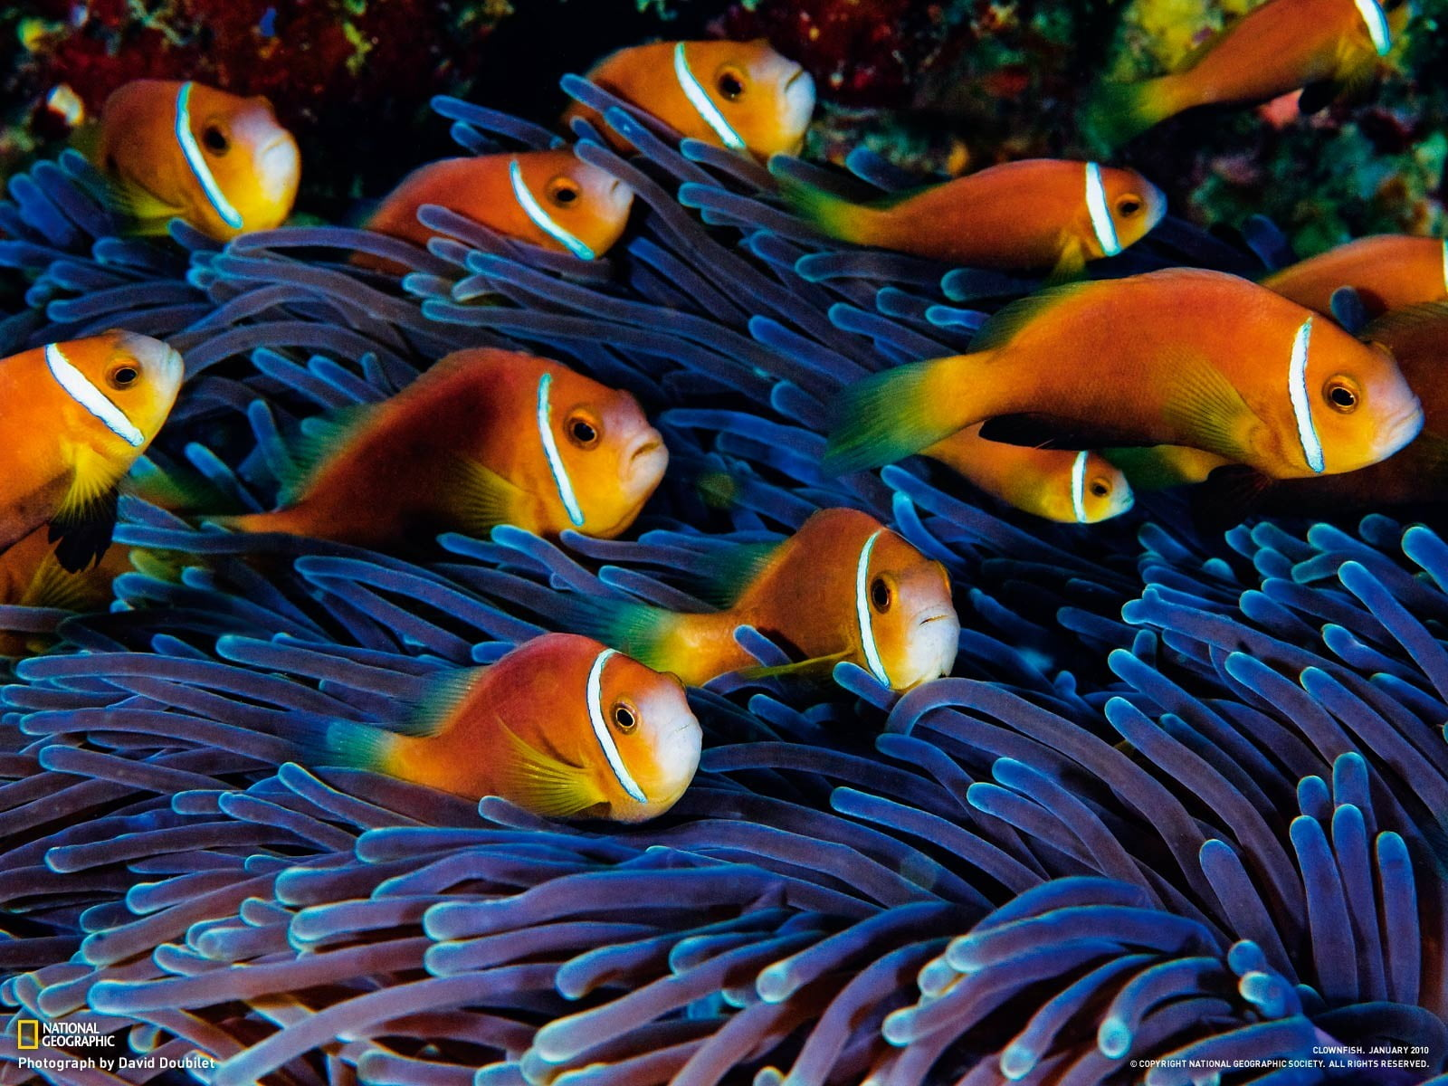
BIODIVERSITY OF MARINE LIFE
Due to abiotic factors, such as salinity, water temperature or light availability, species are not evenly distributed throughout the sea and the diversity of life varies in different parts of the sea.

Slide 3
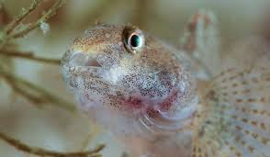
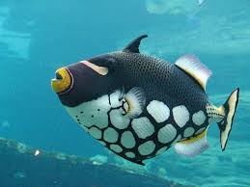
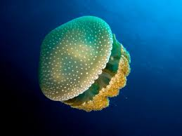
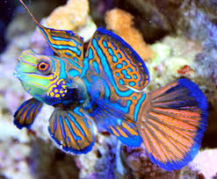
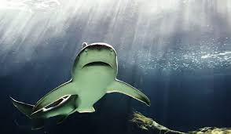
Remember you have to attribute!*

Slide 4
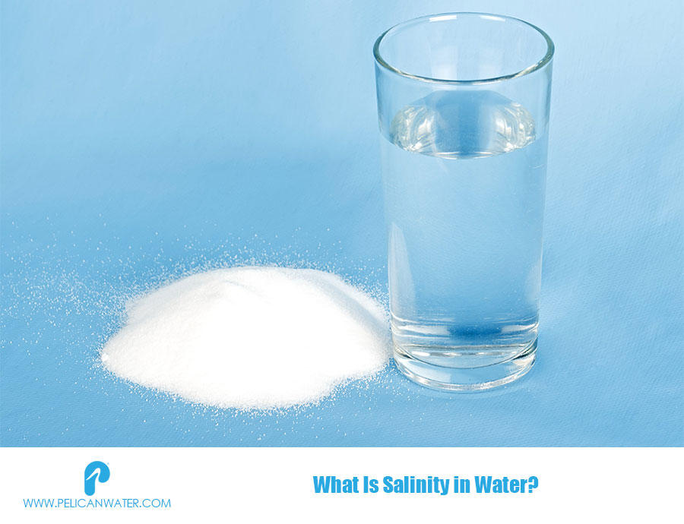
Determination of water salinity
Salinity is a chemical property of seawater that plays an important role thermal regime flow, in the water currents formation and in the development of marine life conditions.
The salinity of water is determined by the chlorides in the water
Chlorides from water result from soil or from animal/human pollution.
The chloride concentration in the water varies over time.

Slide 6
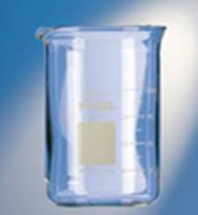
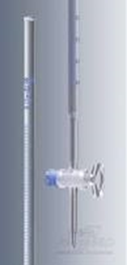
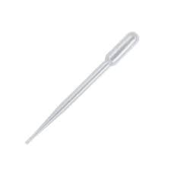
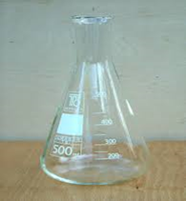
Necessary lab equipment and reagents
Berzelius beaker Biurette Pipette Erlenmeyer beaker
0.1 N AgNO₃ solution
10% K₂CrO₄ solution
distilled water

Slide 7
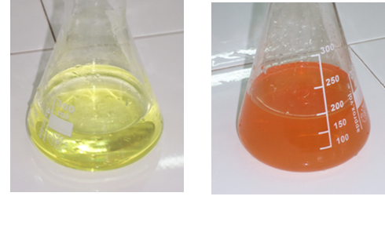
Procedure
take 2 ml of water sample in an Erlenmeyer beaker
add 3 drops of potassium chromate solution
titrate with silver nitrate solution (AgNO₃), until the color turns from yellow to brick-red

Slide 8
Calculations
Where:
V_{AgNO3} - stands for the volume of AgNO₃ solution used in titration, measured in ml
C_{AgNO3} – stands for the concentration of the solution of AgNO₃
A_{Cl} – stands for the atomic mass of chlorine (35,5)
V_{p} - stands for the water sample volume, measured in ml
Salinity is calculated by the Knudsen method
Q = 1,811×Cl (0/00)

Slide 9
LABORATORY TASK # 3
Determine the salinity of your water sample,
and write the value on your worksheet.
Sample No. | The source of the water sample | Salinity of analyzed water 0/00 | Standard Salinity ​​of water 0/00 | Remarks
1 | Atlantic Ocean |  | 33-37
2 | Adriatic Sea |  | 35-38
3 | Black Sea |  | 18
4 | Fresh water |  | ≤ 0.5

Slide 10
Homework assignment – next meeting
Compare the results of the analyzes with the standard values.
Compare the physical and chemical water properties of the Atlantic Ocean, Adriatic Sea and Black Sea.
Identify 3 stenohaline and 3 euryhaline species that you can find in your local marine ecosystems.

Slide 11
Thank you for your attention!

