Slide 1

Connecting seas
KA229 - School Exchange Partnerships
Nr: 2019-1-RO01-KA229-063231_1

Slide 2
DIVERSITY OF SEA LIFE
The chemical composition of the seawater influences the marine biodiversity and sea life.

Slide 3
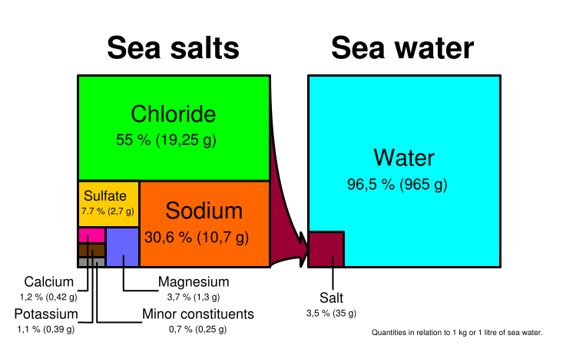



Main chemical constituents in seawater

Slide 4
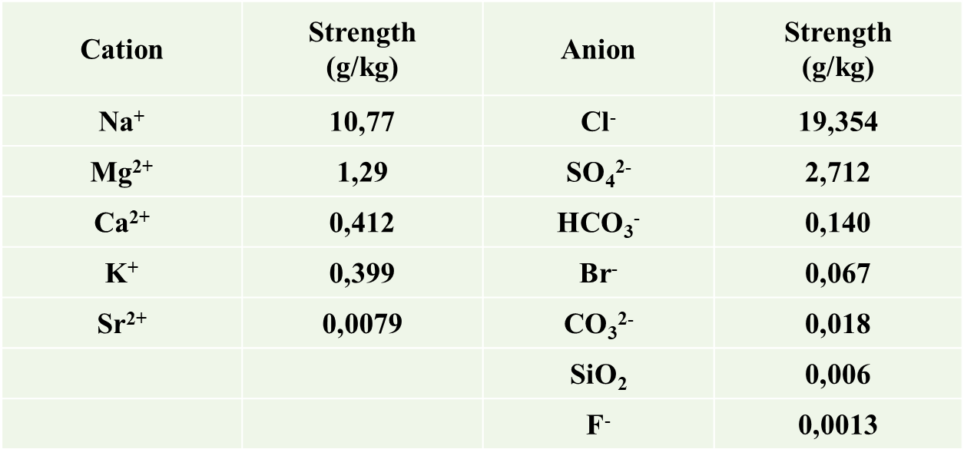
Ocean water composition at salin
Seawater chemical composition at a salinity of 35 ‰ (parts per thousand) and a pH between 7.5 and 8.3 (common range 7.8 - 8.2)
‰ pH between 7.5 and 8.3 (often 7.8 and 8.2)

Slide 5
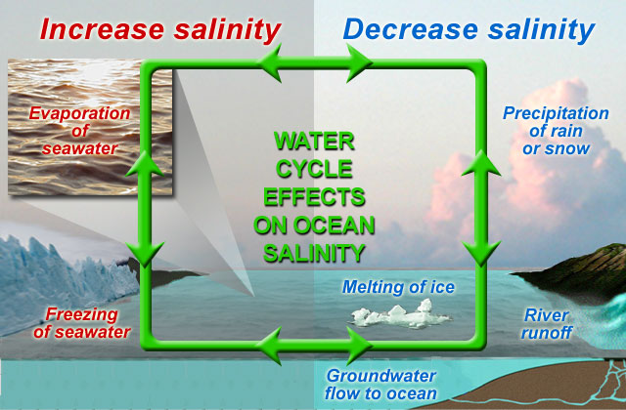
Seawater salinityThe Salinity of sea water
  - The Black Sea has low salinity (18 0/00), because many rivers flow into it.
  The Mediterranean Sea has a salinity of 39 0/₀₀ because rivers with low flow are discharged in it.
  The Atlantic Ocean has the highest salinity (35.4 0/ ₀₀); this is explained by the transport of hot and salt water.

Slide 6
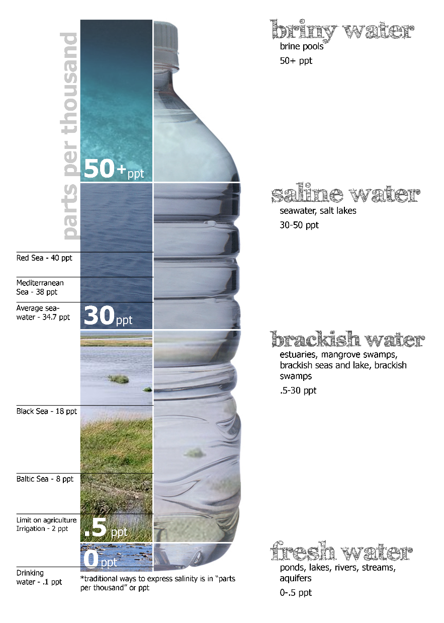
Bodies of water by salinity Salinity of sea water

Slide 7
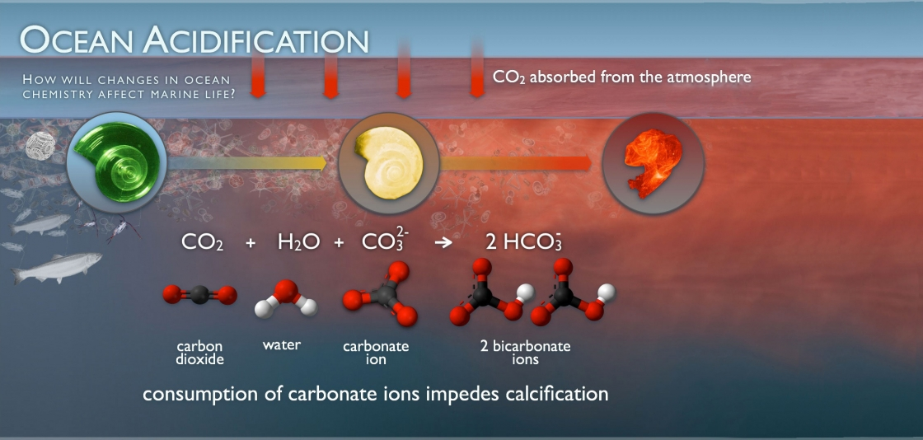
Remember you have to attribute!*

Slide 8
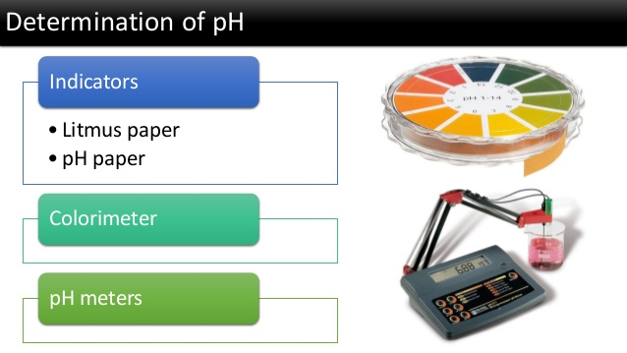
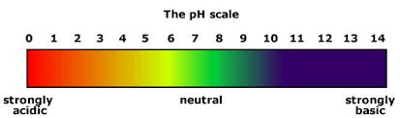

Slide 9
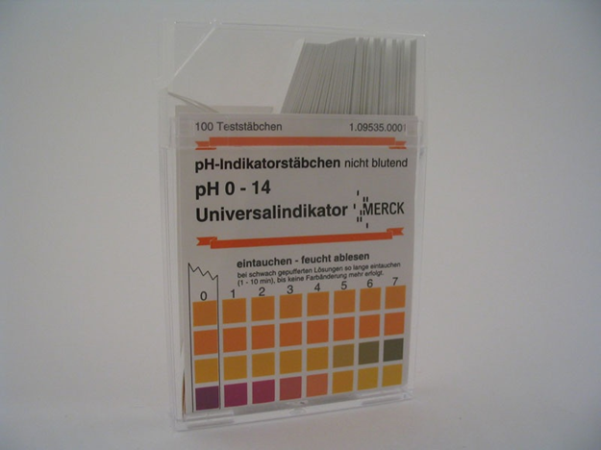
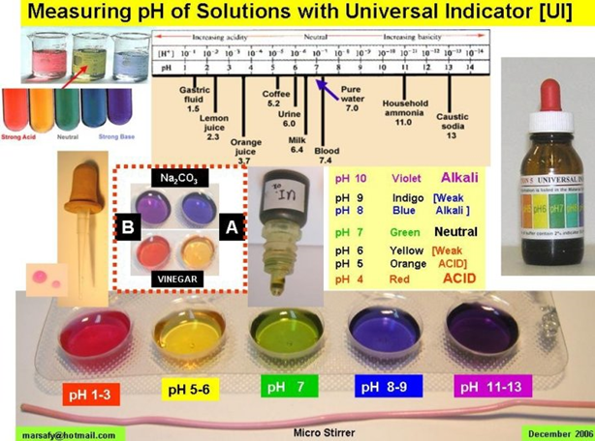

1. The colorimetric Method
pH Paper
Universal indicator

Slide 10
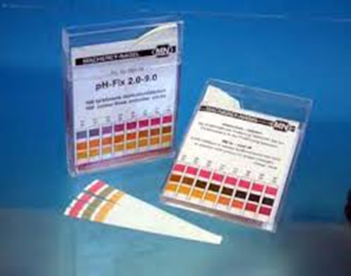
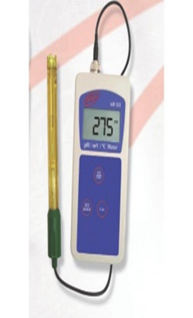
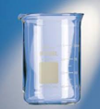
Necessary lab equipment
pH paper pH meter Berzelius beaker
Procedure
1. The colorimetric method
• a quantity of water is taken from the sample to be analyzed
• the sample is placed in a Berzelius beaker
• take a piece of indicator paper/pH paper and insert into the water sample
• the color that appears on the paper is observed and it is compared with the calibration scale after which the pH value is read

Slide 11
Thank you for your attention!

