Slide 1
FROM Czechoslovakia TO THE CZECH REPUBLIC
Viktorie Durčáková

Slide 2
What is czechoslovakia ?
Czechoslovakia was a soveregin state in Central Europe that existed from Otober 1918, when it declared its independence from the Austro-Hungarian Empire, until its peaceful dissolution into the Czech Republic and Slovakia on 1 January 1993.

Slide 3
Presidents
Tomáš Garrigue Masaryk (1850-1937)
Edvard Beneš (1884-1948)
Emil Hácha (1872-1945)
Antonín Zápotocký (1884 – 1957)
Antonín Novotný (1904 – 1975)
Ludvík Svoboda (1895 – 1979)
Gustáv Husák (1913 – 1991)
Václav Havel(1936 – 2011)
Václav Klaus (2011 – 2013)
Miloš Zeman (2013- to this day)

Slide 4
Official names
1918–1920: Republic of Czechoslovakia.
1920–1938: Czechoslovak Republic.
1938–1939: Czecho-Slovak Republic.
1945–1960: Czechoslovak Republic
1960–1990: Czechoslovak Socialist Republic.
1.January 1993: Czech republic, Slovakia

Slide 5
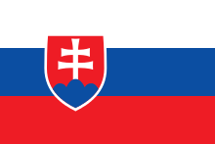
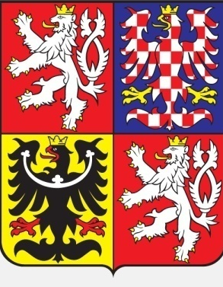
Flags and coats of arms
Czechoslovak and Czech flag
Czechoslovak coat of arms
Slovak flag
Czech coat of arms
Slovak Coat of arms

