Slide 1
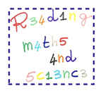
Impossible
Cristina Catana
Ilaria Monni
Dividing by zero is strictly forbidden!!!
You cannot divide a number by zero…
Why?
Because the result is not real!
:
=

