Slide 1
Endangered plants and animals in Romania
Don’t let them become extinct!

Slide 2
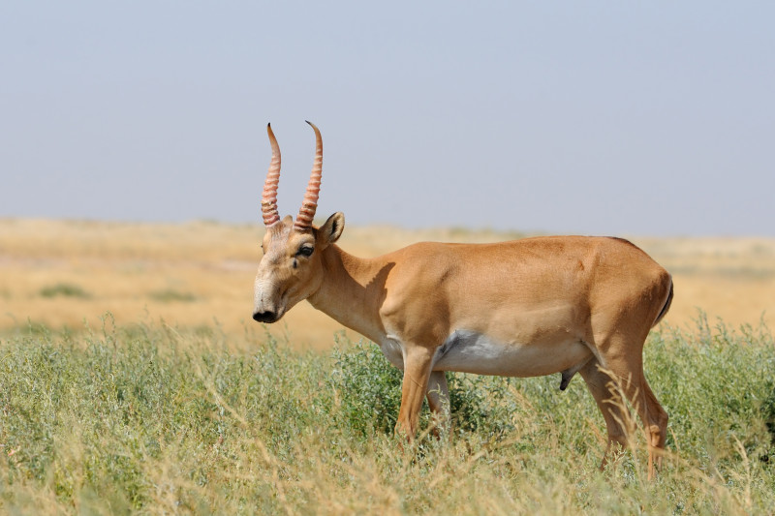
The Saiga Antelope
The saiga antelope (Saiga tatarica), or saiga, is a critically endangered antelope which during antiquity inhabited a vast area of the Eurasian steppe spanning the foothills of the Carpathian Mountains in the northwest and Caucasus in the southwest.
Today, the populations have again shrunk enormously – as much as 95% in 15 years.. The saiga is classified as critically endangered by the IUCN. A few saigas can be found in the natural reservation Lunca Prutului, but in Romania they don’t live in the wild anymore.

Slide 3
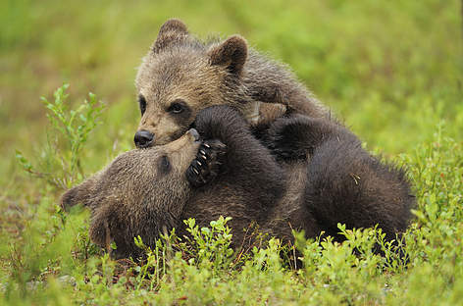
The Brown Bear
The Carpathians are home to about 8,000 brown bears in Slovakia, Poland, the Ukraine and Romania, the second largest population in Europe. Bears are considered of high priority in conservation. Given their dependence on large natural areas, they are important management indicators for a number of other wildlife species. This understanding has been reflected in their protection status in international legislation such as the Convention on the Conservation of European Wildlife and Natural Habitats (Bern Convention, Bern, 1979), where the brown bear is listed in Appendix II (strictly protected species), the EU Habitats Directives and the Pan-European Biological and Landscape Diversity Strategy (PEBLDS).

Slide 4
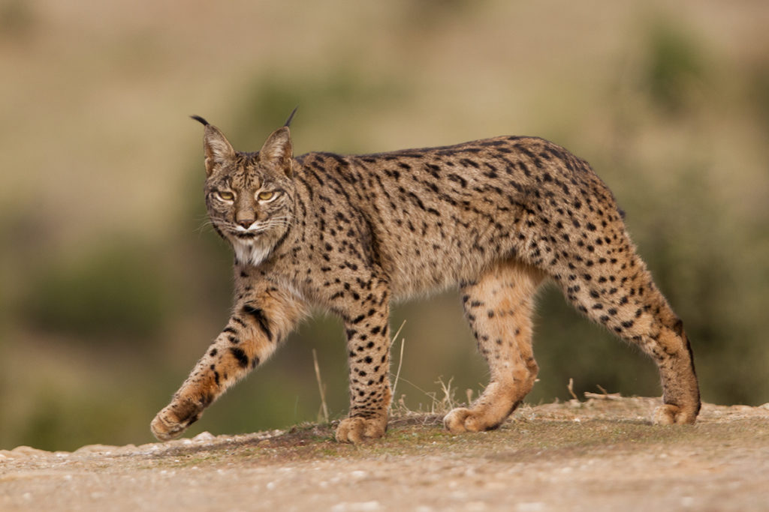
The Lynx
Lynx are like most cats: they have terrific eyesight, especially at night, and better hearing than humans.
The Eurasian lynx Lynx lynx in the Carpathians normally live above 1000m, resting on cliffs and rocks, out of human reach, but watching and curious all the time. In wintertime, they may follow their prey down to lower altitudes where there is less snow.
The lynx population in the Carpathians is officially estimated to be about 2,500 - the densest in Europe.

Slide 5
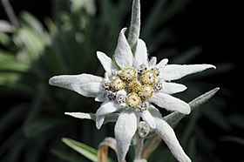
Floarea de Colt
Leontopodium nivale, commonly called edelweiss (is a mountain flower belonging to the daisy or sunflower family Asteraceae. The plant prefers rocky limestone places at about 1,800–3,000 metres (5,900–9,800 ft) altitude. It is non-toxic and has been used in traditional medicine as a remedy against abdominal and respiratory diseases.
Leontopodium nivale is considered a least concern species by the IUCN.
The population of this species declined due to overcollection, but is now protected by laws, ex situ conservation and occurrence in national parks.

