Slide 1
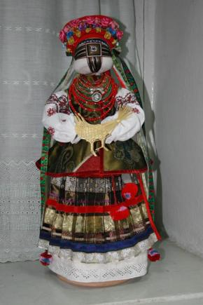
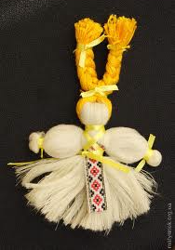
How to make a national Ukrainian doll “motanka”
Lubny School 6, Ukraine

Slide 2
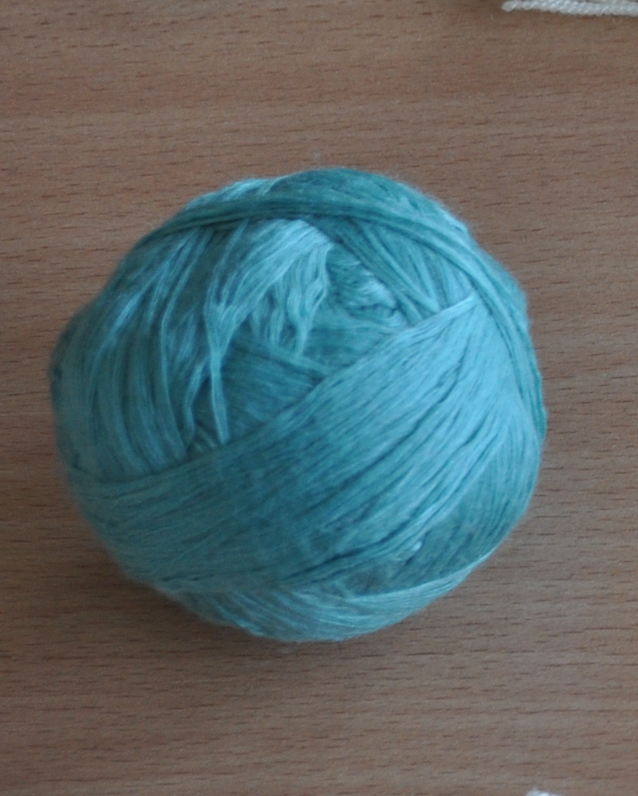
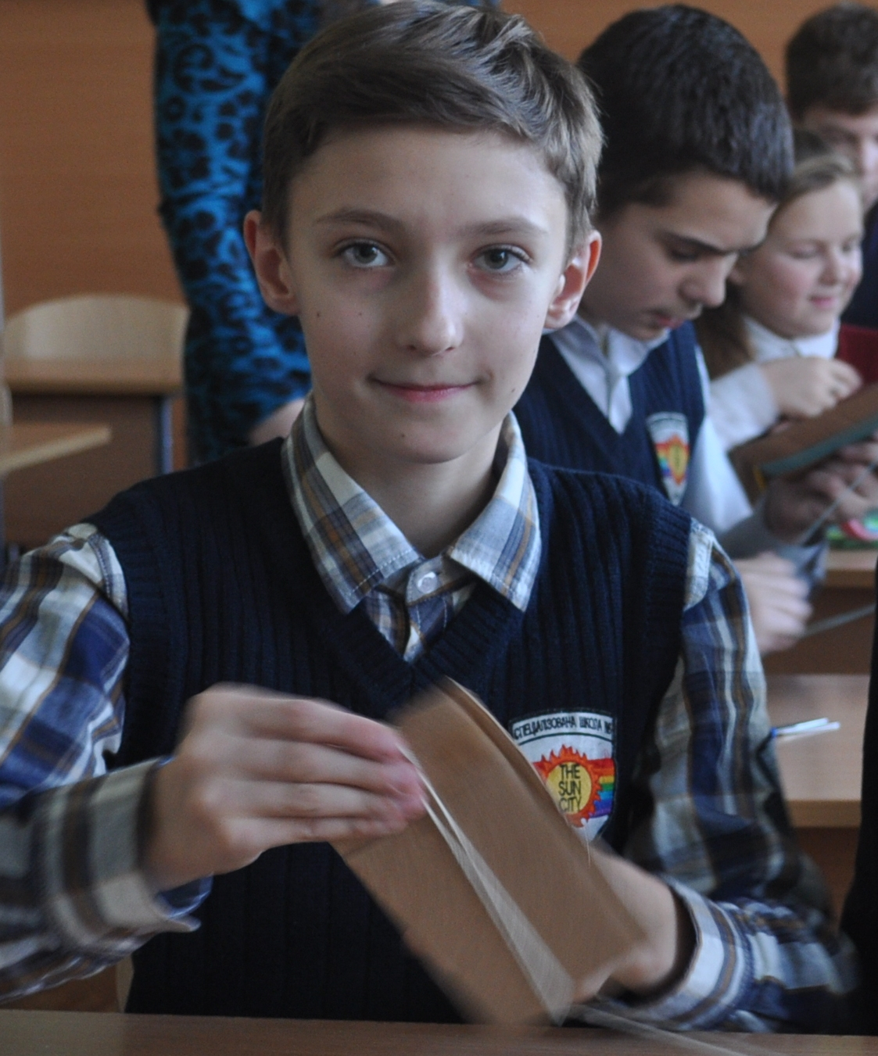
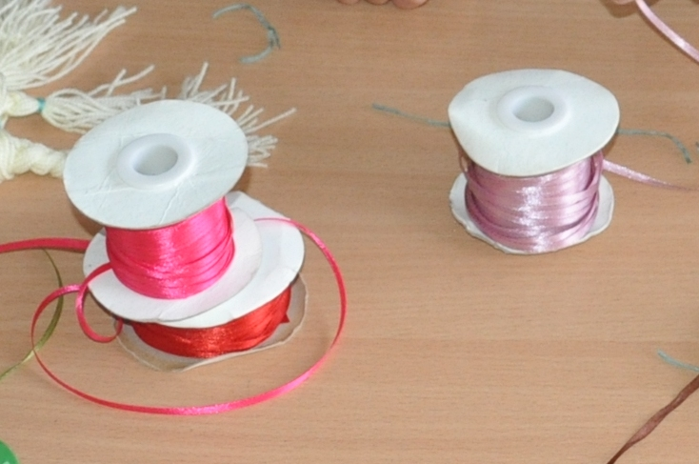
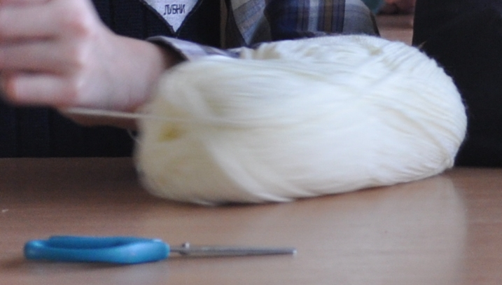
You need - yarn for knitting (50gr) - carton for stencil -scissors - ribbons for decoration

Slide 3
Step 1
To make the yarn pieces of the same length, cut the rectangular carton stencil. The size is 20cm x 40cm.
Notes:
Dolls were given basically human shapes

Slide 4
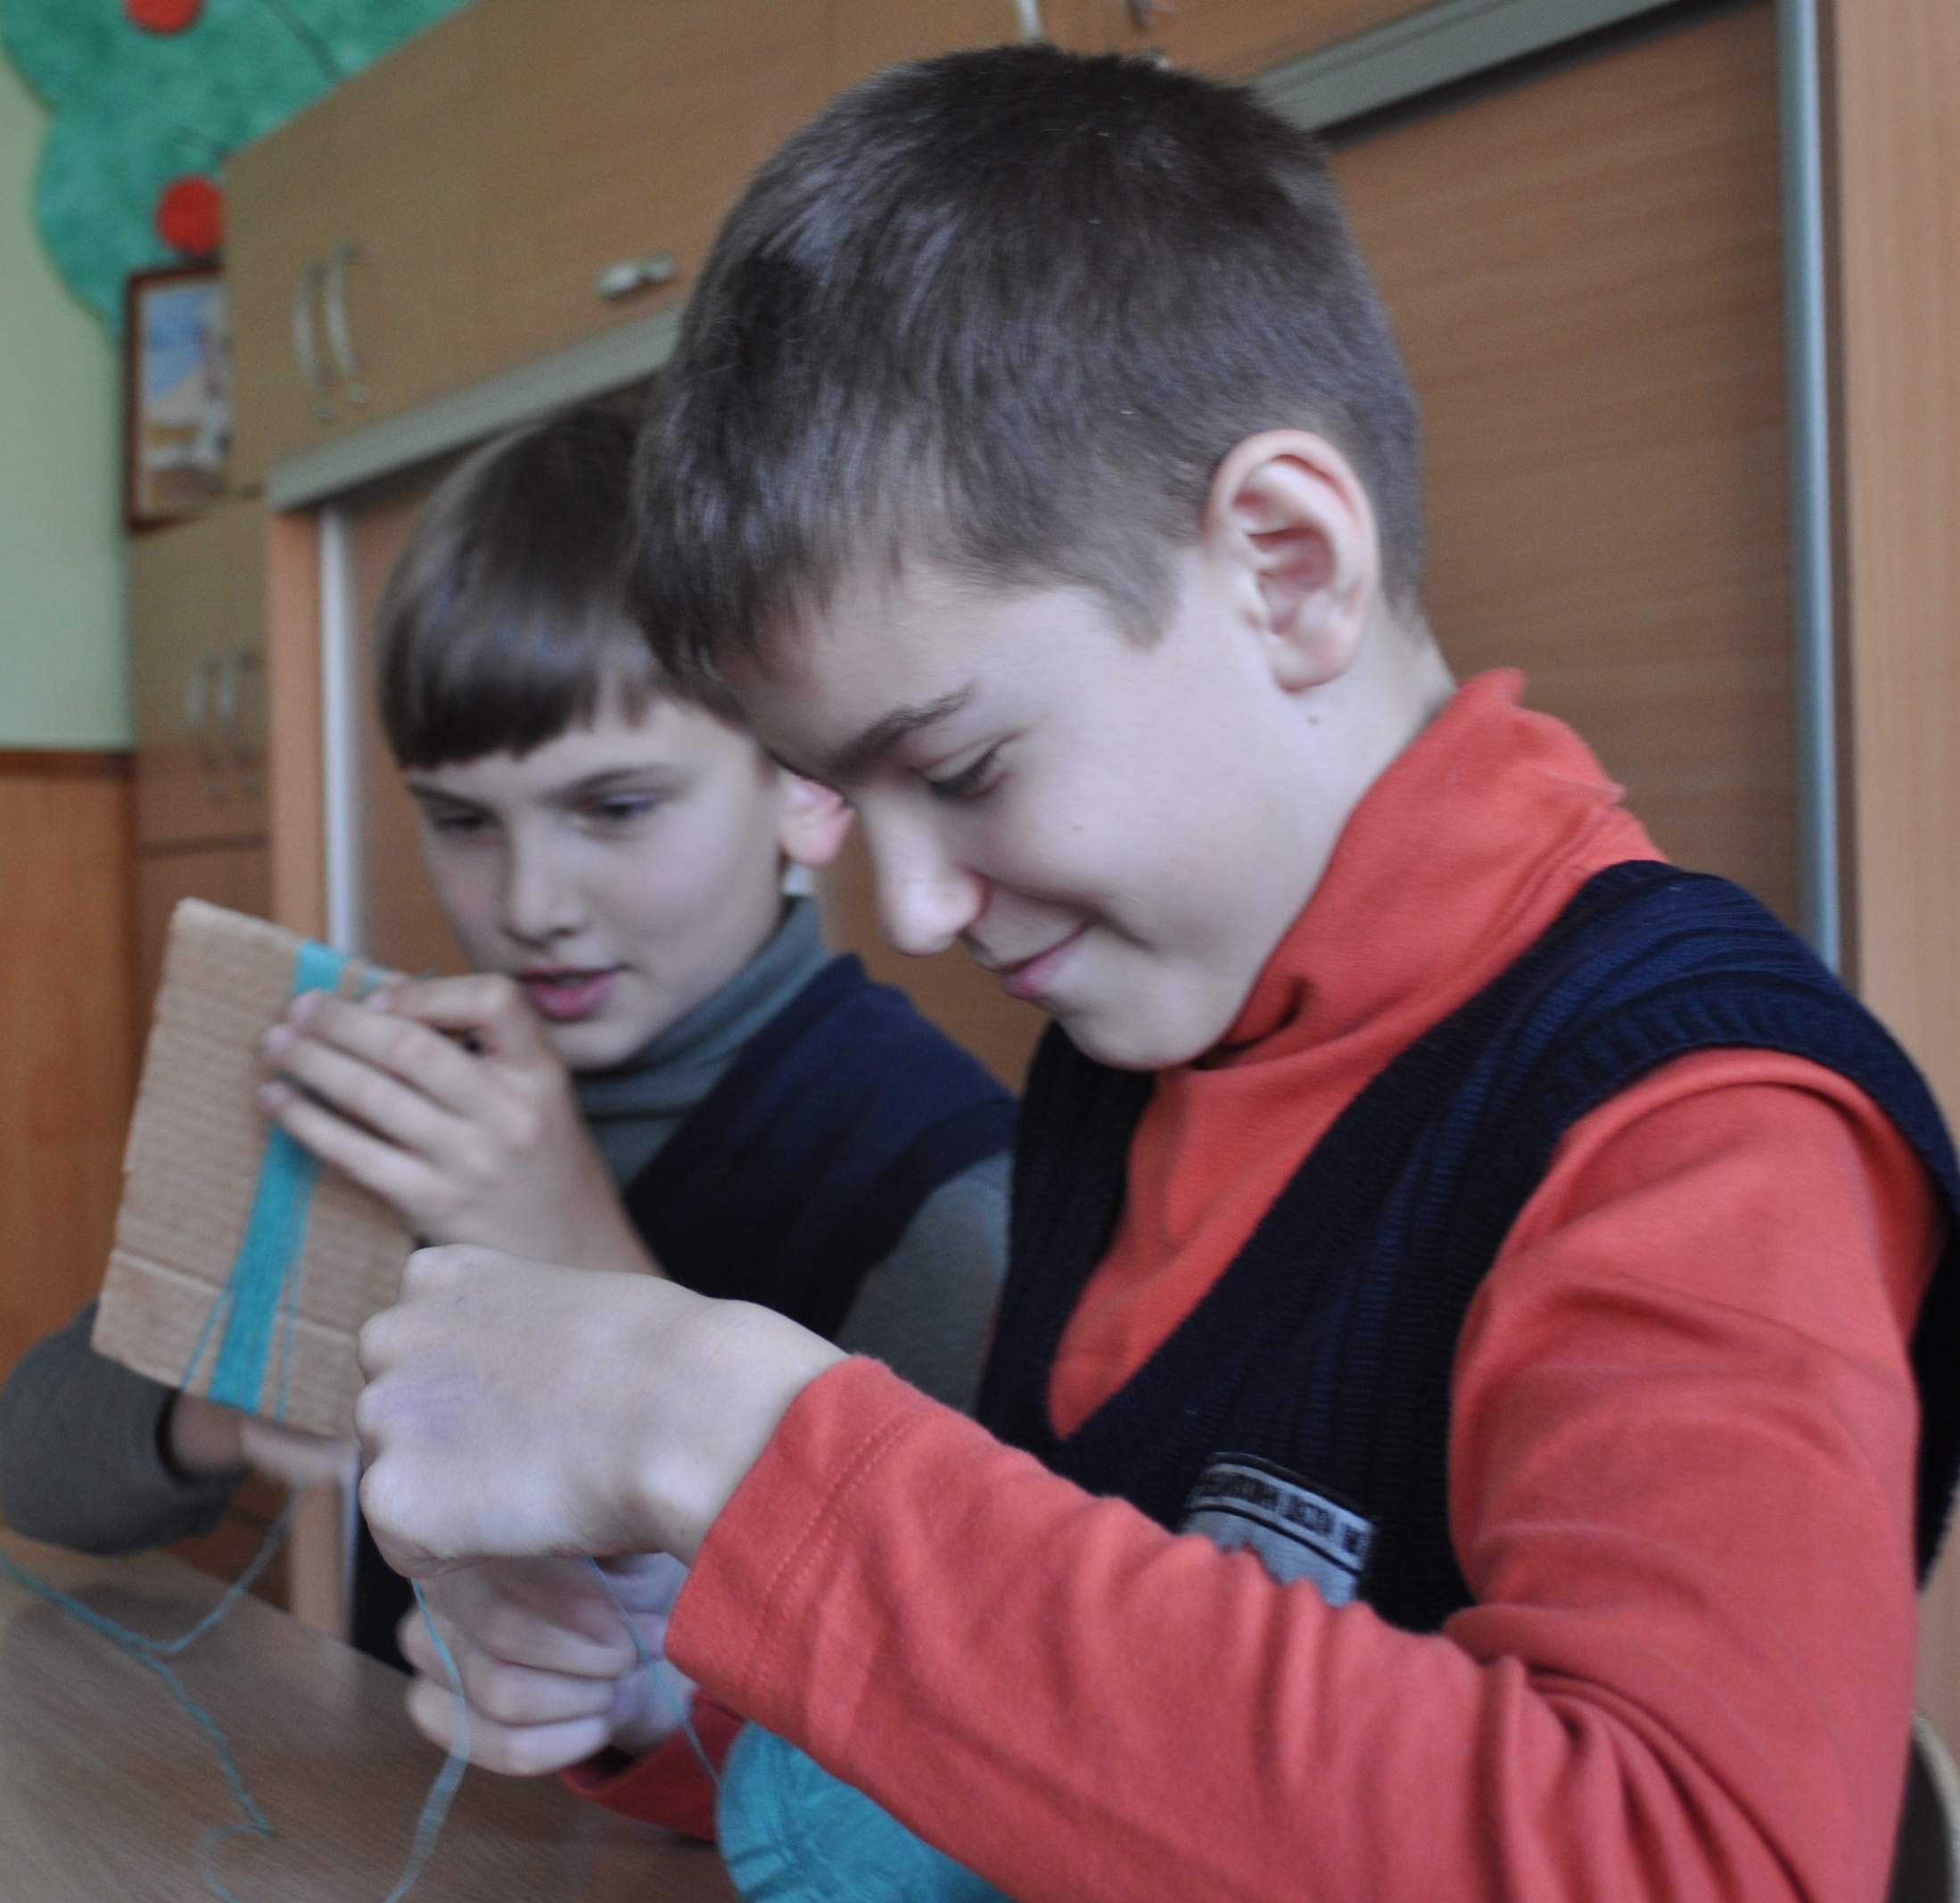
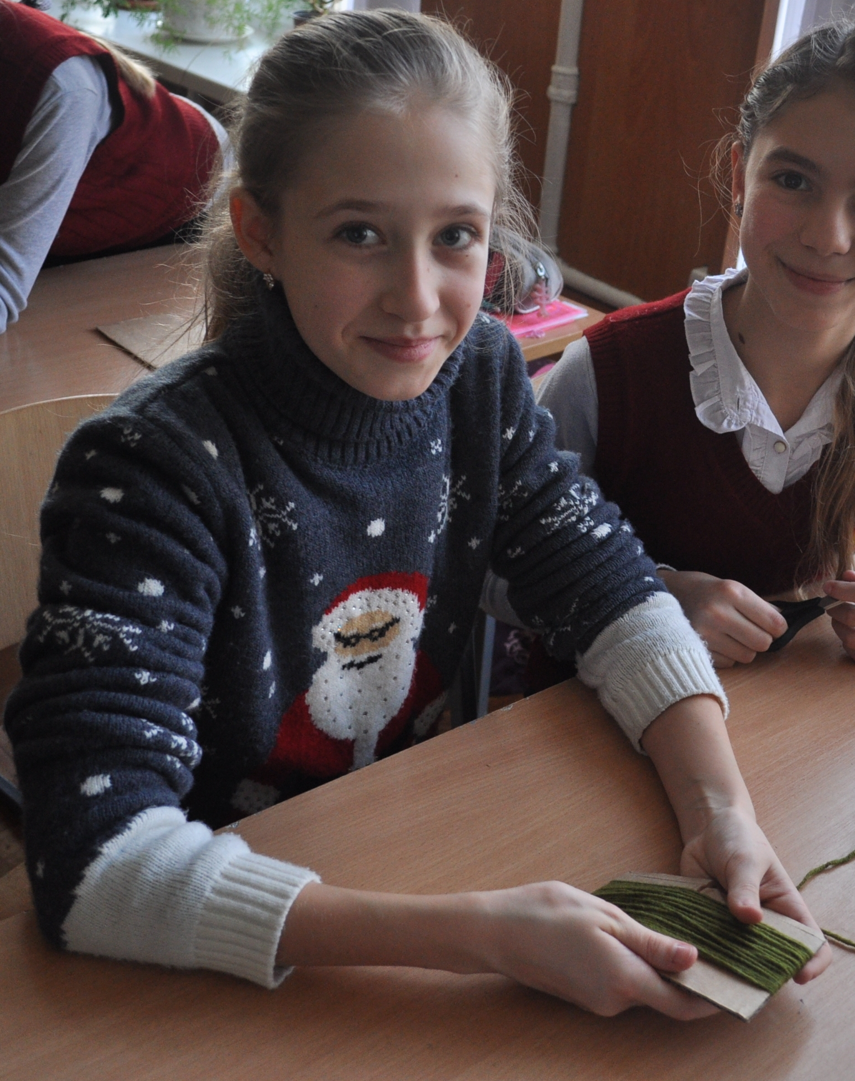
Step 2
Wind yarn on the stencil to make doll’s body, arms and hair.
To make the body and the hair wind the yarn horisontally 40-50 times.
To make the arms wind vertically 20-30 times.

Slide 5
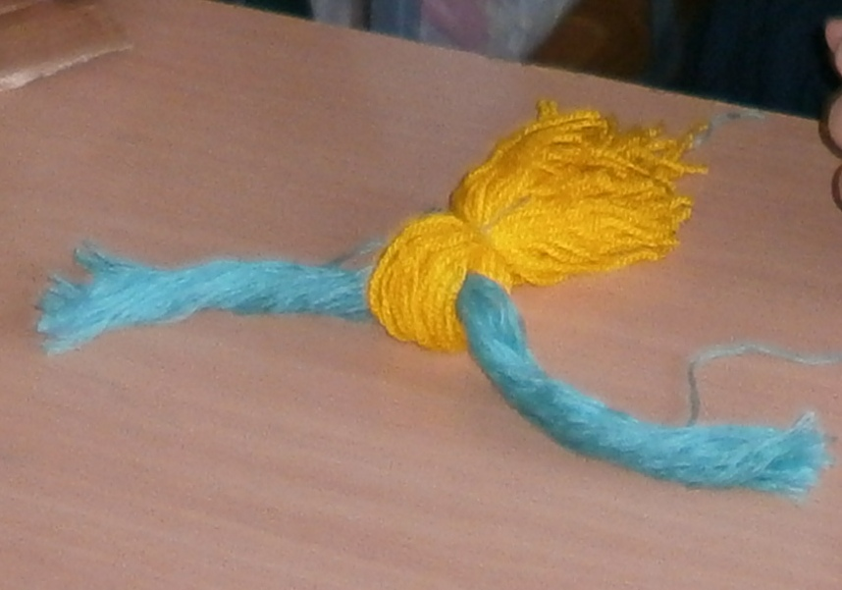
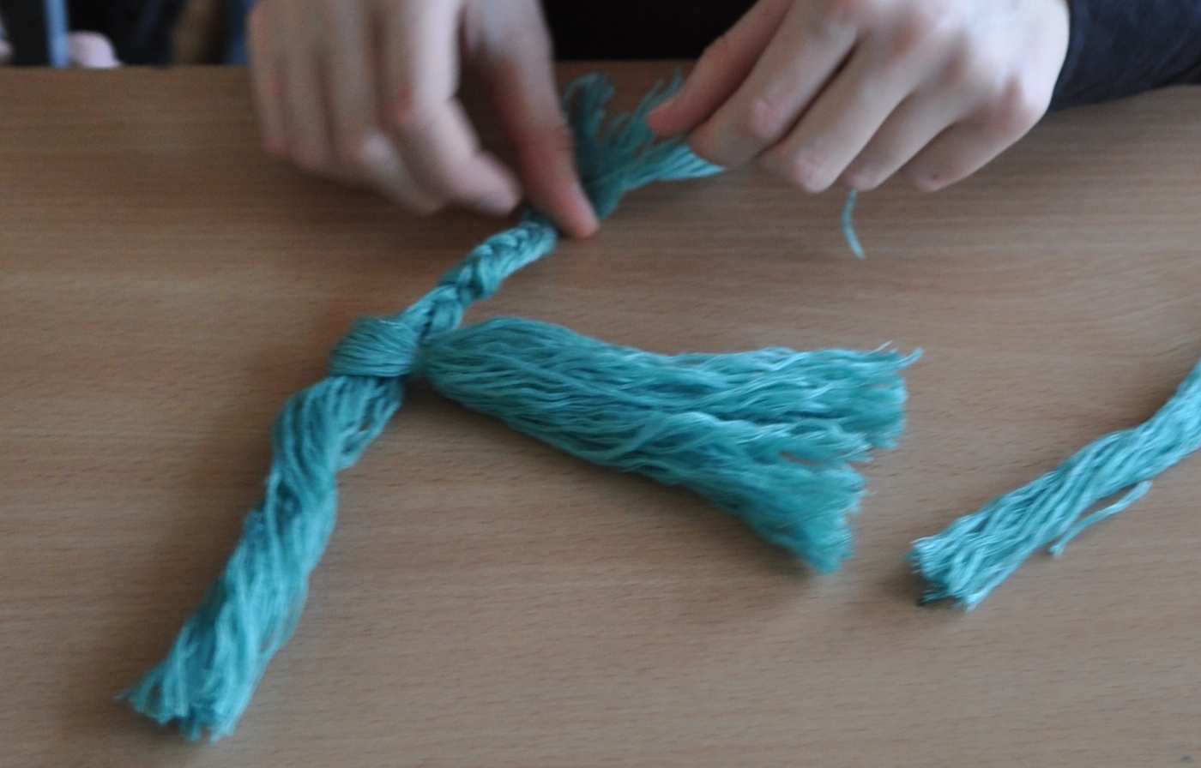
Step 3
Cut the yarn from the one side and take off from the other one.
Take the wound yarn intended for the body, bend it in the center and put in the yarn intended for the hair.

Slide 6
Step 4
Leave 2-2,5 cm from the top ( the yarn of the hair inside) and tie the body with a separate piece of yarn to make a head.

Slide 7
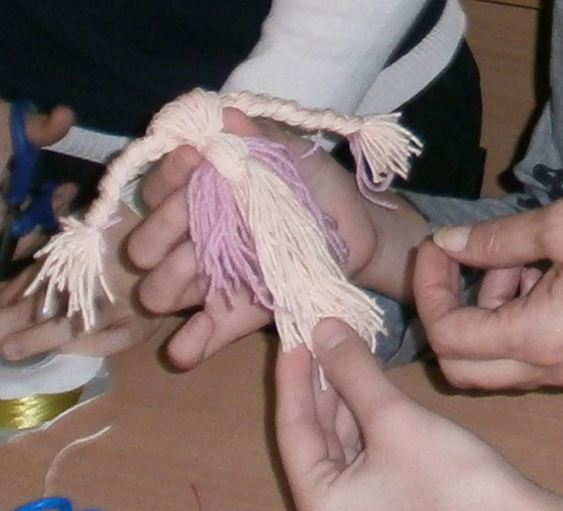
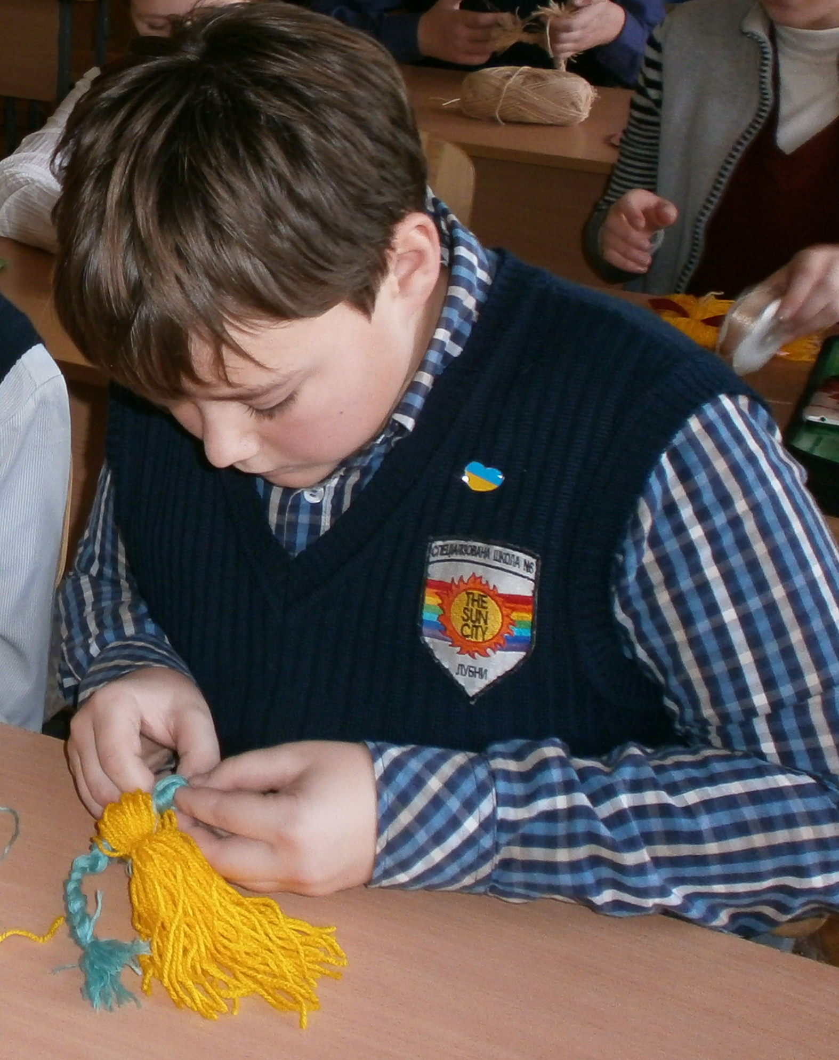
Step 5
The hair can also be tied with a piece of yarn or it’s possible to make two plaits.

Slide 8
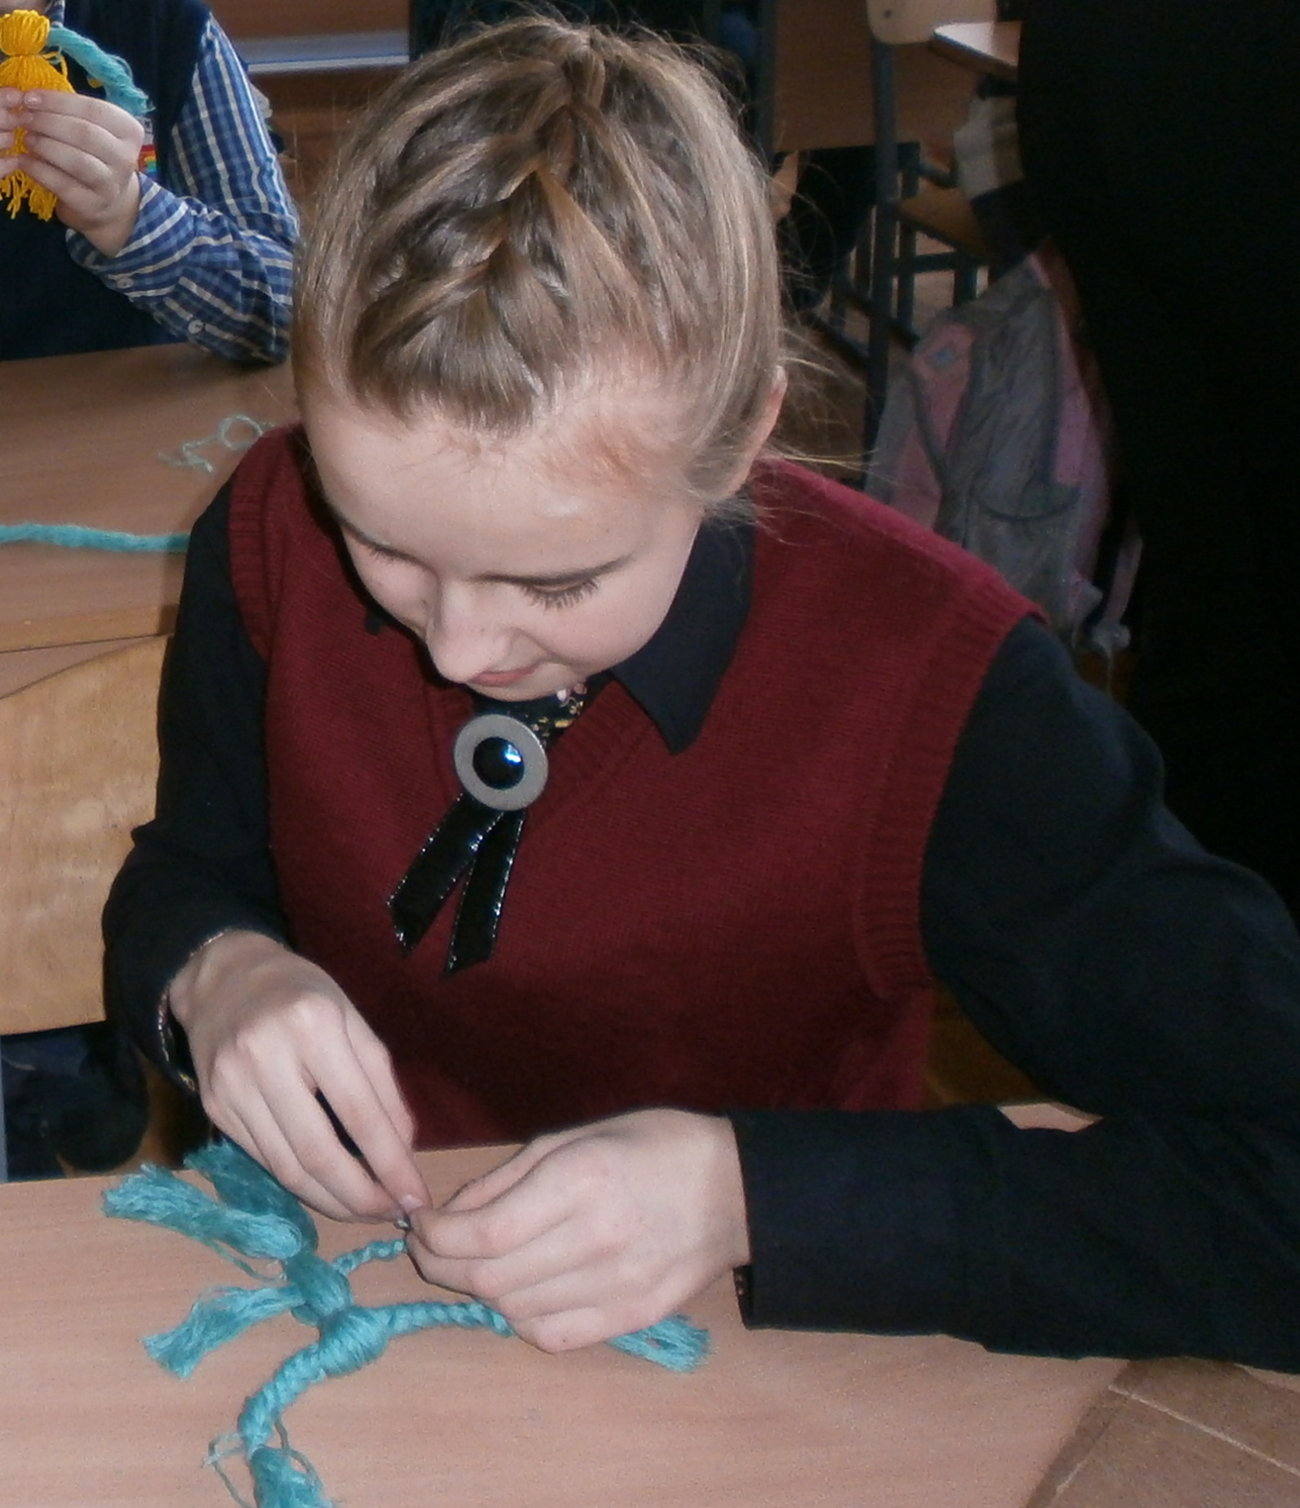
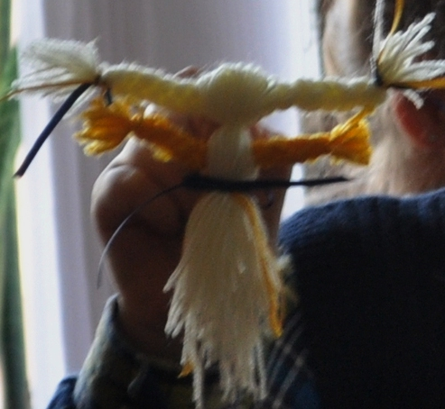
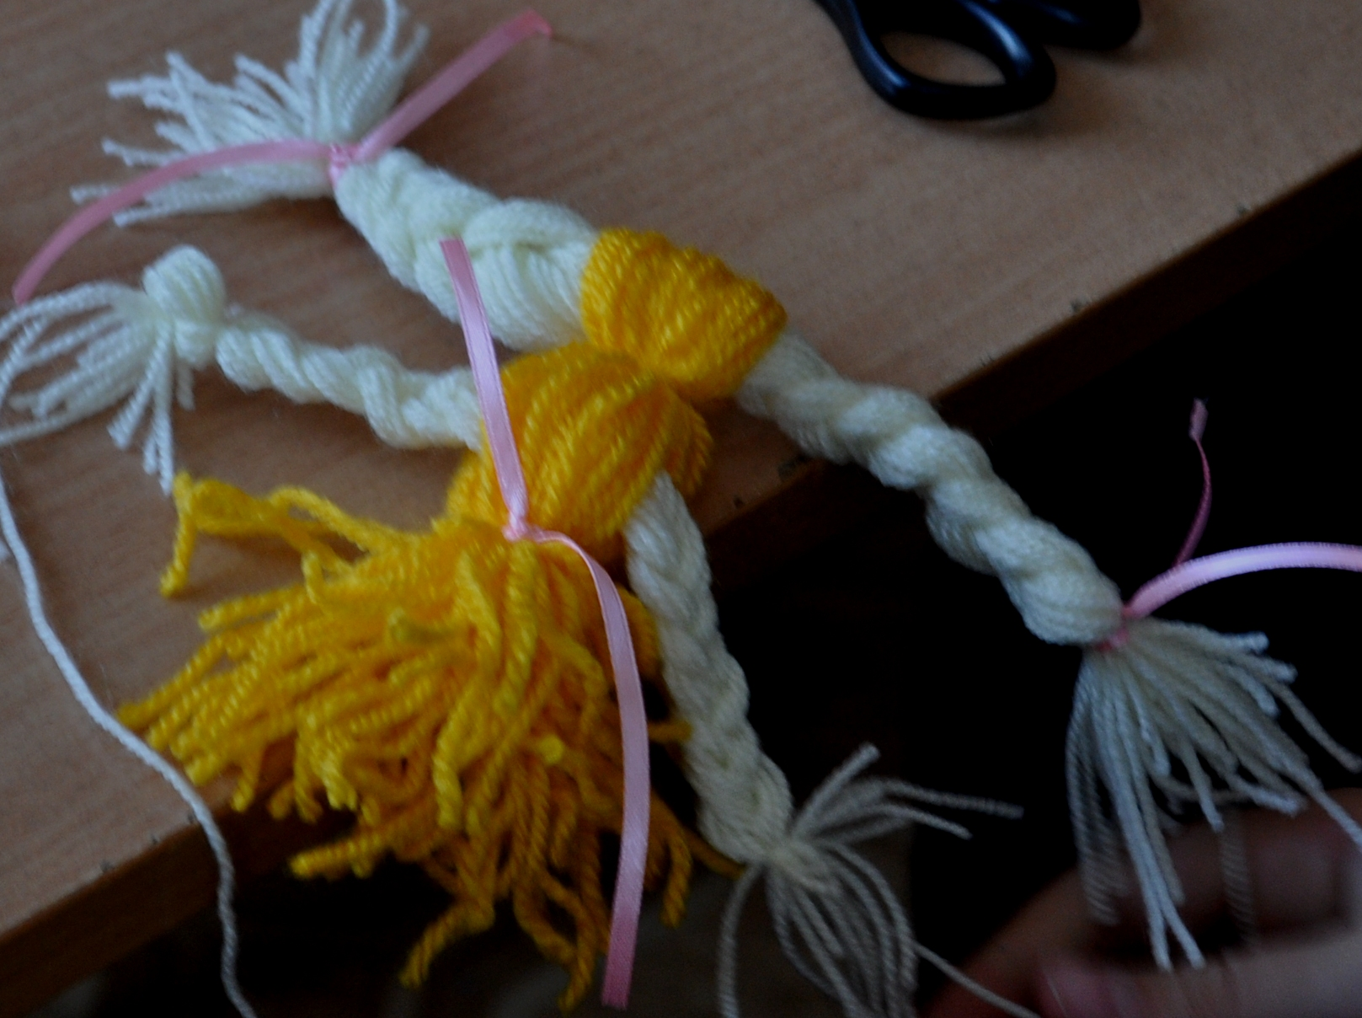
Slide 6
Make the arms in a form of a plait and tie them at the extremities with separate pieces of yarn.

Slide 9
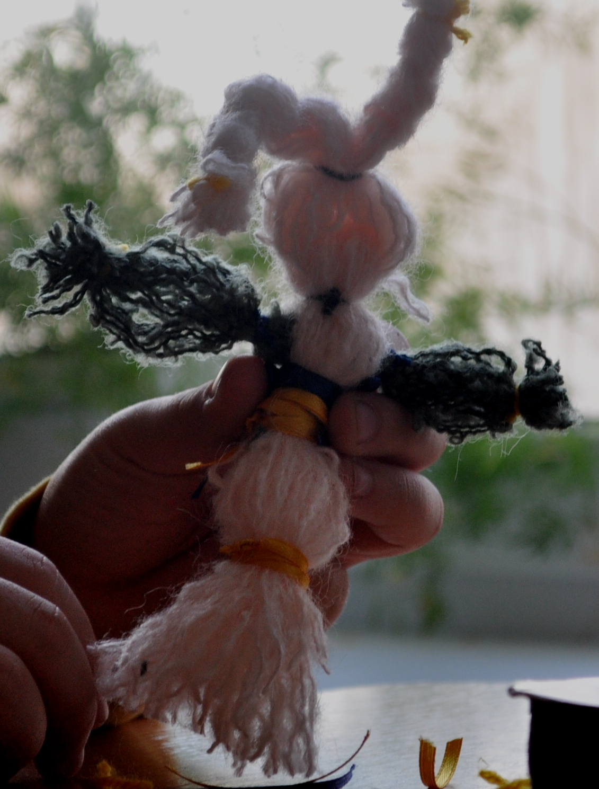
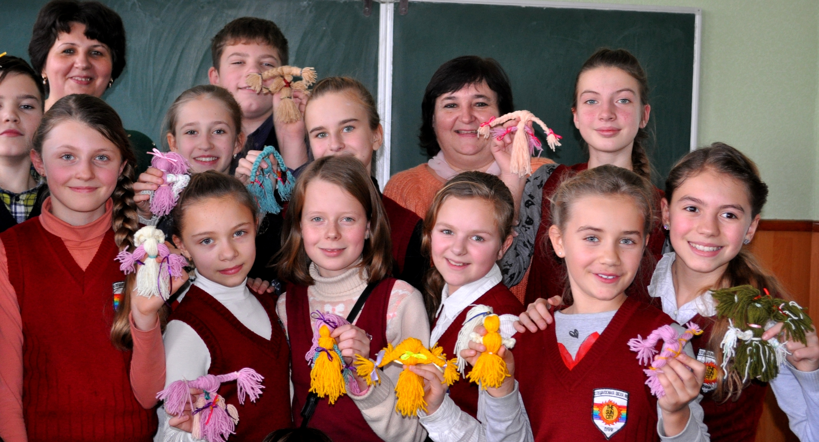
Step 7
Our process is complete.
To make your doll brighter, you can decorate it with colourful ribbons.

