Slide 1
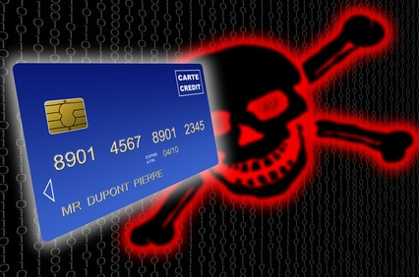
Safer Internet Day
Bank data on the internet

Slide 2
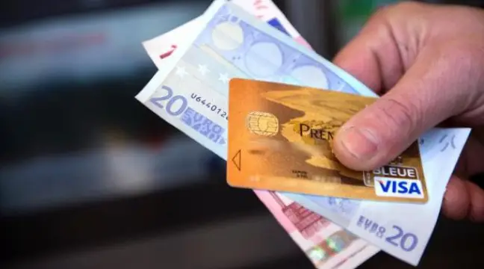
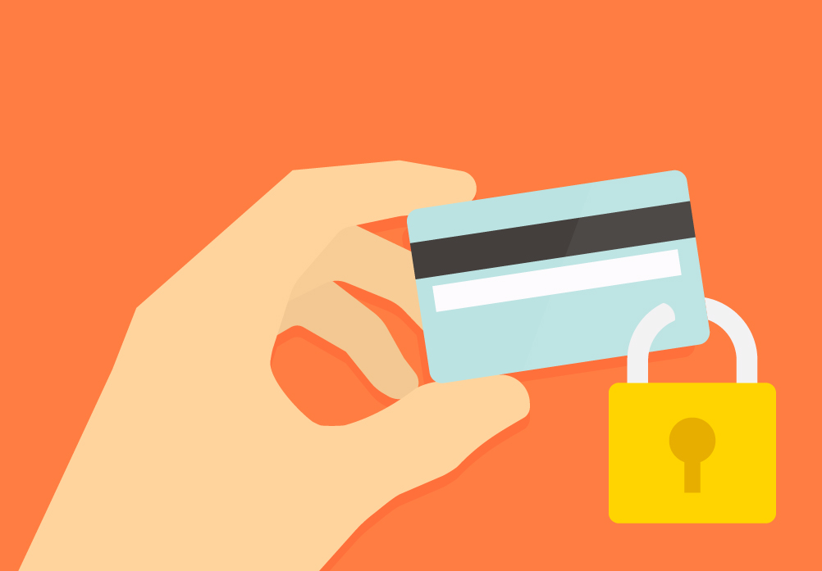
Protect your bank data so that theft is reduced

Slide 3
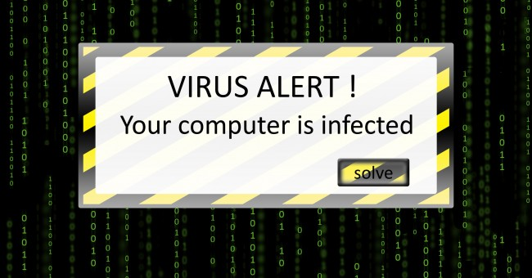
1- Update your IT tools
In order to best protect its payment transactions on the Internet, the computer's operating system, as well as the browser used to go on the Net (Internet Explorer, Firefox, Safari, etc.) and anti-viruses (free or paid) ) should be updated regularly. Likewise, it is recommended to delete cookies from time to time.

Slide 4
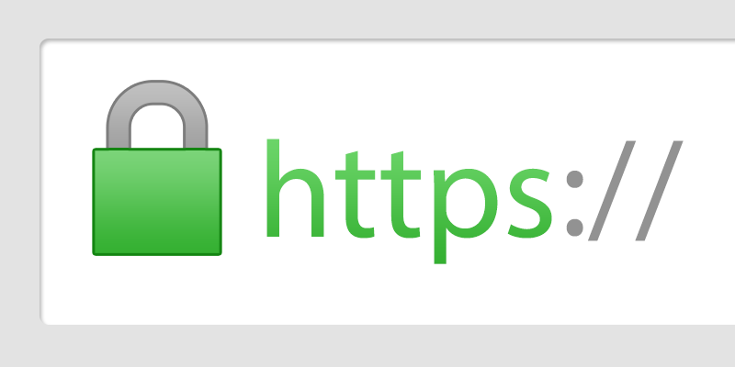
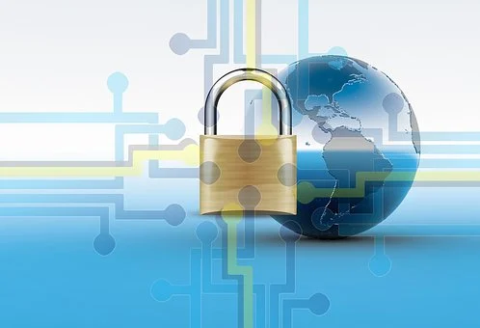
2-Frequent known and secure sites
frequenting well-known sites, the seriousness of which is no longer to be demonstrated, allows a secure payment, symbolized by a small closed padlock, But that's not all: the address of the page on which the data of the credit card are requested must also begin with: "https: //"

Slide 5
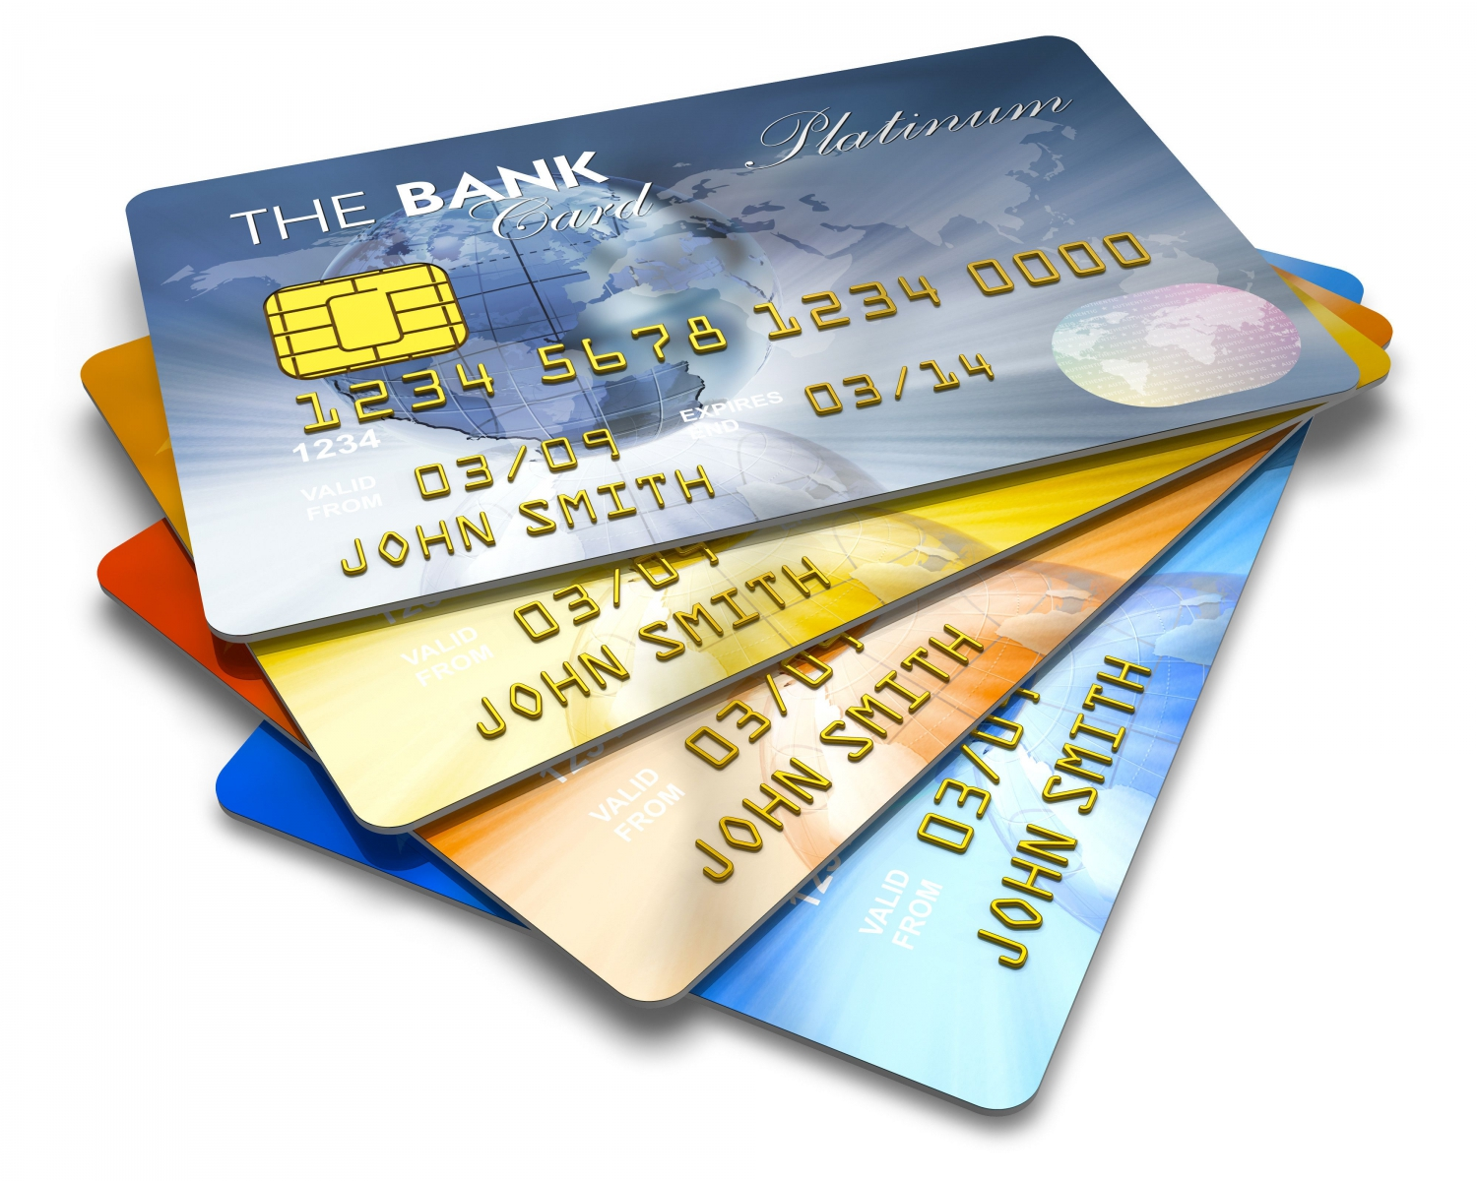
3-Transmit only the data necessary for payment
Whatever the merchant site visited and whatever the amount of the payment, only the following data must be transmitted: 16-digit card number, expiry date, security code and name of the holder. Under no circumstances should the confidential 4-digit PIN code of the bank card be communicated.

