Slide 2
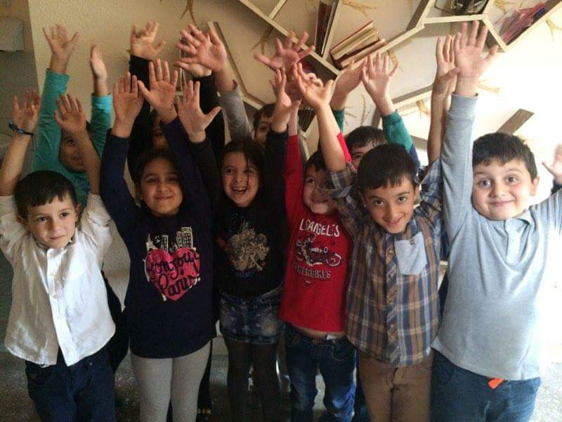
Second grade

Slide 3
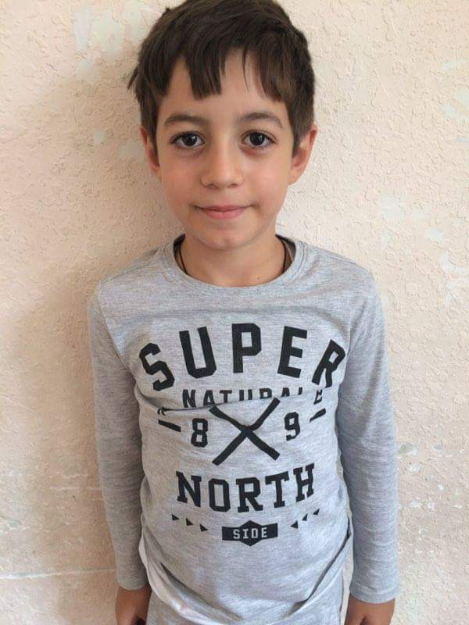
Vardanyan Hamlet 8 years old
Hamlet likes school subjects especially science and reading books.

Slide 4
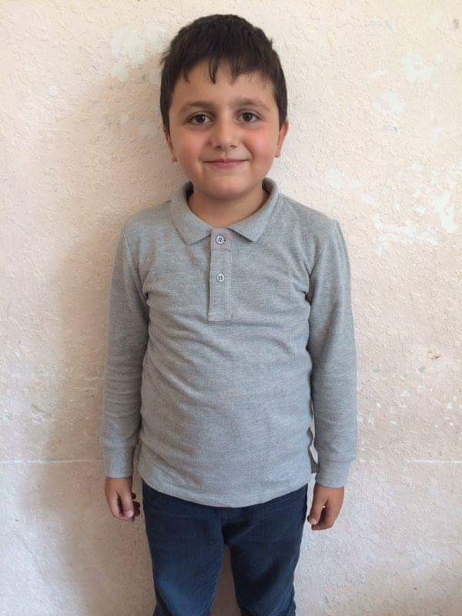
Mayamyan Hrachya 7 years old
Hrachya Is fond of swimming, also likes armenian language.

Slide 5
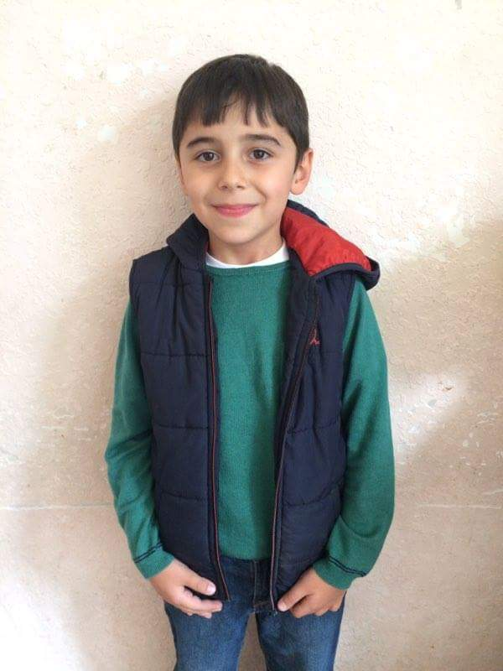
Tadevosyan Narek 7 years old
Narek is a big fan of science and swimming.

Slide 6
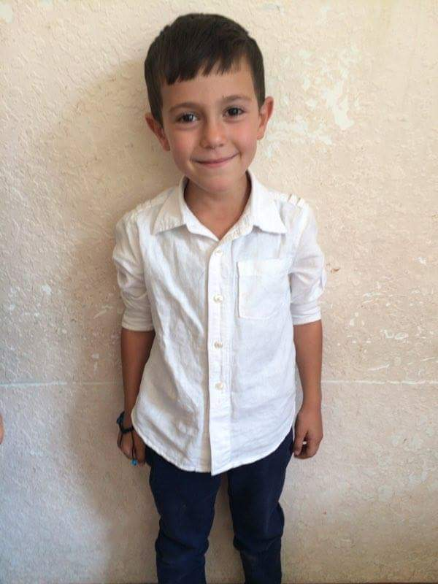
Chilingaryan Badal 7 years old
Badal’s favorite school subject is Math, also likes swimming.

Slide 7
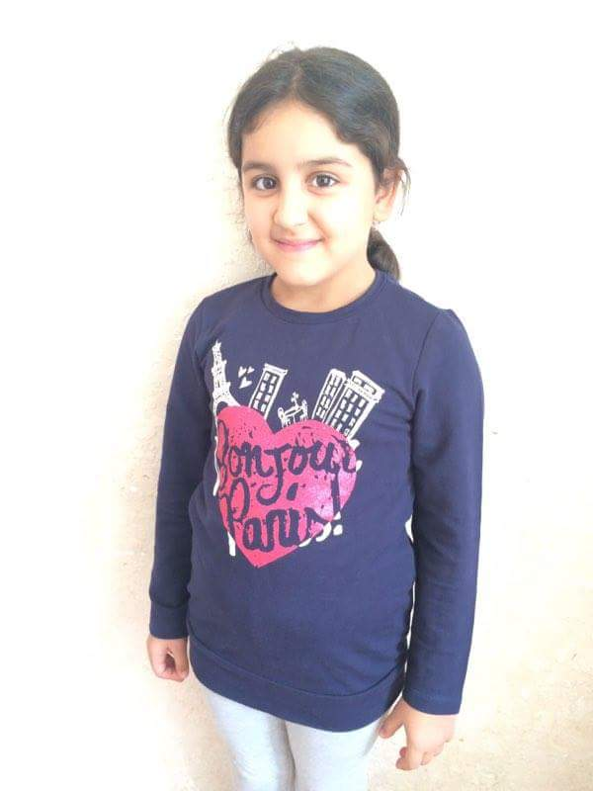
Avetisyan Lusine 7 years old
Lusine can draw beautiful pictures. Her favorite hobby is gymnastics.

Slide 8
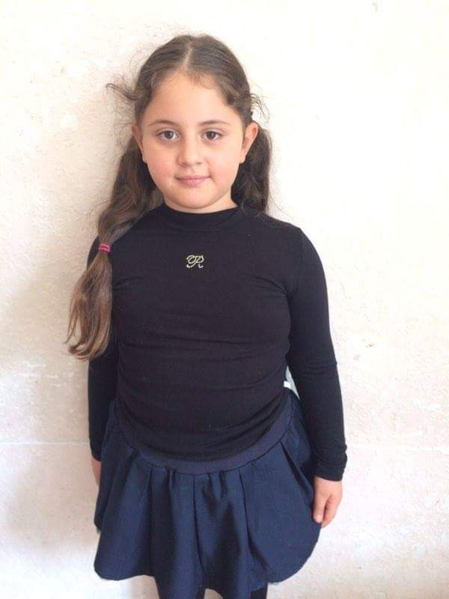
Soxomonyan Anahit 7 years old
Anahit likes drawing and technology.

Slide 9
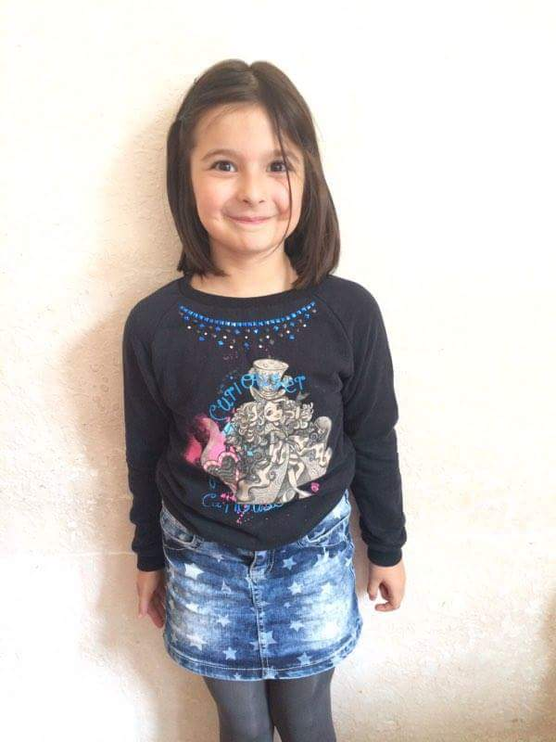
Movsisyan Vika 7 years old
Vika is fond of robotics and Computer science.

Slide 10
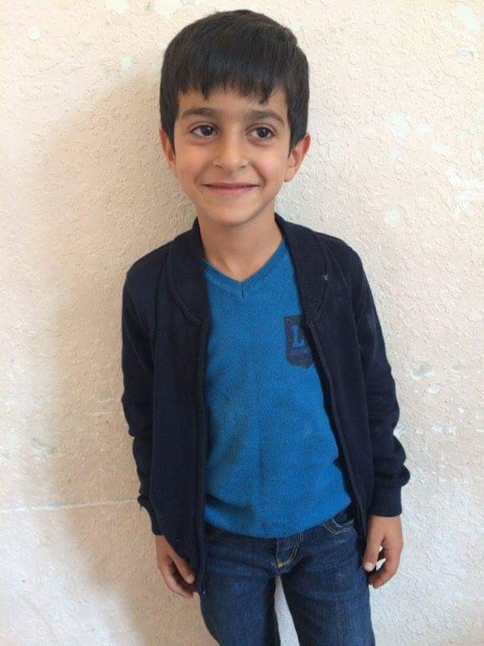
Manukyan Alexander 7 years old
Alexander likes box and karate.

Slide 11
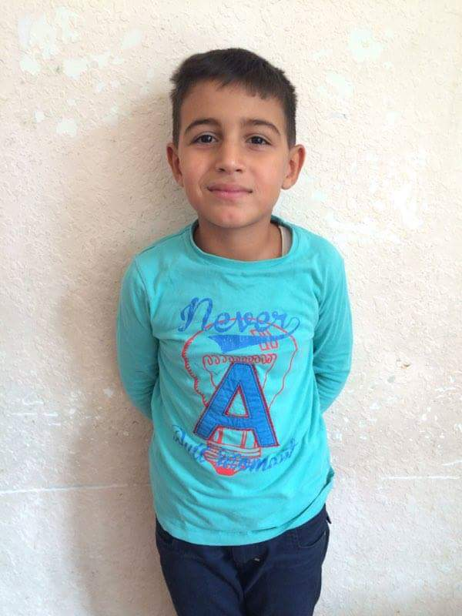
Xcheyan Levon 7 years old
Levon is a bog fan of football and armenian language.

Slide 12
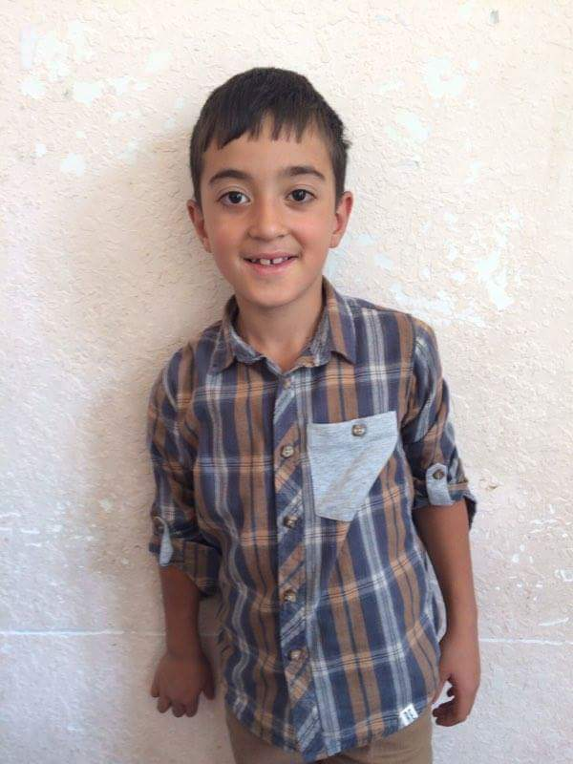
Episkoposyan Vladimir 7 years old
Vladimir likes swimming.

