Slide 1

HELLO FROM CZECH REPUBLIC!
Přerov, ZŠ Trávník 27
Our school is situated on the outskirts of the town Prerov.

Slide 2
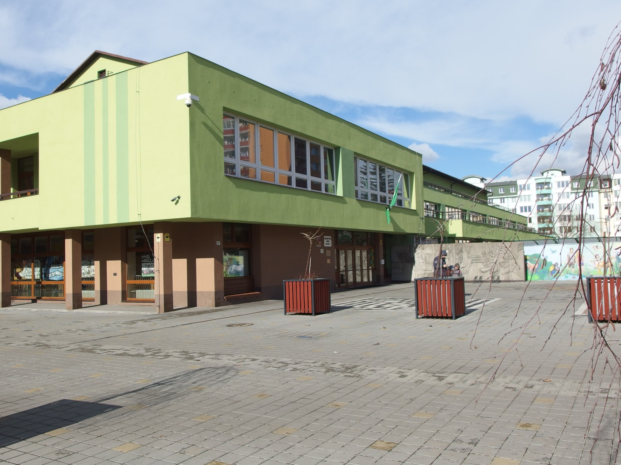
OUR SCHOOL

Slide 3
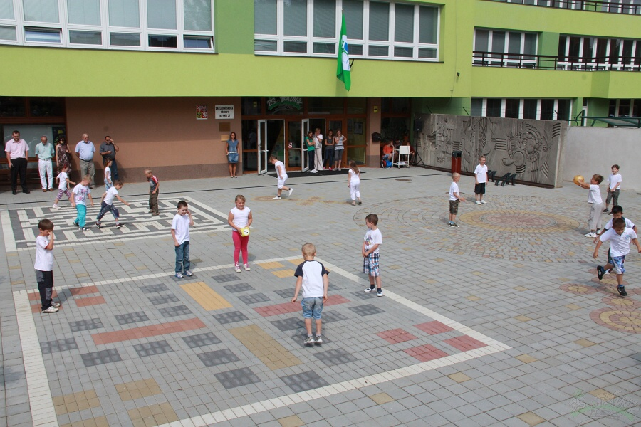
In front of school

Slide 4
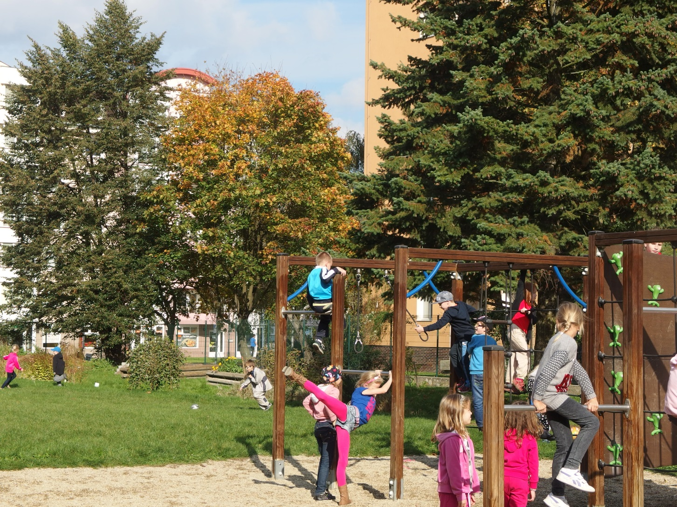
In the afernoon chidren play on the playground.

Slide 5
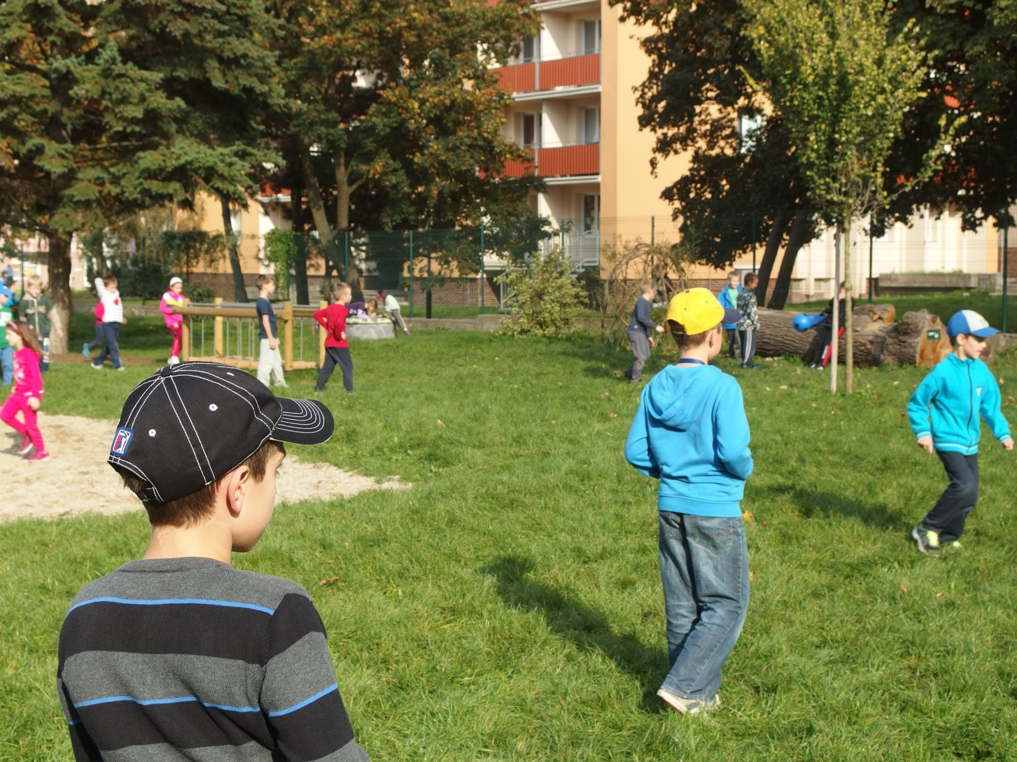
School playground

Slide 6
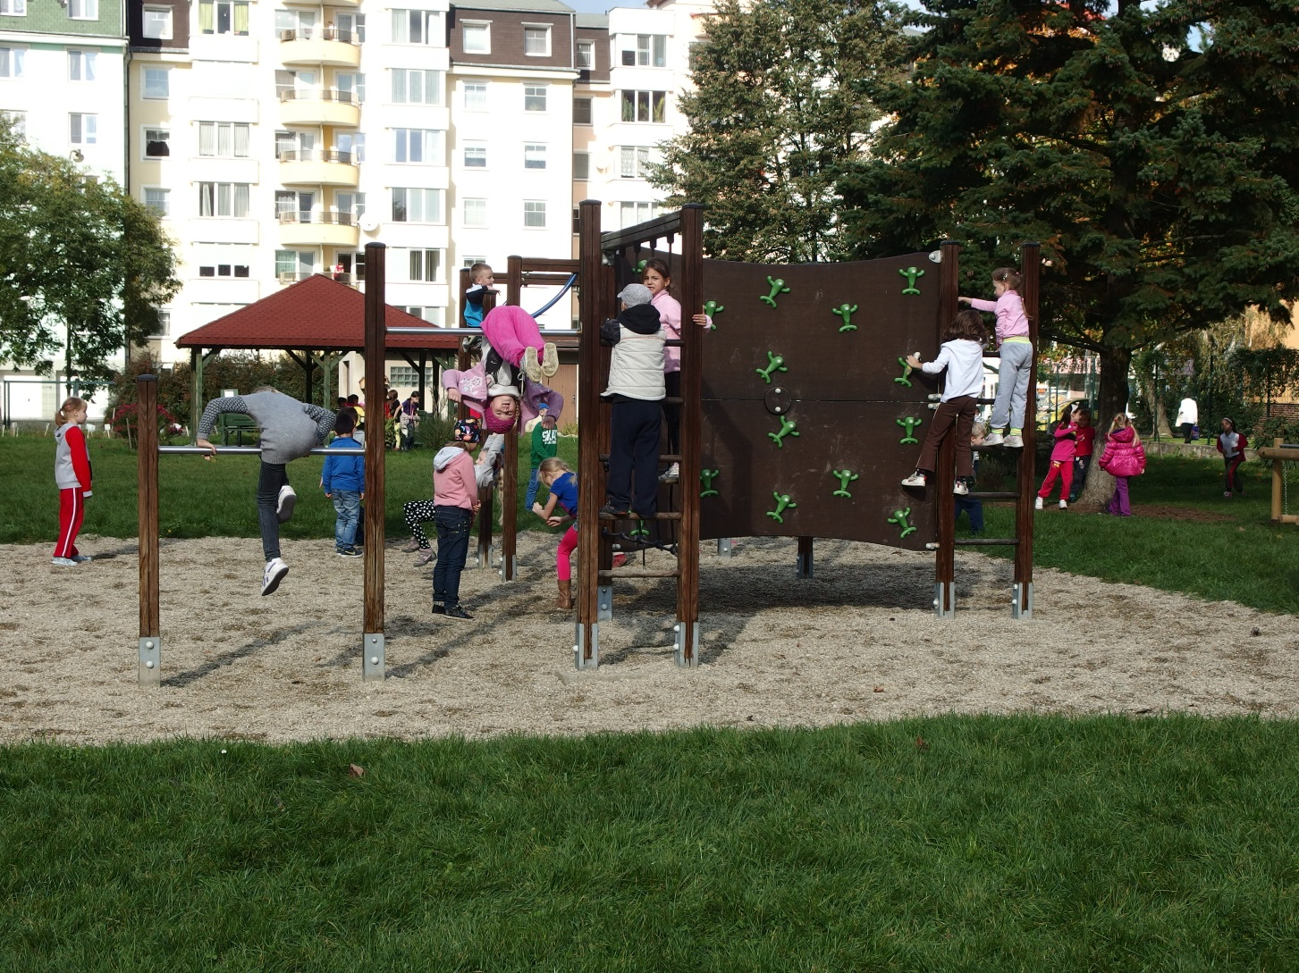

Slide 7
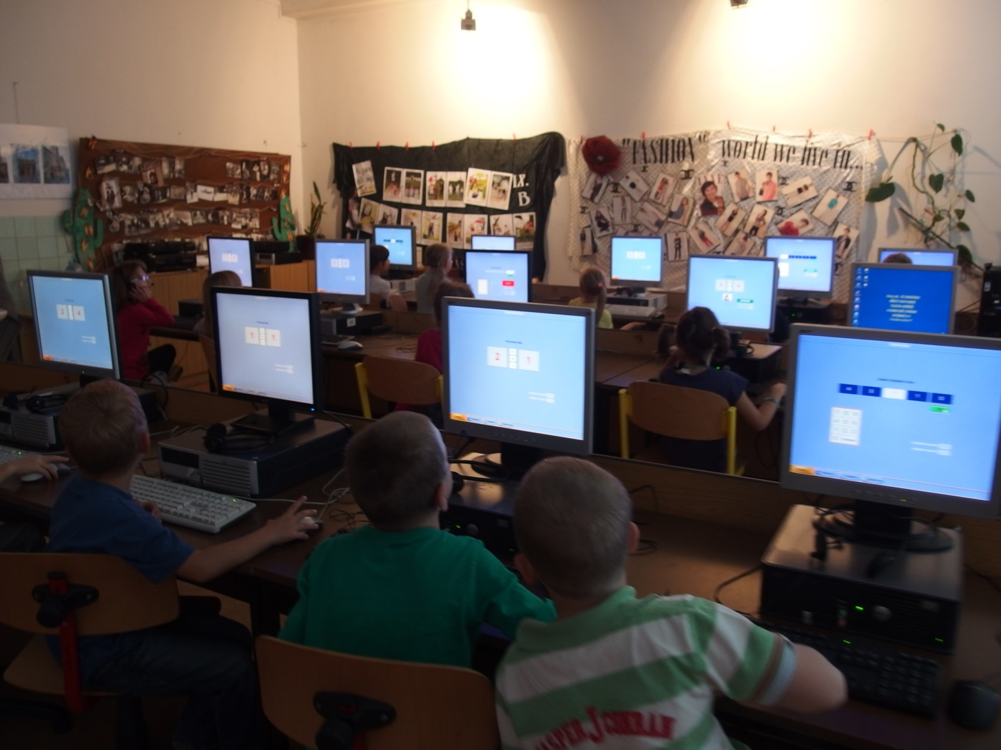
Children love to learn on computers

Slide 8
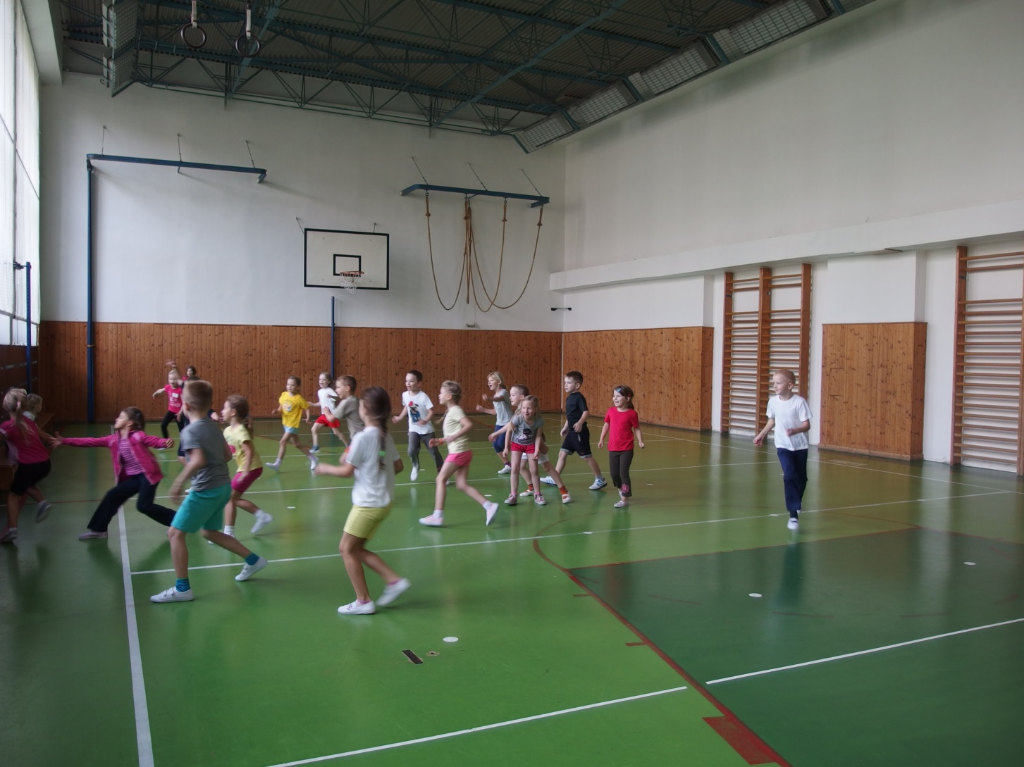
Our gym

Slide 9
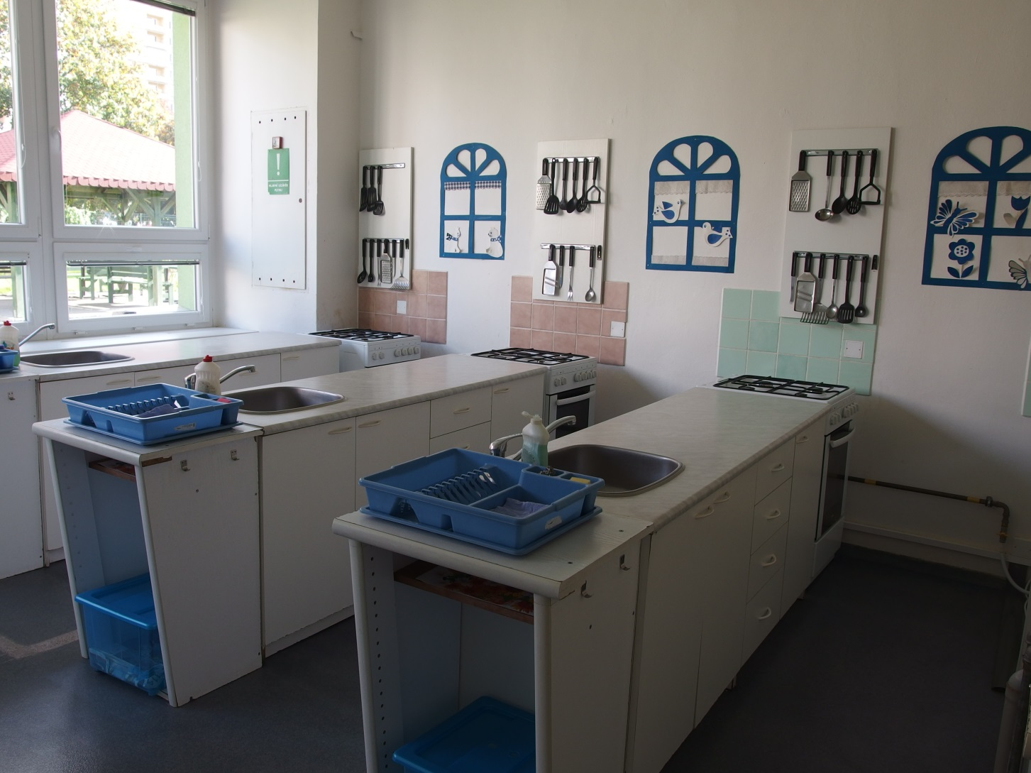
School training kitchen

Slide 10
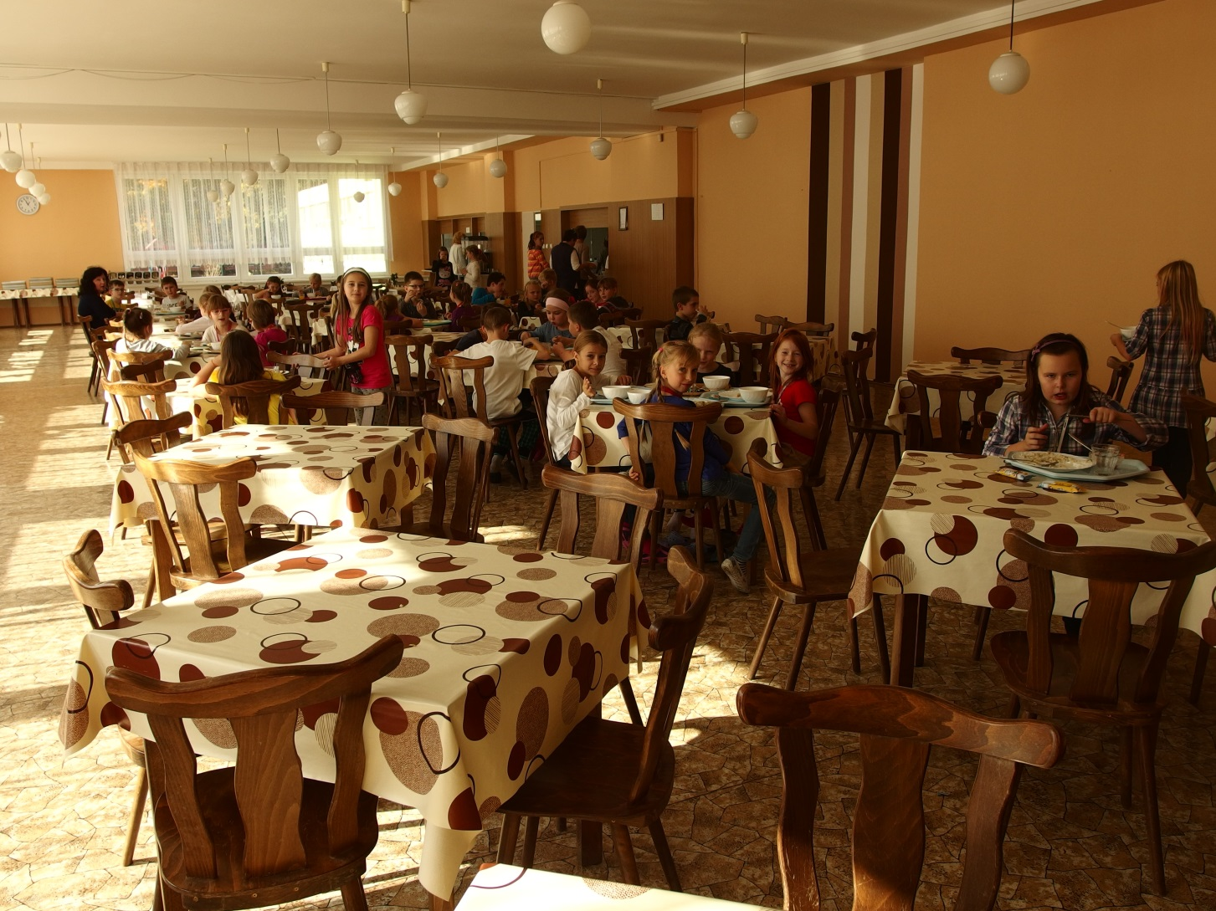
School canteen

Slide 11
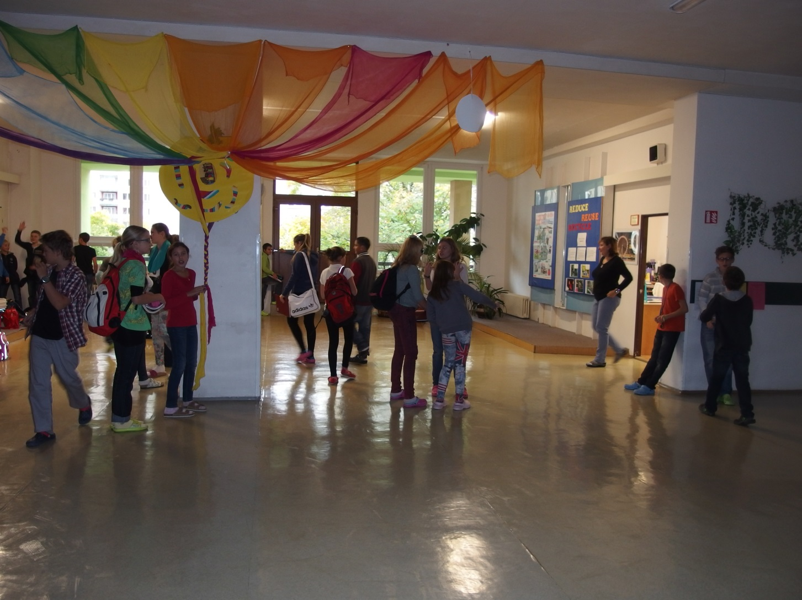
School corridor

Slide 12
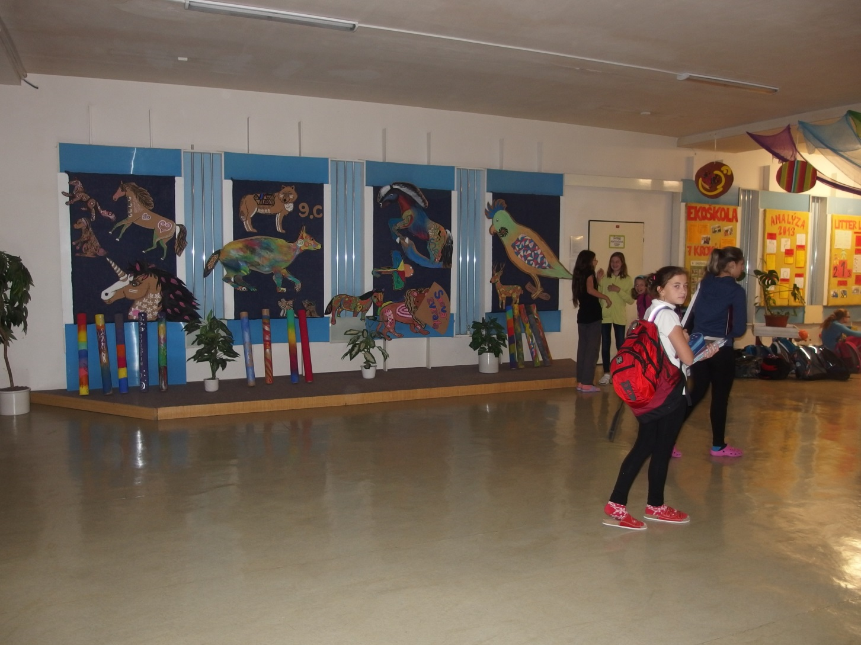
Scool corridor

Slide 13
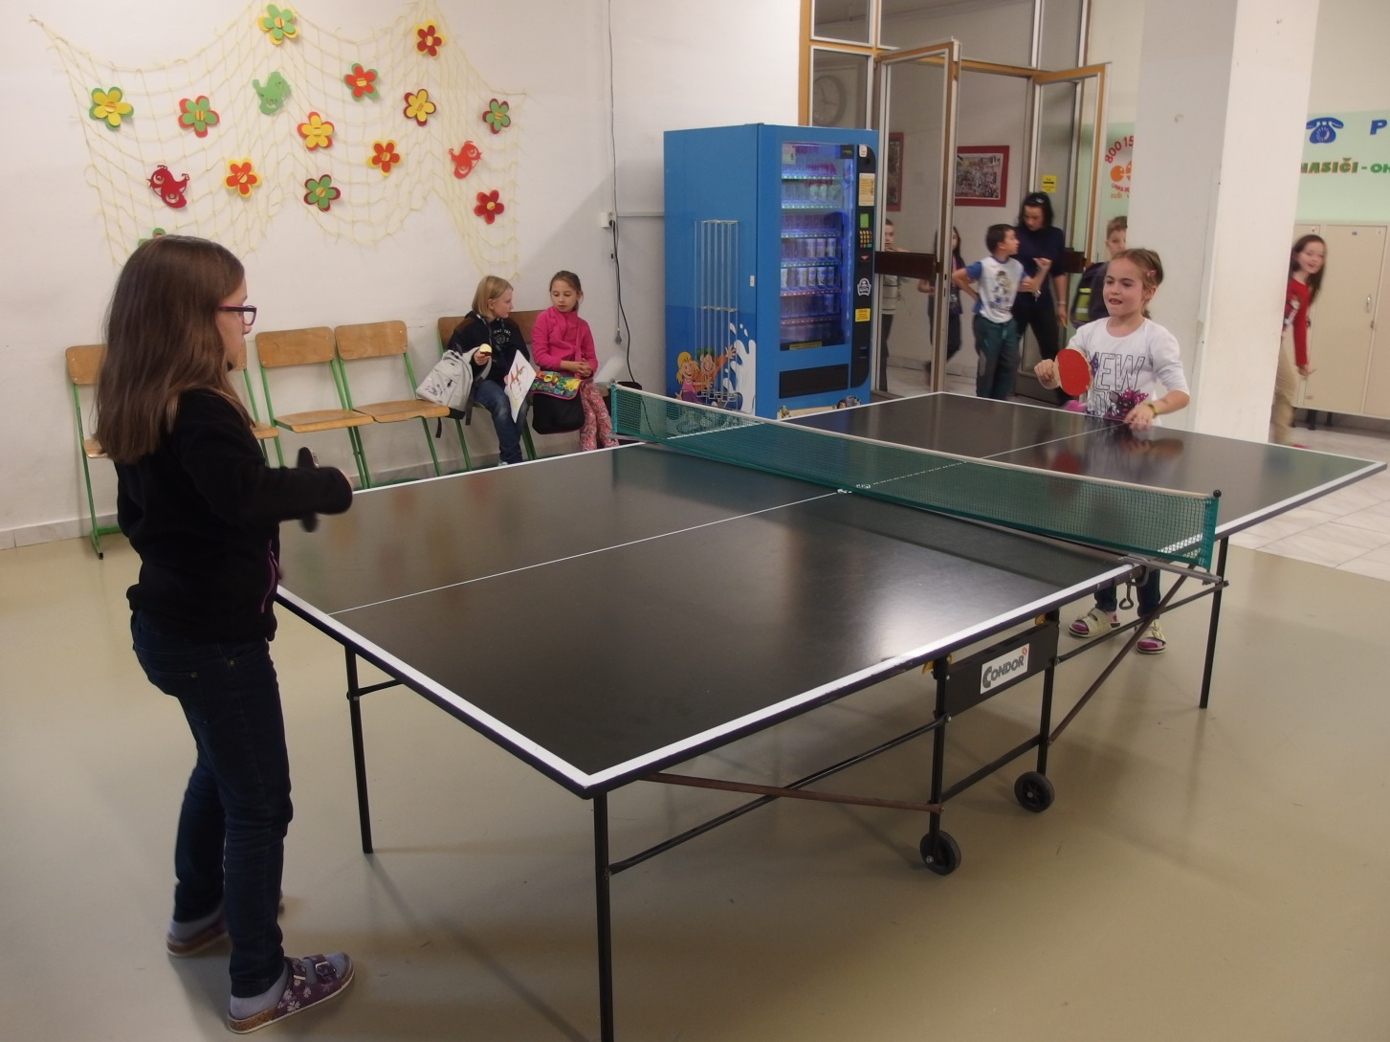
Resting after lesson

Slide 14
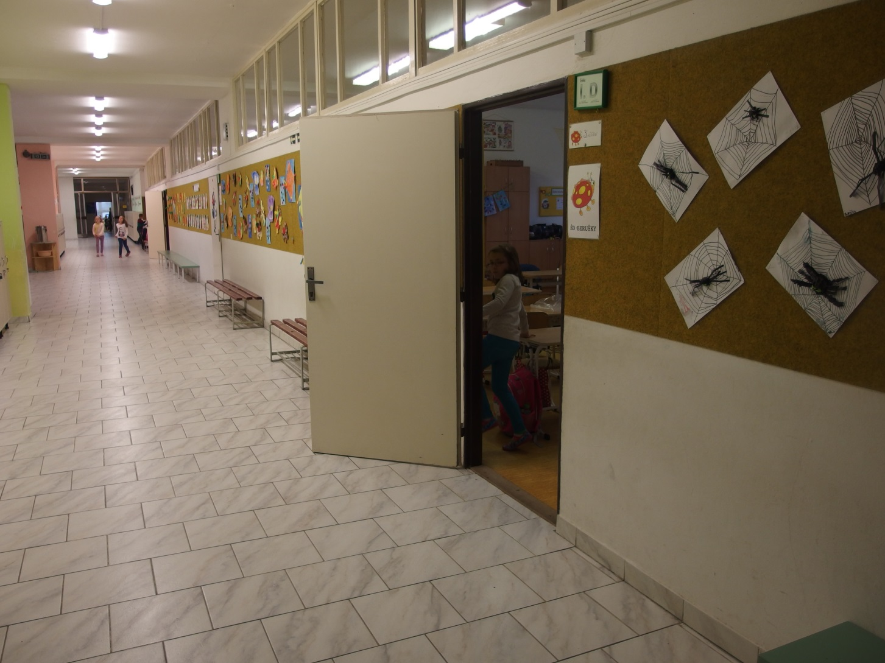
The corridor with classes

Slide 15
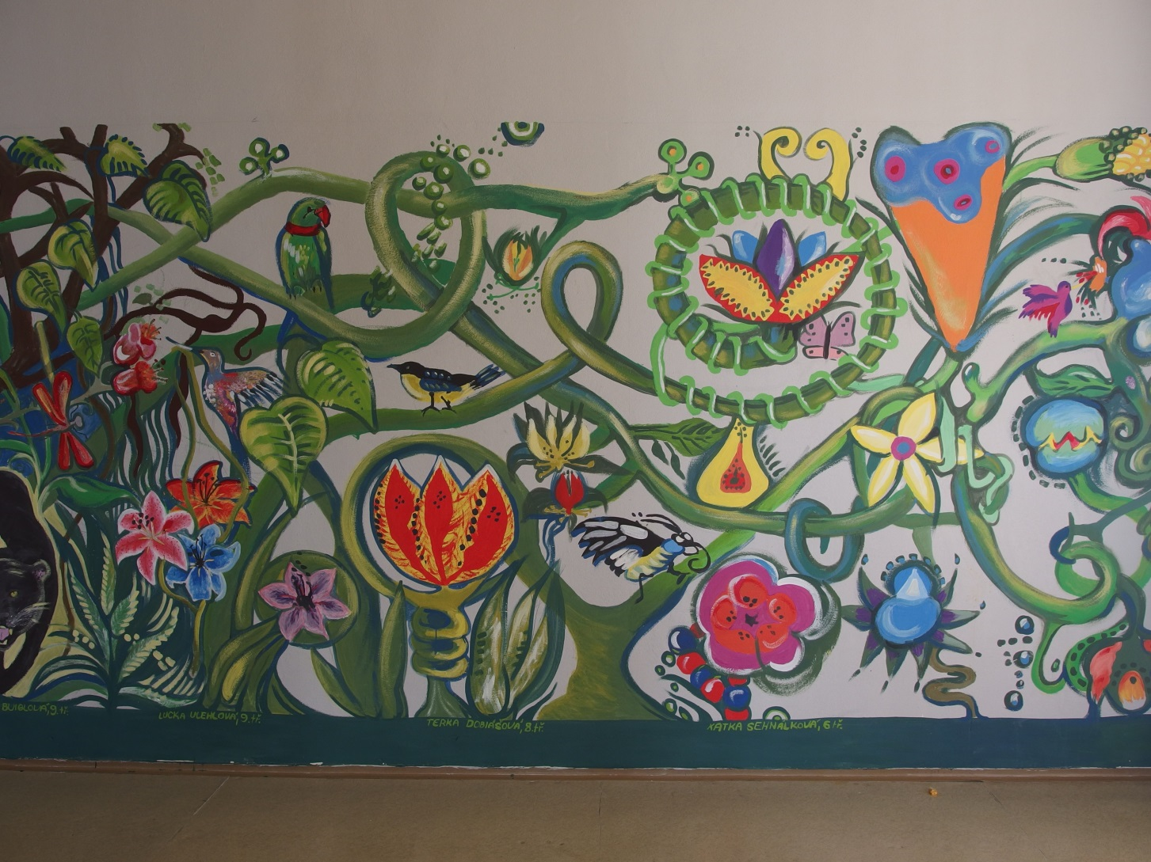
The wall painted by pupils

Slide 16
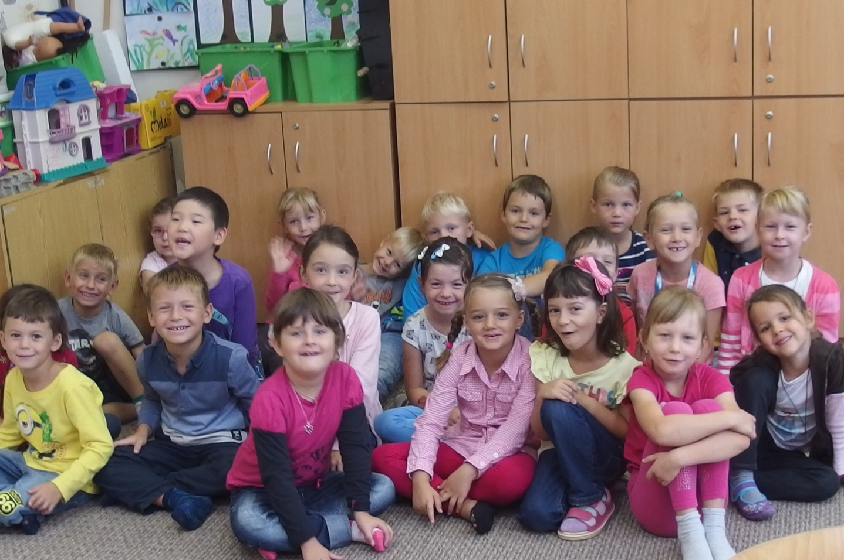
We are here!

Slide 17
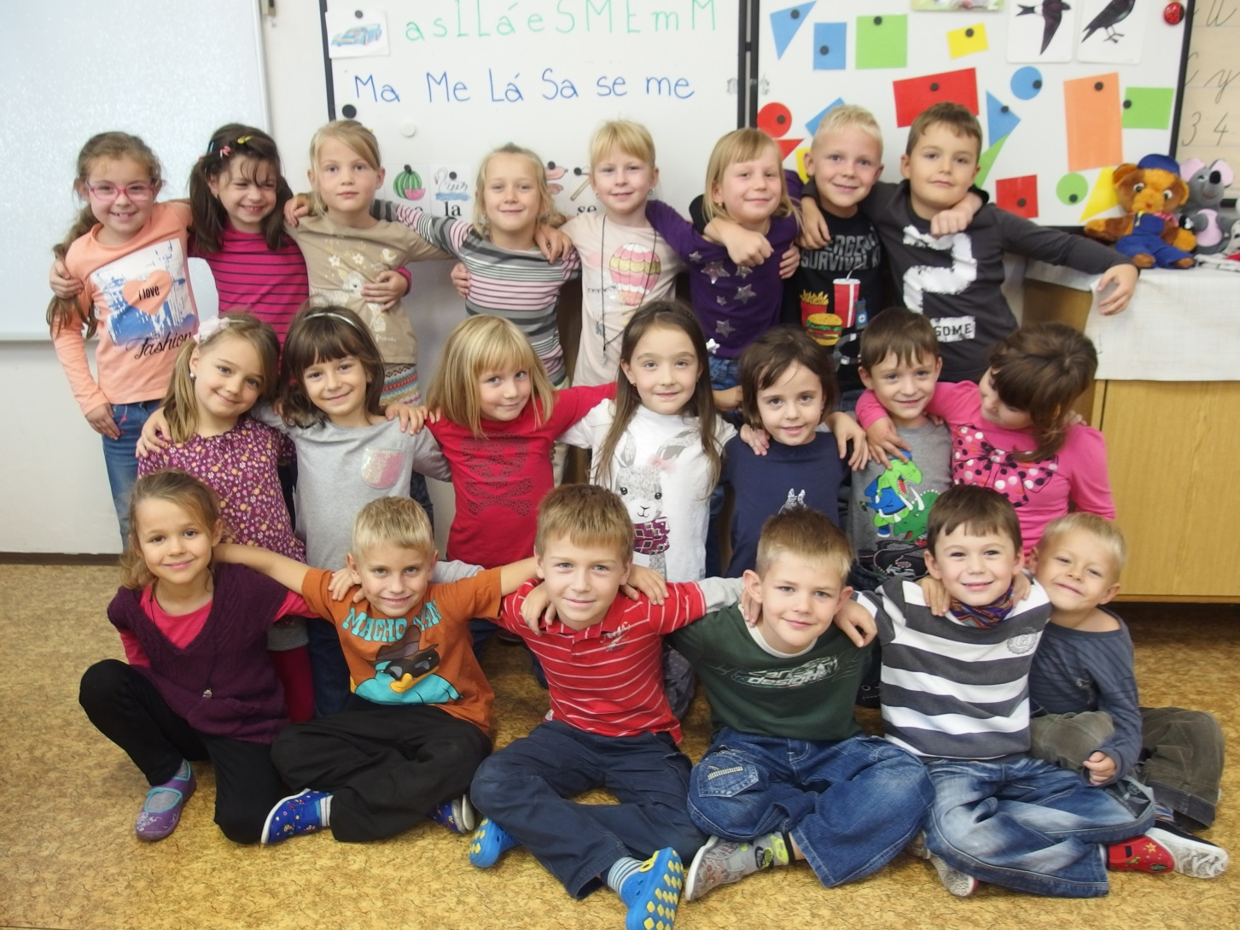
Our class

