Slide 1
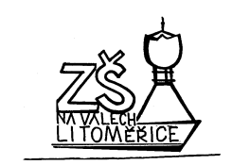
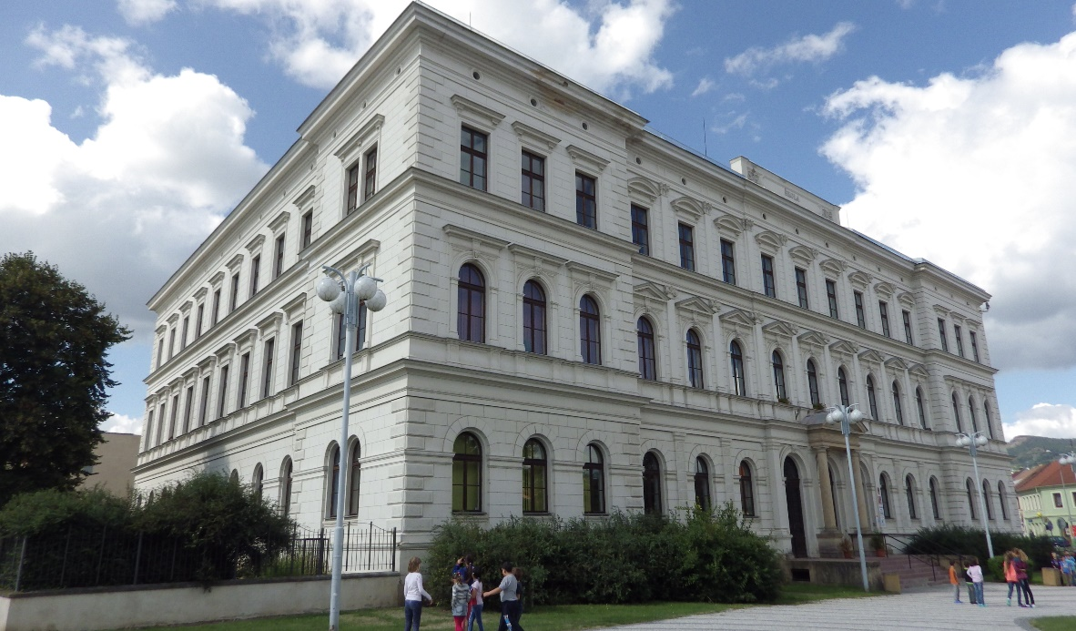
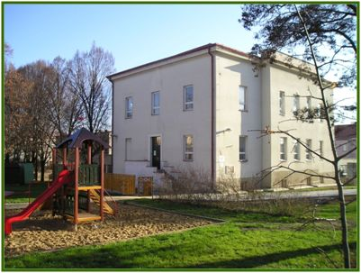
The primary school, Na Valech 53, Litomerice, Czech Republic
School with … Enviromental education

Slide 2
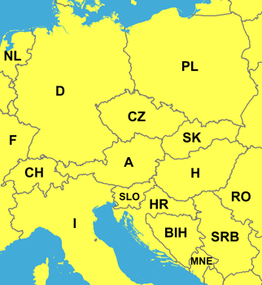
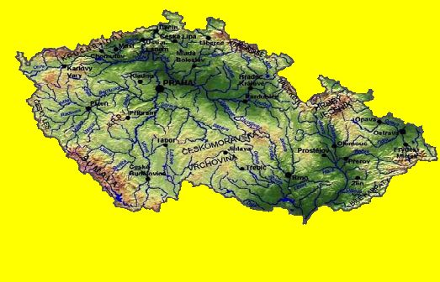
The Czech Republic is in the middle
of Europe
It has 10.000.000 of people.
The capital city is Prague.

Slide 3
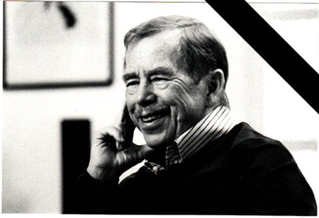
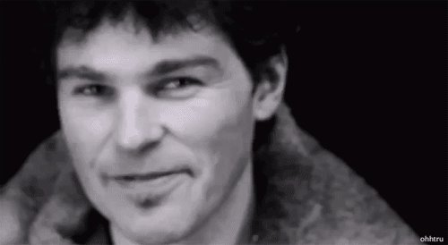
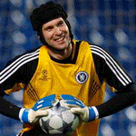
Czech celebrities
VÁCLAV HAVEL
JAROMÍR
JÁGR
PETR ČECH

Slide 4
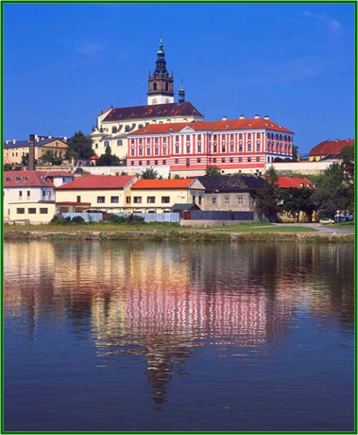
The city Litomerice is situated in the northern part of the Czech Republic.
Some 60 km of the capital city of Prague,
at the confluence of the rivers Ohre and Labe.
http://www.litomerice-info.cz/cz/turisticke-cile-ve-meste/

Slide 5
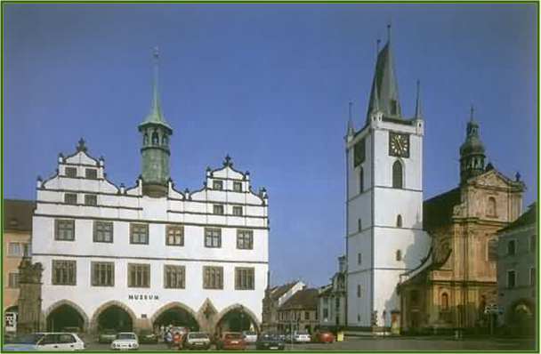
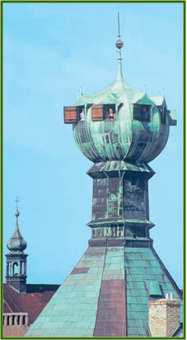
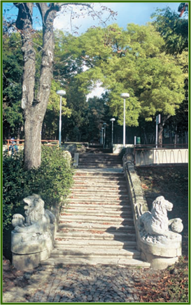
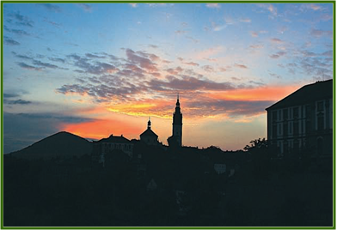
Litomerice lies near the foothills of the Bohemian Low Mountains.
The city is noted for its deep and varieated historical tradition as much as for its many well-preserved historical monuments.

Slide 6
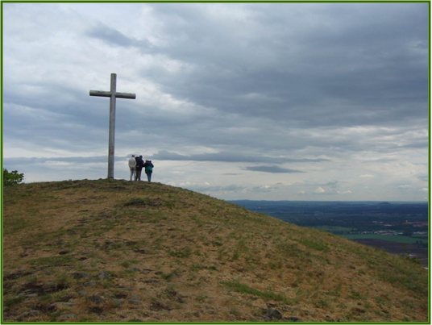
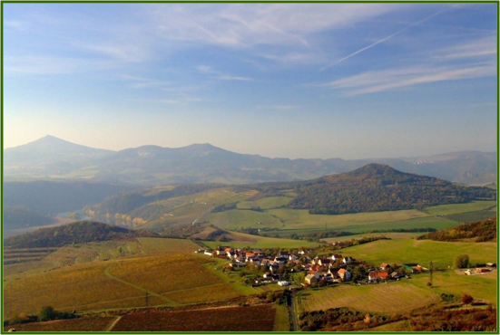
The Bohemian
Low Mountains

Slide 7
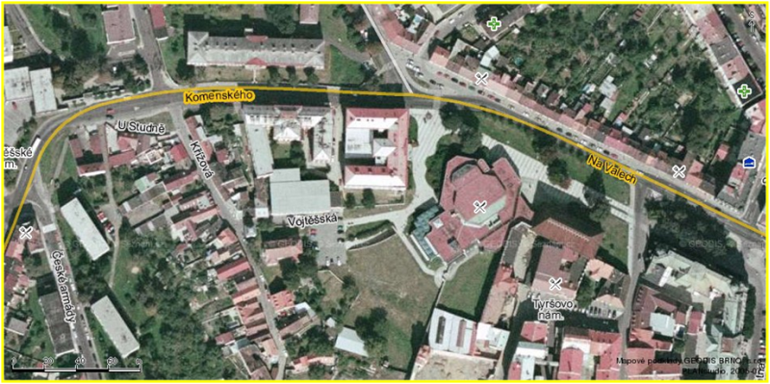
SCHOOL

Slide 8
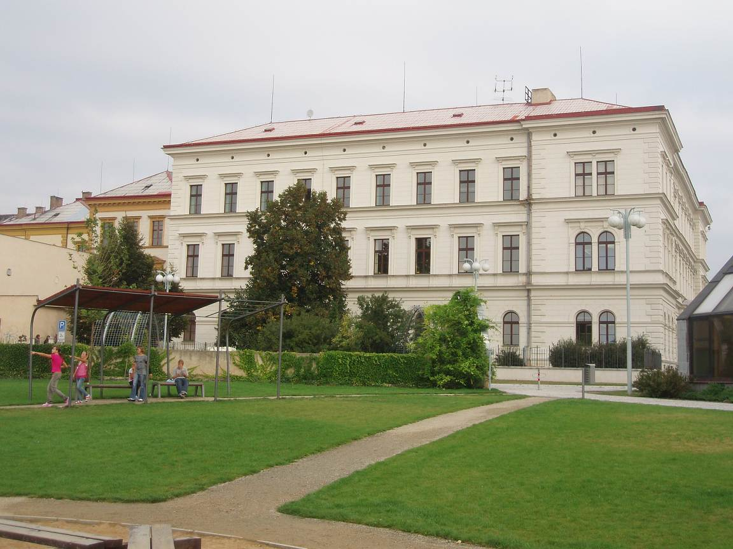
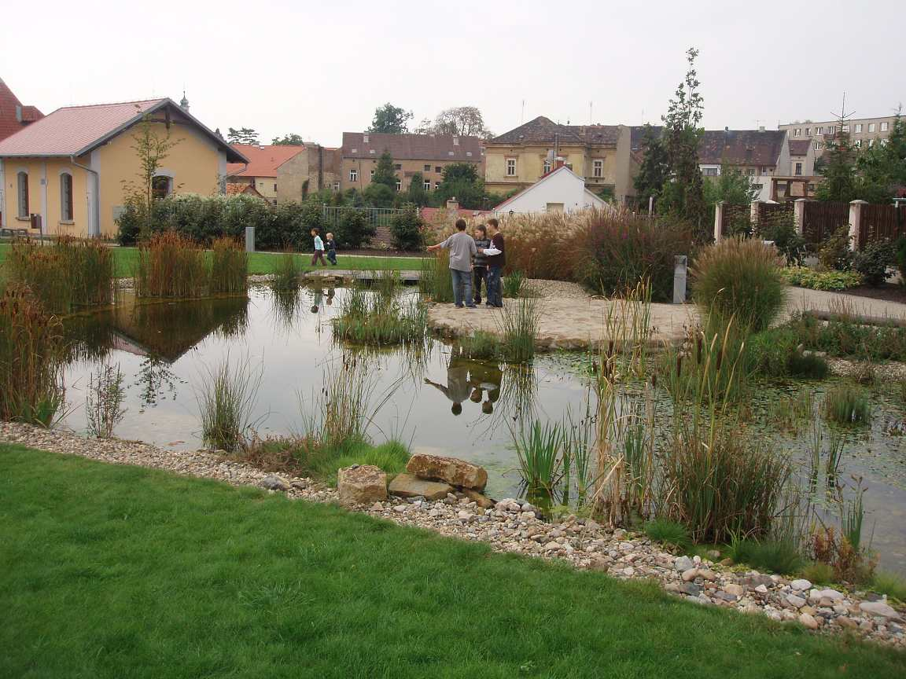
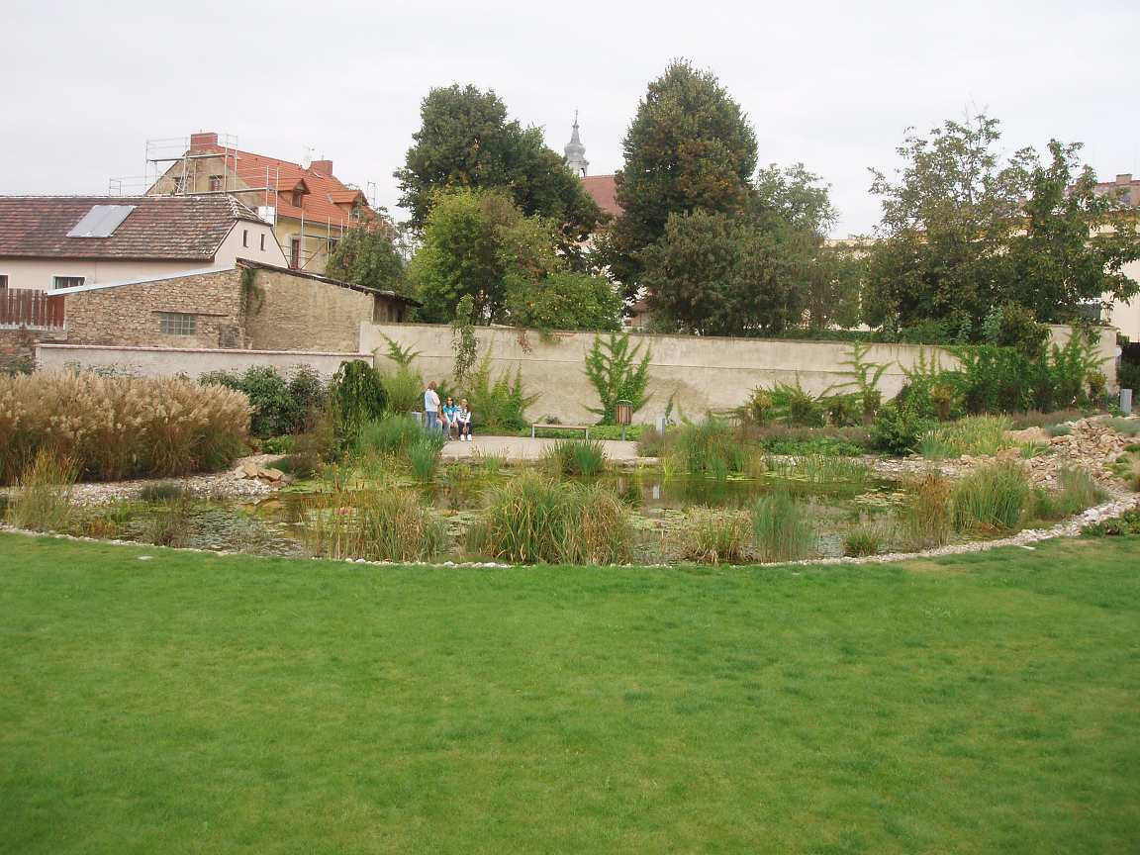
This is
a surround
of our school
Notes:
Něco o nás a našich dětech – 4.A

Slide 9
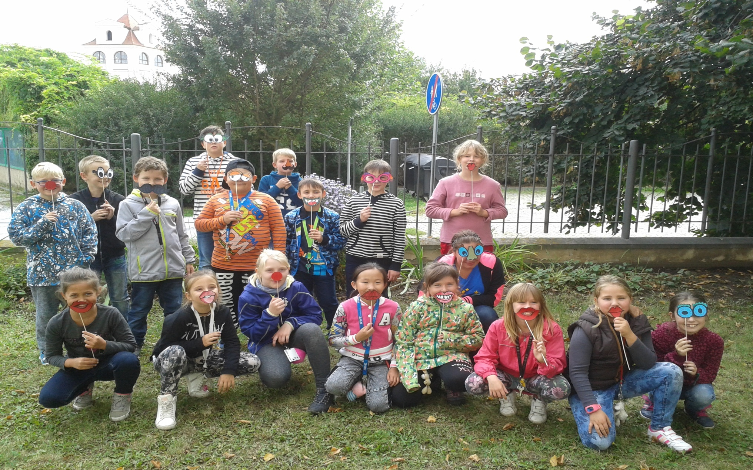
This is VALIK,
mascot of our school
CHILDREN CONNECTED
IN ETWINNING

Slide 10
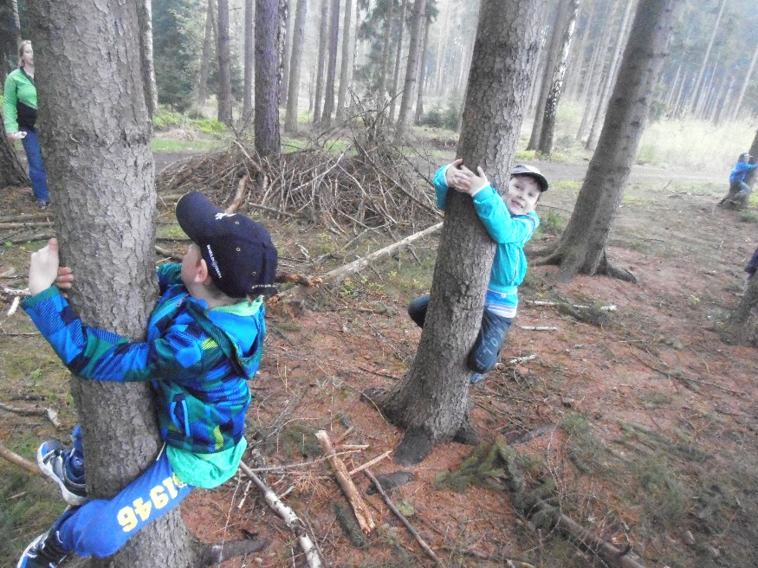
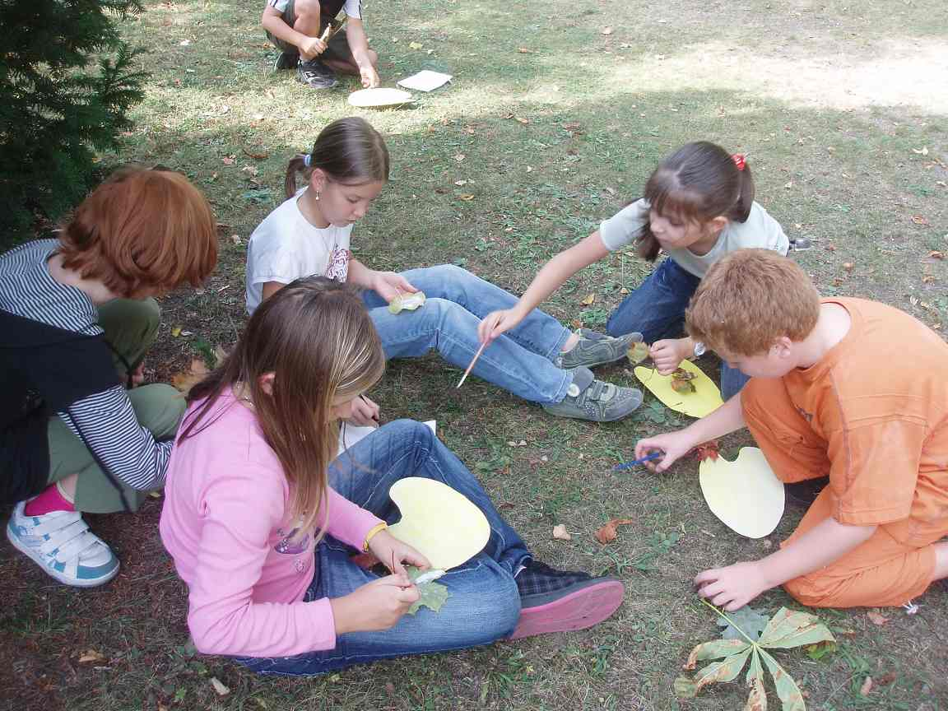
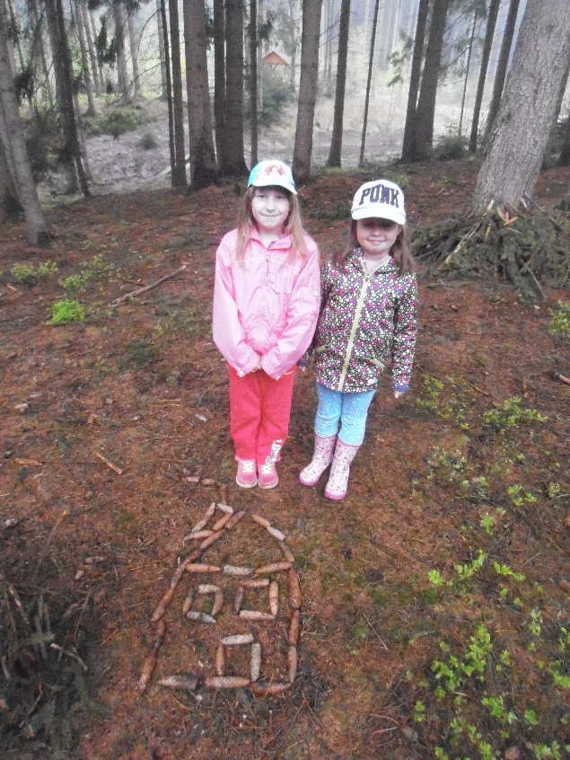
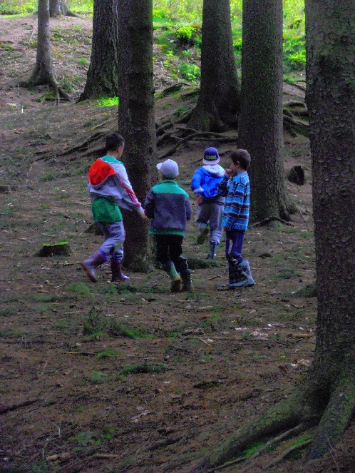
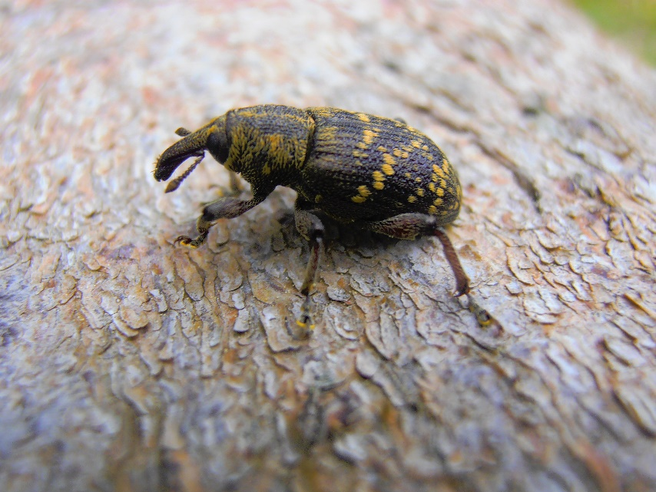
We like nature
Notes:
Něco o nás a našich dětech – 2.A

Slide 11
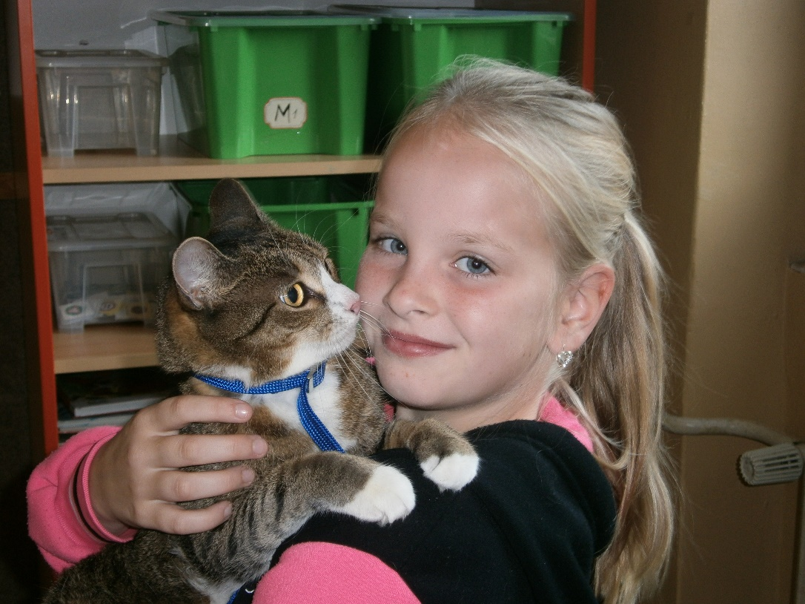
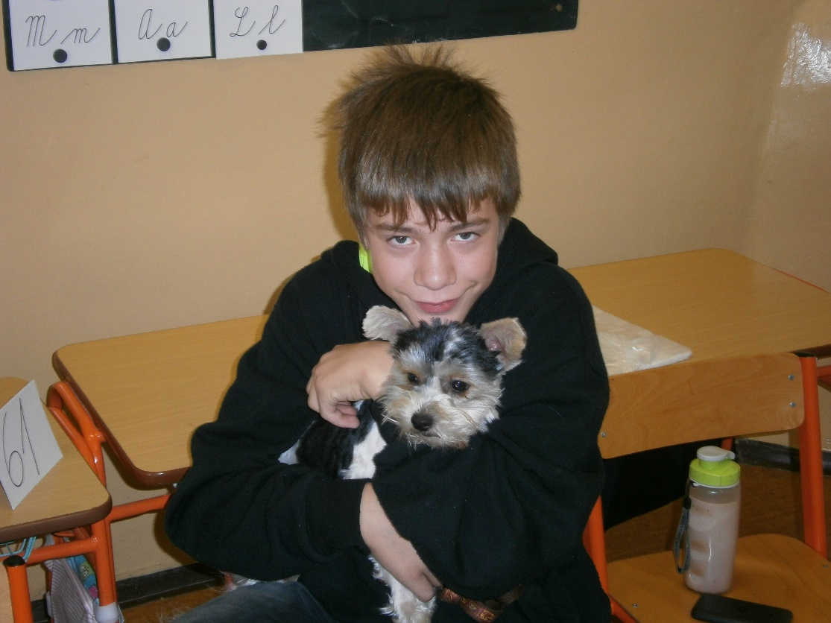
We hold an exhibition of animals in our school…

Slide 12
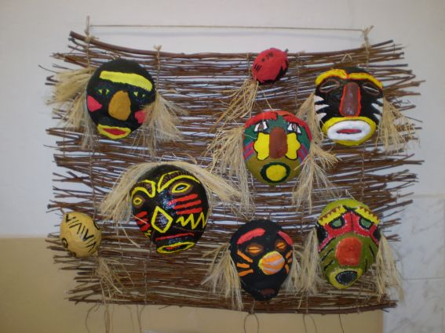
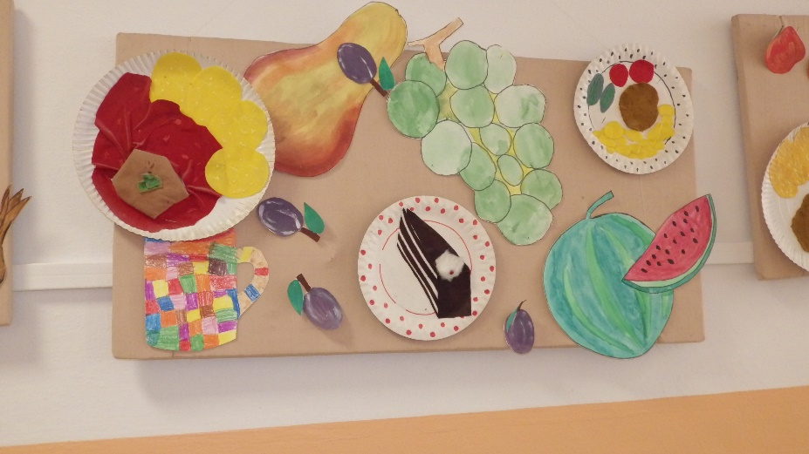
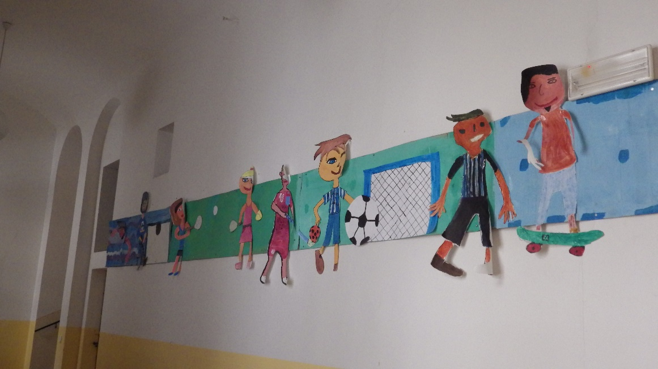
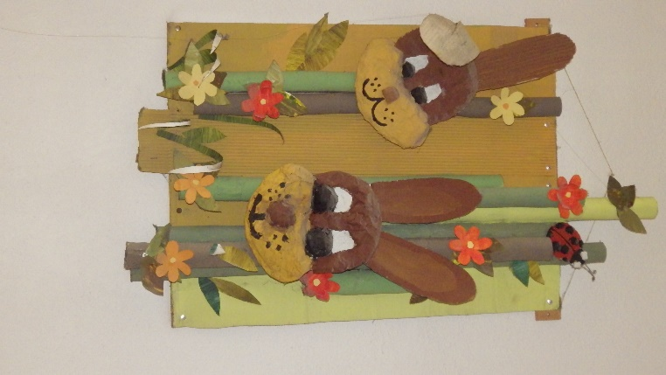
Our art ☺

Slide 13
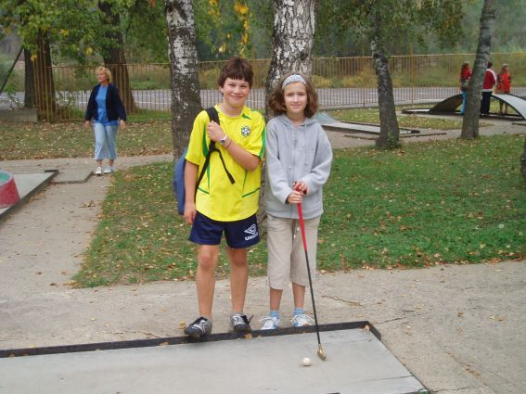
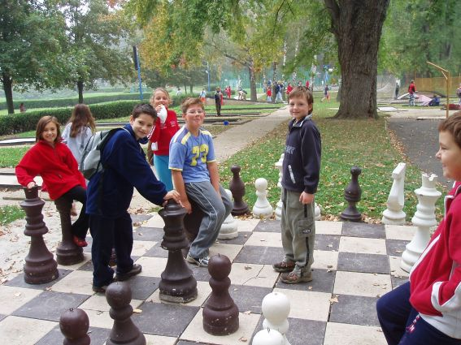
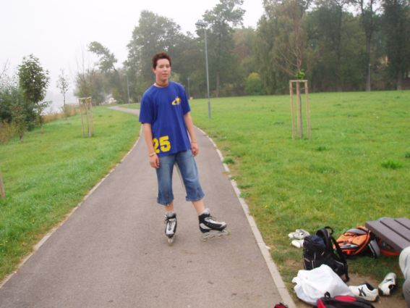
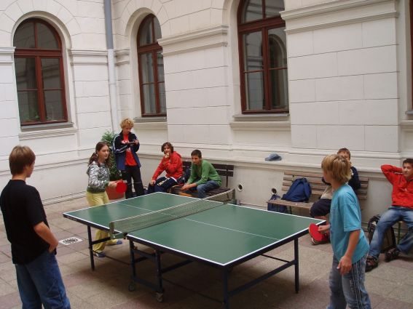
We hold sport actions…

Slide 14
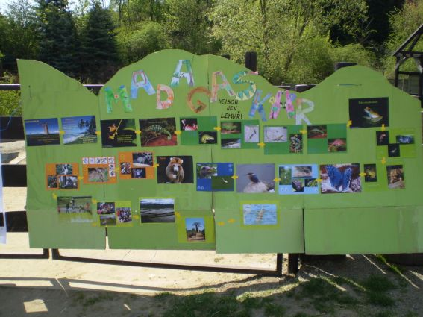
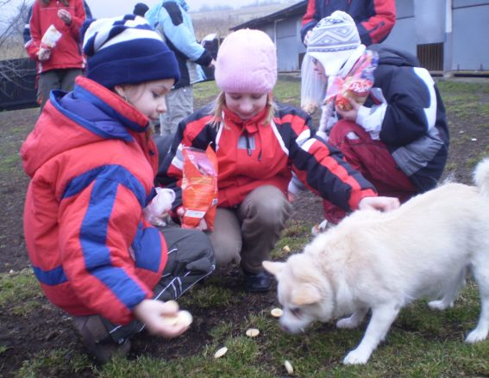
We help to animals in ZOO
and to dog´s asylum…

Slide 15
We are looking forward to working with you in our project „Full school of fun“ in this school year.

