Slide 1
Lobachi school Ukraine

Slide 2
The Day of Ukrainian writing

Slide 3
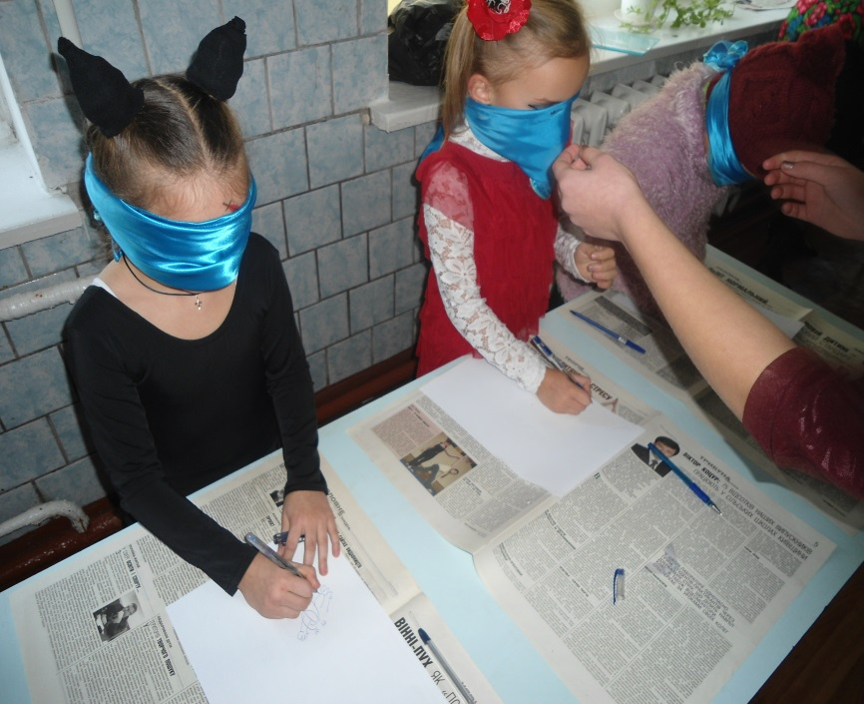
Our Halloween day

Slide 4
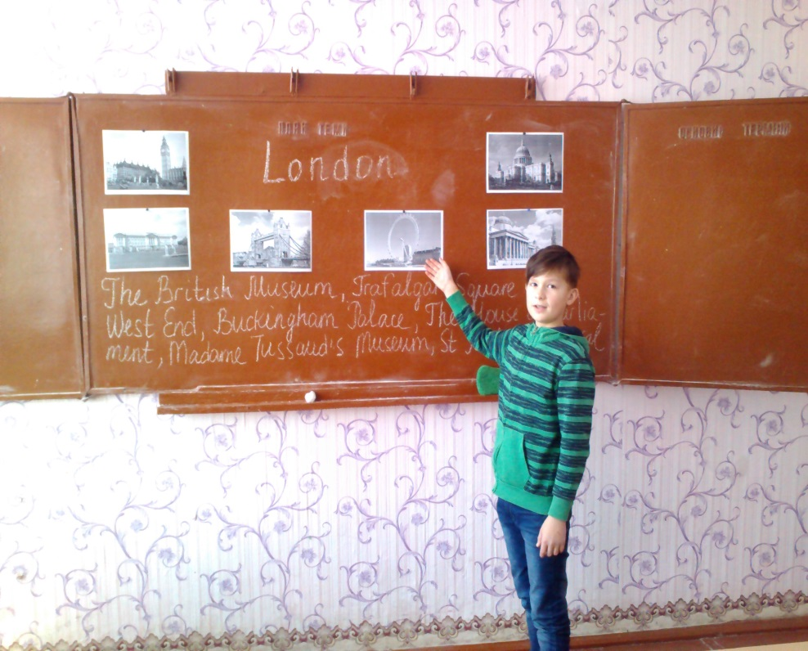
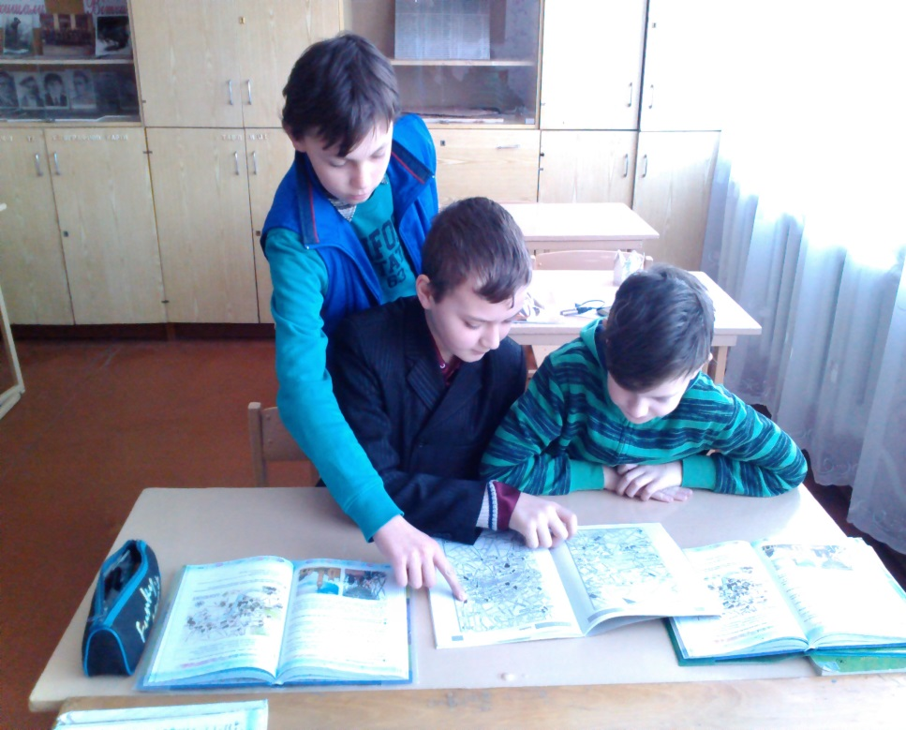
Welcome to great Britain

