Slide 1
Climate Warriors

Slide 2
The internet is a very interesting place you can learn with it, you can research for a project, and also you can connect with family and friends. But the internet can also be a very dangerous place because some websites on the internet can lead kids into inappropriate websites and dangerous situations, and also online posts can have lasting effects.
Let’s start with the inappropriate websites, well you never know what could be on that website. It could be inappropriate pictures, videos, ads and a lot more. Kids can be easily lured into that type of thing for example, if the child has a laptop in his or her room and has seen something on the television and searches for that subject and it can end up with being a subject that is exposed to inappropriate applications and situation if they dont how to be safe on net
Now being lured into a dangerous situation that is also called “stranger danger” he or she has access to the internet and gives out personal information then predators hunt him or her down and him or her ends up being missing because of the information that was given on the accessible laptop or computer.
Last but not least whatever you have posted online can have a lasting effects later in your life, example you could have a hard time trying to get a job because of what you have done. Also you could end up not being trusted in life just for having done the things you did on net in your past.You have a bad digital footprint and it influences your future badly.
I hope that you realize that the internet can be very helpful place but also a very dangerous place. Remember that if you ever end up getting into one of these things think of the effects that can happen which are inappropriate websites, dangerous situations, and also posts have lasting effects. Please learn how to be safe on internet and dont forget that nothing is actually deleted on net.Hence,take care of your steps on net all the time .
Mertcan - Emual

Slide 3
"We are all now connected by the Internet, like neurons in a giant brain". -Stephen Hawking
"The nature of the internet is that you don't know who is behind the screen. " - Louise Mensch
" The internet has been a boon and a curse for teenagers. " -J. K. Rowling
"It's like the Wild West, the Internet. There are no rules. " -Steven Wright
If they email you asking for cash, be sure to throw it in the trash
Spyware is a Nightmare, show you care, Be aware
If you don’t know the sender, it might be a pretender
Prevent a jam, don’t open spam
SEC_RITY is not complete without U!
Passwords: Longer is Stronger.
Sec-UR-rity - You are at the center
prepared by Zeki Emual

Slide 4
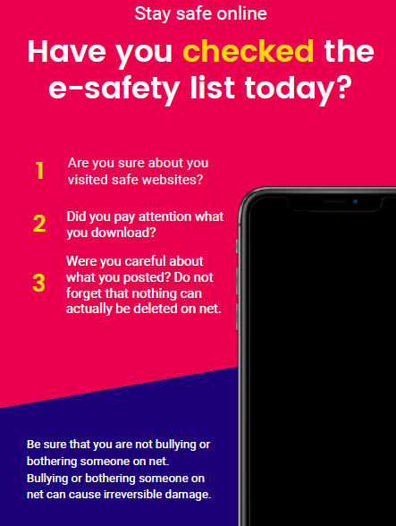
Prepared by Azra

Slide 5
Arda Emual
Zeki Emual
Azra Emual
Buse Emual
Mertcan Emual

