Slide 1
Water footprint analysis
Climate warriors

Slide 2
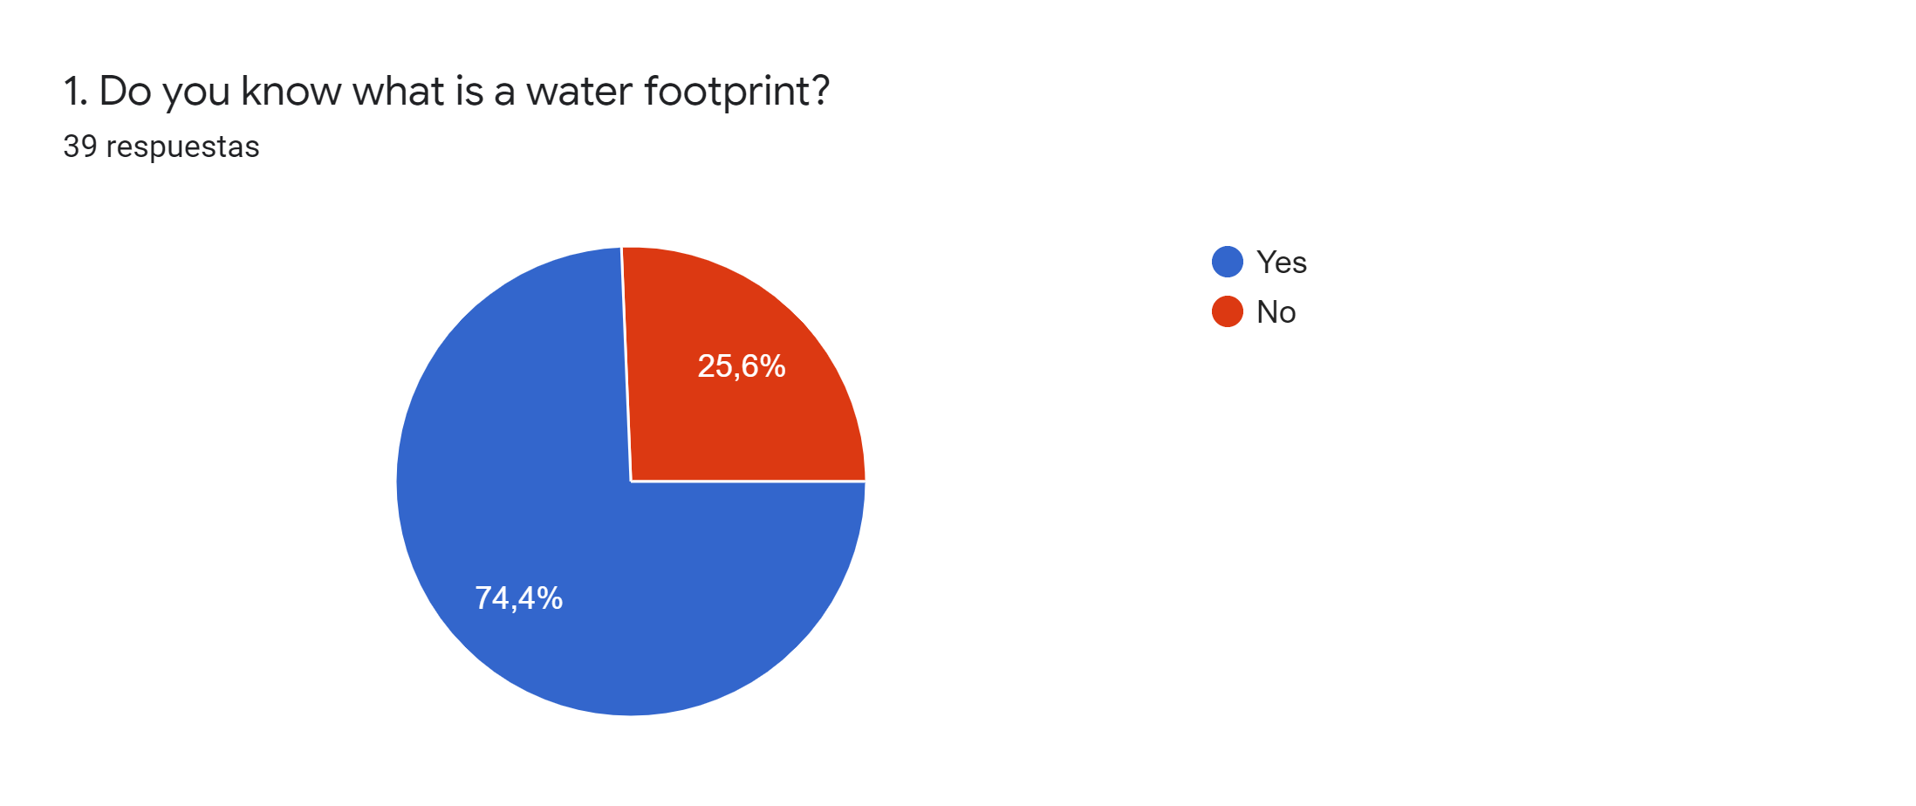
answers
Almost 75% of our participants know what a water footprint is, however they don’t know the water comsuption in the Eatrh

Slide 3
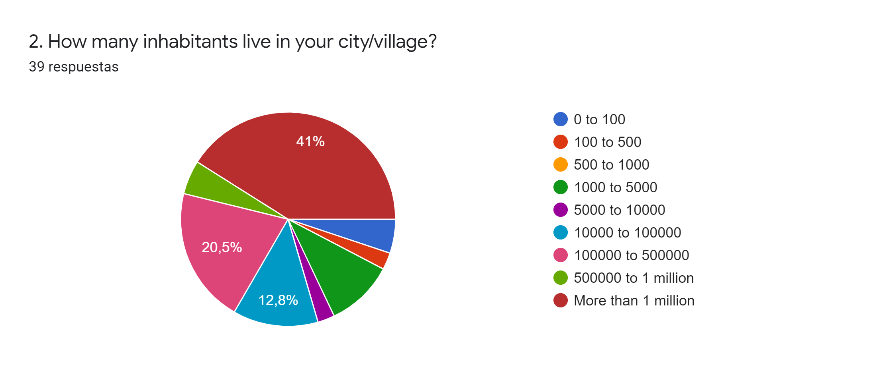
answers
Most of our participants live in a big city.

Slide 4
This is an activity with 8 questions about water consumption, to analyse the knowledge of our participants about this topic.
We have divided the water consumption in two subgroups: food production and industrial production.
This is our global results
As a global result, we can see that our participants know more about the water consumption in food production that in industrial production.

Slide 5
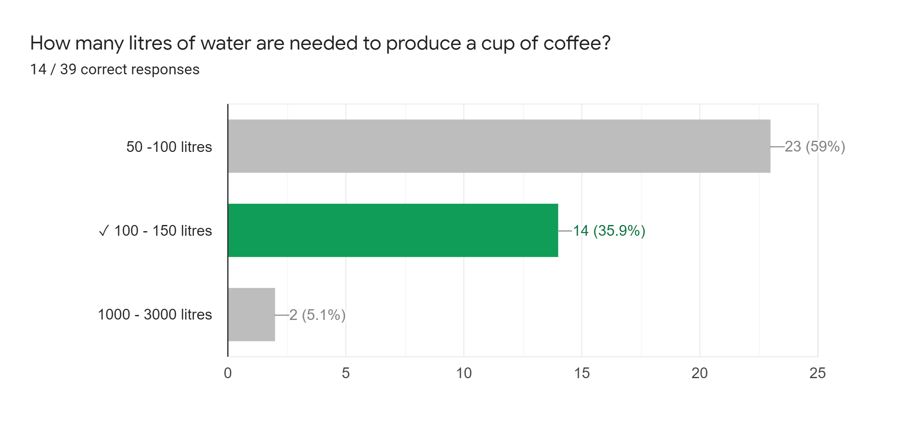
FOOD PRODUCTION

Slide 6
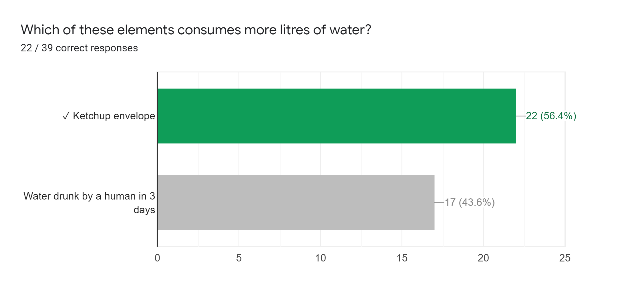
FOOD PRODUCTION

Slide 7
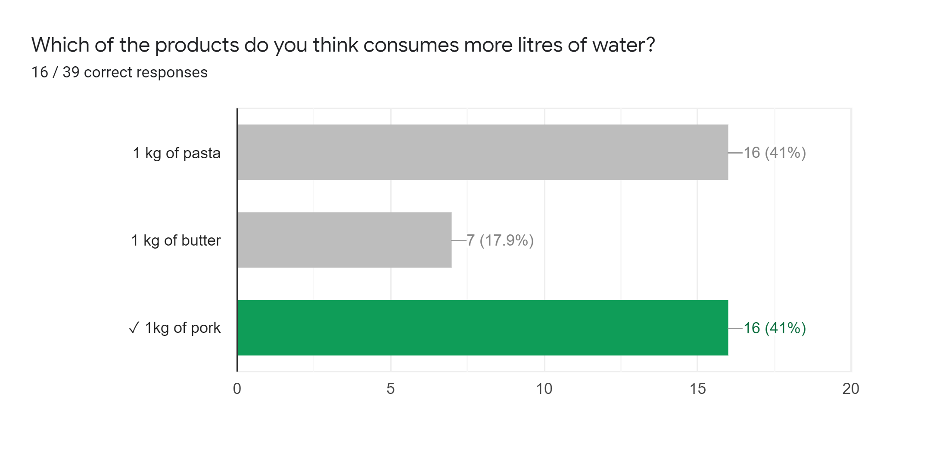
FOOD PRODUCTION

Slide 8
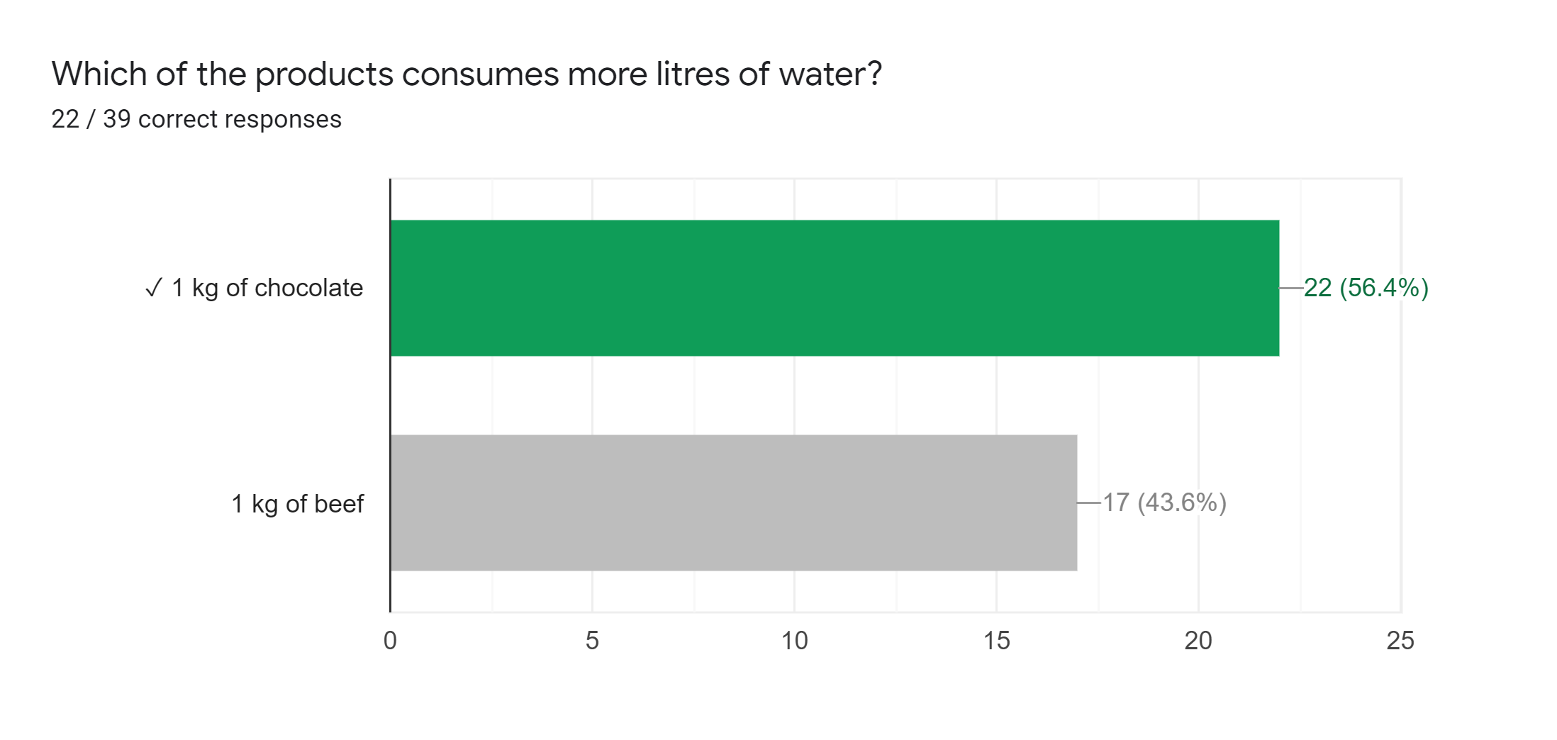
FOOD PRODUCTION

Slide 9
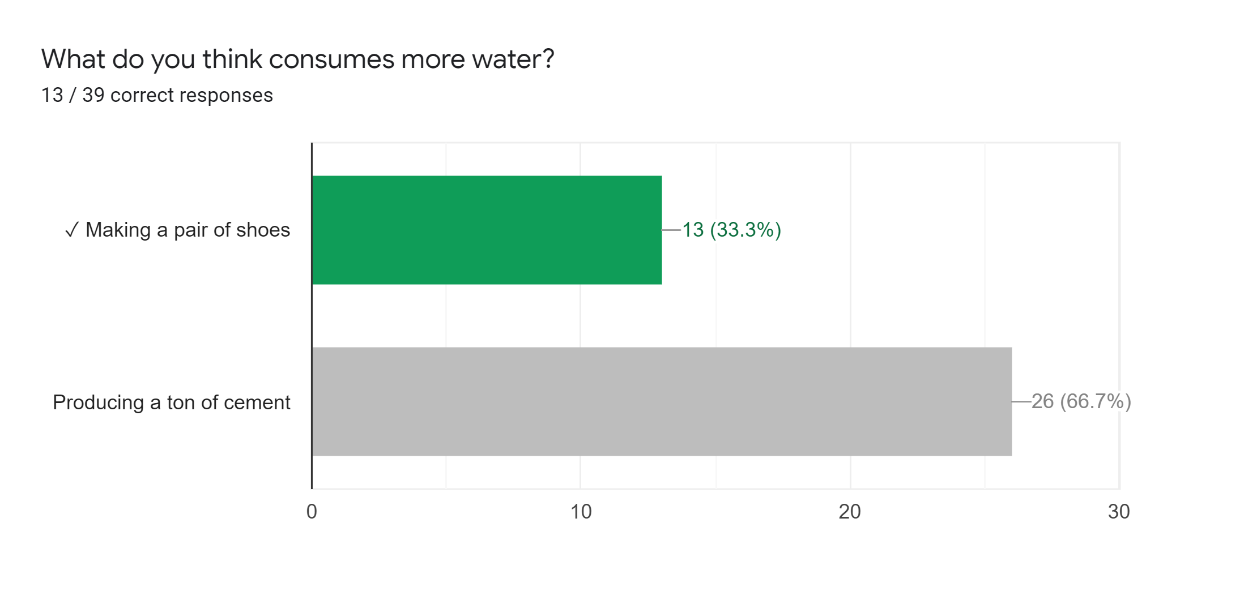
INDUSTRIAL PRODUCTION

Slide 10
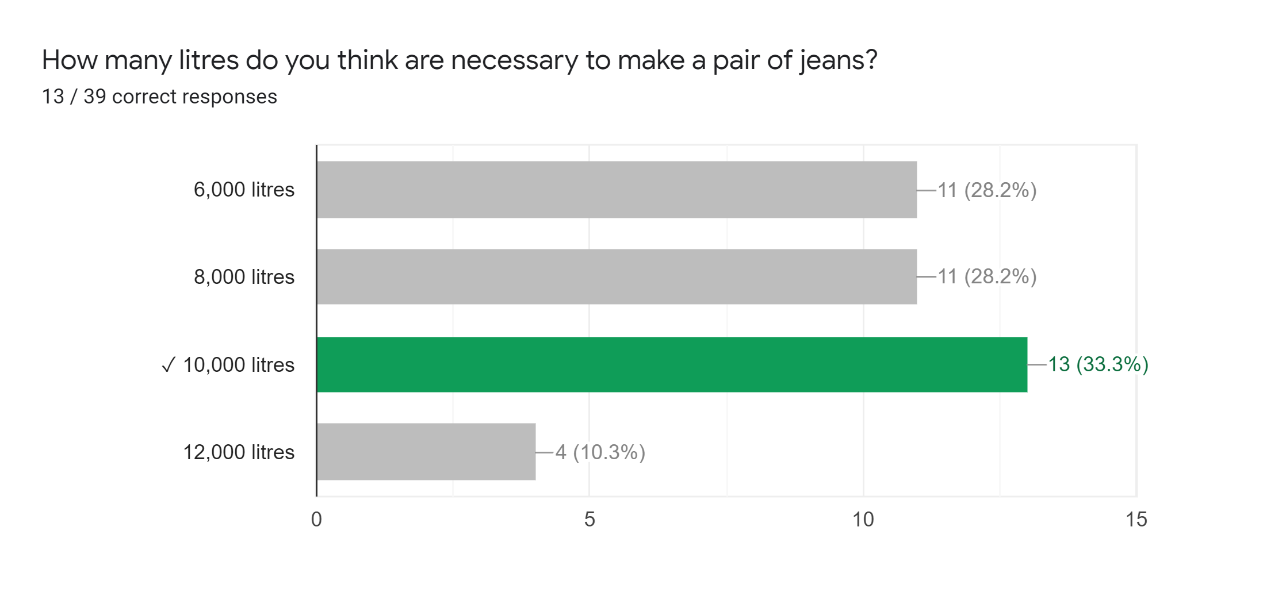
INDUSTRIAL PRODUCTION

Slide 11
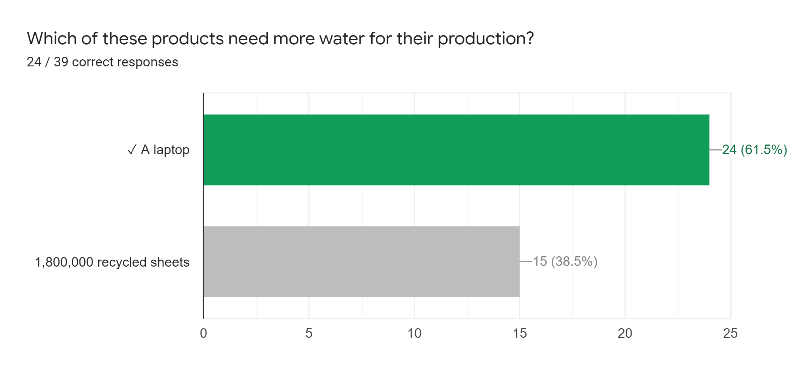
INDUSTRIAL PRODUCTION

Slide 12
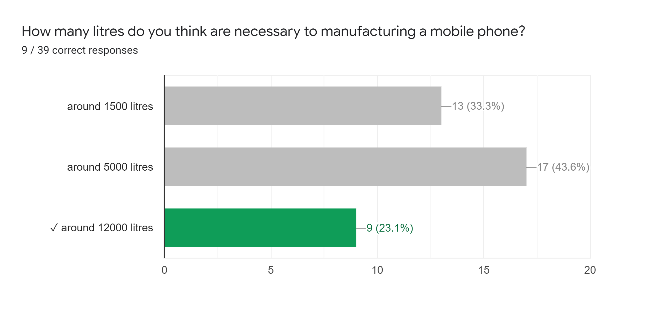
INDUSTRIAL PRODUCTION

