Slide 1
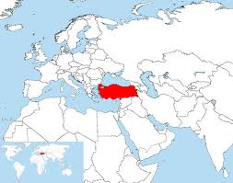
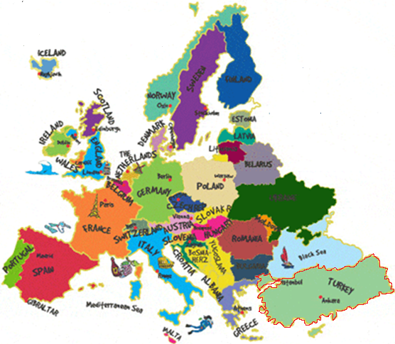
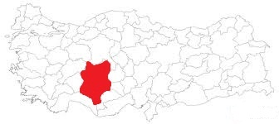
KONYA SCIENCE AND ART CENTER FROM TURKEY

Slide 2
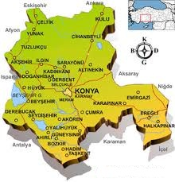
KONYA
Konya is a city in Central Anatolia in Turkey which has protected its name for centuries. Legend says that Perseus killed a dragon that had been ravaging the town. The people set up a special monument to honor him, a stone obelisk with an icon of Perseus carved in it. This event gave the city it’s name, Ikonyon, Ikonyum, Iconium.
However, among Muslims, another legend is told. Two dervishes, friends of Allah, were making an excursion through the skies from the far away countries of Horasan toward the west. When they flew over the lands of central Anatolia, one asked the other, “Shall I land?” (”Konayim mi?”). The other answered, “Sure, land.” (”Kon ya!”) So, they landed and founded the city of Konya.

Slide 3
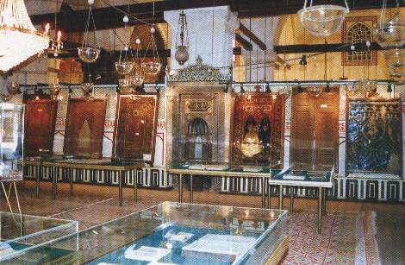
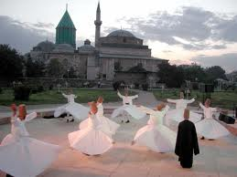
Mevlana Mosque
Archaeology shows that the Konya region is one of the most ancient settlements of Anatolia. The results of excavations in Catalhöyük, Karahöyük, Cukurkent and Kucukoy show the region was inhabited as far back as the Neolithic Period (Late Stone Age) of BC 7000. Other settlers of the city before Islam were; the Calcolitic Period (Copper Age) civilizations, Bronze Age civilizations, Hittites, Frigians, Lidians, Persians, Romans and finally Byzantines.
Konya is an important place for Christians as well because St. Paul and St. Barnabas came to the city on one of their journeys in Asia Minor around 50 AD. St. Paul preached in Konya but they angered both Jews and Gentiles so they had to leave the city and went to Derbe and Lystra.
The first exposure of the city to Islam happened during the time of the Caliph Muaviya. Later, attacks made by Arabic Muslims, whether Emevi’s or Abbasi’s, yielded no results. Konya’s real meeting with and adopting of Islam began some time after the victory of Seljuks at Malazgirt in 1071, in the time of Kutalmisoglu Suleyman. The attacks of the Crusaders from 1076 to the end of the 12th century could not wrench the city from Islam.

Slide 4
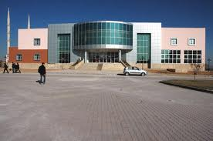
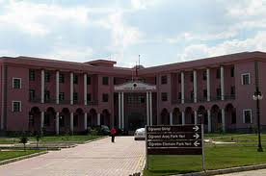
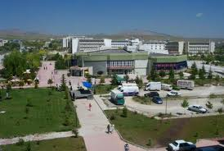
Universities
Konya is home to Selçuk University, one of the largest universities in Turkey.
There are also Mevlana University and
Karatay University.

Slide 5
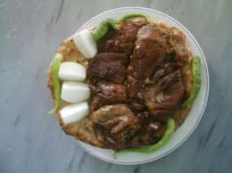
Special Foods of Konya TANDIR KEBABI
Stone baked in the oven. Lamb is done. Served with sweet white onions.

Slide 6
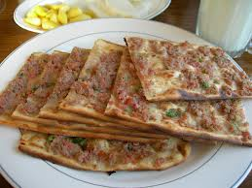
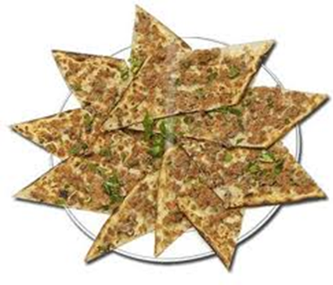
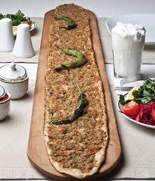
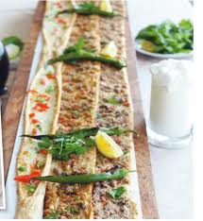
Etliekmek
Bread with ground meat layer on top
Etliekmek is favorite food in Konya.

Slide 7
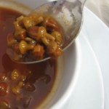
Bamya Çorbası
Gombo:
Okra, tomato, onion, small pieces of meat. A delicious soup

Slide 8
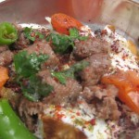
TİRİT
Tandoori fried bread.
Meatballs.
Meat broth.
Yogurt,
Onion and
Spices ...
Unforgettable taste

Slide 9
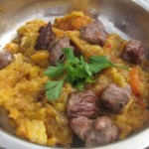
Vegetable grill
Wood fire roasted eggplant prepared in a special sauce.
Served with meat.

Slide 10
PHOTOS

Slide 11
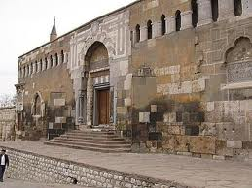
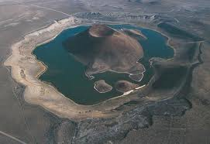
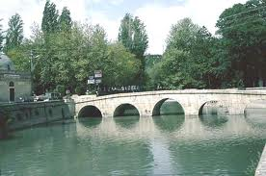
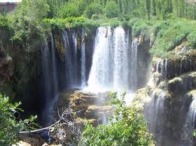
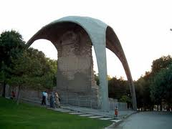
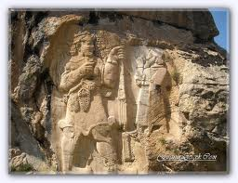
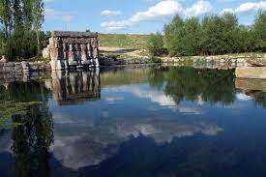
From Konya, history and nature

Slide 12
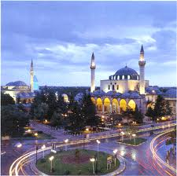
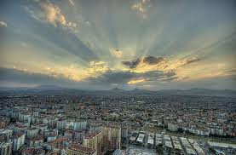
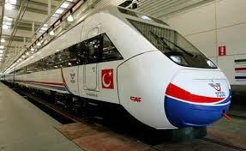
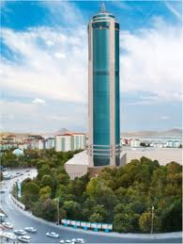
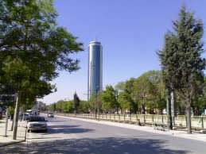
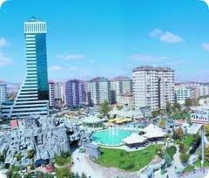
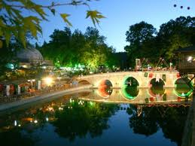
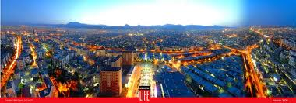
My City Konya
Notes:
My City Konya

Slide 13
To be continued
Konya
Turkey

