Slide 1
Inventions & Cultural Behaviour

Slide 2
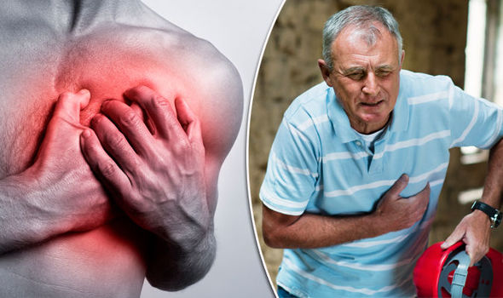
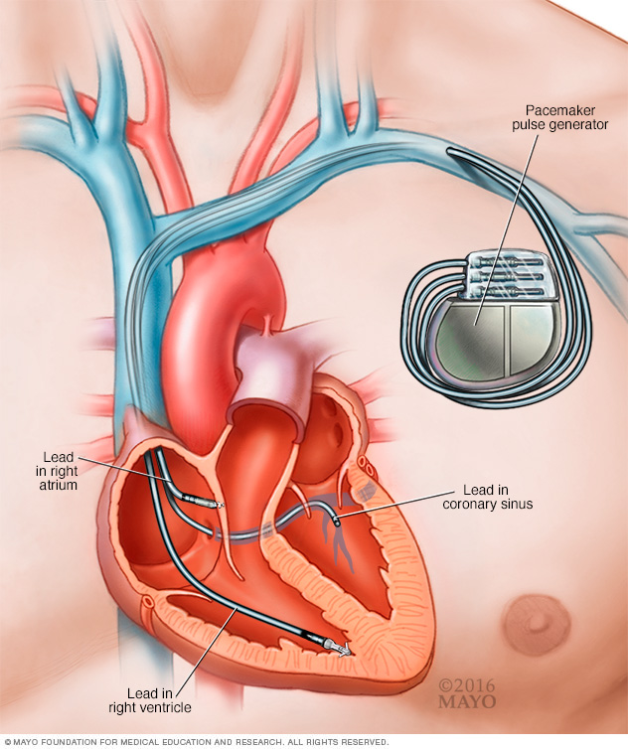
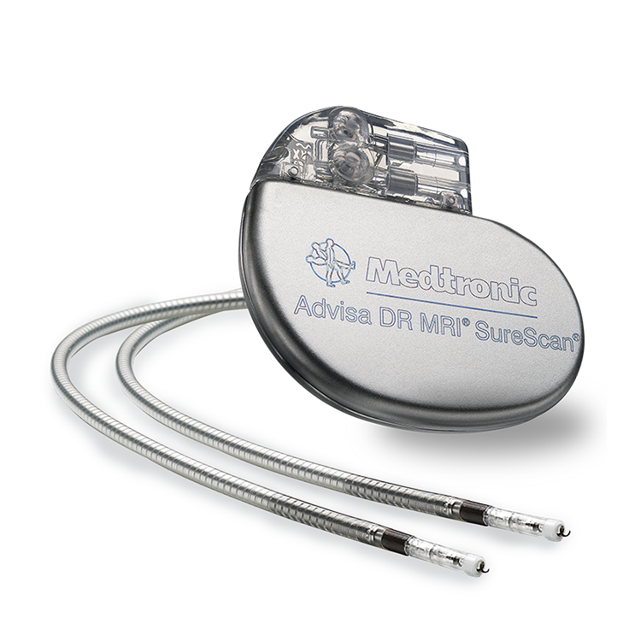
Medicine and chemistry- pacemaker
Before:
Higher death rate
Now:
Revives people, smaller death rate, longer living…

Slide 3
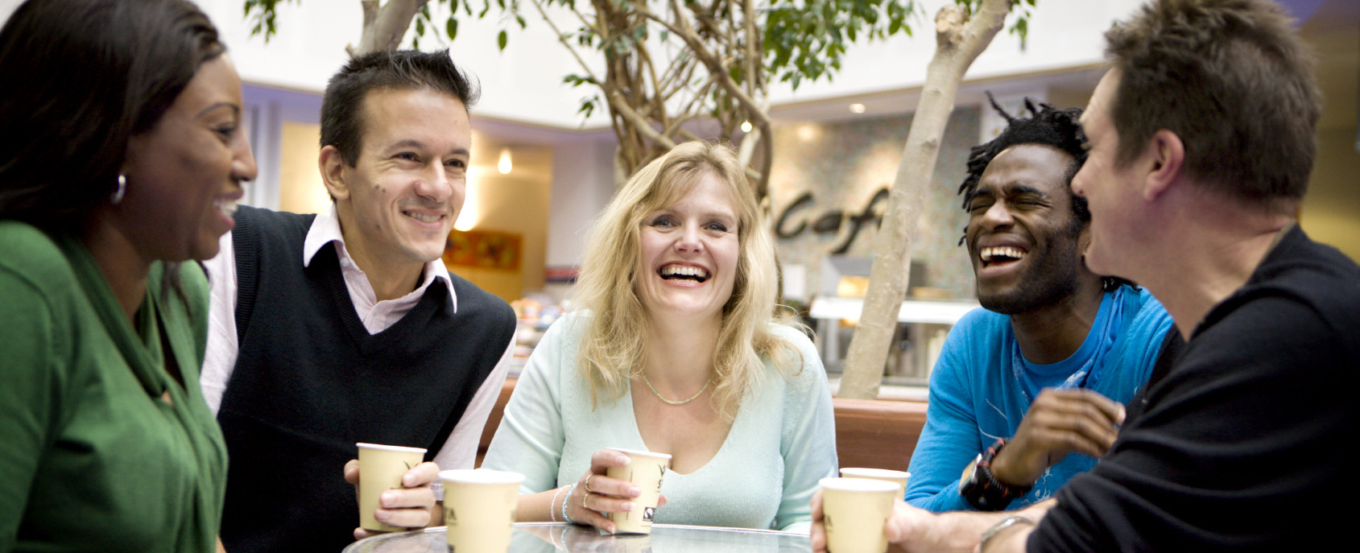
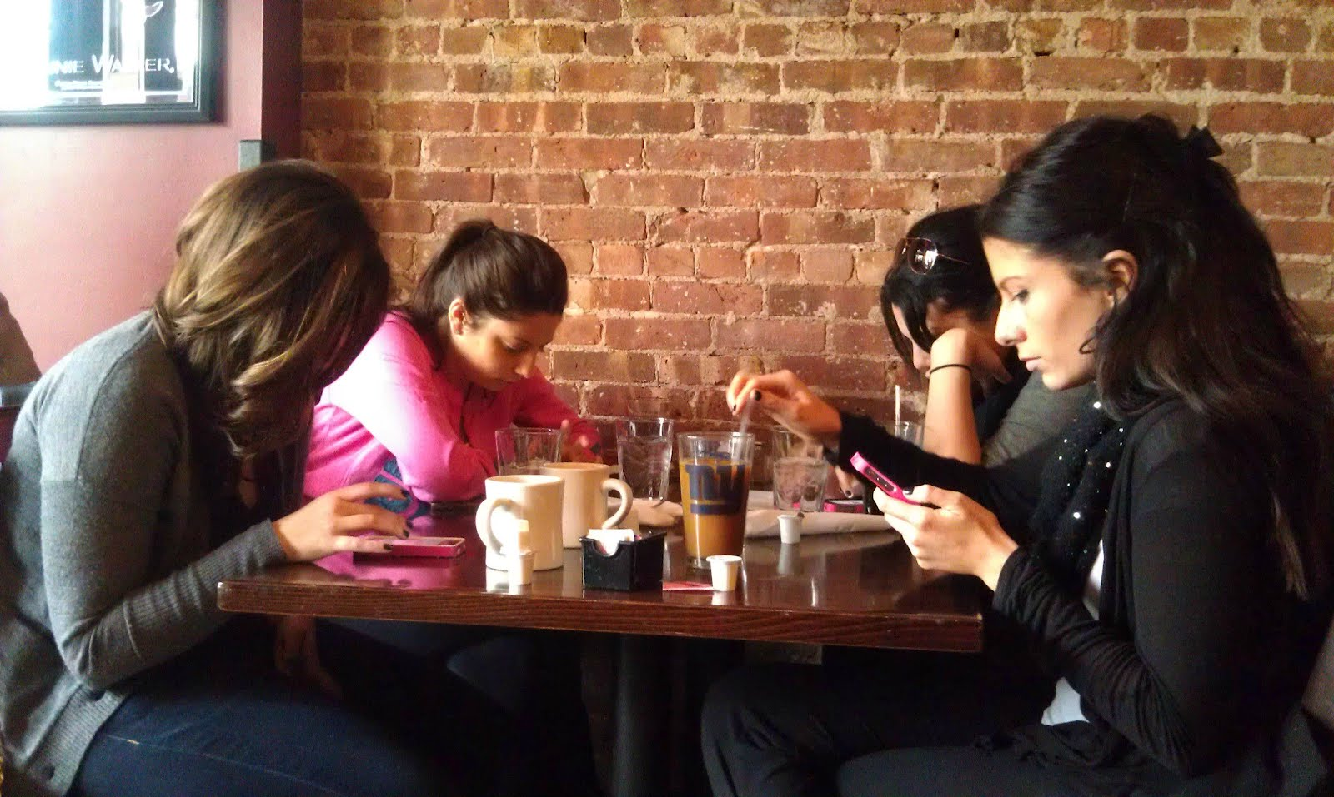
COMUNICATION- MOBILE PHONE
Before:
more personal communication,
Now:
No eye to eye communication, no hanging out, it made communication easier,
You can make more friends,…

Slide 4
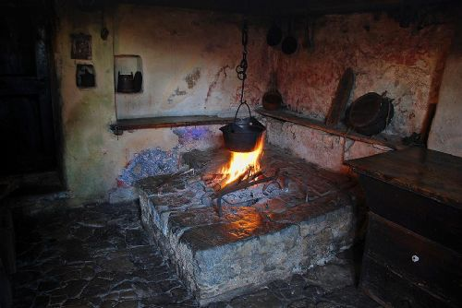
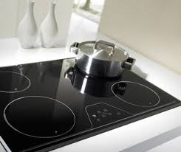
FOOD PREPARATION- cooker
Before:
Harder to cook, no options to choose…
Now:
Faster cooking, easier, different food options to cook…

