Slide 1
ECO-SCHOOLS PROGRAMME
https://www.ecoschools.global/

Slide 2
It all starts in the classroom
Eco-Schools is a growing phenomenon, which encourages young people to engage in their environment by allowing them the opportunity to actively protect it. It starts in the classroom, it expands to the school and eventually fosters change in the community at large. Through this programme, young people experience a sense of achievement at being able to have a say in the environmental management policies of their schools, ultimately steering them towards certification and the prestige which comes with being awarded a Green Flag.

Slide 3
Includes everyone
Combining learning with hands-on experiences, the whole programme is run according to an all-inclusive, participatory approach involving students, teachers and the local community at large.

Slide 4
Improves School Environments
The Eco-Schools programme is an ideal way for schools to embark on a meaningful path towards improving the environmental footprint of a school, a change which inevitably leads to a more sustainable, less costly and more responsible school environment.

Slide 5
Motivates
Eco-Schools challenges students to engage in tackling environmental problems at a level where they can see tangible results, spurring them on to realise that they really can make a difference.

Slide 6
Improves Attitudes
Eco-Schools instills in students a sense of responsibility and cultivates a sustainable mindset which they can apply on a daily basis. It equips those involved with the drive to really make a difference and to spread such proactive behaviour amongst family and friends, ultimately passing it on to future generations.

Slide 7
Involves Communities
Eco-Schools places great emphasis on involving the local community from the very beginning. By doing so, the lessons the students pick up are transferred back into the community where they take hold and lead to more sustainable, environmentally responsible behaviour patterns all round.

Slide 8
Connects Globally
Eco-Schools facilitates contact between participating institutions not just at the national level, but also internationally. These links provide an opportunity for schools to share environmental information, they can also be used as a means for cultural exchanges and for improving language skills.

Slide 9
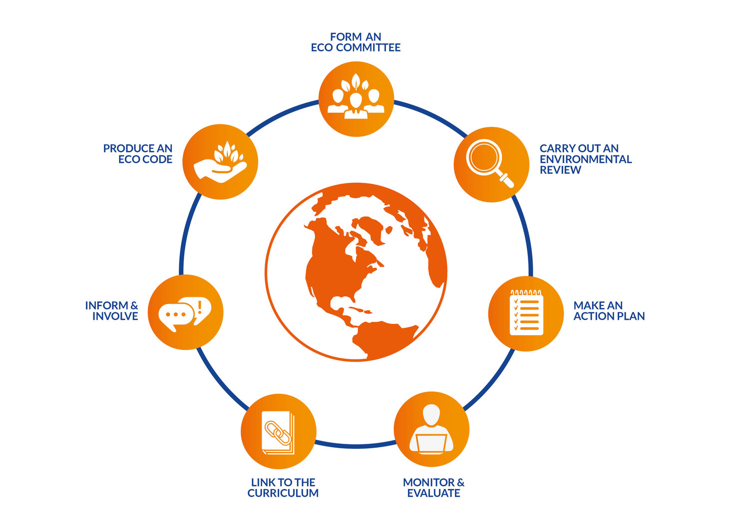
HOW
ECO-SCHOOLS
WORKS?

Slide 10
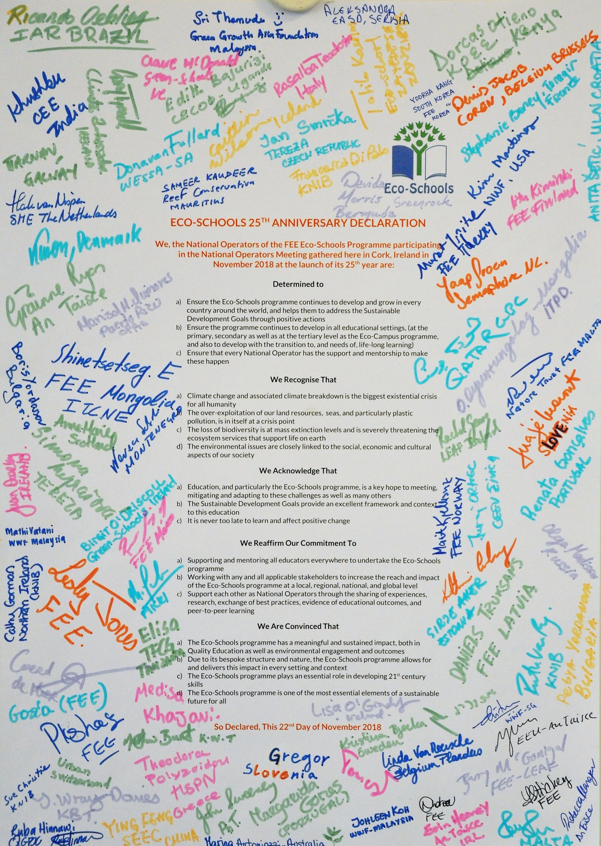
25 Years Declaration
Eco-Schools 25th anniversary declaration is our commitment to growing from 68 countries to every country in the world. Helping and empowering young people to take positive actions for a sustainable future for all. Bring on the next 25 years!

Slide 11
SEVEN STEPS TOWARDS AN ECO-SCHOOL
1. Form an Eco Committee
2. Carry out a Sustainability Audit
3. Action Plan
4. Monitor and Evaluate
5. Curriculum Work
6. Inform and Involve
7. Produce an Eco Code

Slide 12
The Green Flag
Usually after two years of implementing the programme and reaching a high level of performance in complying with these seven steps (sometimes national mandatory criteria also applies), schools can then apply for and be awarded the Green Flag.
Before receiving their first Green Flag, schools must be assessed by means of a visit. After the first Green Flag, other means of assessment are allowed, although visits are always recommended. Assessment should be carried out on a yearly basis.

Slide 13
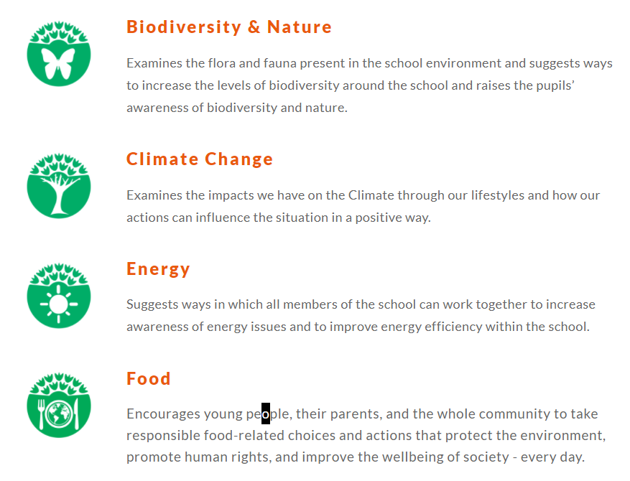
Eco-Schools Themes

Slide 14
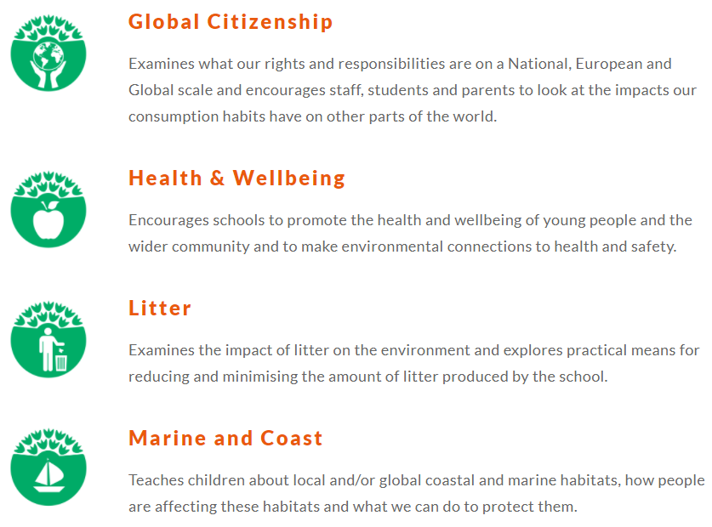
Eco-Schools Themes

Slide 15
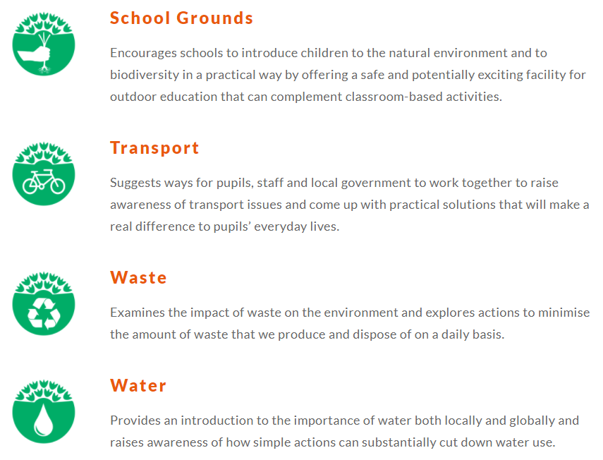
Eco-Schools Themes

Slide 16
THANK YOU ☺
MR. BEE’S DODOS
PROJECT TEAM

