Slide 1
Lithuanian Education System
Slides made by gymnasium students from Lithuania

Slide 2
Structure of the educational system in Lithuania
Pre-primary education (1 – 6 years old); Pre-school (6 – 7 years old); Primary (7 – 11 years old); Basic (11 – 16 years old); Secondary (16 – 18/19 years old); Higher education ( 18/19 – 26).

Slide 3
Explanation of the Educational system. Pre-primary education
Pre-primary education is considered a part of non-formal education and caters to children from 1 year to 6/7 years of age. Attendance is optional.

Slide 4
Pre-school
The Pre-school program is offered for children aged from 5 to 6 at nursery schools, and primary school is conducted by qualified teaching staff and is voluntary.

Slide 5
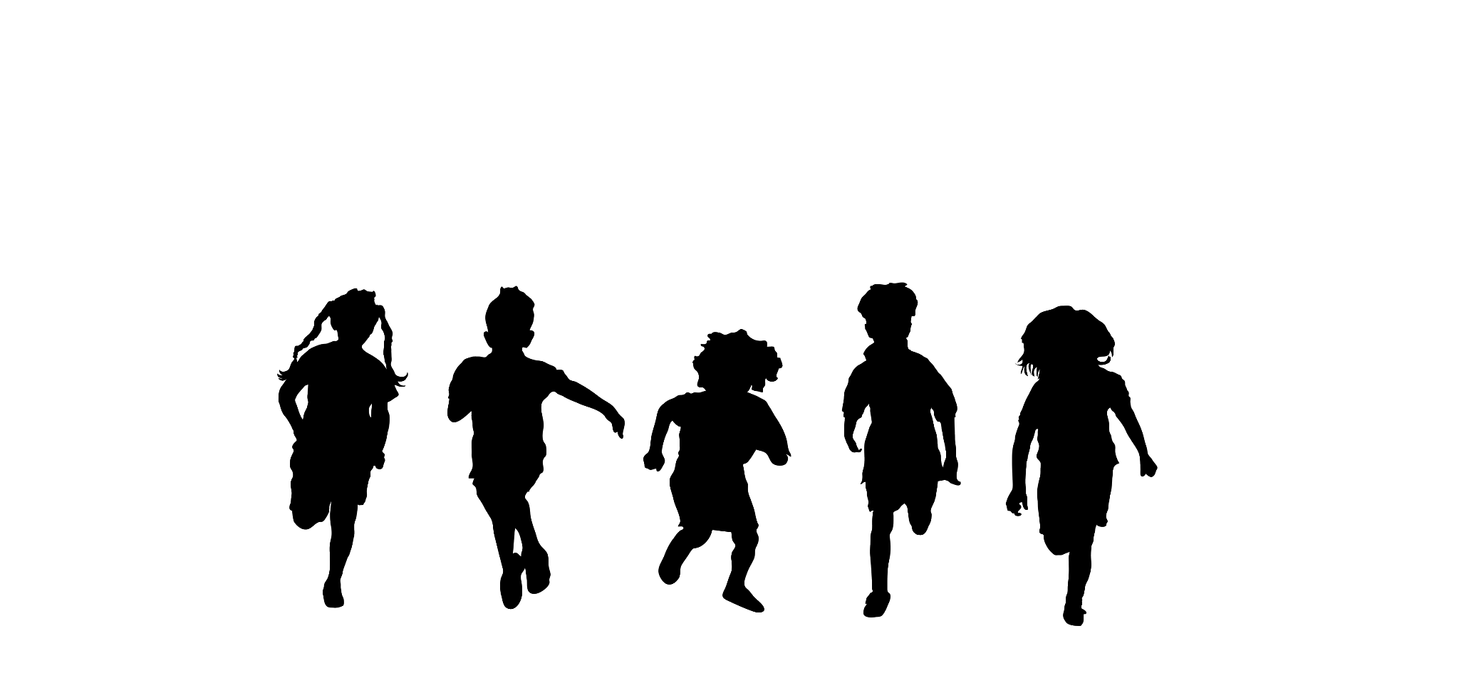
Primary and Lower Secondary School
Begins at the age of 6-7, ten class system for primary and lower secondary education. The 4-year primary school is followed by 6 years of basic education.

Slide 6
Gymnasium
Gymnasium has 9-12 forms which are often called 1-4 gymnasium years. Students who intend to enter Universities study in gymnasiums and take National exams.

Slide 7
Higher education
Higher education is based on the European credit system. The duration of the course of study leading to the acquisition of a Bachelor's degree (basic higher education study) is 4 years. This can be followed by a one or two-year vocational qualification diploma, such as a teaching qualification or a Master's degree, which in turn can be followed by a doctorate.

Slide 8
Grading / evaluation system in Lithuania
Pre-school children are not evaluated (do not get any marks).
The 1-4 formers are rated by levels. For example, “good”; “very good”; ”bad’’.
At Secondary School Level, it is a ten-point scale.
10
4

Slide 9
Result
Grade
Pass 10
Pass 9
Pass 8
Pass 7
Pass 6
Pass 5
Pass 4
Fail 3
Fail 2
Fail 1
Short description in English
Excellent
Very good
Good
Good enough
Satisfactory
Satisfactory enough
Weak
Bad
Very bad
Nothing answered, task was not completed

Slide 10
General principles
A lesson lasts for 45 minutes and 30-35 minutes for pre-school pupils and the first formers
Students have 22-35 lessons per week (from Monday to Friday)
There are 24-30 students in a class, as a rule.

Slide 11
Weather in Lithuania in winter
Winters in Lithuania are blessed with heavy snowfall, especially during January and February. The winter temperature in Lithuania is likely to reach -20 degrees Celcius in the winters. This pretty much gives you an idea about the cold months in Lithuania. If you visit the place during this time of the year, you are likely to enjoy a lot of snowfall. However, the snow melts away within two to three days of falling out.

