Slide 1
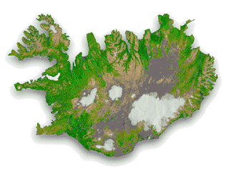
ICELAND

Slide 2
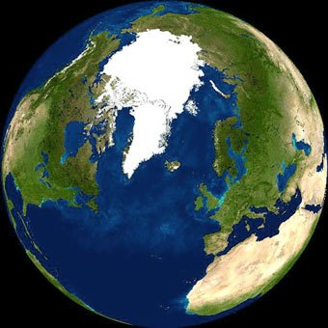

Slide 3
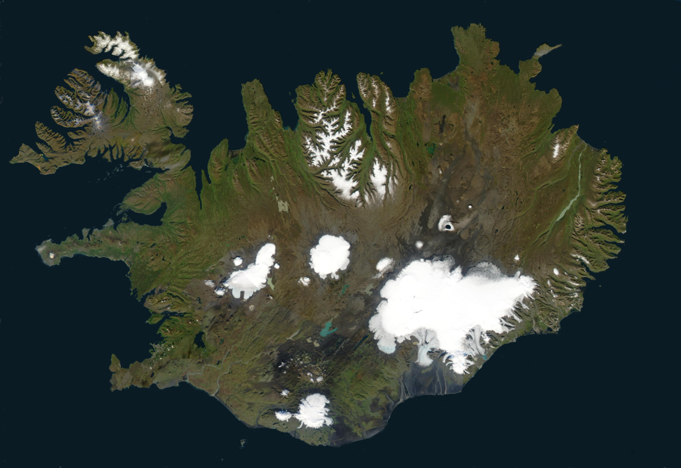
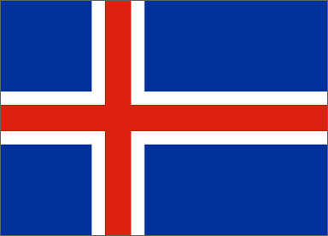
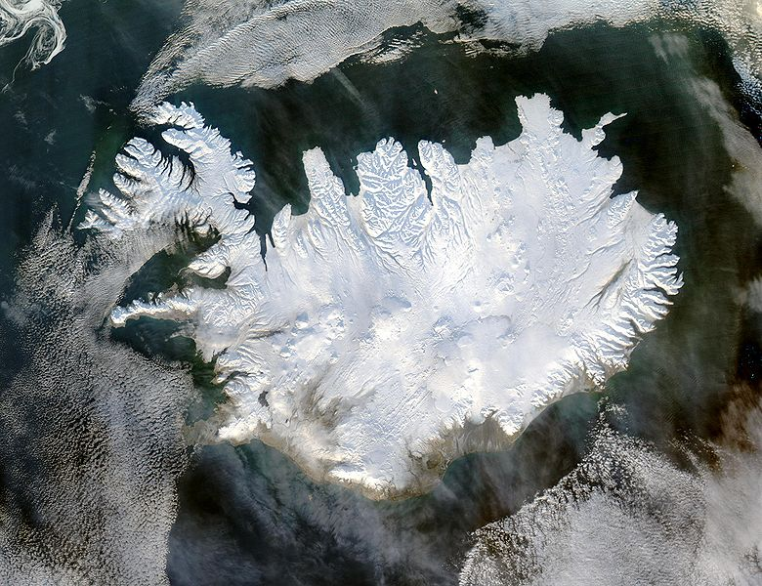
Iceland by summer
Iceland is an European island in the North Atlandic
(population 320.000)
Reykjavik is the capital of Iceland
(population 120.000)
Iceland is 39,756 square miles in size;
23% is habitable
11% covered with glaciers
63% is wasteland
2% lakes.
Iceland by winter

Slide 4
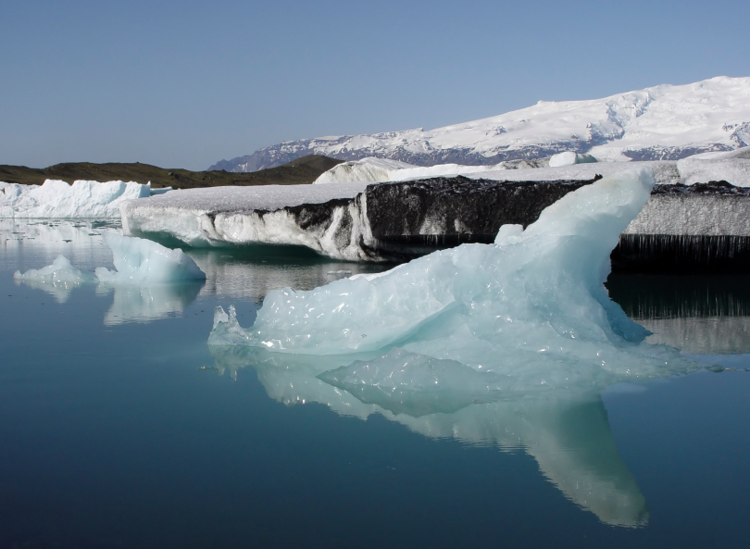
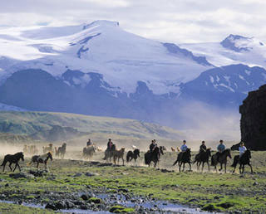
Vatnajökull
Vatnajökull is the largest glacier in Europe (8,400 km²). It covers 8% of Iceland and has an average thickness of 400 m. There are still active volcanoes under the ice.

Slide 5
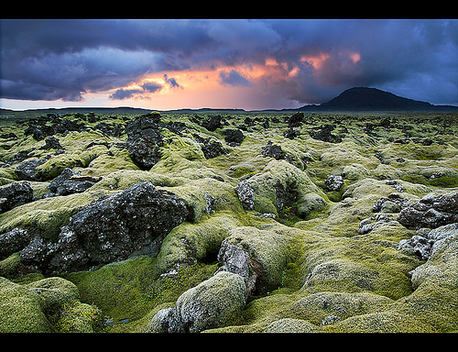
Iceland is one of the youngest countries in the world but
was the last country settled in Europe. Vikings from Norway
and other Scandinavian countries settled in Iceland in the 9th and 10th
century. Icelandic is one of the oldest languages in the world. It is Norwegian
as it was spoken in the days of the settlement. Norwegian has changed since
then due to the closeness of other countries but since Iceland is so isolated
the language has remained the same.

Slide 6
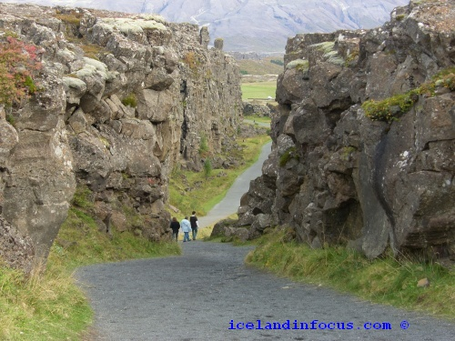
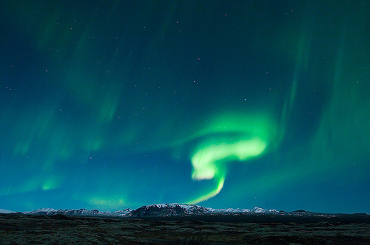
Aurora Borealis
Þingvellir
America vs Europe

Slide 7
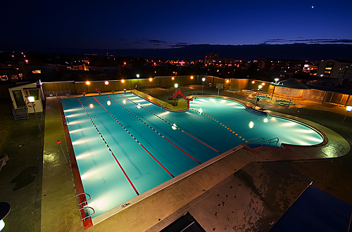
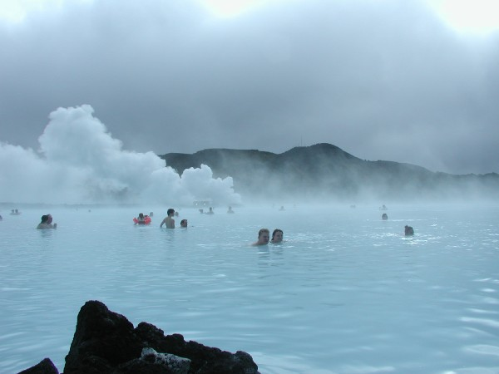
The Blue Lagoon
Swimming pools
There are geo-thermal swimming pools
all over Iceland.
Swimming is an official subject in school
and all children age 6-16 have to take
swimming lessons every week.
Notes:
there are 160 public swimming pools in Iceland

Slide 8
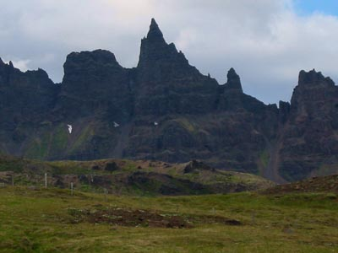
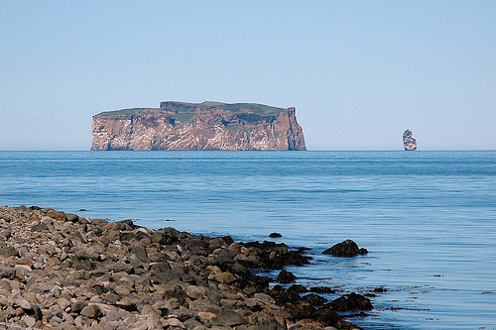
Icelandic giants and elves
Many Icelanders believe that giants and elves live among them. The giants are believed to live in the mountains and elves in rocks.
Although they are human-like in form, they are still inhumanly strong, huge and ugly. They are very often thought to be fearsome and cruel creatures.
But, like elves, giants often treat people as they are treated and they return favors for favors, exerting vengeance if harmed.

Slide 9
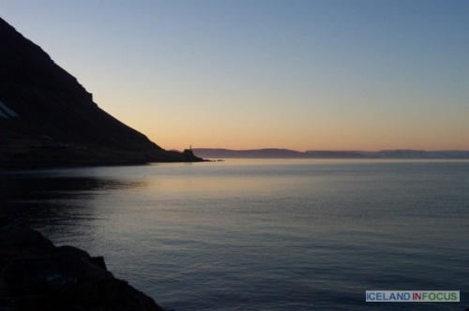
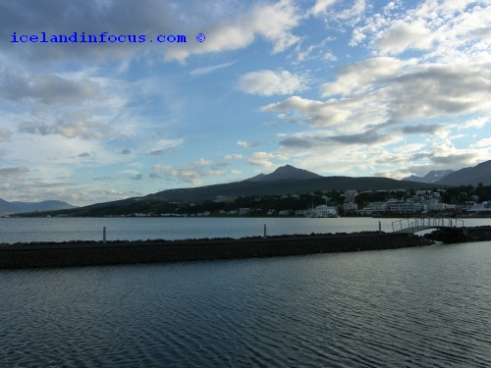
The land of the midnight sun
In late December the sun shines only for four hours and in many places in the north-west and northern parts of Iceland the sun cannot be seen for months.
June 22nd is the longest day of the year and the sun doesn´t set at all so you can experience daylight during the night for few weeks.

Slide 10
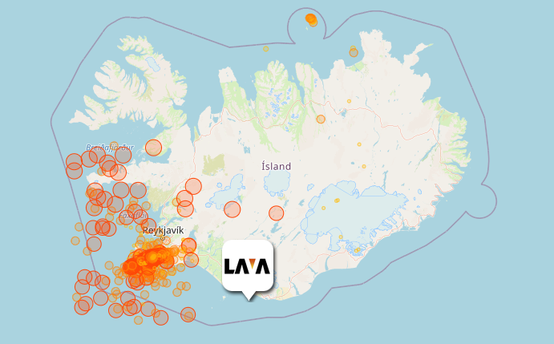
March 4. 2021 at 8:54:07 Am.
Number of tremors in the last 48 hours: 3326.
The magnitude of the strongest quake was 4.5 .

Slide 11
Do you remember Eyjafjallajökull?
Iceland is on alert for a possible volcanic eruption. The name of the volcano is Sundhnjúkagígaröð in Þráinsskjaldahraun ☺

Slide 12
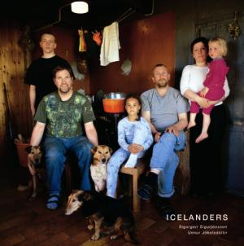
Icelandic names
Icelanders address each other by their first name. The last name (patronymic) is never used alone. Icelanders say for example, "the President of Iceland, Ólafur Ragnar Grímsson," but never "President Grímsson".
If a man is called Aron Stefansson, his proper or given name is Aron, and his patronymic is Stefansson (the son of a man named Stefan)
A woman called Margret Magnusdottir has the proper name Margret and her patronymic is Magnusdottir (the daughter of Magnus)
Women do not change their name after marriage.
In a family of four, a couple with a boy and a girl, all four will therefore
usually have different last names.
Father: Aron Stefansson
Mother: Margret Magnusdottir
Daughter: Helga Aronsdottir
Son: Markus Aronsson

Slide 13
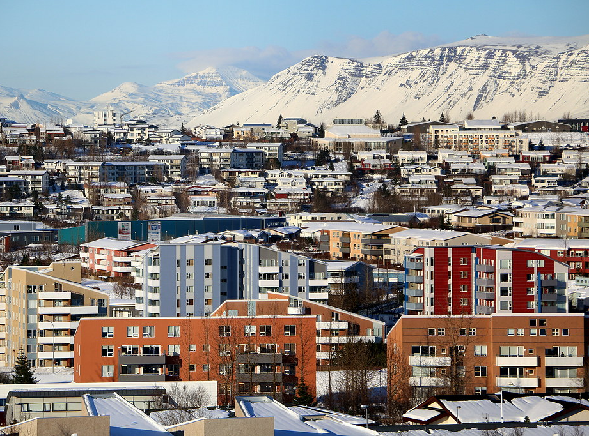
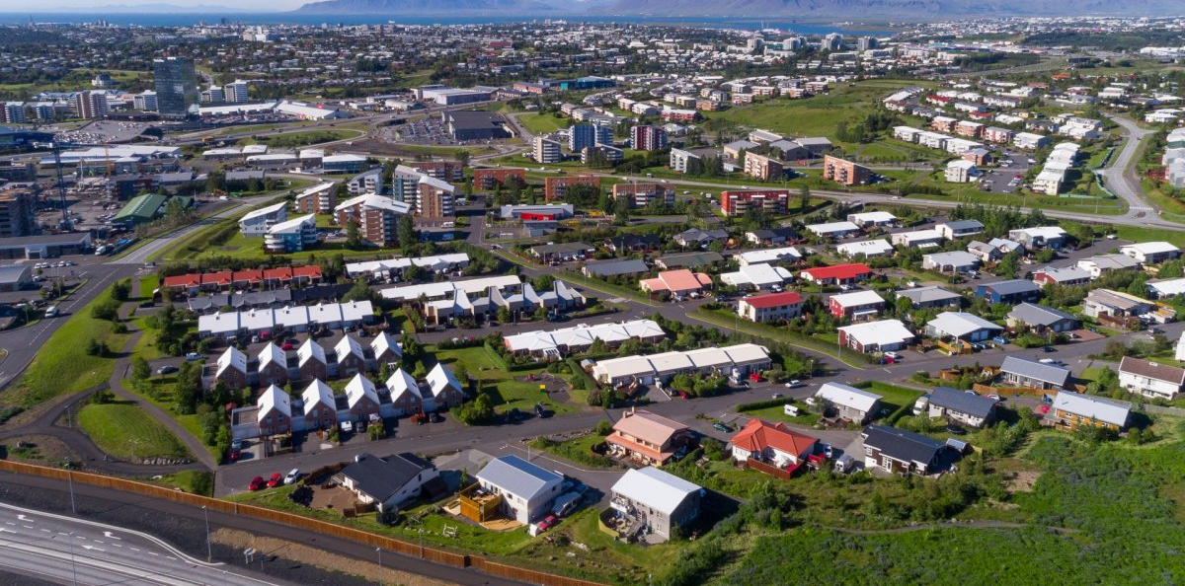
Kópavogur
Notes:
The area of ​​Kópavogur is 80 square kilometers. In Kopavogur lives 35 thousand people. There are nine elementary schools there. Our school is in Vatnsendi.

Slide 14
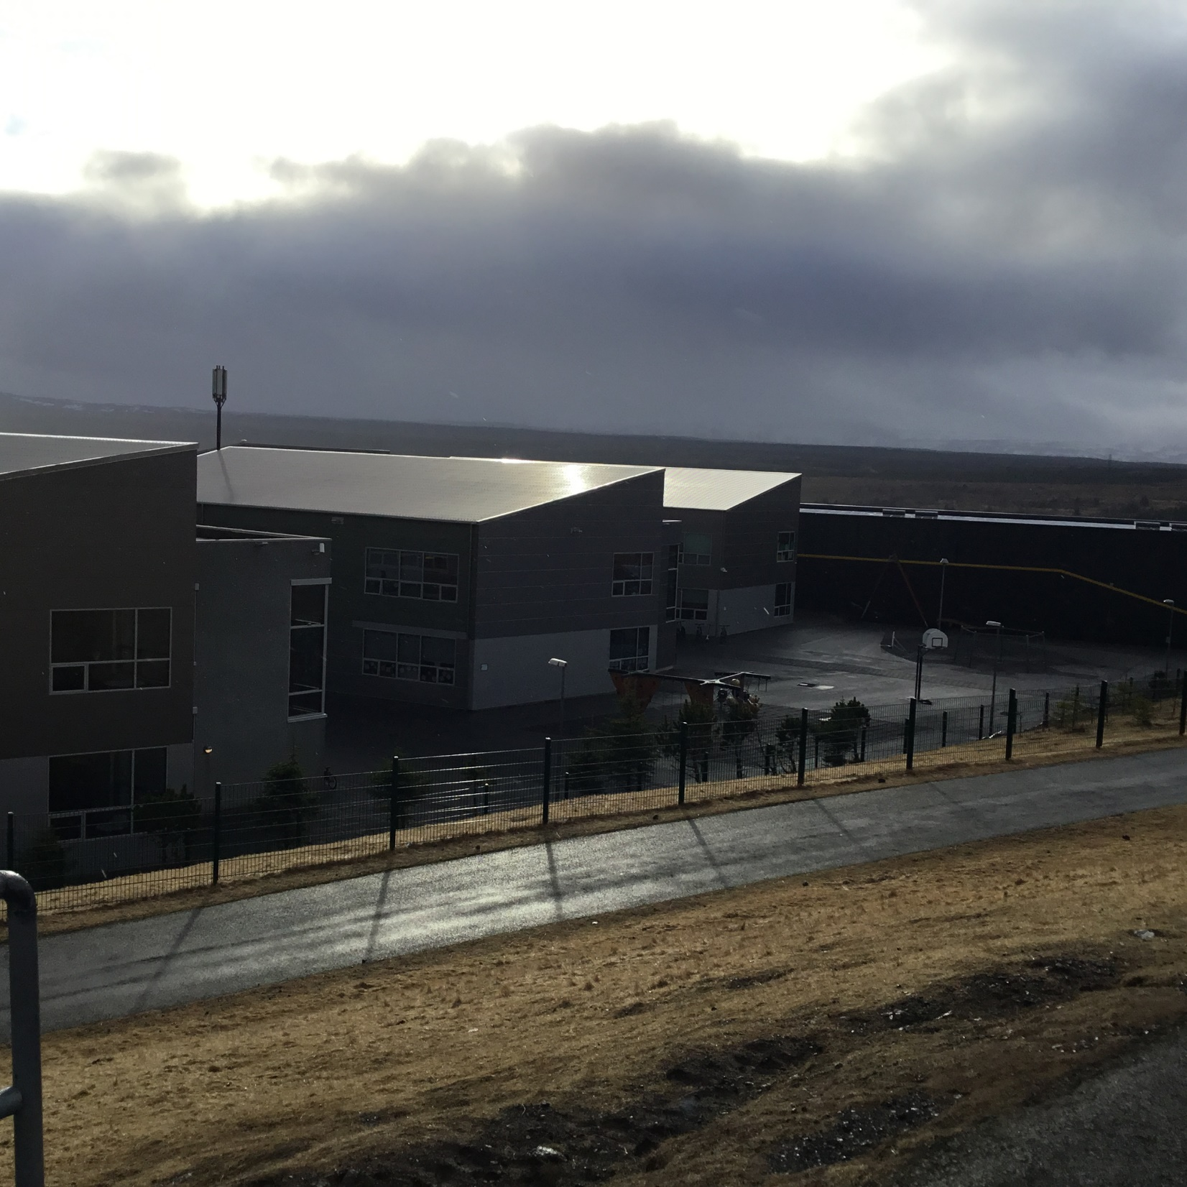
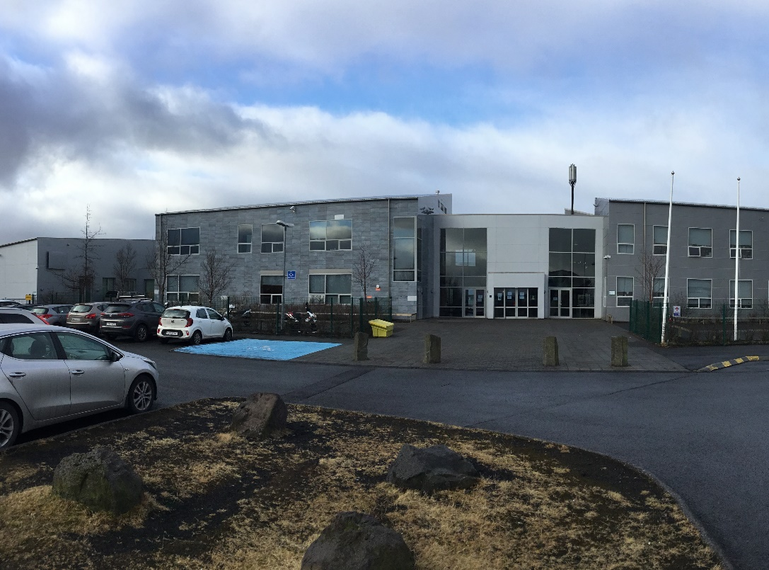
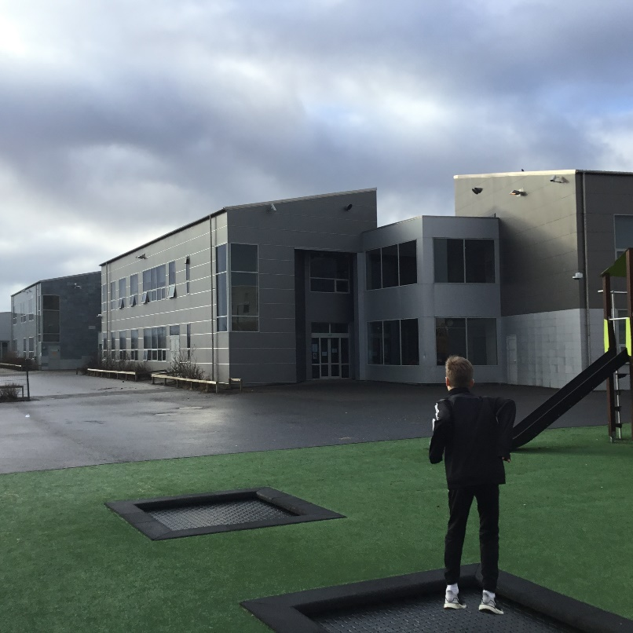
Vatnsendaskóli Vatn = water Edna= end skóli= school
Notes:
This is our school Vatnsendaskóli

Slide 15
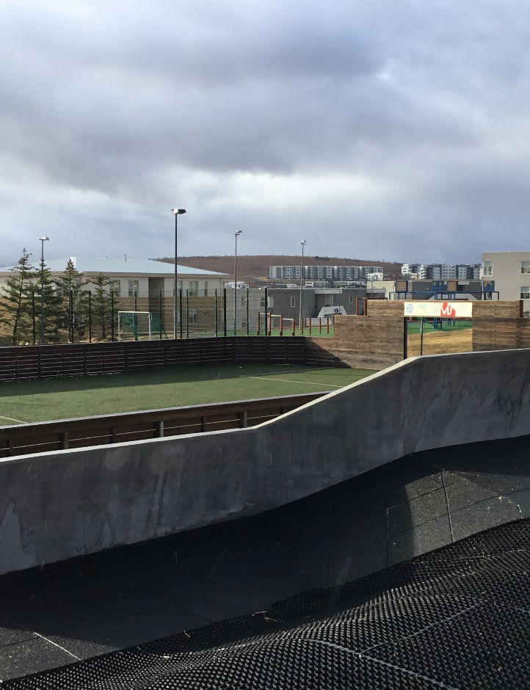
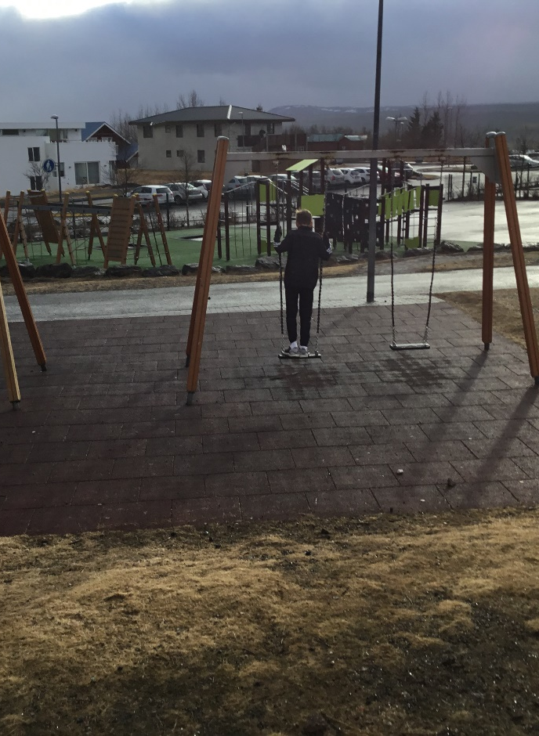
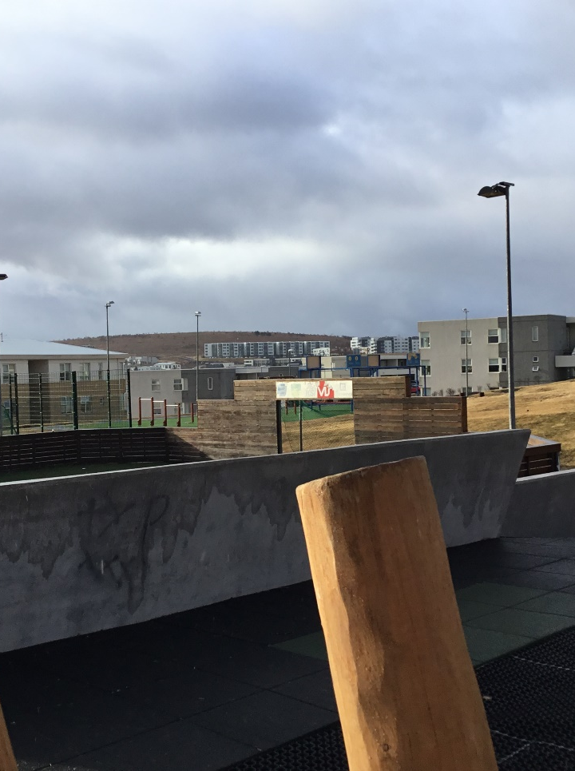
Our school grounds
Notes:
Our school grounds have a lot to offer such as a grass field for football, basketball court, swings, climbing wall, etc.

Slide 16
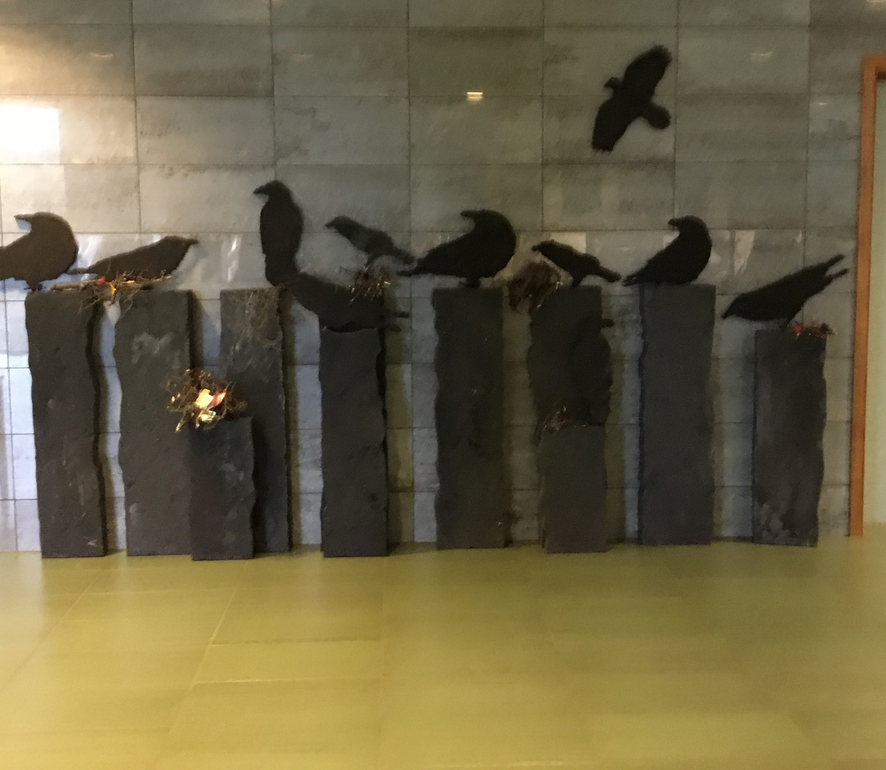
Student assignment
Notes:
Student assignments
Here are two assignments done by students

Slide 17
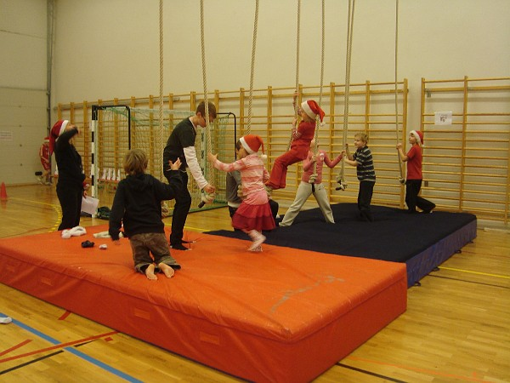
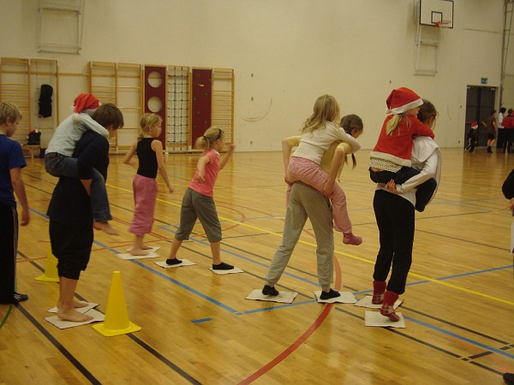
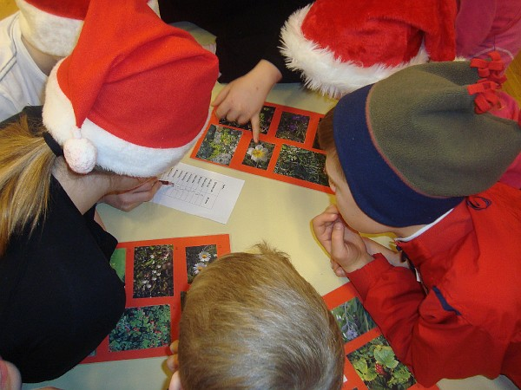
Santa Claus games
Notes:
In the santa claus games, we are in groups and are diffrent santa clauses, beaucuse in iceland there are 13 santa clauses. We get points if we win one of the games and 1-2 weeks later we find out who wins

Slide 18
Recycling in Vatnsendaskóli and Kópavogur
Notes:
Kópavogur collects waste from the home with two barrels for general waste and paper and plastic. In addition, everyone is encouraged to use the sorting stations located at 10 locations in the town.

Slide 19
Thank you = Takk fyrir
Anton, Eiður, Emma Dís, Sylvía, Viktor, Vilhjálmur og Virgill

