Slide 1
KĖDAINIAI ŠVIESIOJI GYMNASIUM Renewable energy in Lithuania
Created by Ignas Černikauskas, Luknė Matukaitė, Aleksandra Naujokaitė, Rokas Leikauskas, Matas Kaupas and Viltė Janonytė.
2021-09-29

Slide 2
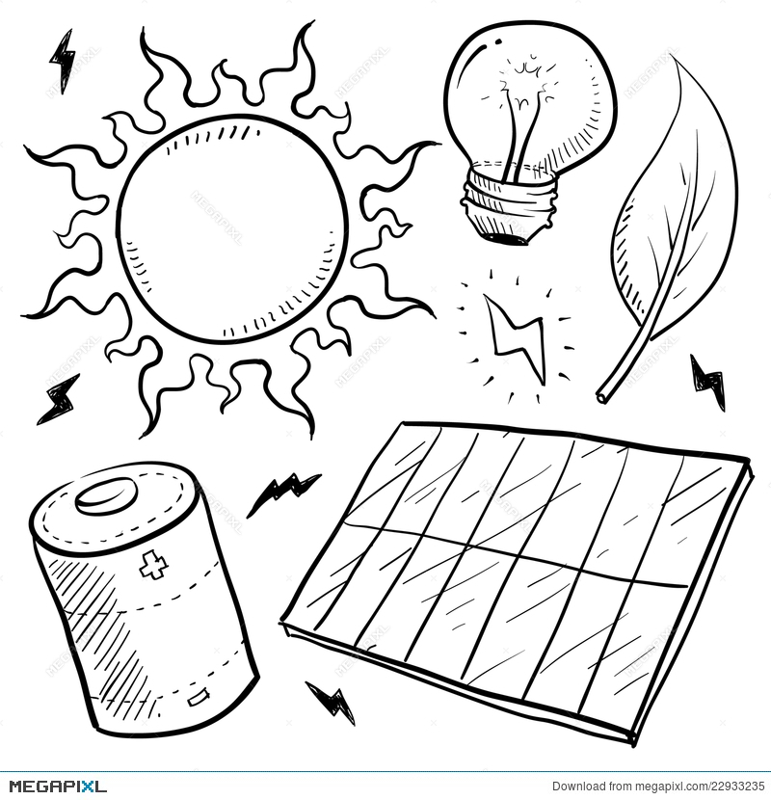
Content of the slides
The understanding of basic terminology
Renewables vs. Non-Renewables
The benefits of renewables
Wind energy
Solar energy
Hydro energy
Biofuels
A short quiz

Slide 3
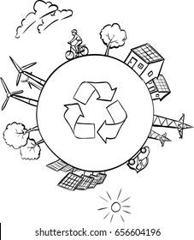
Basic terminology
RES - reusable energy sources
"Renewable energy" means energy from RES: wind, solar, aerothermal, geothermal, hydrothermal, hydropower, biomass, biogas.

Slide 4
Renewables vs. Non-Renewables
Renewable energy is crucial for mitigating climate change
Energy sources are divided into conventional (fossil fuels) and renewable.
Burning fossil fuels contributes to climate change by emitting large amounts of greenhouse gases.
It takes thousands of years for fossil fuels to form, but the layers of fossil fuel are constantly dwindling and shrinking.

Slide 5
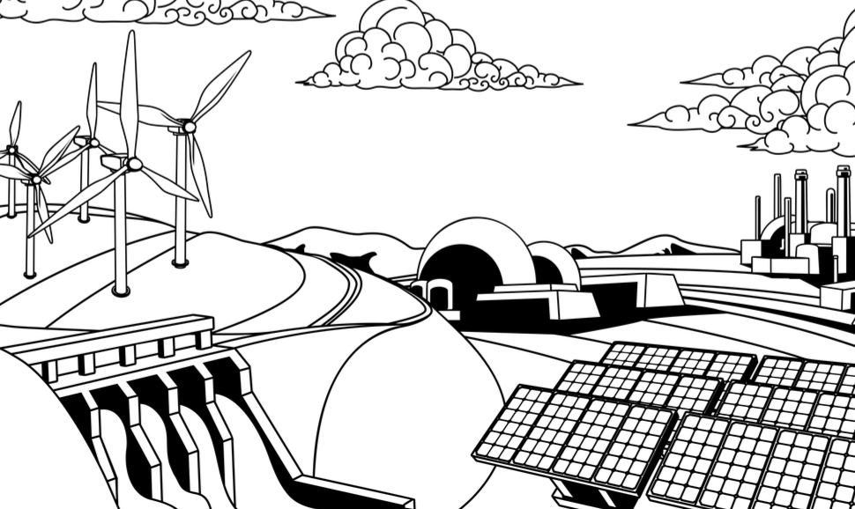
The benefits of renewables
Potentially infinite energy supply
Free energy
Environmental benefits
Energy generated on site which provides security of supply
Reduced greenhouse gas emissions

Slide 6
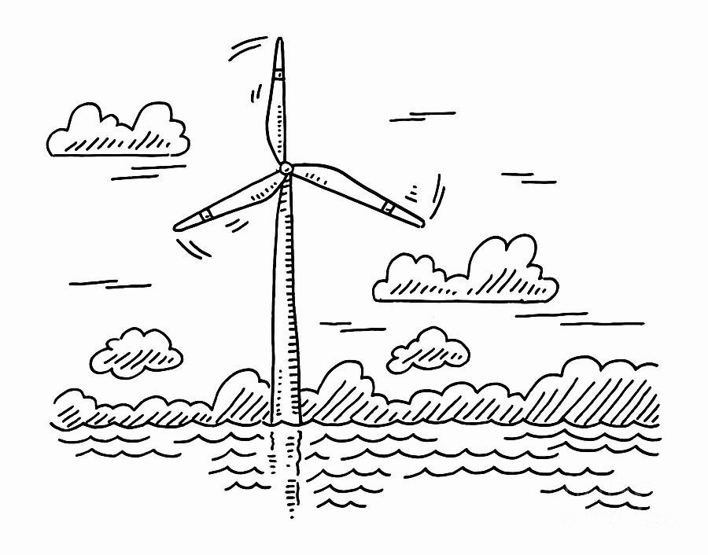
Wind energy
Wind energy is the energy of air movement used to produce energy. Recently, more wind farms are being installed on the high seas, where the strongest winds are blowing.
One major issue that people have with wind turbines is that they can ruin the look of the landscape, they can also be harmful to birds who might fly into them.

Slide 7
Solar energy
Solar energy is the energy (light or heat) emitted by the sun. Solar energy is the cleanest and most abundant renewable energy source available.
At the end of 2007, there were about 1,852 solar power plants operating in our country.

Slide 8
Hydro energy
Hydropower, or hydroelectric power, is a renewable source of energy that generates power by using a dam or diversion structure to alter the natural flow of a river or other body of water.
Hydropower utilizes turbines and generators to convert that kinetic energy into electricity.
Hydropower is a method of sustainable energy production.

Slide 9
Biofuels
Solid biofuels have the greatest potential for renewable energy. In 2019 its largest amount was consumed for the production of electricity and district heating (50.1%) and in households (37.6%).
Using ethanol or biodiesel reduces the consumption of gasoline and diesel fuel with are non-renewables.

Slide 10
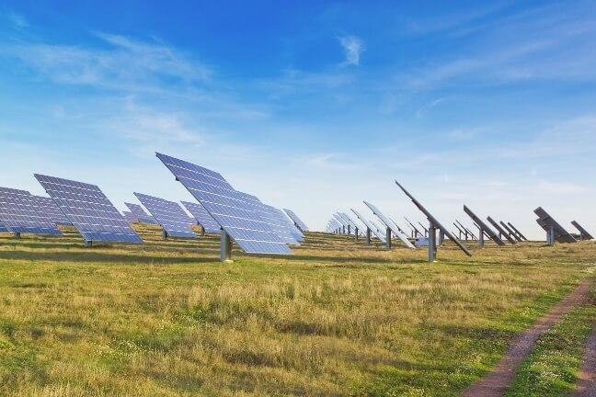
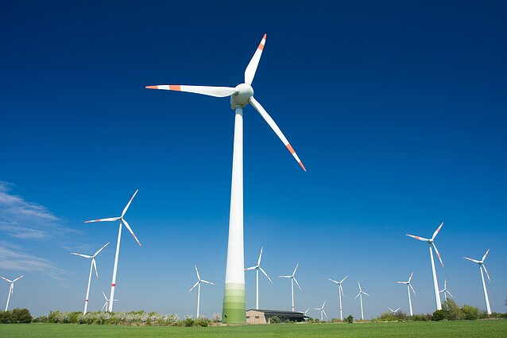
Facts about Lithuania and it’s renewable energy
There are 23 wind turbine parks in Lithuania.
In the major cities in our country there are solar parks that generate power for the city.

Slide 11
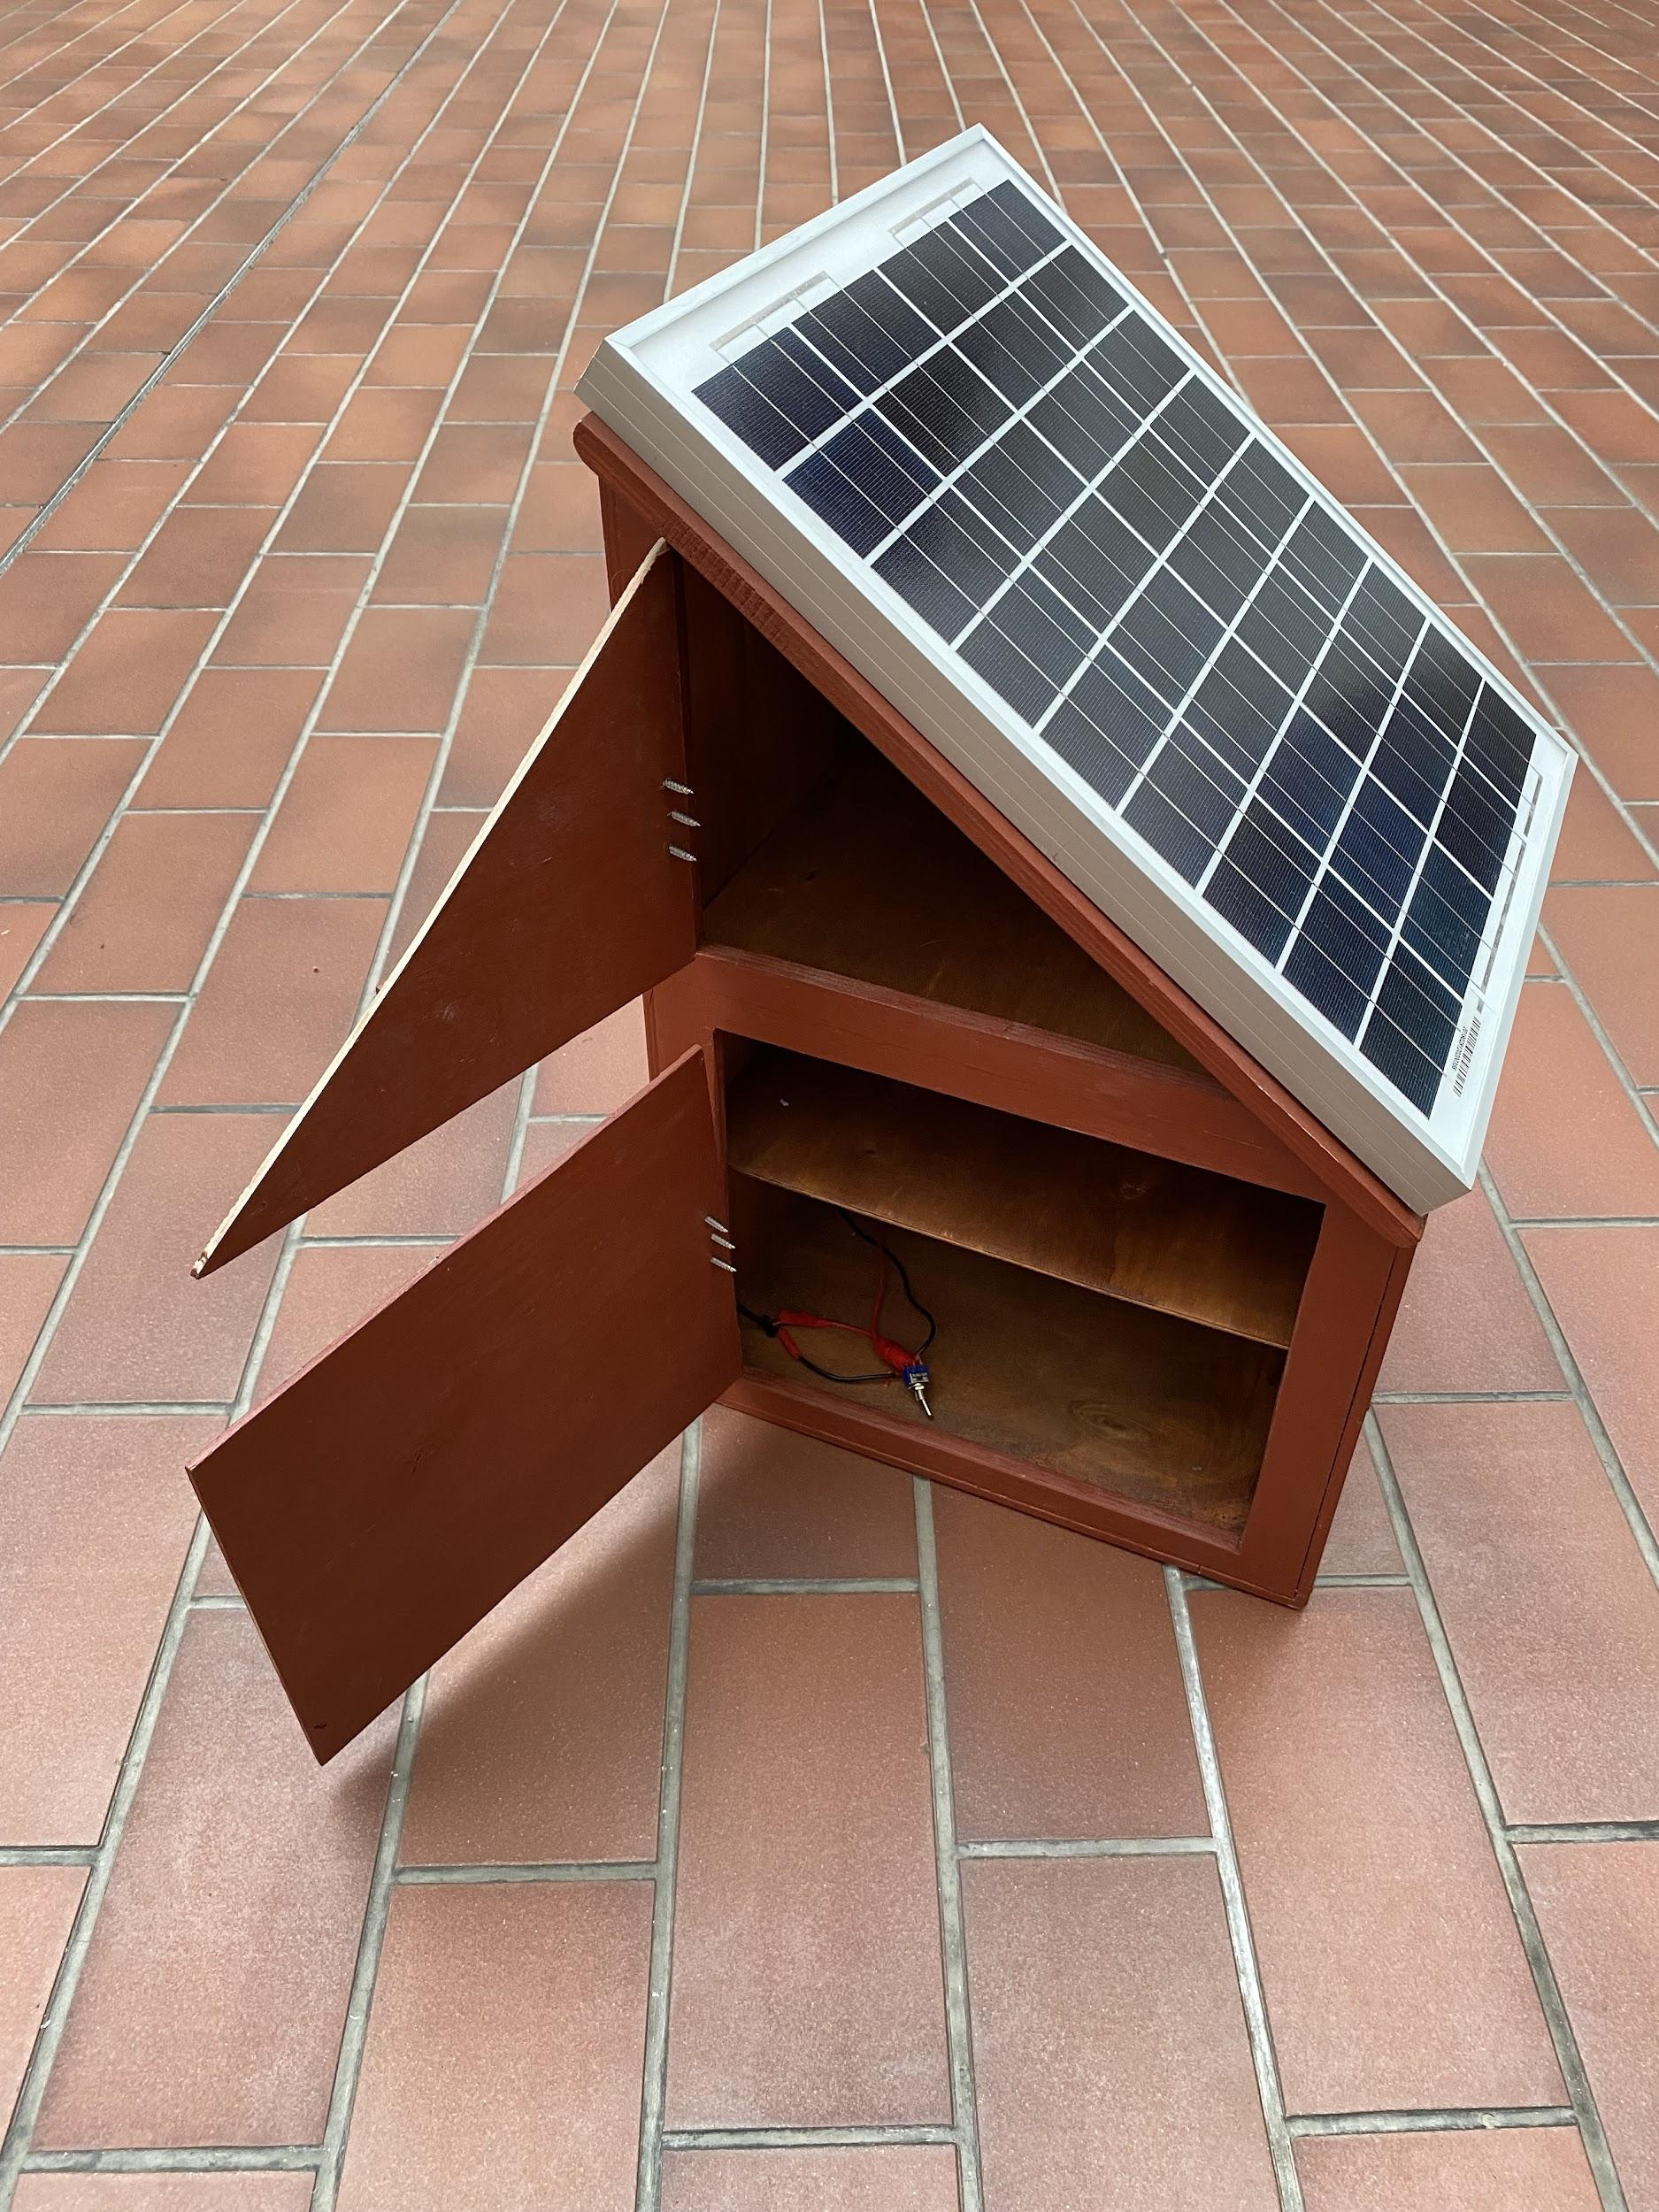
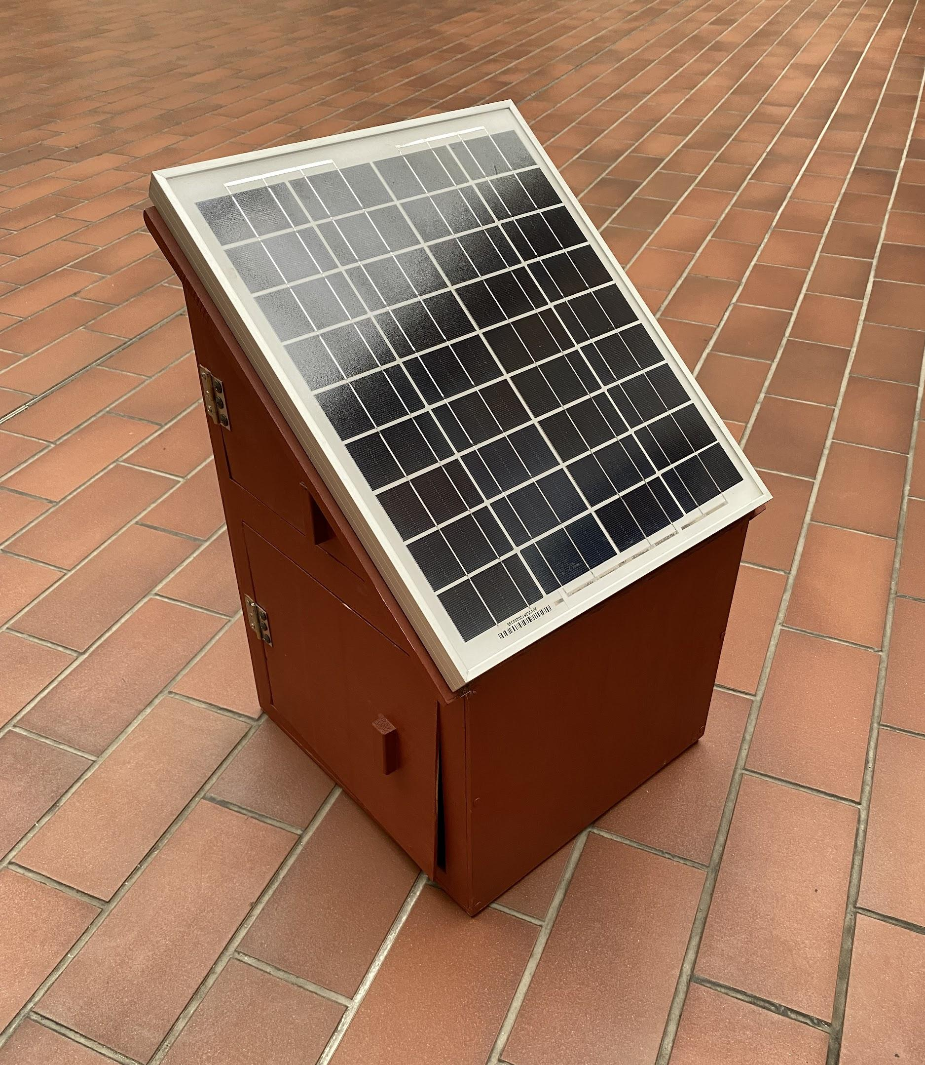
Our gymnasium’s achievement
Our school has “Smart box”. It uses solar energy and creates electricity. The box can charge your phone.

Slide 12
THE PROJECT IS FUNDED BY

Slide 13
A short quiz

