Slide 1
RENEWABLE ENERGY SOURCES IN TURKEY
(1st Student exchange in Iceland)

Slide 2
WHAT IS WIND ENERGY? Wind power, form of energy conversion in which turbines convert the kinetic energy of wind into mechanical or electrical energy that can be used for power.

Slide 3
WIND POWER IN TURKEY Wind power in Turkey is gradually expanding in capacity, mainly in the Aegean and Marmara regions. 20 TWh was generated in 2018 which was 7% of Turkey's electricity.

Slide 4
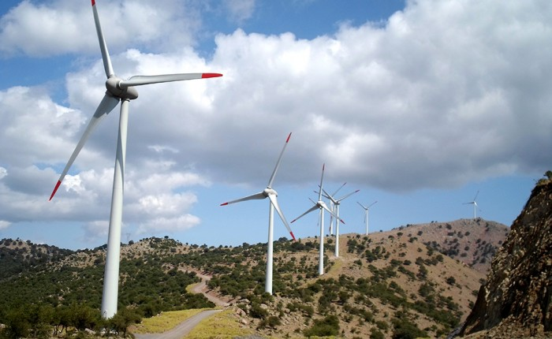
TURKEY’S BIGGEST WIND ENERGY PLANT MANİSA / SOMA

Slide 5
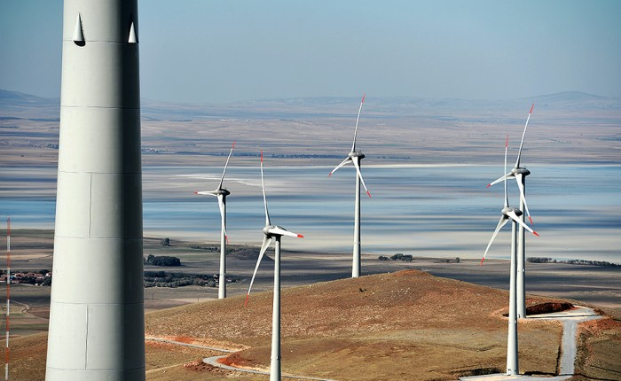
--This plant consisting of 119 wind turbines with an installed output power of 140 MW in total, it is one of Turkey's largest wind farms.

Slide 6
WHAT IS THE SOLAR ENERGY? The Sun’s energy is in the form of solar radiation. Solar radiation makes the production of solar electricity possible. The process of converting this radiation into electrical energy by panels defines the system.

Slide 7
SOLAR POWER IN TURKEY Solar potential is very high in Turkey, especially in South Eastern Anatolia and Mediterranean regions. 7 TWh was generated in 2018 which was 3 % of Turkey's electricity.

Slide 8
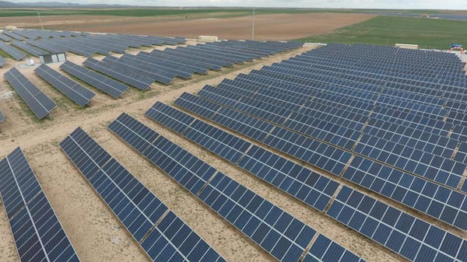
TURKEY’S BIGGEST SOLAR PLANT Konya / Kızören

Slide 9
-- This plant which was established on an area of ​​430 thousand M² in total, produces 30,730,000 kWh of electricity annually. -- With this project, the annual saving of 45 thousand trees and an average of 18 thousand tons of CO2 emissions are prevented.

Slide 10
WHAT IS THE GEOTERMAL ENERGY? Geothermal energy is heat within the earth. Geothermal energy is a renewable energy source because heat is continuously produced inside the earth. People use geothermal heat to generate electricity.

Slide 11
GEOTHERMAL ENERGY IN TURKEY Turkey is ranked seventh richest country in the world in geothermal potential.It’s theoretical geothermal potential is 60GW and potential is 4.5GW In addition to electric power generation, geothermal heat is used directly.

Slide 12
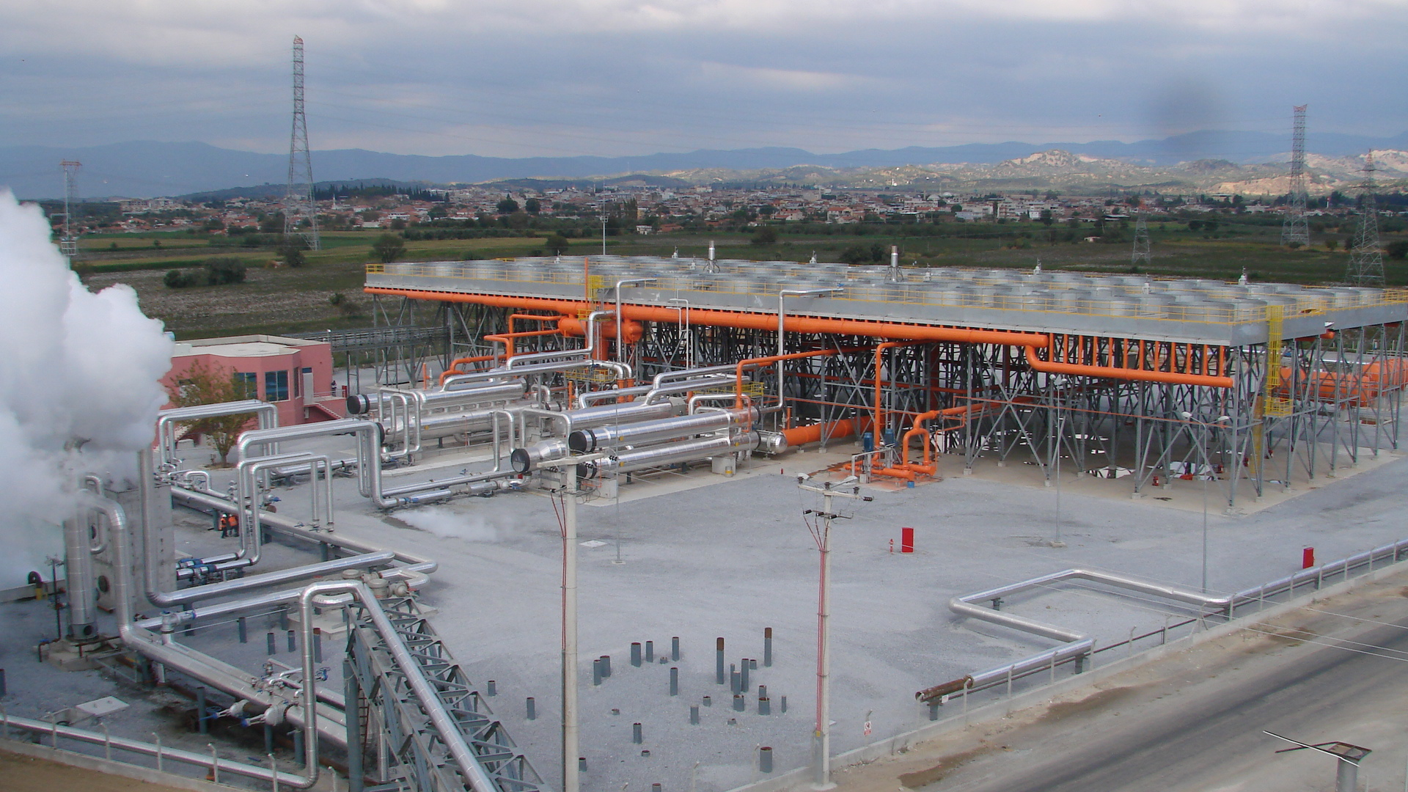
TURKEY’S BIGGEST GEOTERMAL POWER PLANT AYDIN / GERMENCİK

Slide 13
Construction of the geothermal power plant with a total installed capacity of 162 MW including 7 Binary Cycle Units.

Slide 14
WHAT IS THE HYDROELECTRICITY? Hydroelectricity is produced when moving water rotates a turbine shaft; this movement is converted to electricity with an electrical generator.

Slide 15
HYDROELECTRICITY IN TURKEY Turkey has a significant hydropower capacity, estimated at some 433 TWh a year in total.

Slide 16
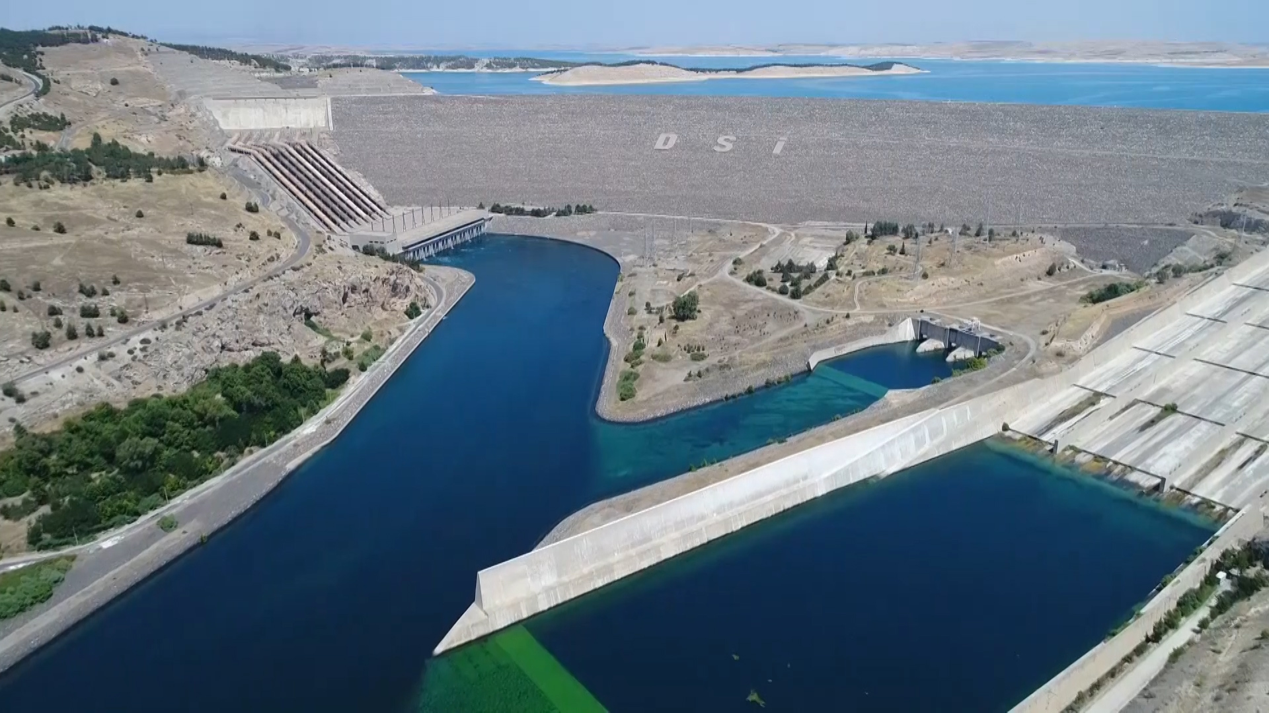
TURKEY’S BIGGEST HYDROELECTRICITY PLANT ŞANLIURFA / BOZOVA

Slide 17
THANKS FOR LISTENING

