Slide 1
DEVELOPMENTS AND IMPROVEMENTS IN ENTERTAINMENT

Slide 2
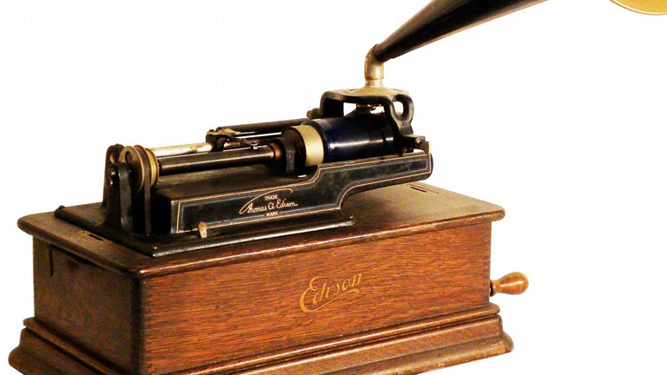
About music
What people refer to today as the music industry started in 1877 with the phonograph, which allowed people to record and play back sounds. After Guglielmo Marconi’s early experiments with wireless telegraphy in 1894, sound was successfully transmitted over the air to a larger audience with the first public radio broadcast in 1910. The next big advancement occurred in 1954 with the production of the first analog pocket transistor radio, which let people listen to music on the go. Some forty years later, the doors of the 21st century opened for music with the introduction of digital audio broadcasting. In 1998, the first MP3 players appeared on the market

Slide 3
In 2003, Apple launched the iTunes Store, allowing users to purchase individual songs and letting them create their own playlists. Subsequent developments, including the explosion of Internet radio, tools such as Shazam for song identification, and so on, are no longer history but rather part of everyday life

Slide 4
Mobil entertainment
Processes that shaped the evolution of the television, movie, video game, and other entertainment industries appear to have many points in common with the music sector. Technology is changing the way stories are created — by removing barriers to artists’ creativity. And this is happening not just in movie productions, with special effects and computer graphics animations, but also in television shows, theme park attractions, video games, and much more. Of course, technology is also modifying the way entertainment is delivered to audiences, by basically canceling space and time boundaries.

Slide 5
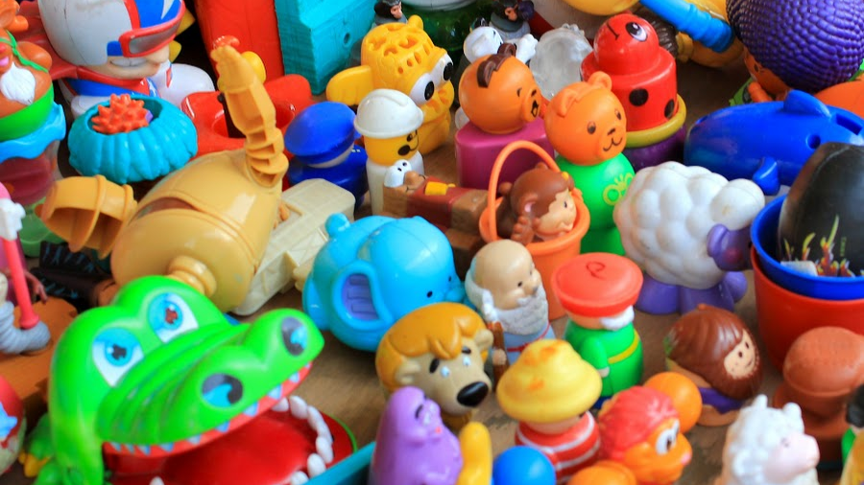
Of course, entertainment isn’t just about telling stories or listening to music. It’s also about sports, arts, and many other recreation or leisure activities. Countless application examples illustrate how relations among all these worlds and their visions are becoming ever tighter. For instance, interactivity is progressively extending to all entertainment objects, including toys. In many sport disciplines, sensors and tracking systems are in use for monitoring athletes’ performances and recording game statistics, even as augmented reality solutions are enhancing live sport shows, as well.

Slide 6
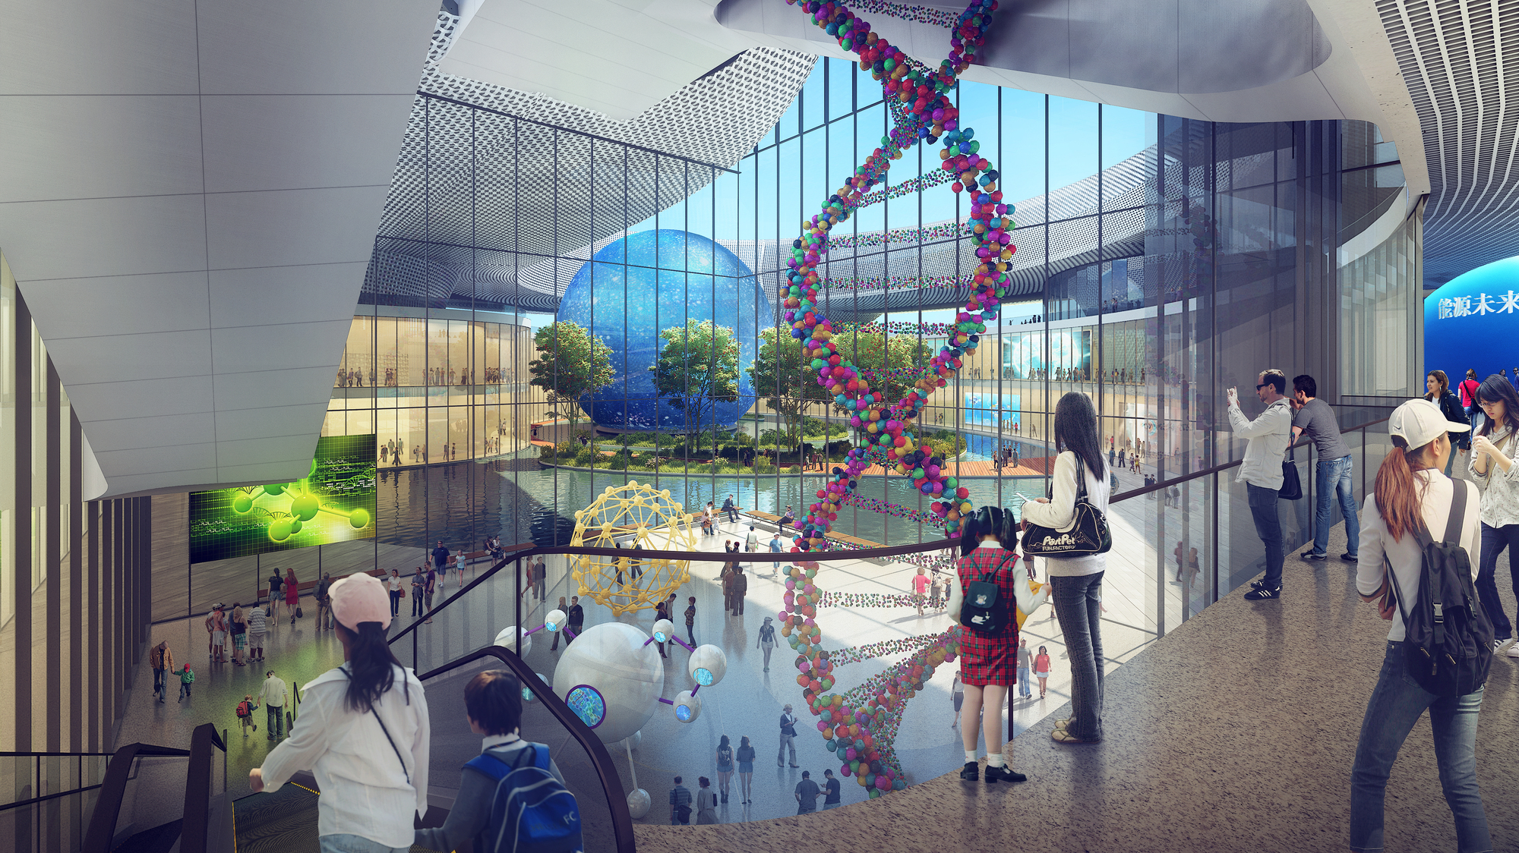
Robots are benefiting from synergies with other industries and thus getting more powerful control and interaction capabilities. Museums and cultural heritage sites are leveraging sensors, mobile, and computer graphics technologies and being transformed into intelligent information spaces that are aware of individual visitors’ behaviors and interests and thus able to feed them the appropriate information at the right time.

