Slide 1
İnventions and Development Processes

Slide 2
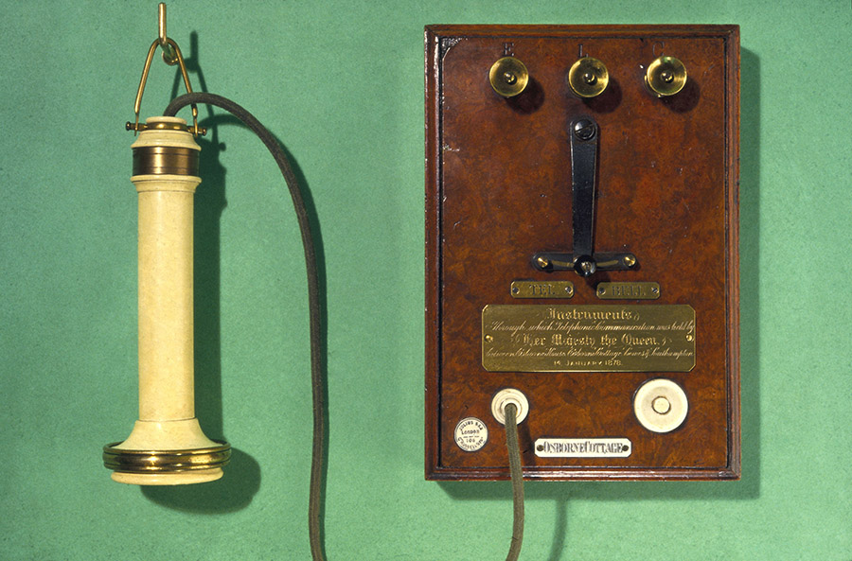
The first phone was invented in 1876 by Alexander Graham Bell.

Slide 3
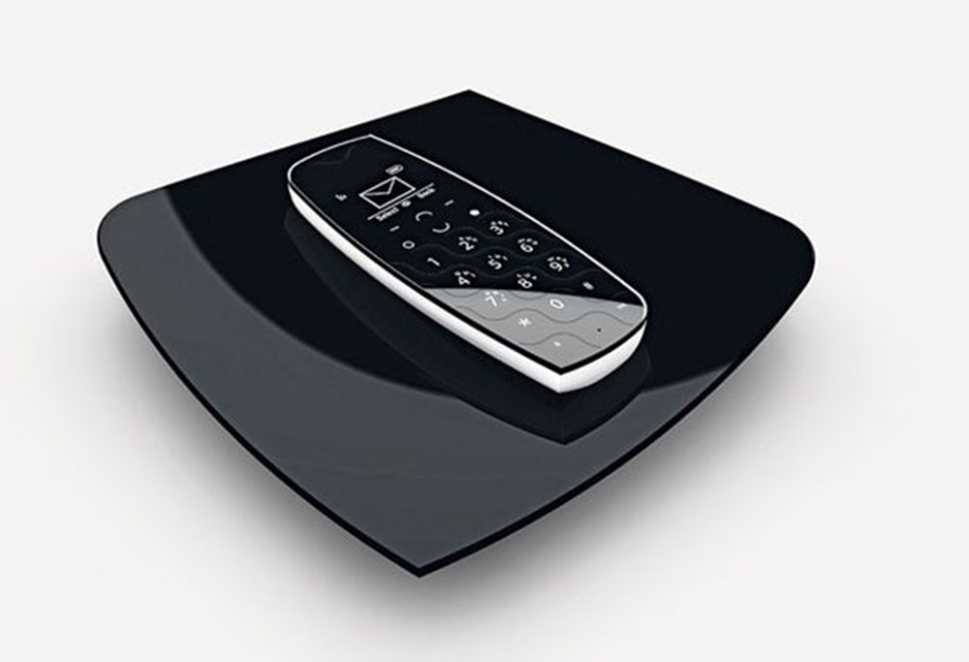
State-of-the-art home phone Magicbox Torque.

Slide 4
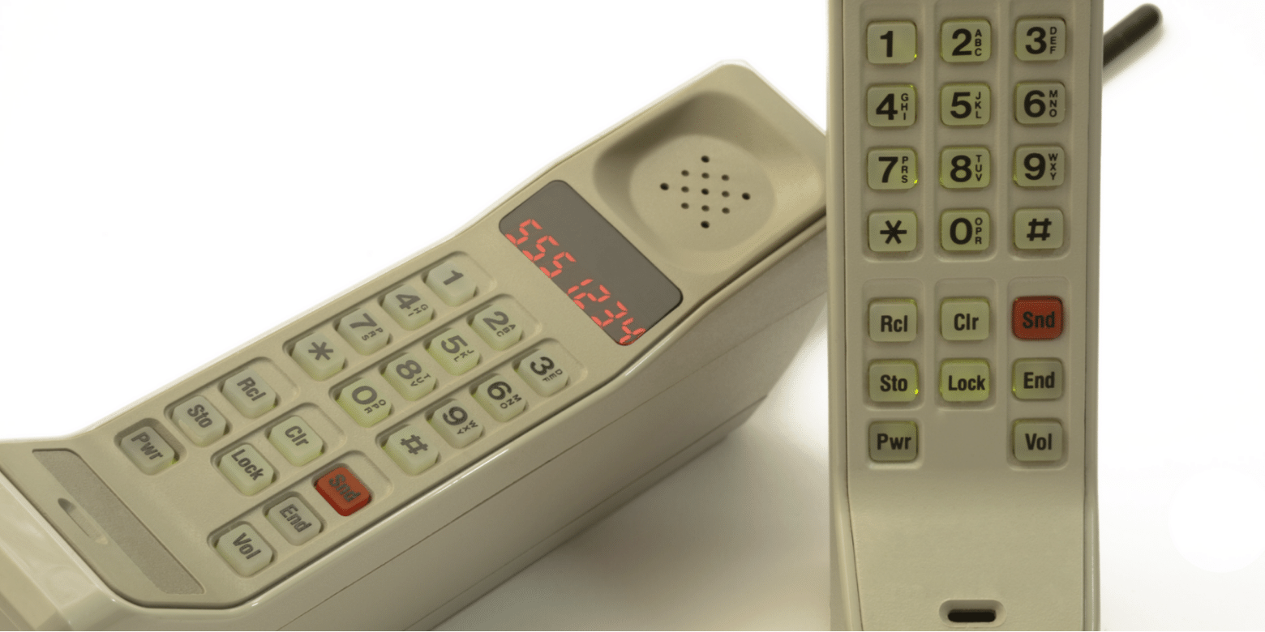
The first cell phone was invented in 1973 by Martin Cooper.

Slide 5
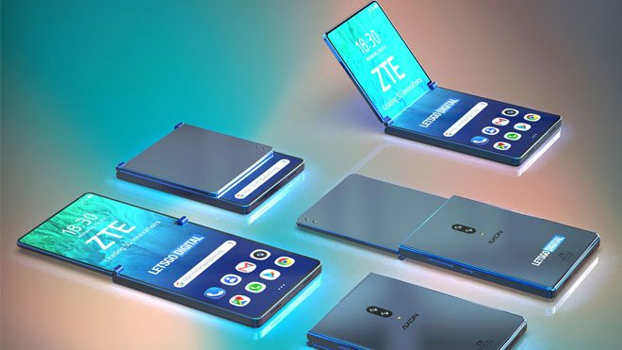
State-of-the-art smart phone.

Slide 6
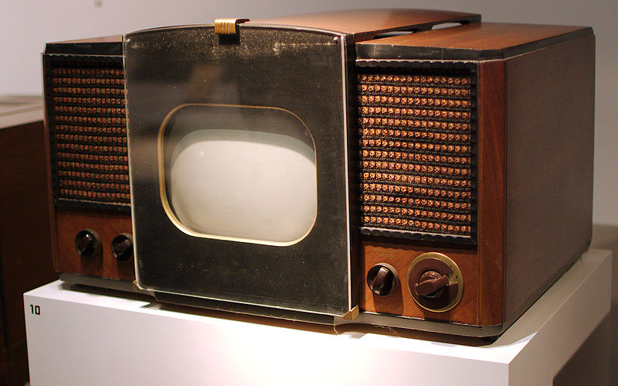
The first television was invented by John Logie Baird in 1923 in the town of Hastings.

Slide 7
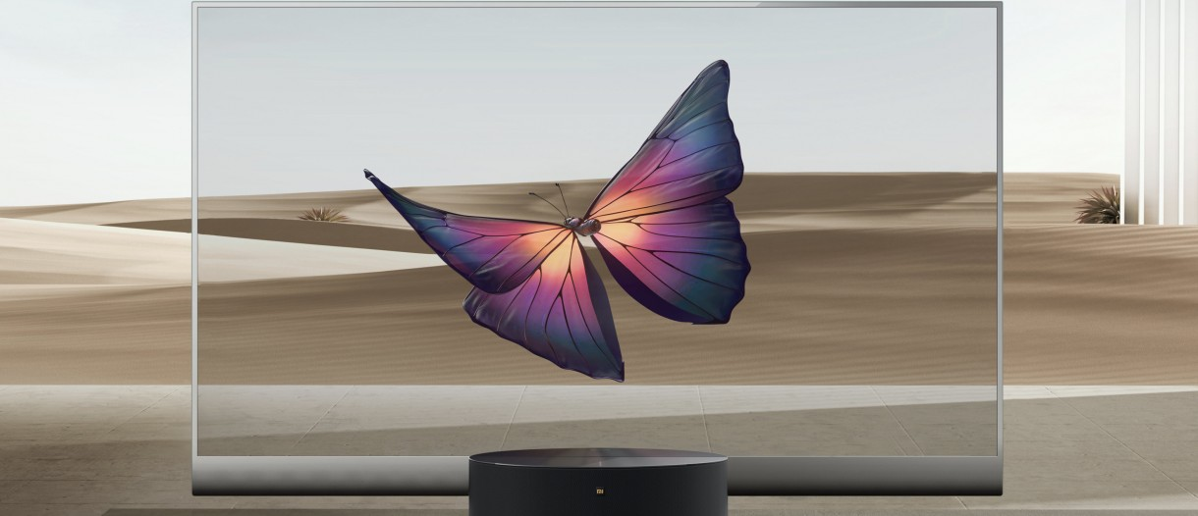
State-of-the-art transparent TV ‘‘ Mi TV Lux Transparent Edition’’.

Slide 8
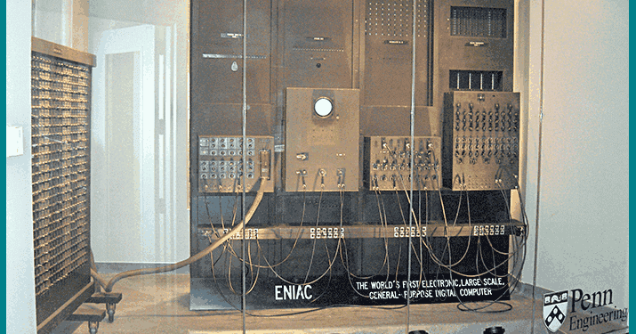
The first computer is ENIAC. It was invented by American scientists during World War II.

Slide 9
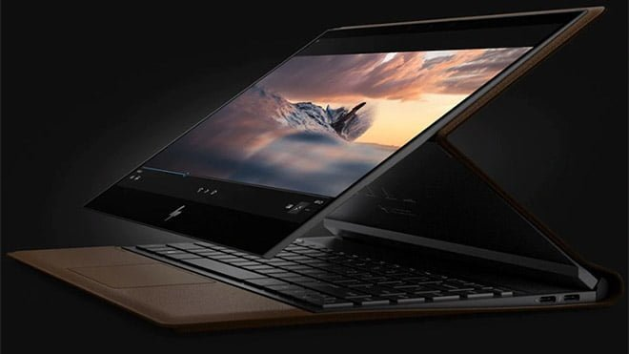
State-of-the-art computer.

Slide 10
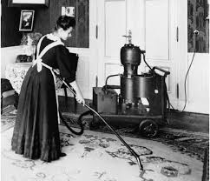
The first vacuum cleaner was built in 1906 by Robert Bimm in France.

Slide 11
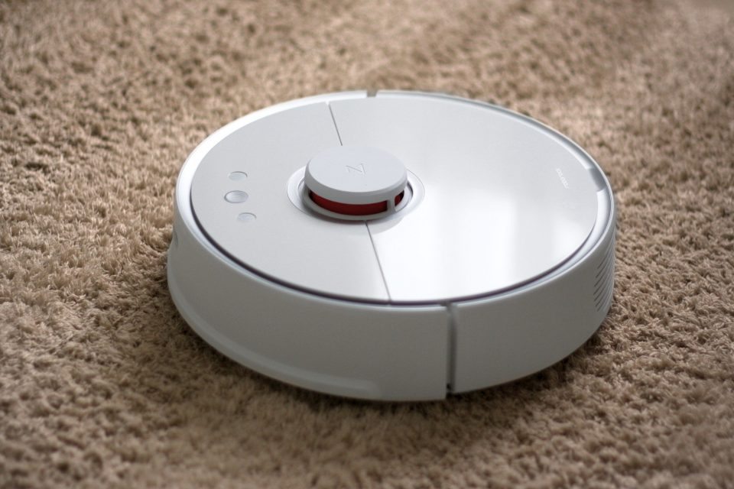
State-of-the-art robot vacuum.

Slide 12
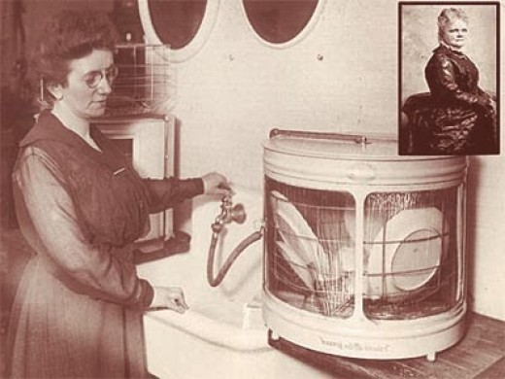
A lot of women have developed different ideas to make dishwashers. But the first patent was in 1885, taken by Josephine G.Cochran.

Slide 13
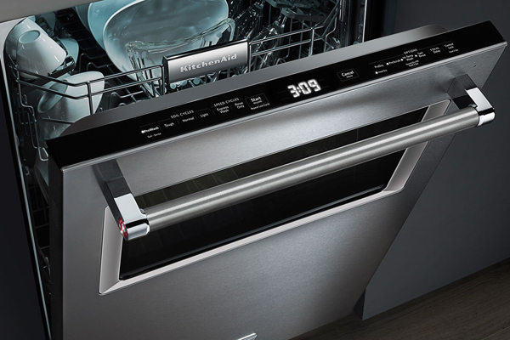
State-of-the-art dishwasher.

Slide 14
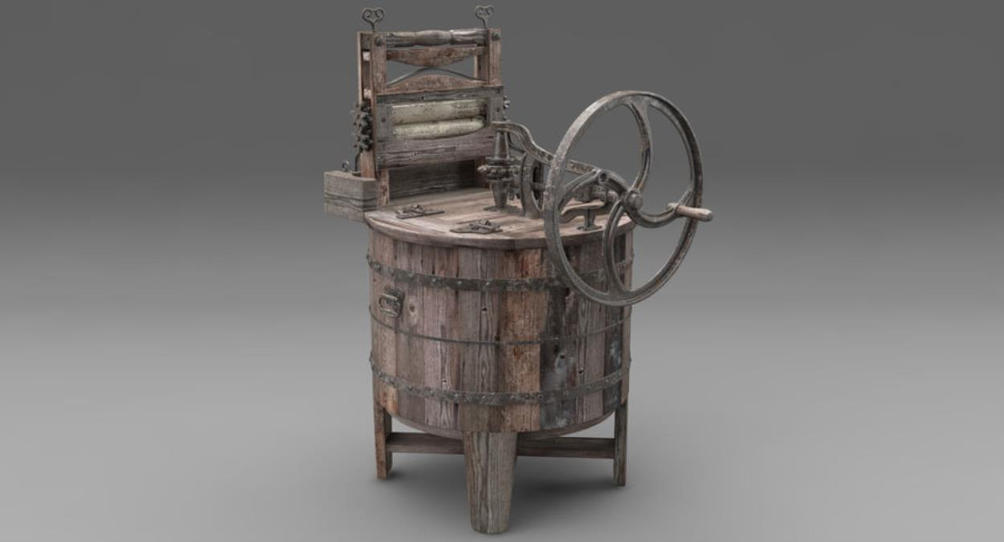
The first washing machine was invented in 1908 by Alva John Fisher.

Slide 15
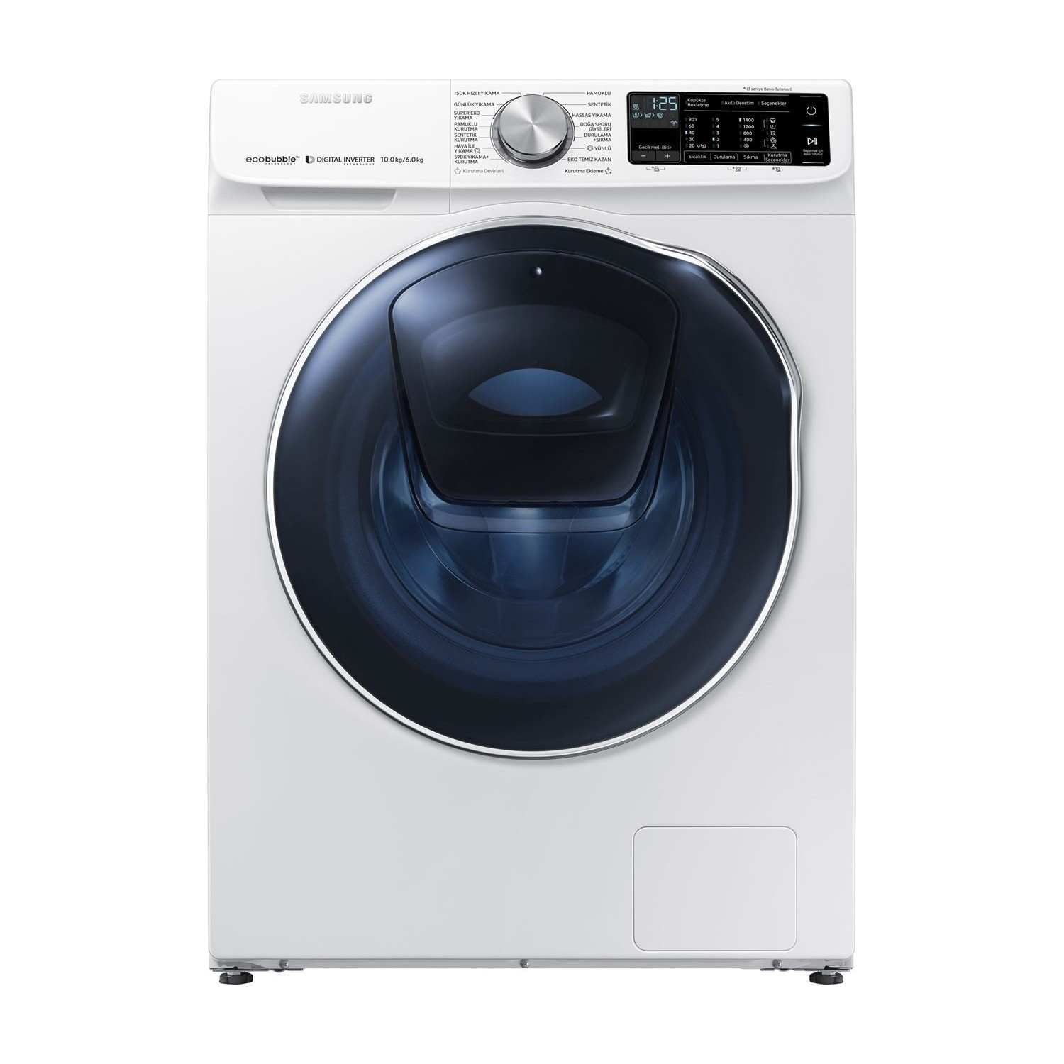
State-of-the-art washing machine.

