Slide 1
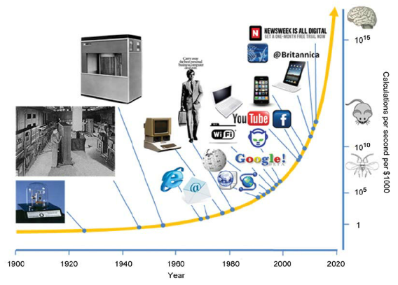
DEVELOPMENTS AND IMPROVEMENTS IN COMMUNICATION
by maria.l.cnme

Slide 2
COMMUNICATION the key to human development
A decisive role can be played by communication in promoting human development in today's new climate of social change. As the world moves towards greater democracy, decentralization and the market economy, conditions are becoming more favourable for people to start steering their own course of change. But it is vital to stimulate their awareness, participation and capabilities. Communication skills and technology are central to this task, but at present are often underutilized. Policies are needed that encourage effective planning and implementation of communication programmes.

Slide 3
Population growth is exerting pressure on natural resources, on food production and on the ability of governments to provide basic services and employment opportunities. Population growth depends on choices made by individuals. Helping people to make more informed choices by raising their awareness of the implications of family size and unwanted pregnancy, and of methods of contraception, requires much more than simply sending out messages. Instead it requires learning, from people and their leaders, how to make such issues socially acceptable and worthy of urgent action. Insight into people's underlying attitudes are needed before they can be helped to change their views.
Women in development is another priority issue. In many countries, women shoulder most of the work in rural areas. Given the opportunity, women have shown themselves again and again to be highly responsive and responsible when helped to mobilise themselves, build upon available resources and produce sustainable results. Women need to learn additional technical and organisational skills and more women are needed at the centre of decision-making. Specific challenges where communication is vital include helping women's groups to increase their self-determination and to broaden the dialogue between the sexes regarding rights, privileges and responsibilities.

Slide 4
A LOOK INTO THE FUTURE
With such rapid advances in communication technology and know-how, the age of telecommunication for rural development may already be upon us. Solar-powered microwave links for telephone communication, facsimile machines and even satellite links, are increasingly reaching into rural areas of the world, offering the possibility of breaking their traditional isolation for the first time in history.
In fact today the idea is being mooted that telecommunication learning centres could be established in villages of the developing world, with user-friendly computer terminals that would download interactive learning and management information programmes from a central supply, similar to a water or electricity service, with users paying modest charges for the time of actual use. The programmes could be video images, sound and computer-type data. This technology already exists, and the speed with which it is becoming cheaper and more accessible is so rapid that the use of computers in the villages of developing countries may someday be part of a pragmatic strategy to reduce the rural-urban population shift and promote rural development.

Slide 5
THANK YOU FOR YOUR ATTENTION!

