Slide 1
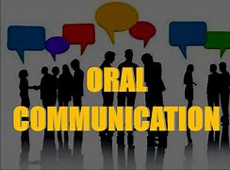
Developments and improvements in communication
By Daria.cnme

Slide 2
A communication tool is more than just a tool for communication; it also supports us in our daily lives and is a "tool" in our professional dealings at work, providing us with information and knowledge to help us make better and faster decisions. This technology growth has an impact on not just our personal lives, but also the frameworks in which businesses and even the global economy collaborate and cooperate.In today's professional world, as well as in our personal lives, communicating pertinent, mission-critical information is a must. Success is determined in part by our level of knowledge, which is determined in turn by how well we communicate and how quickly we assimilate information.

Slide 3
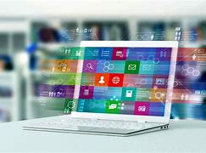
What changed the communication industry?
Due to changing conditions and requirements of information processing, as well as the necessity to communicate and interact in our global economy, a technical shift occurred in the last few decades.Numerous technological advancements, in addition to globalization, have generated a significant benefit for business. For example, since the introduction of the printing press, the invention of the Internet has been regarded as one of the most significant shifts in the information community. The first networking of universities and research institutes, which later moved into the commercial sector and then into the private sector, had an unforeseen impact on a variety of aspects of daily life. The Internet was handed to the globe as a communication network for free by the US National Science Foundation in 1990.

Slide 4
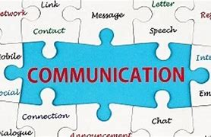
Understanding modern business communication needs
E-mail is no longer a fad; it is now a well-established mode of communication that is thoroughly integrated into our communication and business operations. Although this technology has resulted in "paperless offices" and telephone cost reductions, communication in businesses has expanded dramatically because it takes less time and money to convey information from point A to point B.
How can we communicate more effectively and efficiently?
Can these tools help businesses reach their objectives more quickly?
Are there any ways to save money by avoiding or reducing costs?
Is it possible to make dealing with this shift in understanding more manageable?
What are the companies' possible profits and advantages here?
What type of changes will we need in the firm, and how will these changes influence the individual who will be responsible for putting them in place?
How can internal projects be used to increase communication?

Slide 5
To solution those questions, it's far critical to study the verbal exchange tendencies in current years. In the beyond 5 to 10 years, with mixed utilization of formerly evolved and installed milestones in verbal exchange technology, the Internet and the telephone, we had been capable of gain from green consumer facts even as continuously growing verbal exchange technology. Wi-Fi, which has most effective existed for numerous years as a widespread in agencies and in public locations which include airports, cafes, and so on, is now utilized by almost all cellular communications devices. Wi-Fi permits us to talk with phrases and pictures wirelessly to the Internet/neighborhood region network.

Slide 6
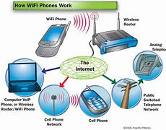
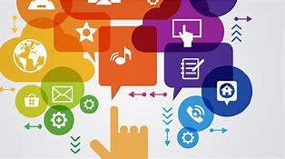
Evolution of communication tools
The old landline phone of the past has grown over time to encompass new applications and features, transforming into the phone of today, which is essentially a mobile communication link. A business telephone with its own PBX (Private Branch Exchange = Telephony system) is not the same as a modern mobile phone with integrated mobile phone operator services. Global corporations spearheaded the integration of various technologies in order to improve communication. Internal investigations and analysis revealed that the average employee utilizes a PC, a work phone (landline), potentially many mobile phones, a tablet, a fax, a notebook, and/or a Netbook, among other devices.

Slide 7
Thank you for your attention!

