Slide 1
eTwinning Project
Work done by: Alexandre Coelho/Mariana Moreira/ Rafaela Novais/Raquel Silva/Rui Sousa ESG, Gondomar, Porto, Portugal

Slide 2
https://www.youtube.com/watch?v=xTuQUSy4muI

Slide 3
Commercial
This commercial portrays women as a vulnerable group, conveying the idea that they just possess and use their sexiness in an excessive way. The poses that the actress does in the commercial are an example of this, for example, the fact that she is always lying on the rug.
The most obvious characteristic is the sensuality, which women are supposed to have, but exaggeratedly. Thus these characteristics become negative.
This commercial shocks us, because women shouldn’t be portrayed in this way. Women can be sensual, but that isn’t their most important quality.

Slide 4
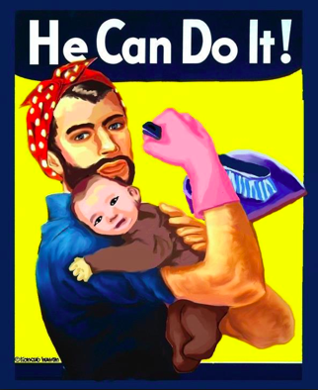
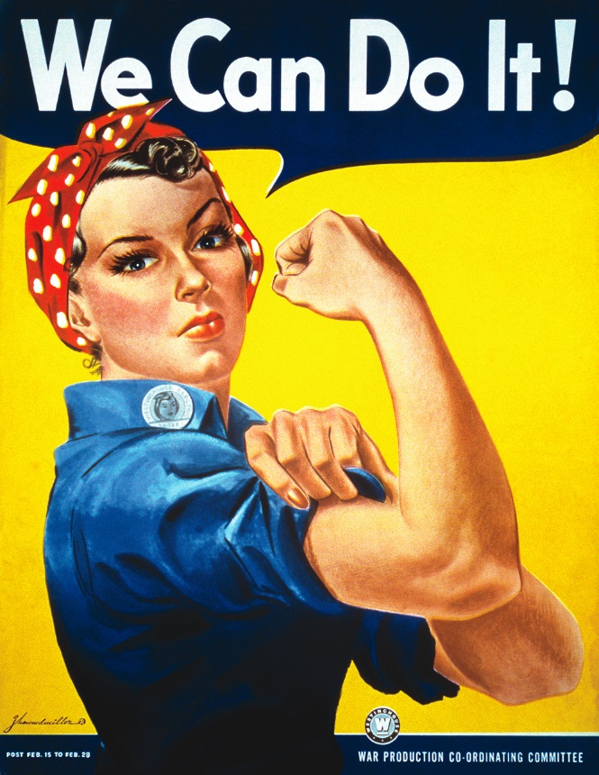
Women are much more than sensuality, being as smart, capable and powerful as men.

Slide 5
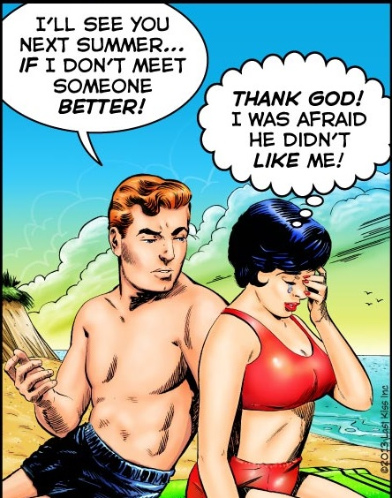
We think this type of commercial can change the perspective on girls and boys. In girls, making them think that only by acting this way they will have sucess and attention from men.

Slide 6
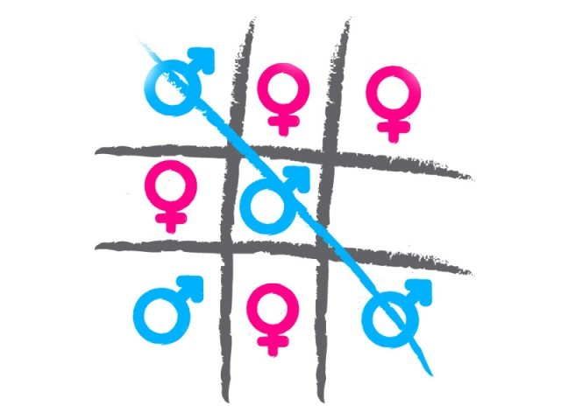
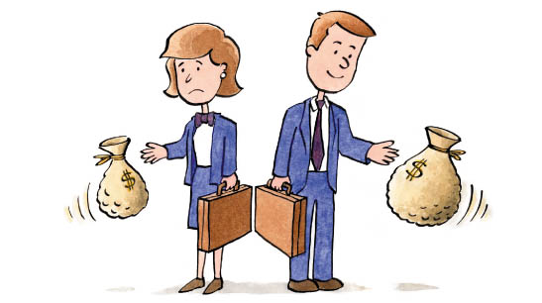
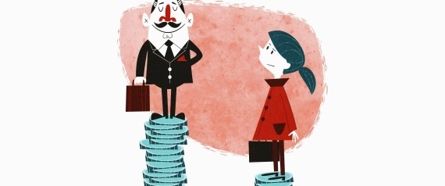
As for boys, leading them to think that only sensuality matters in women, and making them believe that women are easy to seduce, which may lead them to treat women as mere “objects”.

Slide 7
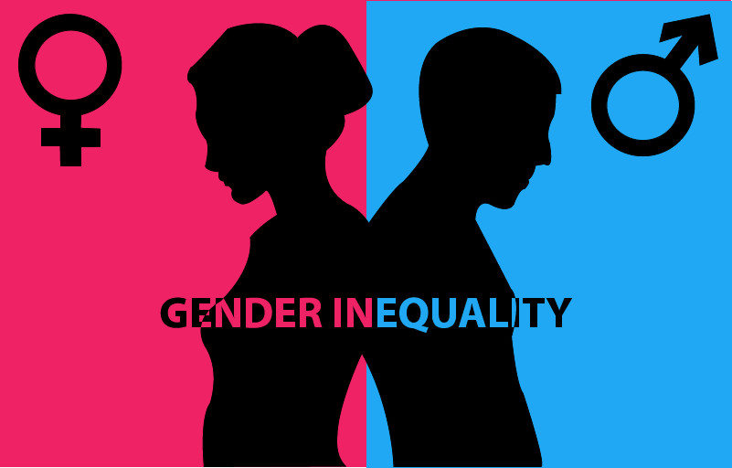
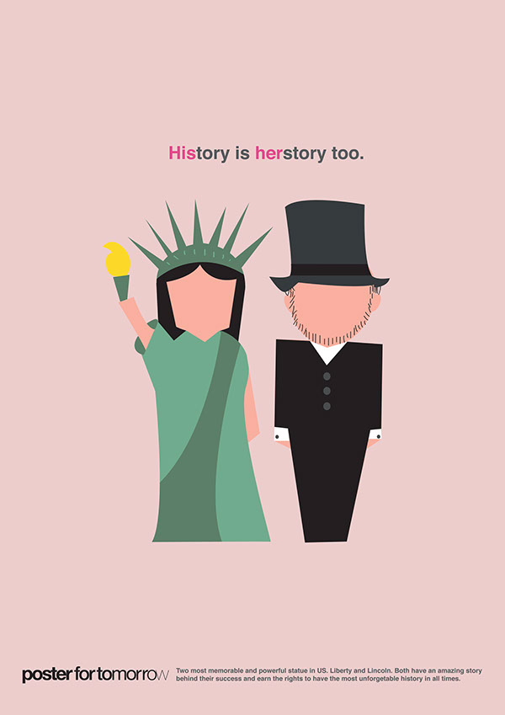
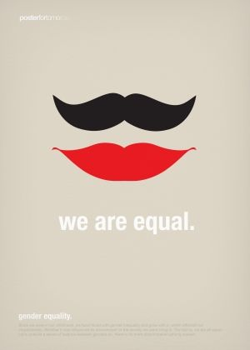
This type of commercial can be changed making people realize how much women and men are equally powerful and both are much more than physical appeararence, showing the qualities of each one.

Slide 8
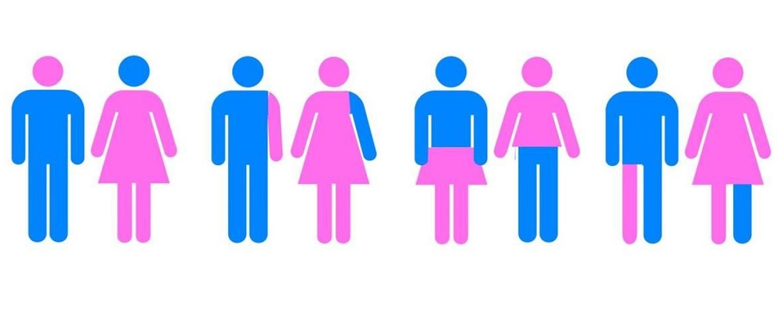
END

