Slide 1
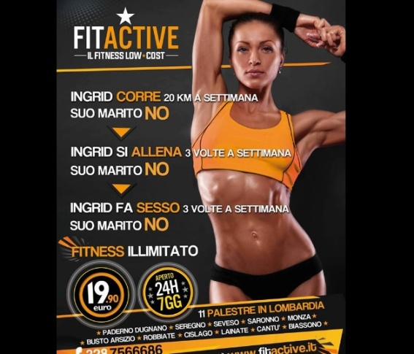
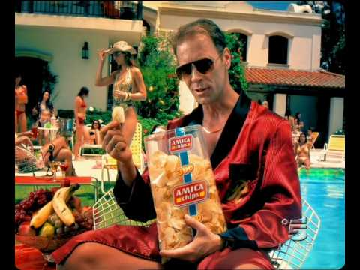
Sexism in Italian Spots
Classe 2 Beta
Alunni: Giacomo Auzino
Lorenza Chiola
Cinzia Flaviana Servilio
LICEO CLASSICO PUBLIO VIRGILIO MARONE AVELLINO

Slide 2
Ingrid runs 20 km a week Her husband DOESN’T Ingrid will train 3 times a week Her husband WON’T Ingrid has sex 3 times a week Her husband DOESN’T
FITACTIVE

Slide 3
Delete your tracks
CLENDY

Slide 4
NOVA We do it everyday

Slide 5
TTL LINES
We have the most famous poops of Italy

Slide 6
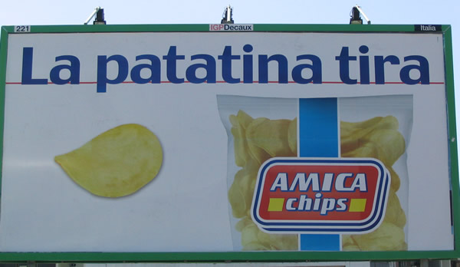
Potato attracts
https://www.youtube.com/watch?v=oUn4-6huLOM

