Slide 1
Stereotyping in ads
Made by :
Paulo Daniel nº17
Paulo Batista nº18
Pedro Mendes nº 19
Rodrigo Ferreira nº 22
Sérgio Teixeira nº 24

Slide 2
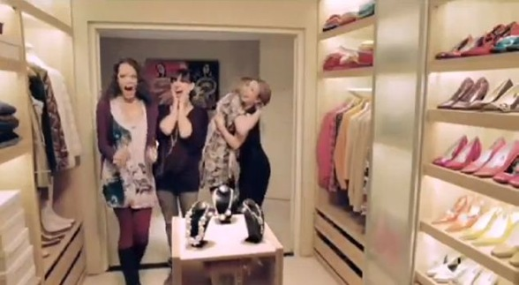
Heineken commercial

Slide 3
Stereotypes presented in the ad
In the ad that we selected men and women are portrayed in men´s case as beer lovers and regarding women the ad conveys the idea that all women love clothes , are superficial and addicted to fashion , accessories and other futile things.

Slide 4
Negative characteristics
We believe that these characteristics are negative , because this ad doesn´t portray all men and women´s likes.
The ad doesn´t shock us , even thought the ad generalizes both genders ,but in a funny way.

Slide 5
Impacts of this ad on youth
This ad can be harmful to the relations among young people because this kind of ad encourages young people to consume beer and alcohol (in men´s case ) and to be fanatic about clothes ( in the women´s case) and makes us have a wrong idea about both genders.

Slide 6
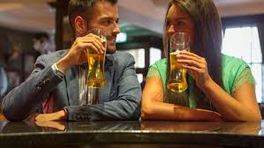
How can we make a more fair ad
We can make them more positive by showing both genders doing both things.

