Slide 1
CLEANING PRODUCTS (by LAURA BARREIRA HUGO BONAL CLAUDIA MANGAS CARMEN PAVÓN MARÍA RIVAS
Spain
Notes:
3/03/17
<número>
<número>

Slide 2
Looking for ads that show us the difference between the genders I found this among others.
https://www.youtube.com/watch?v=Qt9A4AwoEY0
https://www.youtube.com/watch?v=n1ammEAXt_0
In this ad we can see a cleanning product, Cillit Bang. The problem is that it shows us women that have problems with time and using this product they can spend more time with their children.
In conclusion we see once again women associated with the chores and with children’s care.
LAURA
Notes:
3/03/17
<número>
<número>

Slide 3
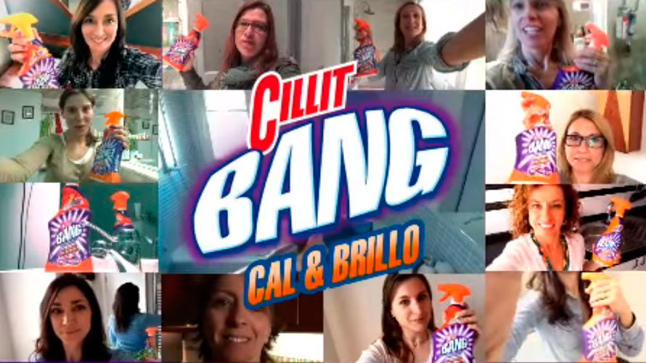
The ads I have chosen are exactly the same as Laura, the previous slide.
In my opinion, those ads are really sexist because they show women as the housewives of the past, the ones who have to do all the housework without any help.
In these ads a man’s voice says: prove it and tell us yourself (in the feminine form). It seems that only women can use cleaning products.
I think that a powerful brand like Cillit Bang shouldn’t post these ads.
Claudia

Slide 4
Also about the Cillit Bang ad, I believe the problem is really serious because they have made many videos, all of them featuring women talking about the same things (cleaning and looking after kids). Not one of the videos in this campaign includes one man.
It is such a serious problem that these advertisements were chosen as “the most sexist advertising in 2015” and a jury has declared it discriminatory and has banned it. Still, the damage is already done, since it was many times on TV and it was seen by many people. Also, it doesn’t look like the brand has had many problems related to the advertisements, apart from the fact that it was banned.
Carmen

Slide 5
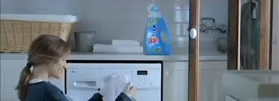
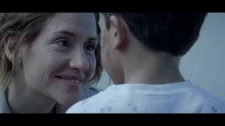
This announcement keeps the sexist tone to show a few actions that are supposed to be done by mothers, such as raise their children, prepare breakfast, take them to school, and of course wash their clothes. It is a very clear example that detergent ads have sexist content. This type of ads always show the woman since a male chauvnist point of view and teach young people that all this activities should be done by woman. Young people must change this because thay can help women.
https://youtu.be/_Pp-ak2c-Z4
This announcement keeps the sexist tone to show a few actions that are supposed to be done by mothers, such as raise their children, prepare breakfast, take them to school, and of course wash their clothes. It is a very clear example that detergent ads have sexist content. This type of ads always show the woman since a male chauvnist point of view and teach young people that all this activities should be done by woman. Young people must change this because thay can help women.
María

