Slide 1
Gender Stereotypes in Advertisements

Slide 2
-Wafer Which Doesn't Cry Behind You
If You Don't Eat It
-#MenDon'tCry
-Wapps

Slide 3
-Our breasts? Our Buttocks?
-#Which Part Of My Body Do You Like Most?
-KFC

Slide 4
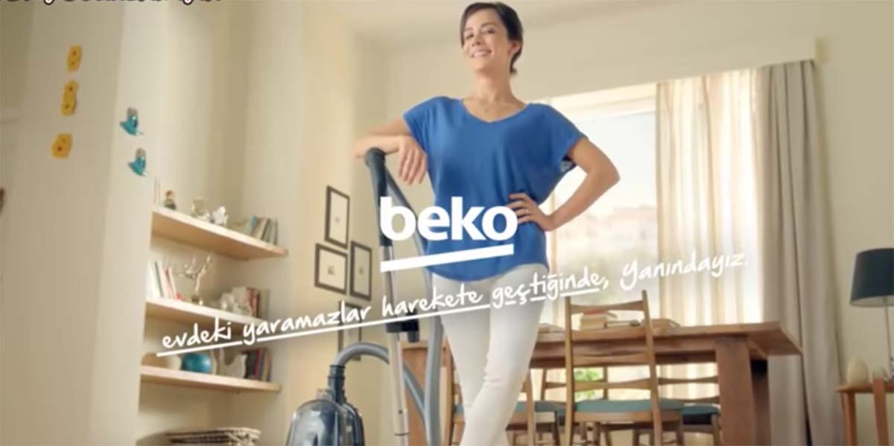
-When scamps in home (kids) start to move, we are with you.
-Beko

Slide 5
-Don't Be Afraid, You Will Enjoy It Too...
-Hasbro

Slide 6
-New Taste Of Being Woman
-Pınar Fruit Juices

Slide 7
-You Can't Be Happy This Much, If You Explain Offside To Your Girlfriend.
-Renault

Slide 8
