Slide 1
Yes, we also rent to women*
(car rental company)
*Of course, Sixt also rents to women, preferably women since the statistics show they have 1.5 less serious accidents than men

Slide 2
A small step for Man, a giant leap for his wife
An ad for a vacuum cleaner!

Slide 3
Download as fast as your wife changes her mind

Slide 4
All paper can be recycled. Let’s sort them out.
It is so simple that even a man can do it

Slide 5
No comment or translation…The woman is an object
Increase your chances to be hired

Slide 6
Sorry (feminin form). Since I am a such a reckless driver, I’d rather leave my car here
(Renault Twingo)
Taste comfort
(Shaving foam)

Slide 7
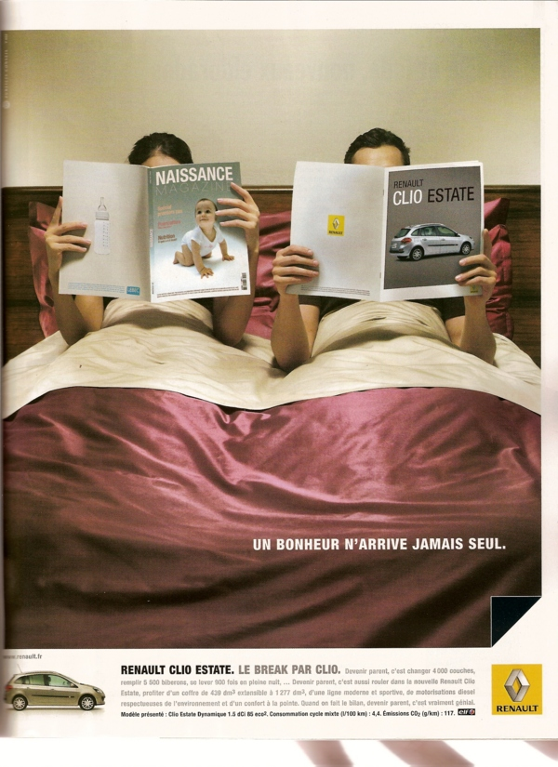
Woman reading a magazine on ‘birth’
Man reading a magazine on the new Clio estate
Happiness never comes alone
(Renault Clio estate)

Slide 8
If the pay gap could get as much attention

