Slide 1
https://www.youtube.com/watch?v=buE8LbN9ZOg
This ad is promoting CIF cream.
It's about the death of an old King and his having no successor. It's been decided that the one who will manage to wash the cauldron will be the new king. Many tried but failed until a knight shows up and tries with a Cif cream. It magically works. And the knight turns out to be a woman !
In my opinion this is a sexist ad because it makes us feel like only woman can do the cleaning. But at the same time, she is a knight… However at the end, we can see the image of the perfect housewife appearing.
Maelle, Lyon, France

Slide 2
You could take her for €1 per day…
Ad for taking your driving test for €1 per day with ECF
This ad presents a young attractive woman hitchhiking, wearing shorts and showing her legs…to attract the drivers’ attention.
Typical of the woman as an object.
Justine, Lyon, France

Slide 3
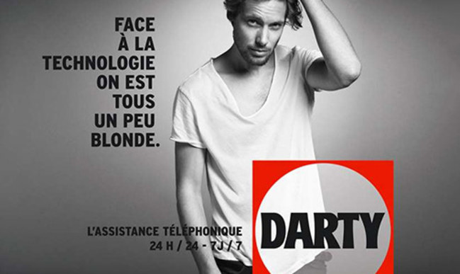
WHEN FACING TECHNOLOGY, WE ARE ALL A LITTLE BLOND
DARTY (a shop selling hi-tech devices, etc…)
A sexist ad that refers to blond women being a bit stupid and not understanding technology and how things work.
Axel, Lyon, France

Slide 4
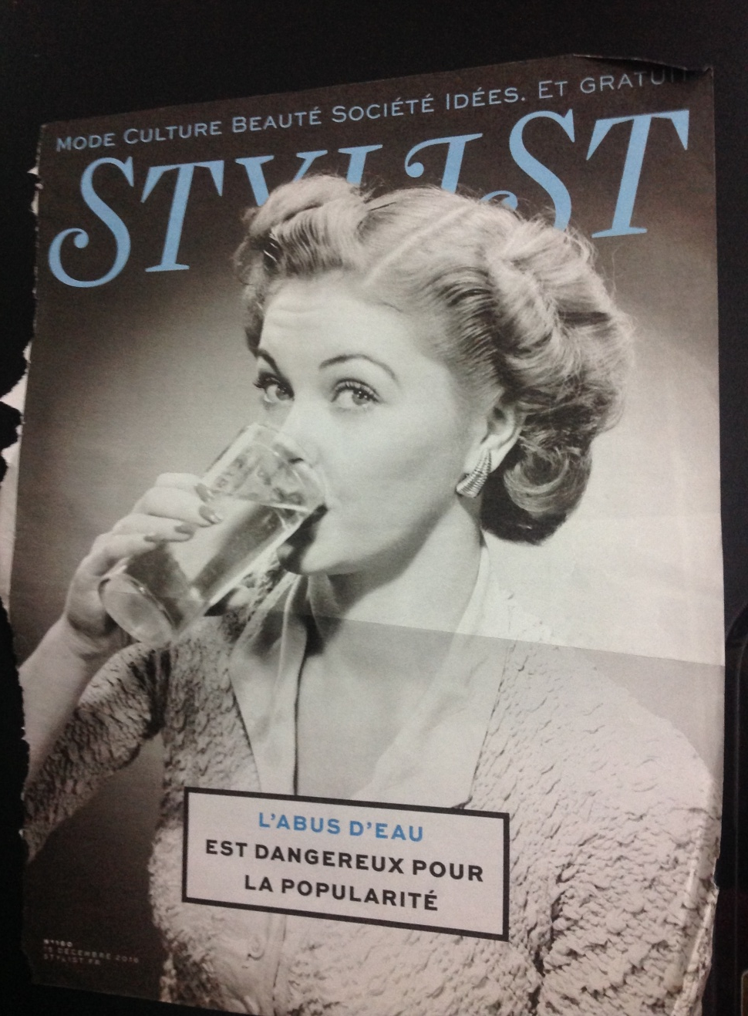
This ad is a promotional campaign from Stylist, a newspaper for women. It's struck my attention because there is a hidden message.
Actually, Stylist has changed a famous slogan of the campaign against alcohol in France. The real slogan was : " L'abus d'alcool est dangereux pour la santé" which means " Alcohol abuse is dangerous for your health". The catchphrase in this ad is " L'abus d'eau est dangereux pour la popularité" which means " water abuse is dangerous for popularity ". You can see a woman drinking a glass of water so it's little bit provocative to say that water is dangerous... And that you cannot be popular if you don’t drink anything else !
Julie, Lyon, France

Slide 5
1st picture : My phone hasn’t rung since the 11th of June
2nd picture : Is there a single guy who doesn't watch the soccer on TV?
3rd picture : I know a much better way to spend 90 minutes
In the yellow strip : 31 days of football. Wake up and be ready.
Ad for the anti-perspirant AXE
This ad was shown during the European football cup. It shows women waiting for the end of the competition, or craving men. Women are shown as sexual objects who just want to attract men with provocative attitude, wearing very little clothes. Very stereotyped and also implying that all men watch football (another sexist idea).
Thomas, Lyon, France

