Slide 1
Adverts & Stereotypes
By IVÁN BARRO
IVÁN CABANAS
PABLO OTERO
XANA RODRÍGUEZ
IVÁN SECO

Slide 2
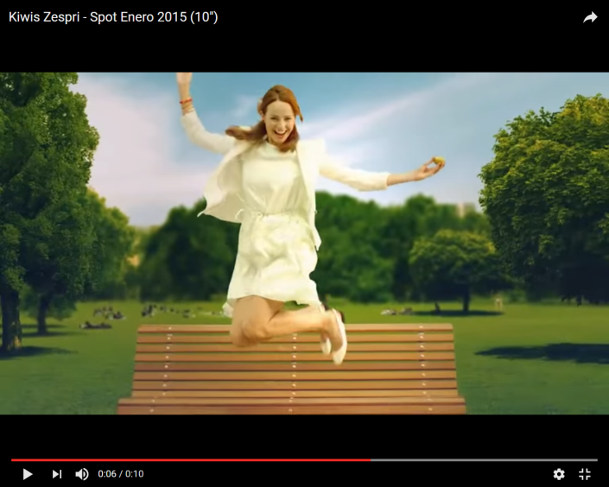
https://www.youtube.com/watch?v=UYFlloASXqY
KIWIS ZESPRI
This type of adverts cause confusion to some people. It shows that only women must be fit and this is not a real thing. It seems as if only women can eat fruit and be healthy because they want to be beautiful. It´s ridiculous. Everybody should be healthy!

Slide 3
Dolce & Gabbana The One Gentleman
This advert shows a man who is a gentleman. Most of the times men are heroes and handsome and women are careful and polite.
https://www.youtube.com/watch?v=0QecomtVPfA

Slide 4
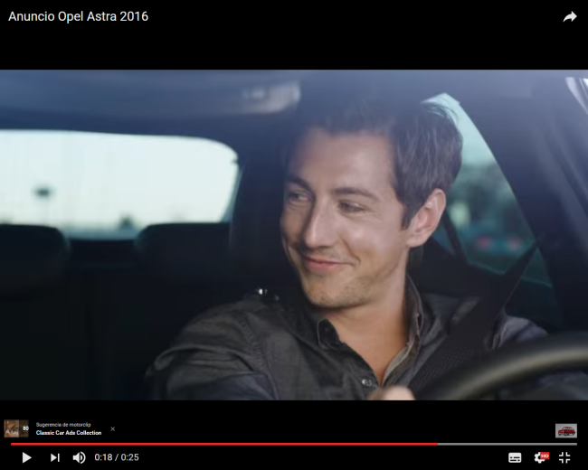
Opel Astra
In this advert, the man drives and not the woman, why? Both can drive in real life.
https://www.youtube.com/watch?v=V1jFZg9sdxw

Slide 5
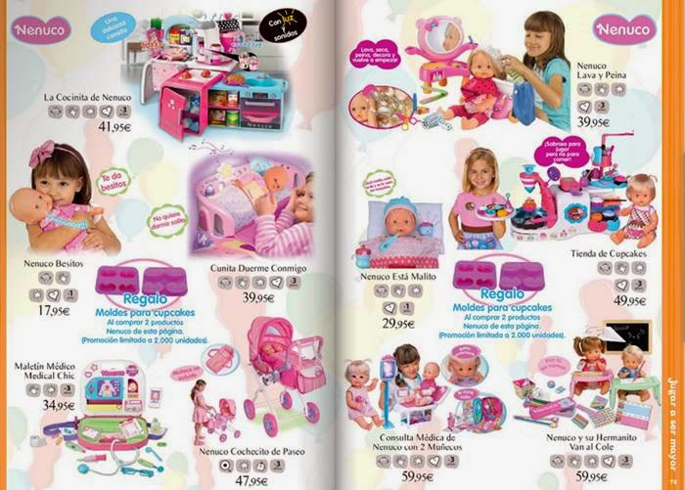
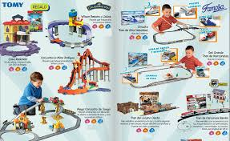
Toys magazines
Normally, women do the laundry and the housework as this advert shows. In real life both men and women have to do the chores.
In this picture we can see how the advertisement of dolls is only for girls. Why? And also we can see how the colour pink is only for girls. Why? Because people usually associated these values to women. But why not to men too?
In this picture we can see the opposite, we can see how the advertisement of cars is only for boys. Why? And we can see the colour blue only for boys. Why?
Because people usually associated this values to men. But why not for women too?

