Slide 1
(DE)construncting gender through advertisement
By Roberto Fusco, Giada Costabile and Antonio Penza.

Slide 2
First Impression
We want to talk about a very famous toy here in italy. It’s a toy that is produced at Easter, and consists in a big egg made of plastic, with inside lots of smaller toys.
We are going to talk about different toys that are inside different types of eggs, one for boys and one for girls.

Slide 3
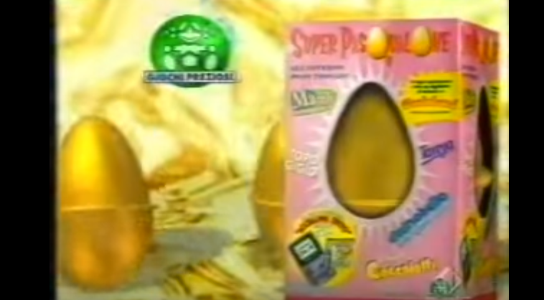
First One: Girl’s one
As you can see from the photo, the colours are brilliant, and gold and pink are the predominants colours.

Slide 4
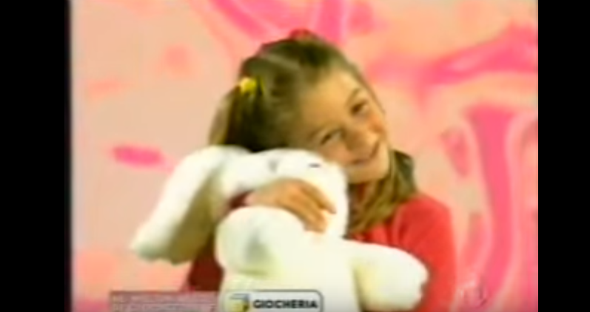
What’s inside the box?
Inside the box there’s the egg, and once you open it there are lots of plushes and charms. A typical stereotype for the girls.

Slide 5
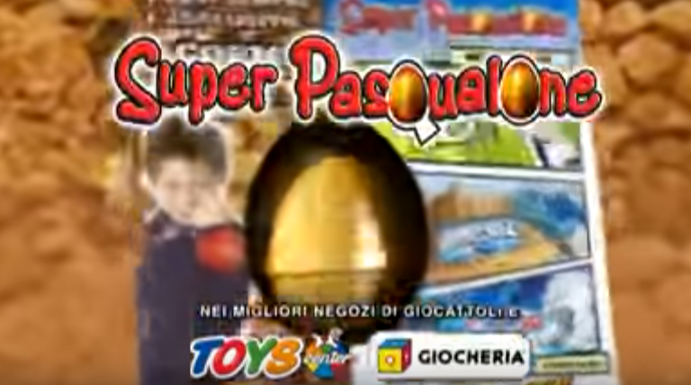
And the boy’s one?
Earth, fire are the predominants elements, brown grey and black are the only colours, and the boy is a strange position, like an hero.

Slide 6
And what’s inside?
Essentially monsters. Powerfull monsters , with strong weapons, that can destroy everything. A boy needs to be stronger than others. That’s the stereotype for boys.

Slide 7
Thank You for your attention.
We worked a lot to find a nice advertisement. We hope you enjoyed.
-Roberto Fusco
-Giada Costabile
-Antonio Penza

