Slide 1
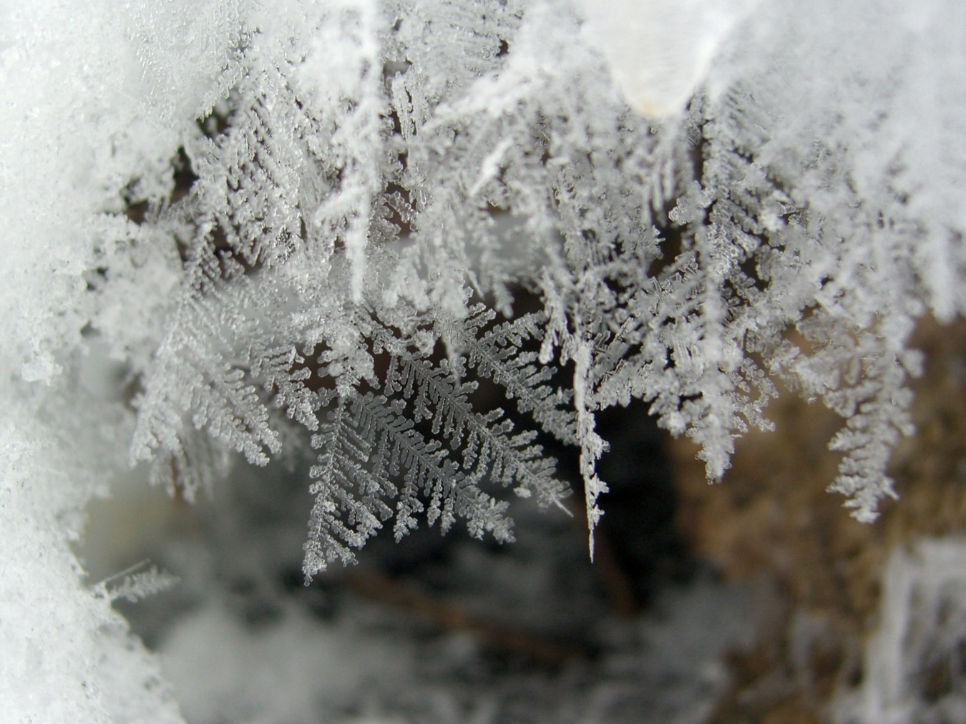
Winter Magic Soup Cho, Mun Jeong It’s freezing outside! We need something to make us warm. First, put some warm tea into your bowl. Then put some cold vegetables into your bowl. Add some sugar and 20 grams of ice in it! Then stir for 3 minutes ! Say 1 hour for times and now your ready to enjoy it!
My new year's wish strengthen physical strength.

Slide 2
<WINTER>
Kim, Sumin
When strong wind blows,
I feel winter is coming as cold as ice. Icicles melted in my warm hands. Now, do you wanna build a snowman? Try to hide snowman from the sun so that it never cries. Every snowman makes me smile. Roll the snowballs along the road.

Slide 3
Winter Acrostic Poem
Shin, Seoyeon
Watching beautiful
illumination at Christmas
night
tell us to be
experienced.
Ready for that?

Slide 4
In Winter
Kyu-Yeon Kim
I can see a snowman.
I can smell Winter's fresh air.
I can make OLAF.
I can eat tangerines.
I LOVE WINTER !

Slide 5
Winter Magic Soup
Ko, Minseo
It's freezing cold outside! We need something to make us warm. First, put some warm wisdom into your bowl. Then put some cold firm into your bowl. Add some effort and 20 grams of luck in it. Then stir 50 times! Say hope, please for times and now your ready to enjoy it!

Slide 6
In Winter
Byun SeoYeon
I can see a snowy field.
I can smell the hot chocolate.
I can make a snowman.
I can eat some Bungeoppang.
I love winter!
This is Bungeoppang : kind of fish-shaped cake.
This is very sweet and we usually eat this in winter. This is a kind of famous street food here in Korea.

Slide 7
Winter
Ryu, Hwan
It’s freezing outside!
We need something to make us warm.
First, put some warm sweet potato into your bowl.
Then put some cold air into your bowl.
Add some fish-shaped bun and 20 grams of happy heart in it!
Then stir 100 times!
Say “All right. You have done a good job so far.” for times and now your ready to enjoy it!

Slide 8
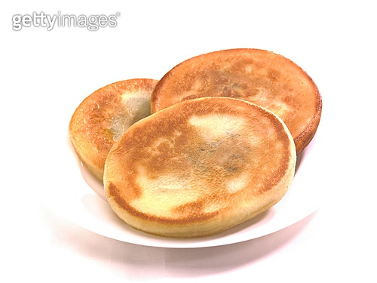
In Winter
Hwang Bo won
I can see snow falling.
I can smell roasted sweet potato.
I can make snow man, and other creative things what you want.
I can eat hot cocoa, roasted chestnuts and
ho-teok (Chinese pancake)
I love winter!!
Roasted sweet potato

Slide 9
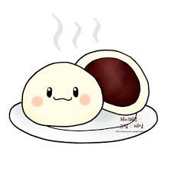
In Winter
Hyewon Ju
I can see snow
I can smell bungeoppangs’ smell
I can see my breath coming out
I can eat steamed bun
I love winter!

