Slide 1
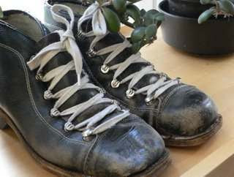
Soili Perkiö
Soili Perkiö studied music education, piano and voice at the Sibelius Academy, Helsinki, and advanced studies in dance and music education at the University Mozarteum in Salzburg in the Carl Orff-Institute.
She is specialiced in music and movement, folk music, and early childhood music education. Since 1995 Soili has been a lecturer in the Department of Music Education, Sibelius Academy, Helsinki. She has also taught at educational conferences on all continents.
Soili has worked for the Finnish Broadcast Company and made TV and radio programmes for children. She continues to give concerts in schools and kindergartens introducing Finnish folk instruments, and has composed music for dance groups, theatre performances and songs for children. Soili has also written over 70 music books and audio material for general music education, elementary school and early childhood music education
( http://www.uniarts.fi/soili-perkiö ).

Slide 2
The song "Menomonot" tells about ski boots, which are very fast; about skiing, down hill skiing, skijumping, skating, ice hockey. Finland is a sport country and Finnish people love winter activities.
A permission to play with recorders and sing "Menomonot" by Muuruvesi School 3.-4. classes has been asked from Soili Perkiö 27.2.2018.

