Slide 1
Manos Loïzos (1937–1982)
Everything reminds
me of you

Slide 2
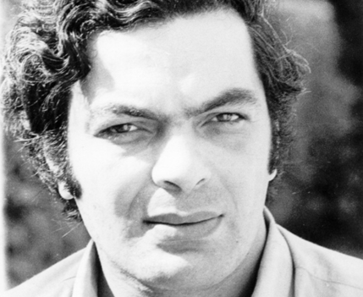
Manos Loïzos is one of the most important Greek Cypriot music composers of the 20th century.

Slide 3
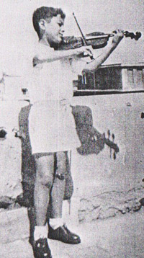
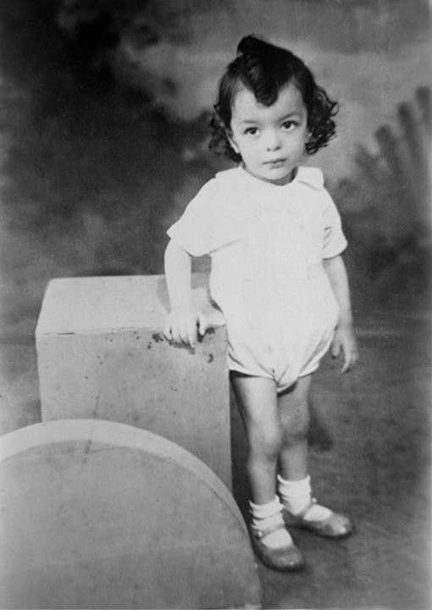
He was born on 22 October 1937 to Cypriot immigrants in Alexandria, Egypt. At the age of seven he started to study the violin. He was a self-taught musician.

Slide 4
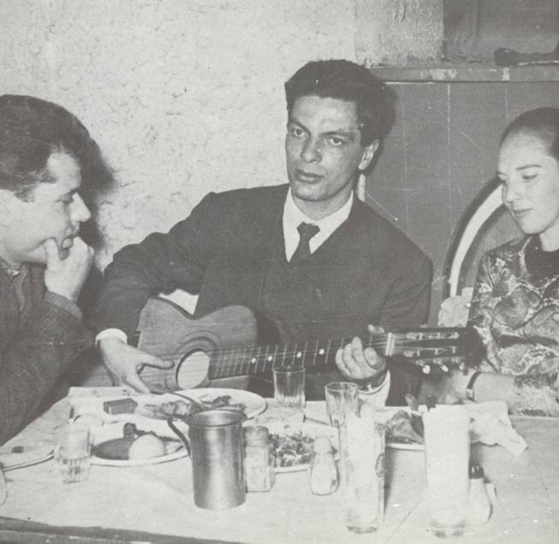
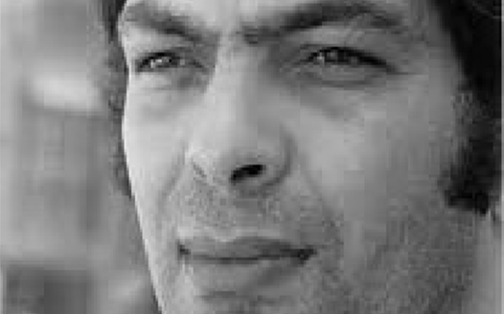
Loizos moved to Athens at the age of 17 intending to study pharmacology but soon gave up his studies in order to concentrate on his musical career.

Slide 5
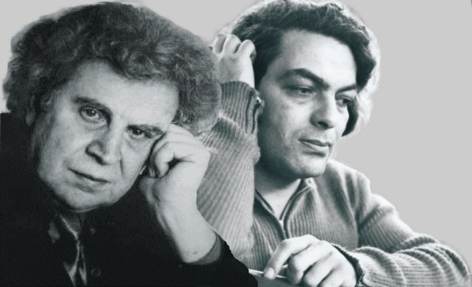
His first recordings were made in 1963 but he started gaining a larger audience after 1967. By 1975 Loizos had become one of the most popular artists in Greek music. He composed many well-known Greek songs and has co-operated with various important composers, singers and lyricists like Mikis Theodorakis.

Slide 6
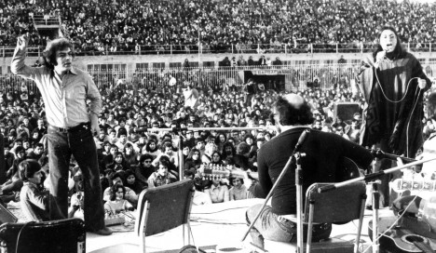
He was well known for his leftist political ideology and was an outspoken critic of the Greek military junta, the Regime of the Colonels. He was also an active member of the Greek Communist Party.

Slide 7
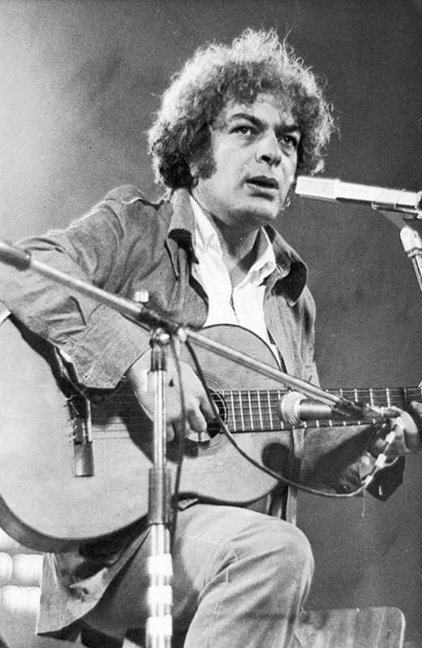
He died on 17 September 1982 in a hospital in Moscow, Soviet Union after suffering several strokes. Although several years have passed since his death greek radios still play his songs. The year 2007 was declared "Manos Loizos Year" in Greece.

Slide 8
Notable work: The road https://www.youtube.com/watch?v=_xnFzF4ntfI The accordion https://www.youtube.com/watch?v=k7tg6J5JOjI Everything reminds me of you https://www.youtube.com/watch?v=gKl69q0XNHc

