Slide 1
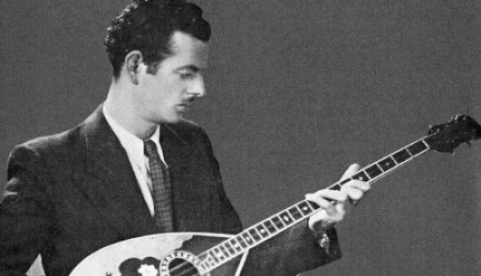
Vasilis Tsitsanis 1915-1984

Slide 2
Vasilis Tsitsanis
One of the greatest Greek songwriters, bouzouki players and composers.

Slide 3
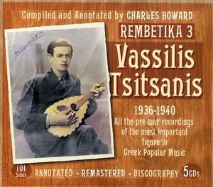
He became one of the leading Greek composers of his time and is widely regarded as one of the founders of modern Rebetiko and Laiko music.

Slide 4
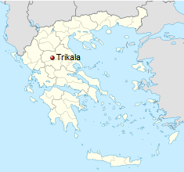
He was born in Trikala and from a young age was interested in music. He learnt to play the violin mandola and the mandolin, which were the mainstay of so many of his songs.

Slide 5
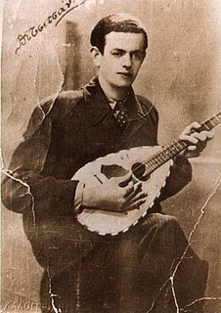
In 1936 he left for Athens to study Law, and by 1937, had learned also bouzouki and made his first musical recording.

Slide 6
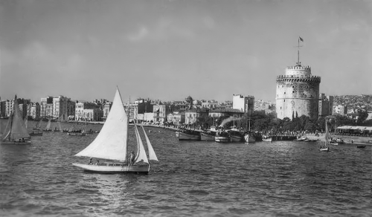
In 1938, he moved to Thessaloniki, where he served his military service.
He stayed there for about ten years, during the German occupation of Greece.

Slide 7
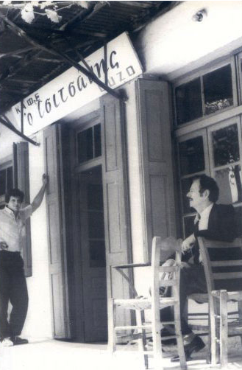
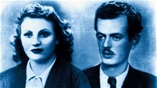
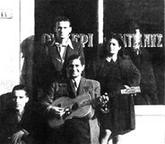
There he opened an ouzeri, a type of greek tavern, got married and wrote many of his best songs that were later recorded after the end of the War.

Slide 8
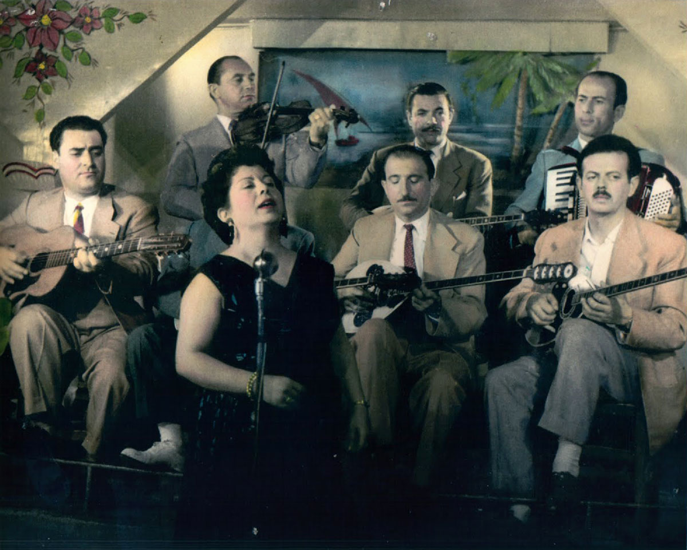
Tsitsanis was already famous when he returned in 1946 to Athens and began recording many of his own compositions that made famous many of the singers that worked with him.

Slide 9
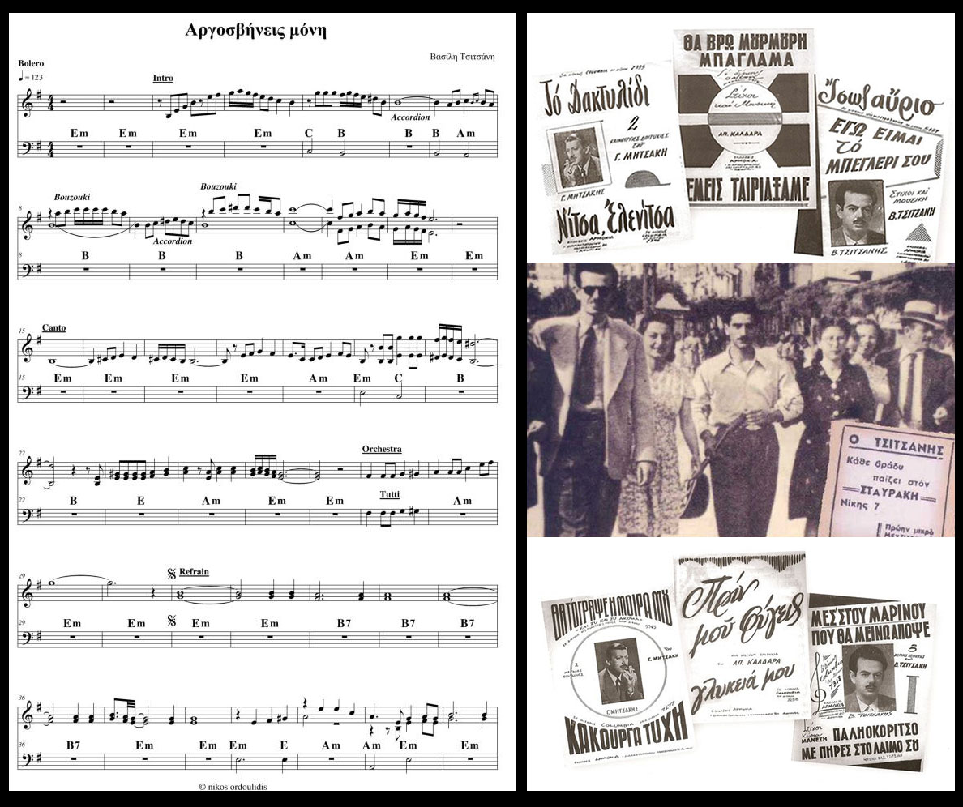
Tsitsanis developed the "westernization" of the rebetiko and made it more known to large sections of the population, setting also the bases for the future laiko.

Slide 10
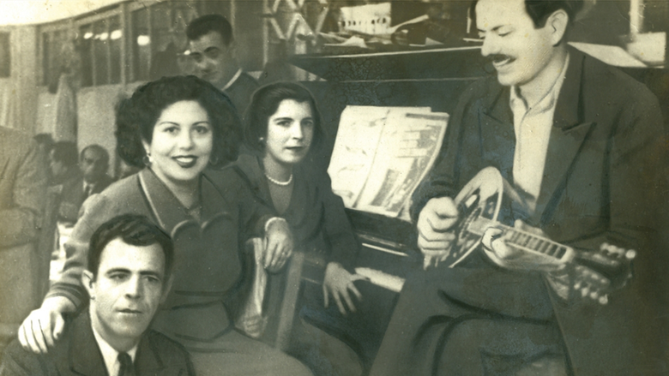
Rebetiko has been inscribed on the UNESCO representative List of the Intangible Cultural Heritage of Humanity. As a great Rebetiko composer and singer Vasilis Tsitsanis was asked to make a live recording on behalf of UNESCO.

Slide 11
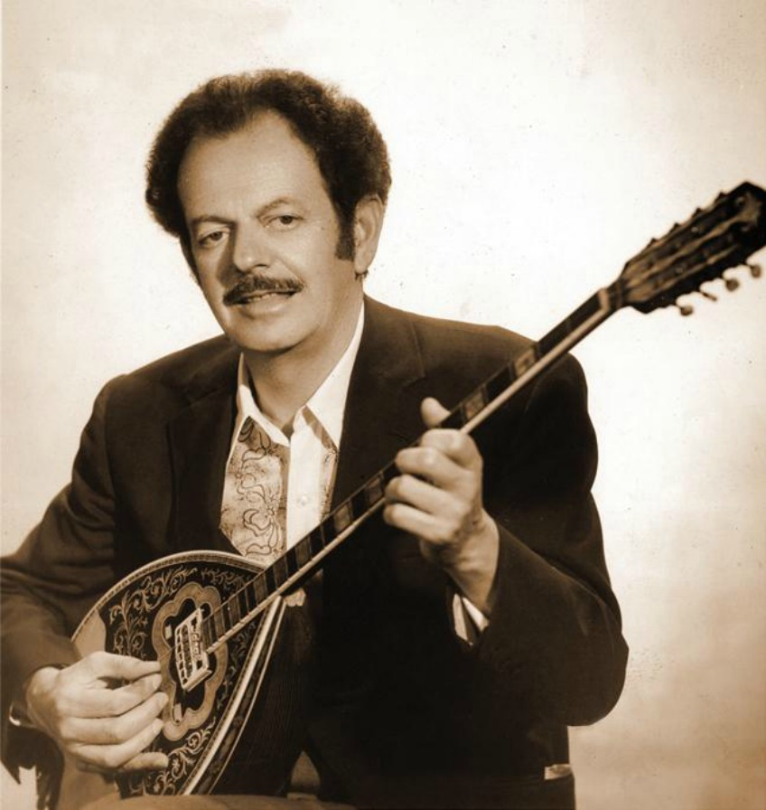
.
Tsitsanis died at the Royal Brompton Hospital in London following a lung operation on his sixty-ninth birthday but his music lives and is still enjoyed to this day.

Slide 12
Notable work :
Cloudy Sunday
https://www.youtube.com/watch?v=wJDg_aXS_7U
The river dragged me
https://www.youtube.com/watch?v=UuYEXzI8nhU
Boat sea
https://www.youtube.com/watch?v=LDvHW8o9PKo

