Slide 1
ÁLVARO TAUCHERT SOLER singer and songwriter

Slide 2
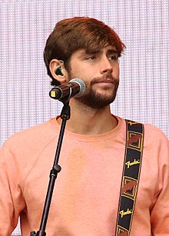
THIS IS ÁLVARO SOLER!

Slide 3
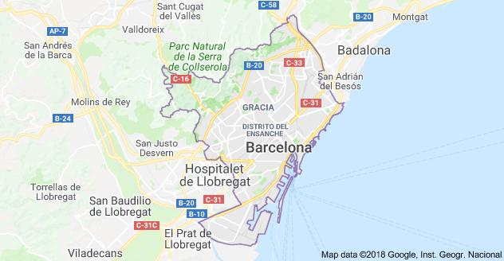
Álvaro Soler was born in Barcelona(Cataluña) in 1991.
He is a German/Spanish singer and a songwriter.
His father is German and his mother is Spanish.

Slide 4
In 2010, he created his musical band “Urban Lights” with his brother and some Friends.
It was a mixture of British pop,indie pop and electronic music.
This band appeared in a Spanish TV progamme “Tú si que vales”.

Slide 5
In 2014, he estabished himself as a musical artist. His most famous songs are:
“El mismo sol” (The same sun)
https://www.youtube.com/watch?v=aNHwNreDp3A
“Agosto” (August)
https://www.youtube.com/watch?v=sHgwnmmv7uo
“Sofía”
https://www.youtube.com/watch?v=qaZ0oAh4evU
“Animal”
https://www.youtube.com/watch?v=YfDhHUuGMuo
“Libre” (Free with Monika Lewczuk)
https://www.youtube.com/watch?v=OMBVoxgZooE
“Yo contigo, tú conmigo” (The Gong Gong Song
https://www.youtube.com/watch?v=3SC0Ze4ta9o

Slide 6
In 2016, Soler was chosen as a judge of an Italian talent contest: “x Factor”.

Slide 7
Awards and nominations
YEAR | AWARD | NOMINATION | WORK | RESULT
2015 | Los Premios 40 Principales | Best Spanish New Artist | Himself | Won
 | European Border Breakers Awards | Best Emerging Artist | Himself | Won
 | MTV European Music Awards | Best Spanish Act | Himself | Nominated
2016 | Latin American Music | Xfinity New Artist of the Year | Himself | Nominated
 |  | Favourite Pop/Rock New Artist | Himself | Nominated
 |  | Favourite Pop/Rock Song | “El Mismo Sol” | Nominated
2017 | Die Elins der Besten | Video-Hit of the Year | “Sofía” | Won
 | Swiss Music Awards | Best Breaking Act International | Himself | Won
 | Los Premios 40 Principales | Best Spanish Song | “Yo contigo Tú Conmigo” | Won

Slide 8
Work made by:
4th grade of Primary Education.

