Slide 1
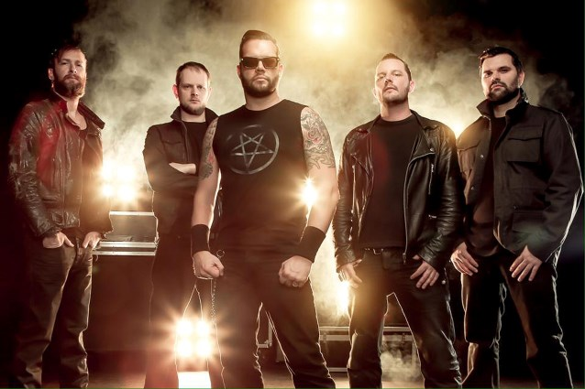
DIABLO BLVb

Slide 2
The origin of diablo blvd:
Is antwerpen from Belgium.
They started in 2005.
Genres: heavy metal.
singer alex agnew and guitarists andries beckers and dave hubrechts and the bass guitarist tim bekaert and the drummer kris martens

Slide 3
photo of diablo blvd

Slide 4
Song of diablo blvd ,1

