Slide 1
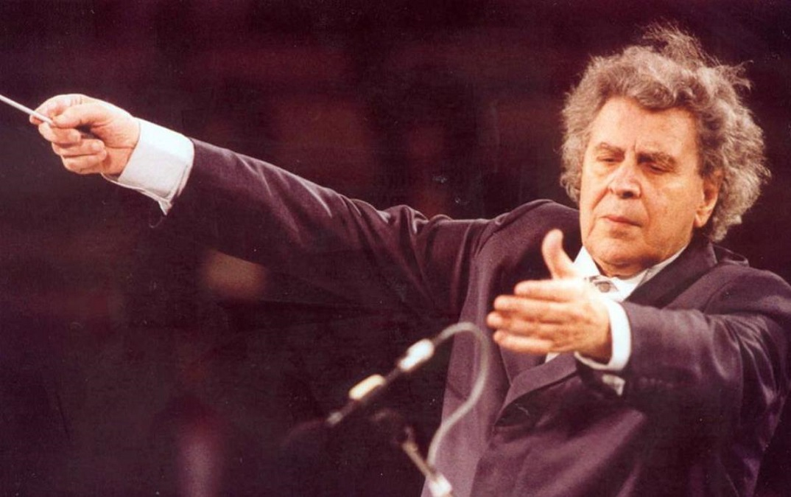
Mikis Theodorakis is a great Greek musician and composer. He was born in 1925, on Chios island.

Slide 2
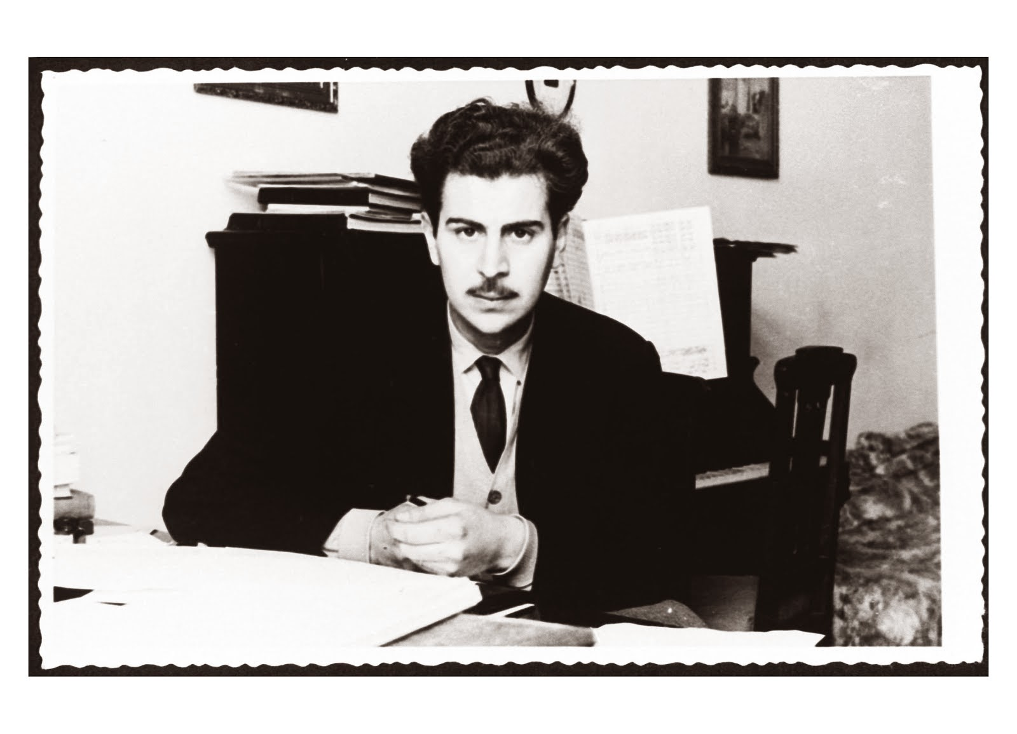
During his childhood he dealt with music and his talent was obvious from the first time. In 1942, at the age of 17 , he gave his first concert. Besides, he took part in the resistance against the German and Italian conquerors. Because of this, he was arrested and tortured.

Slide 3
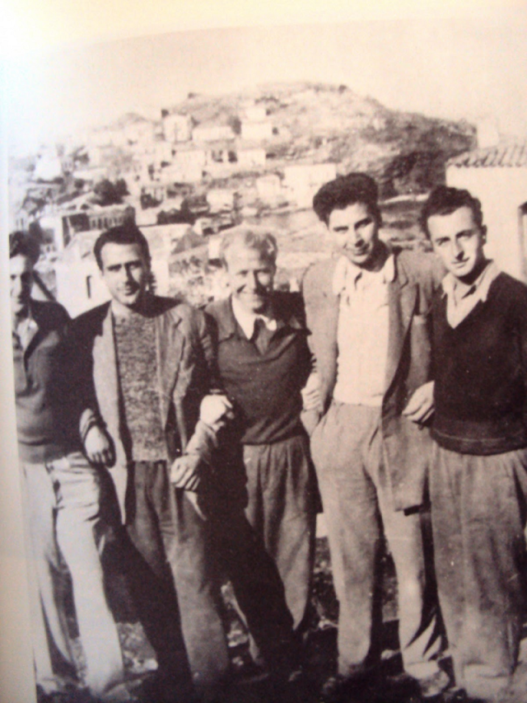
During the civil war (1945-1948) he fought for the left-wing forces (EAM-ELAS) and he was arrested (again) and exiled. Despite the difficulties, in 1950 he graduated from the Athens Audit.

Slide 4
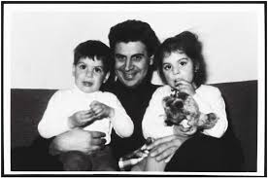
In 1953 he married his wife, Mirto. They have two children, Giorgos and Margarita.

Slide 5
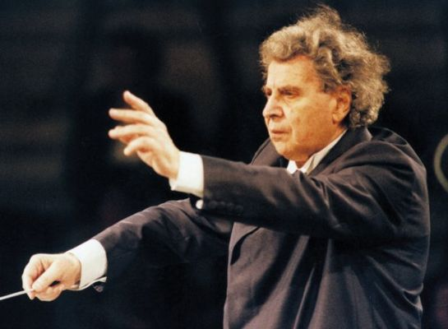
In 1954 he went to Paris, to continue with his music studies. There he started dealing with European music and in 1957 he was awarded the first prize at the festival of Moscow. In 1959 he was prized as the best European composer, with Copley prize.

Slide 6
In 1964 Theodorakis returned to Greece and he started “dressing musically” poems of great Greek poets ( Giorgos Seferis and Odysseas Elitis, both awarded the poetry Nobel prize, and Giannis Ritsos). In this way he succeeded to connect modern Greek folk music with modern Greek poetry.

Slide 7
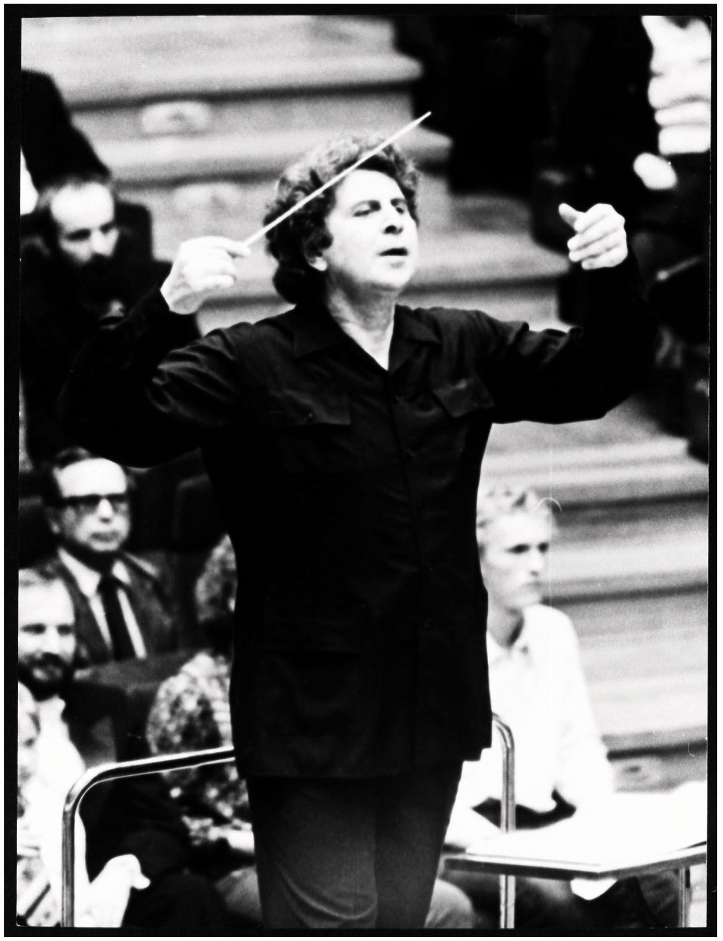
Leading the Athens Symphony Orchestra, he has given a lot of concerts all over Greece, getting Greek people in touch with this kind of music, which is his greatest success.

Slide 8
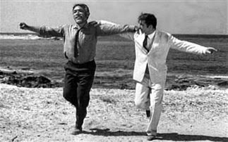
In 1964 he composed the music for the world-famous cinema film “Zorba the Greek” starring Anthony Quinn, becoming famous all over the world. He has also composed musical items for other great cinema films, such as “Z” of Kostas Gavras and “Serpico”, starring Al Pacino.

Slide 9
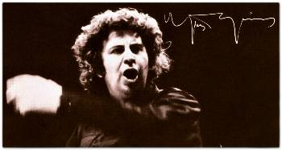
During “juda” (the status of Greek dictators), in 1967, he was arrested for another time and imprisoned. This period health problems bothered him. Under the pressure of many intellectual personalities, he was released and went to Paris in 1970. He gave many concerts against dictators.

Slide 10
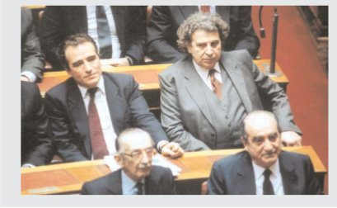
After the fall of juda, in 1974, he went back and continued his music work. During all these years he has given lots of concerts , in Greece and abroad, and he has composed music for over 1.000 songs. He has been a member of the Greek Parliament and minister.

Slide 11
CLASS A 2017-8

