Slide 1
ASTIKI SCHOLI 11TH PRIMARY SCHOOL OF CHIOS
OUR STUDENTS’ CREATIONS

Slide 2
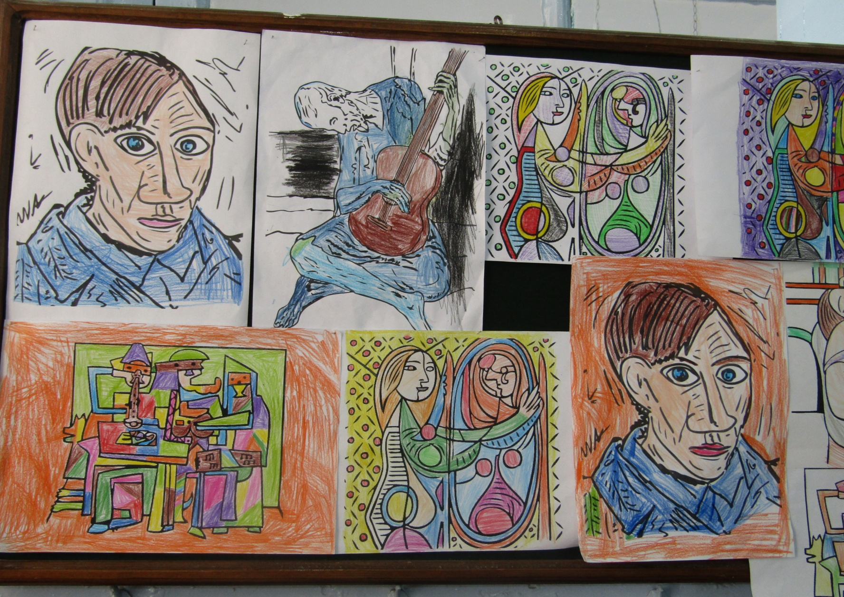
CLASS A1 – PICASSO - SPAIN

Slide 3
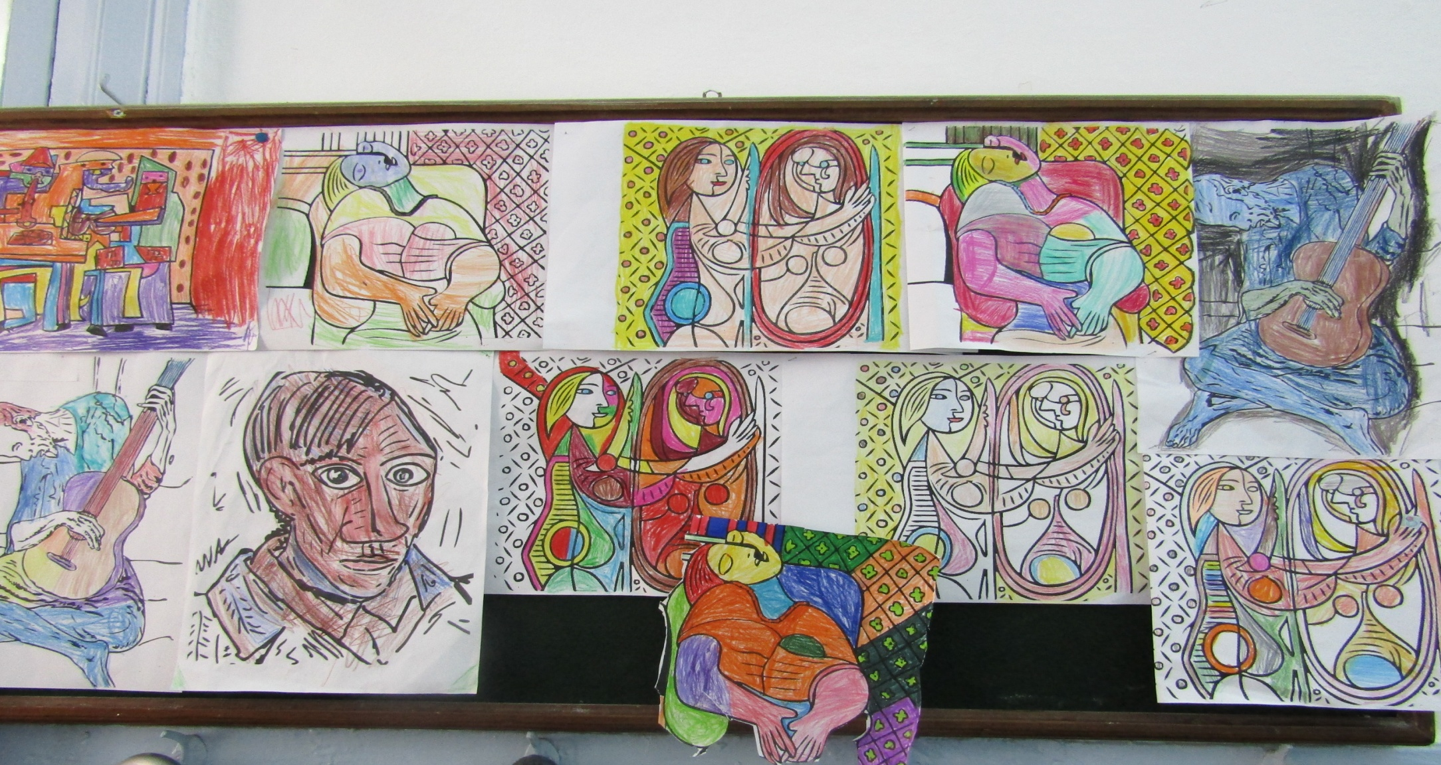
CLASS A1-PICASSO- SPAIN

Slide 4
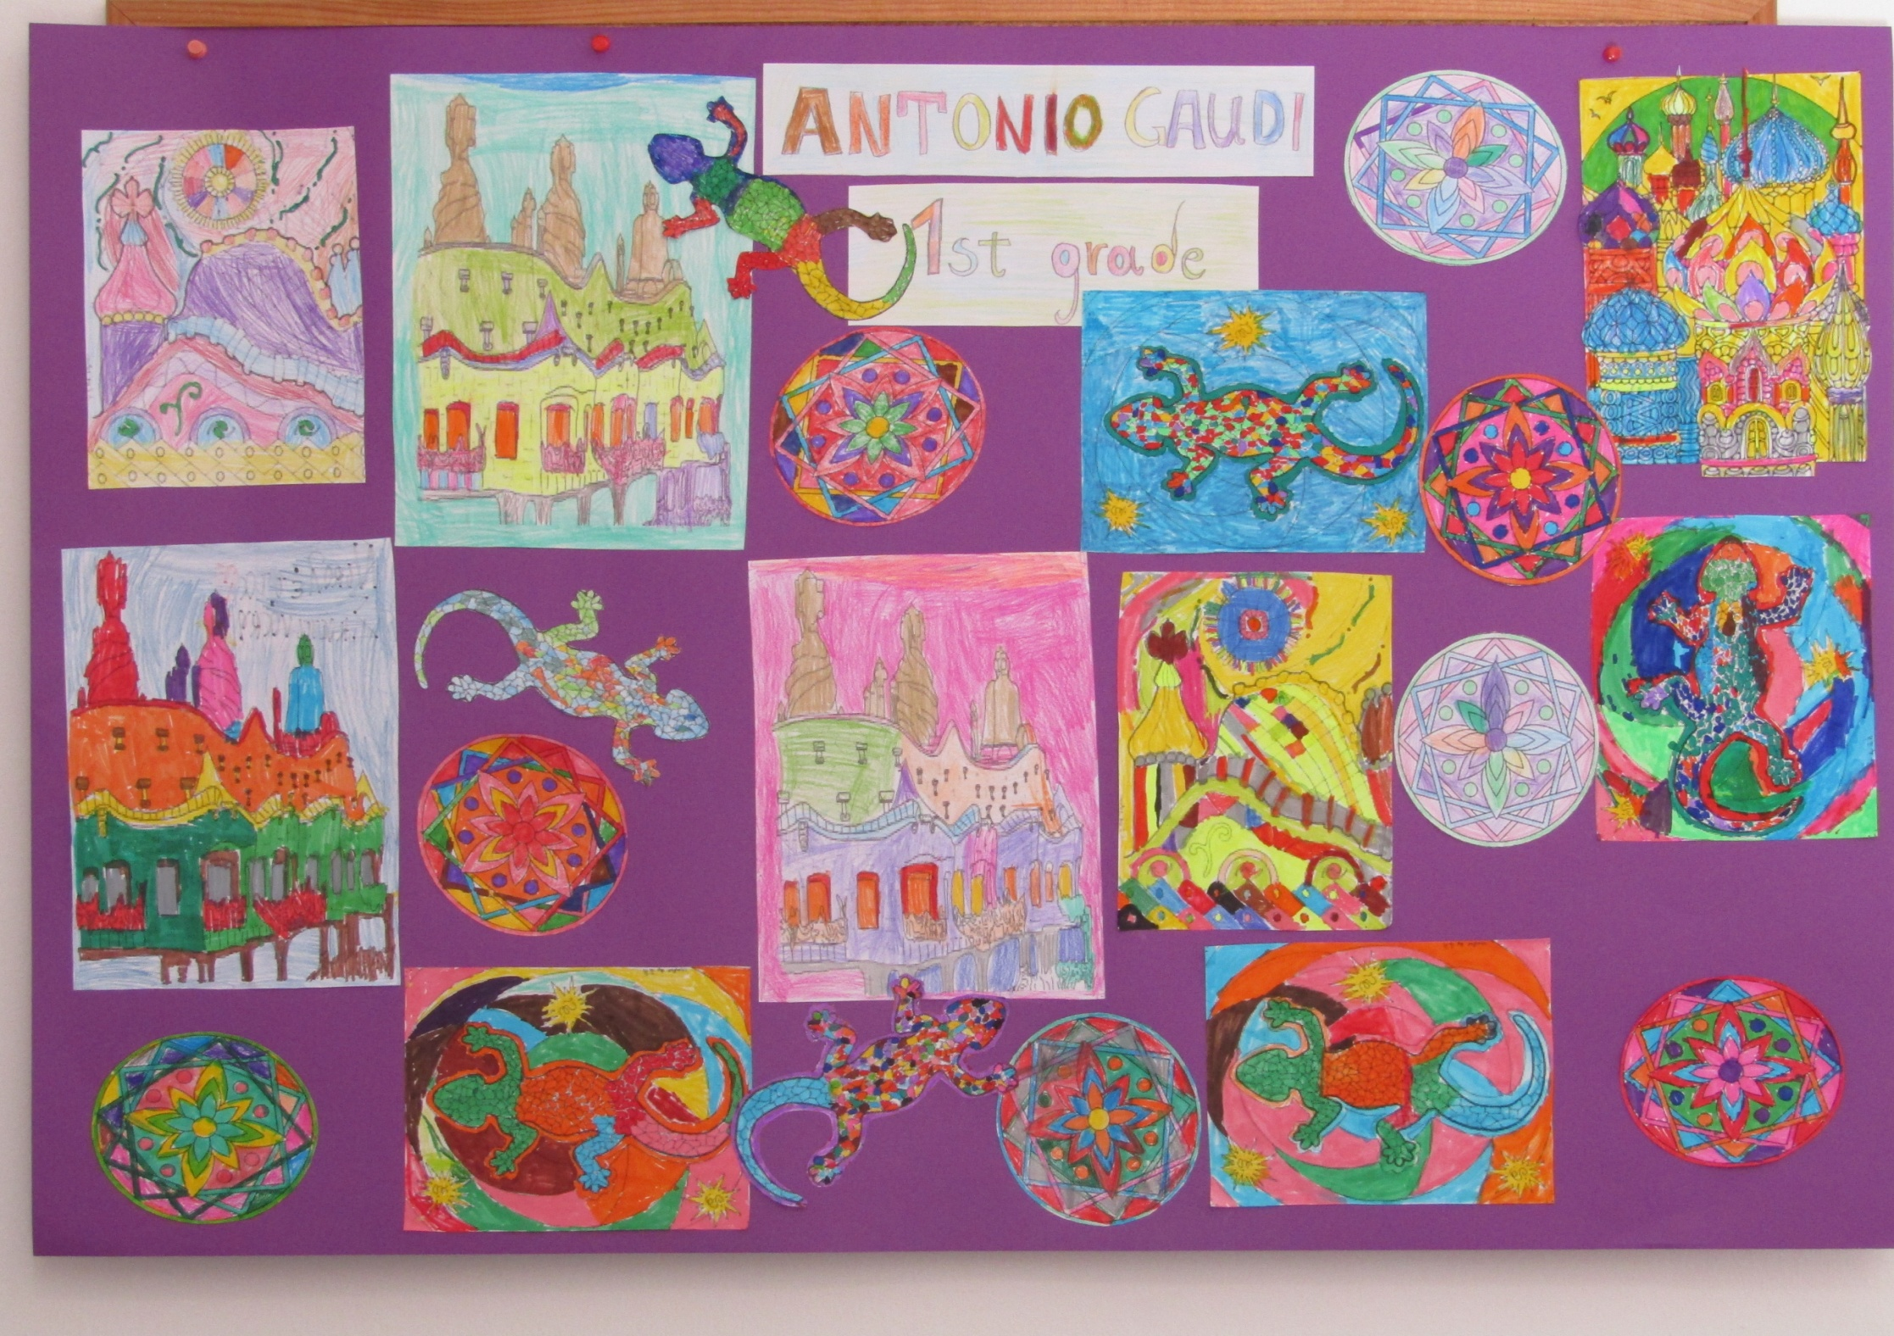
CLASS A2 ANTONIO GAUDI - SPAIN

Slide 5
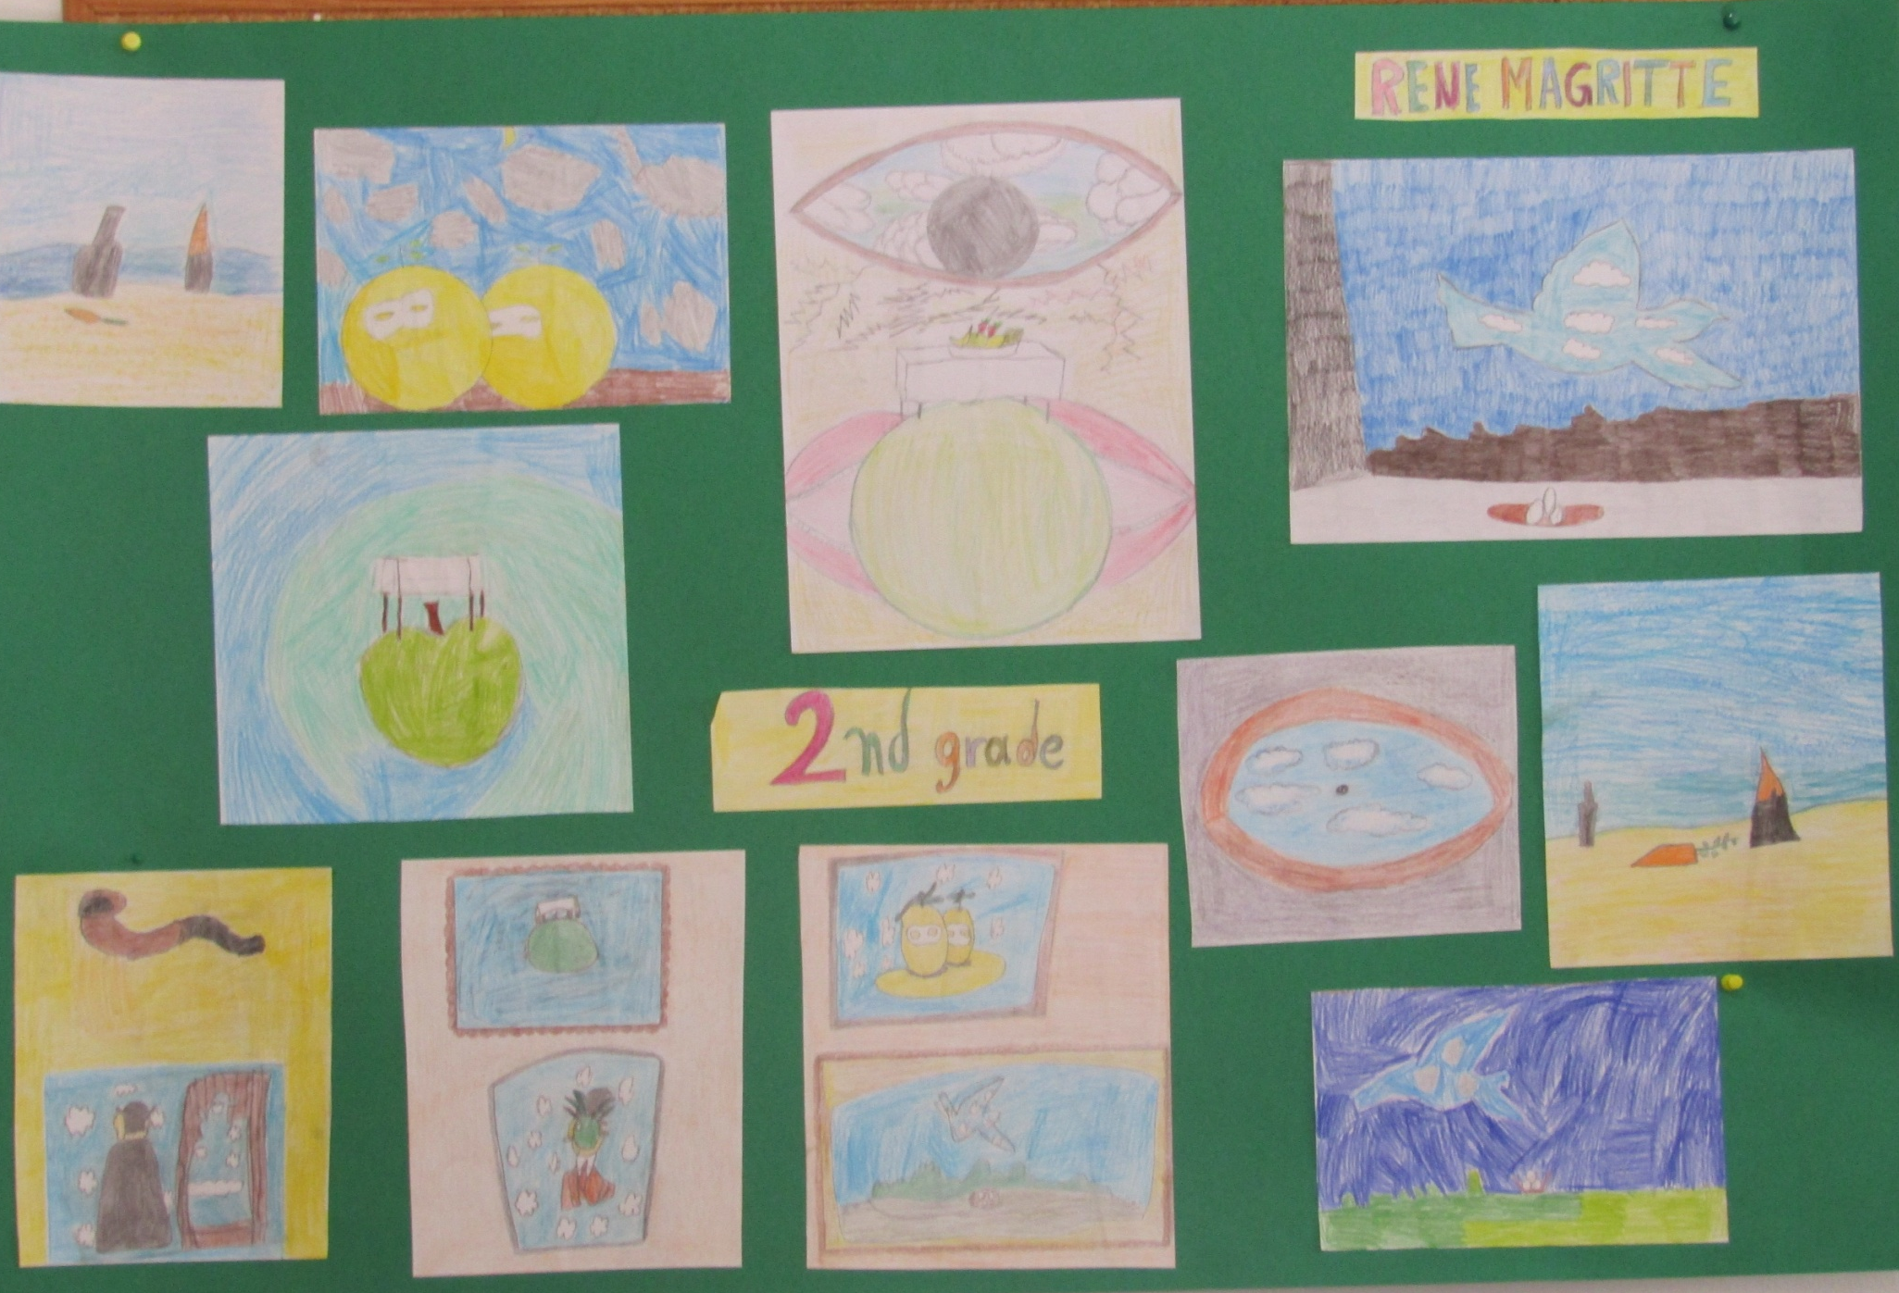
CLASS B2 RENE MAGRITTE - BELGIUM

Slide 6
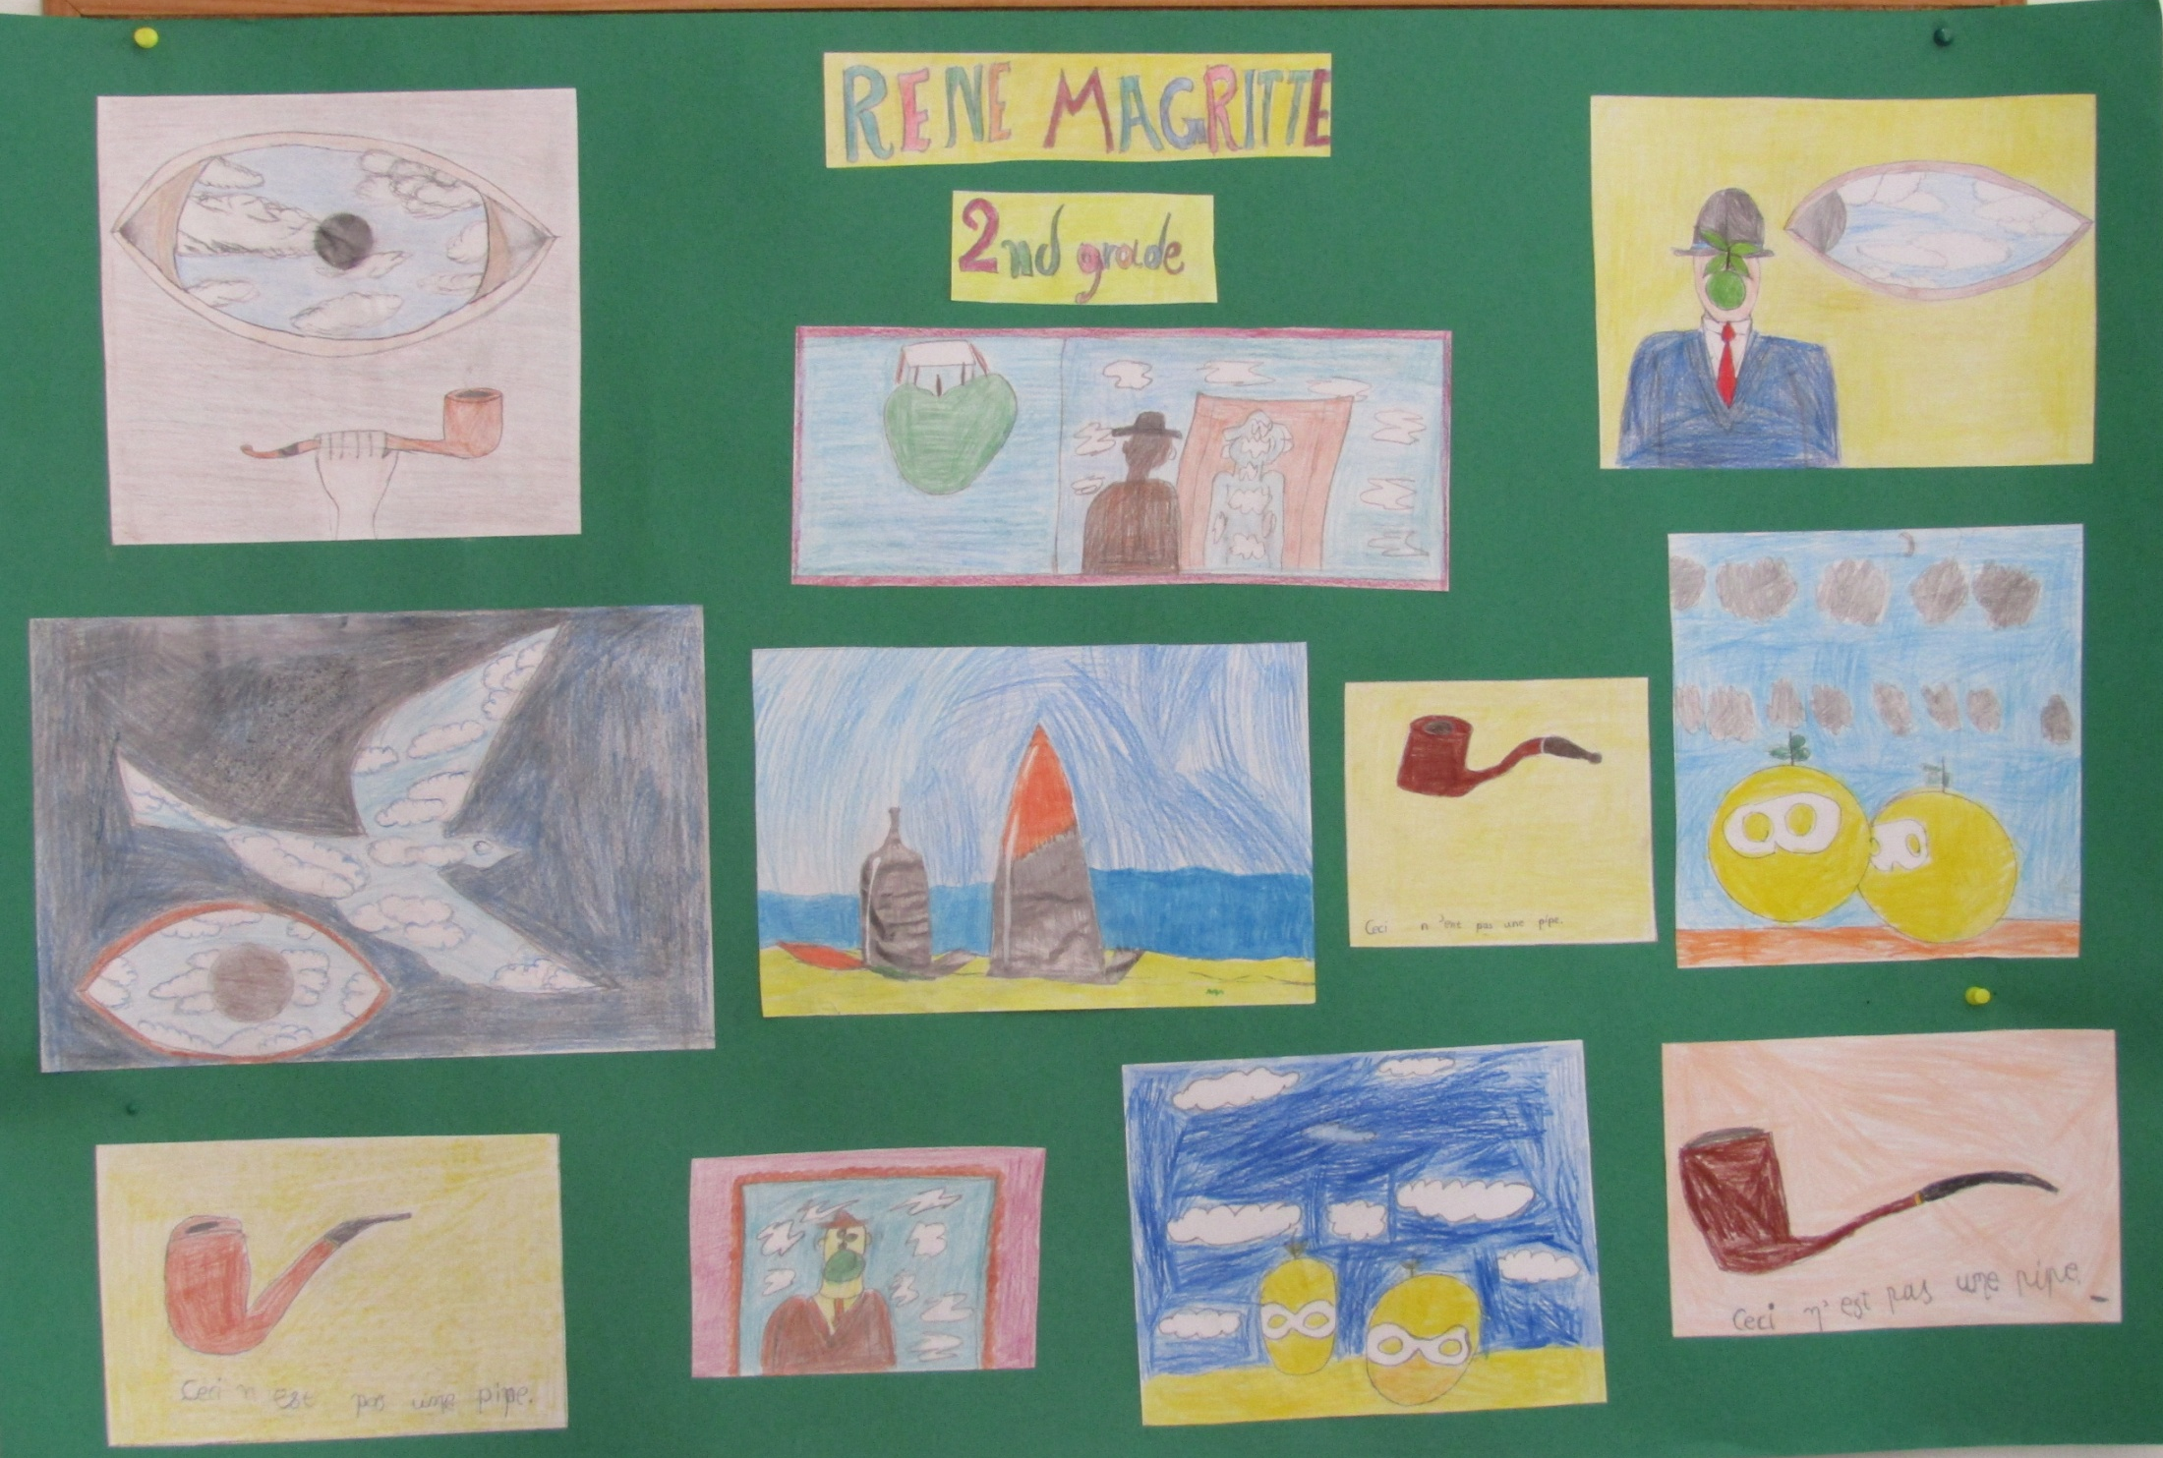
CLASS B2 RENE MAGRITTE- BELGIUM

Slide 7
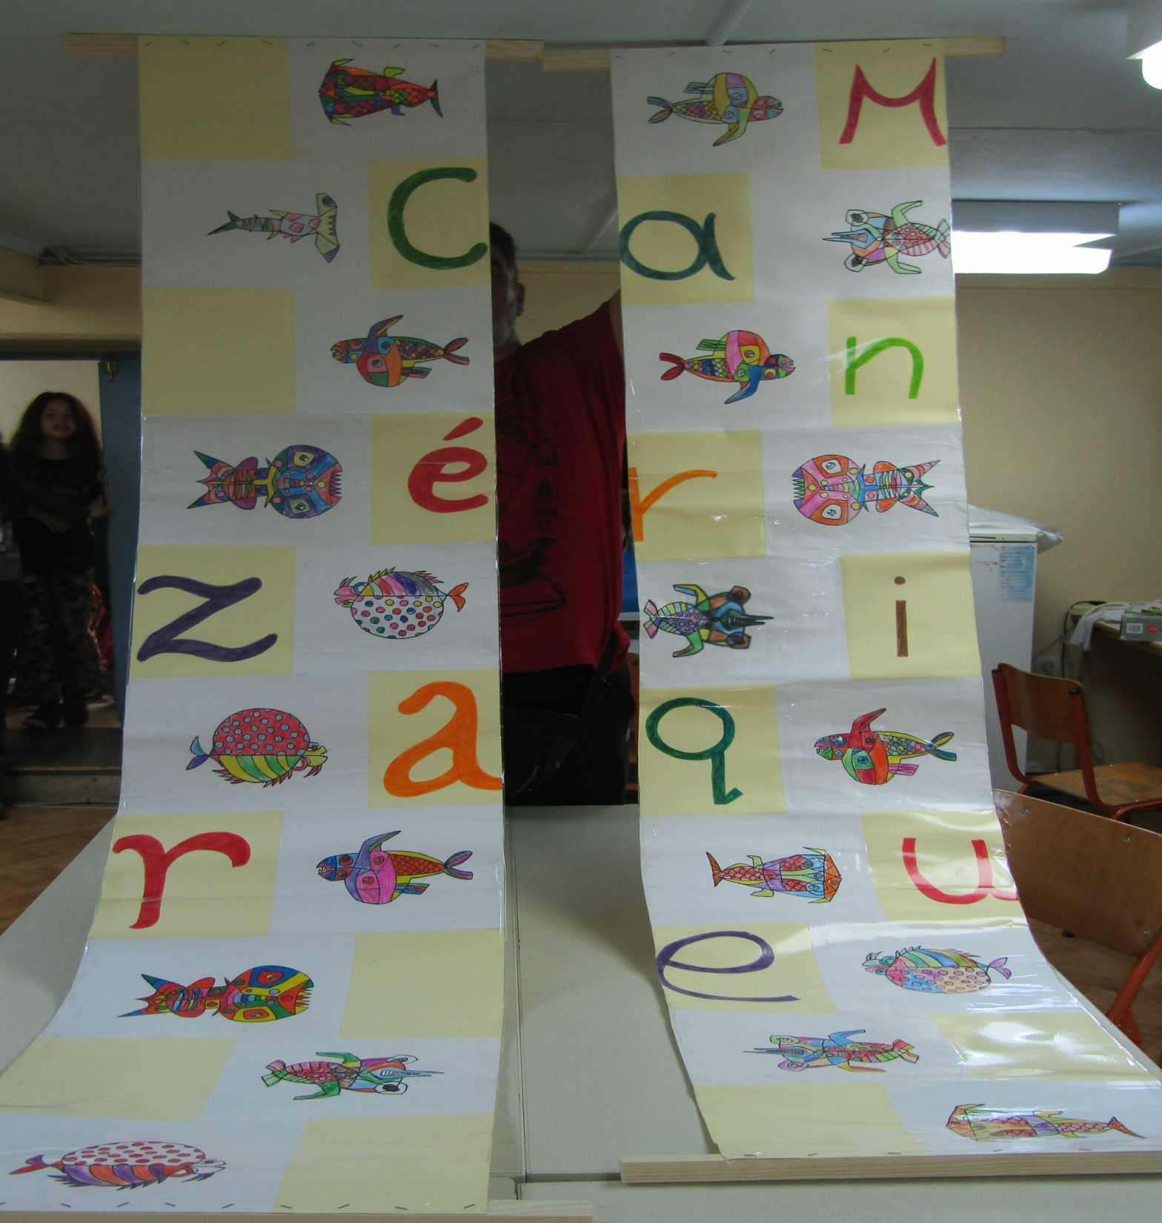
CLASS B1
C. MANRIQUE- SPAIN

Slide 8
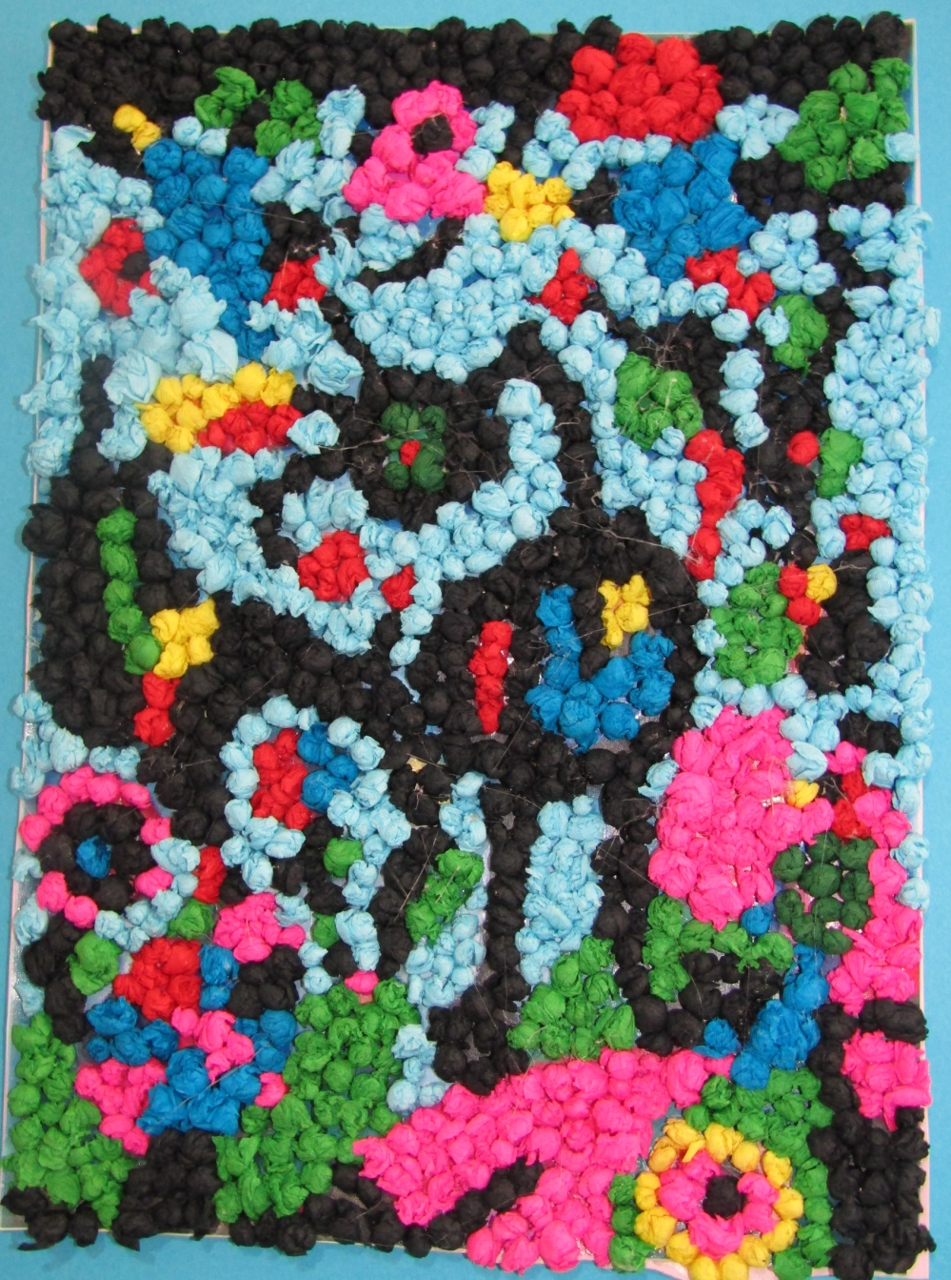
CLASS C , ‘ THE GARDEN’ MIRO-SPAIN

Slide 9
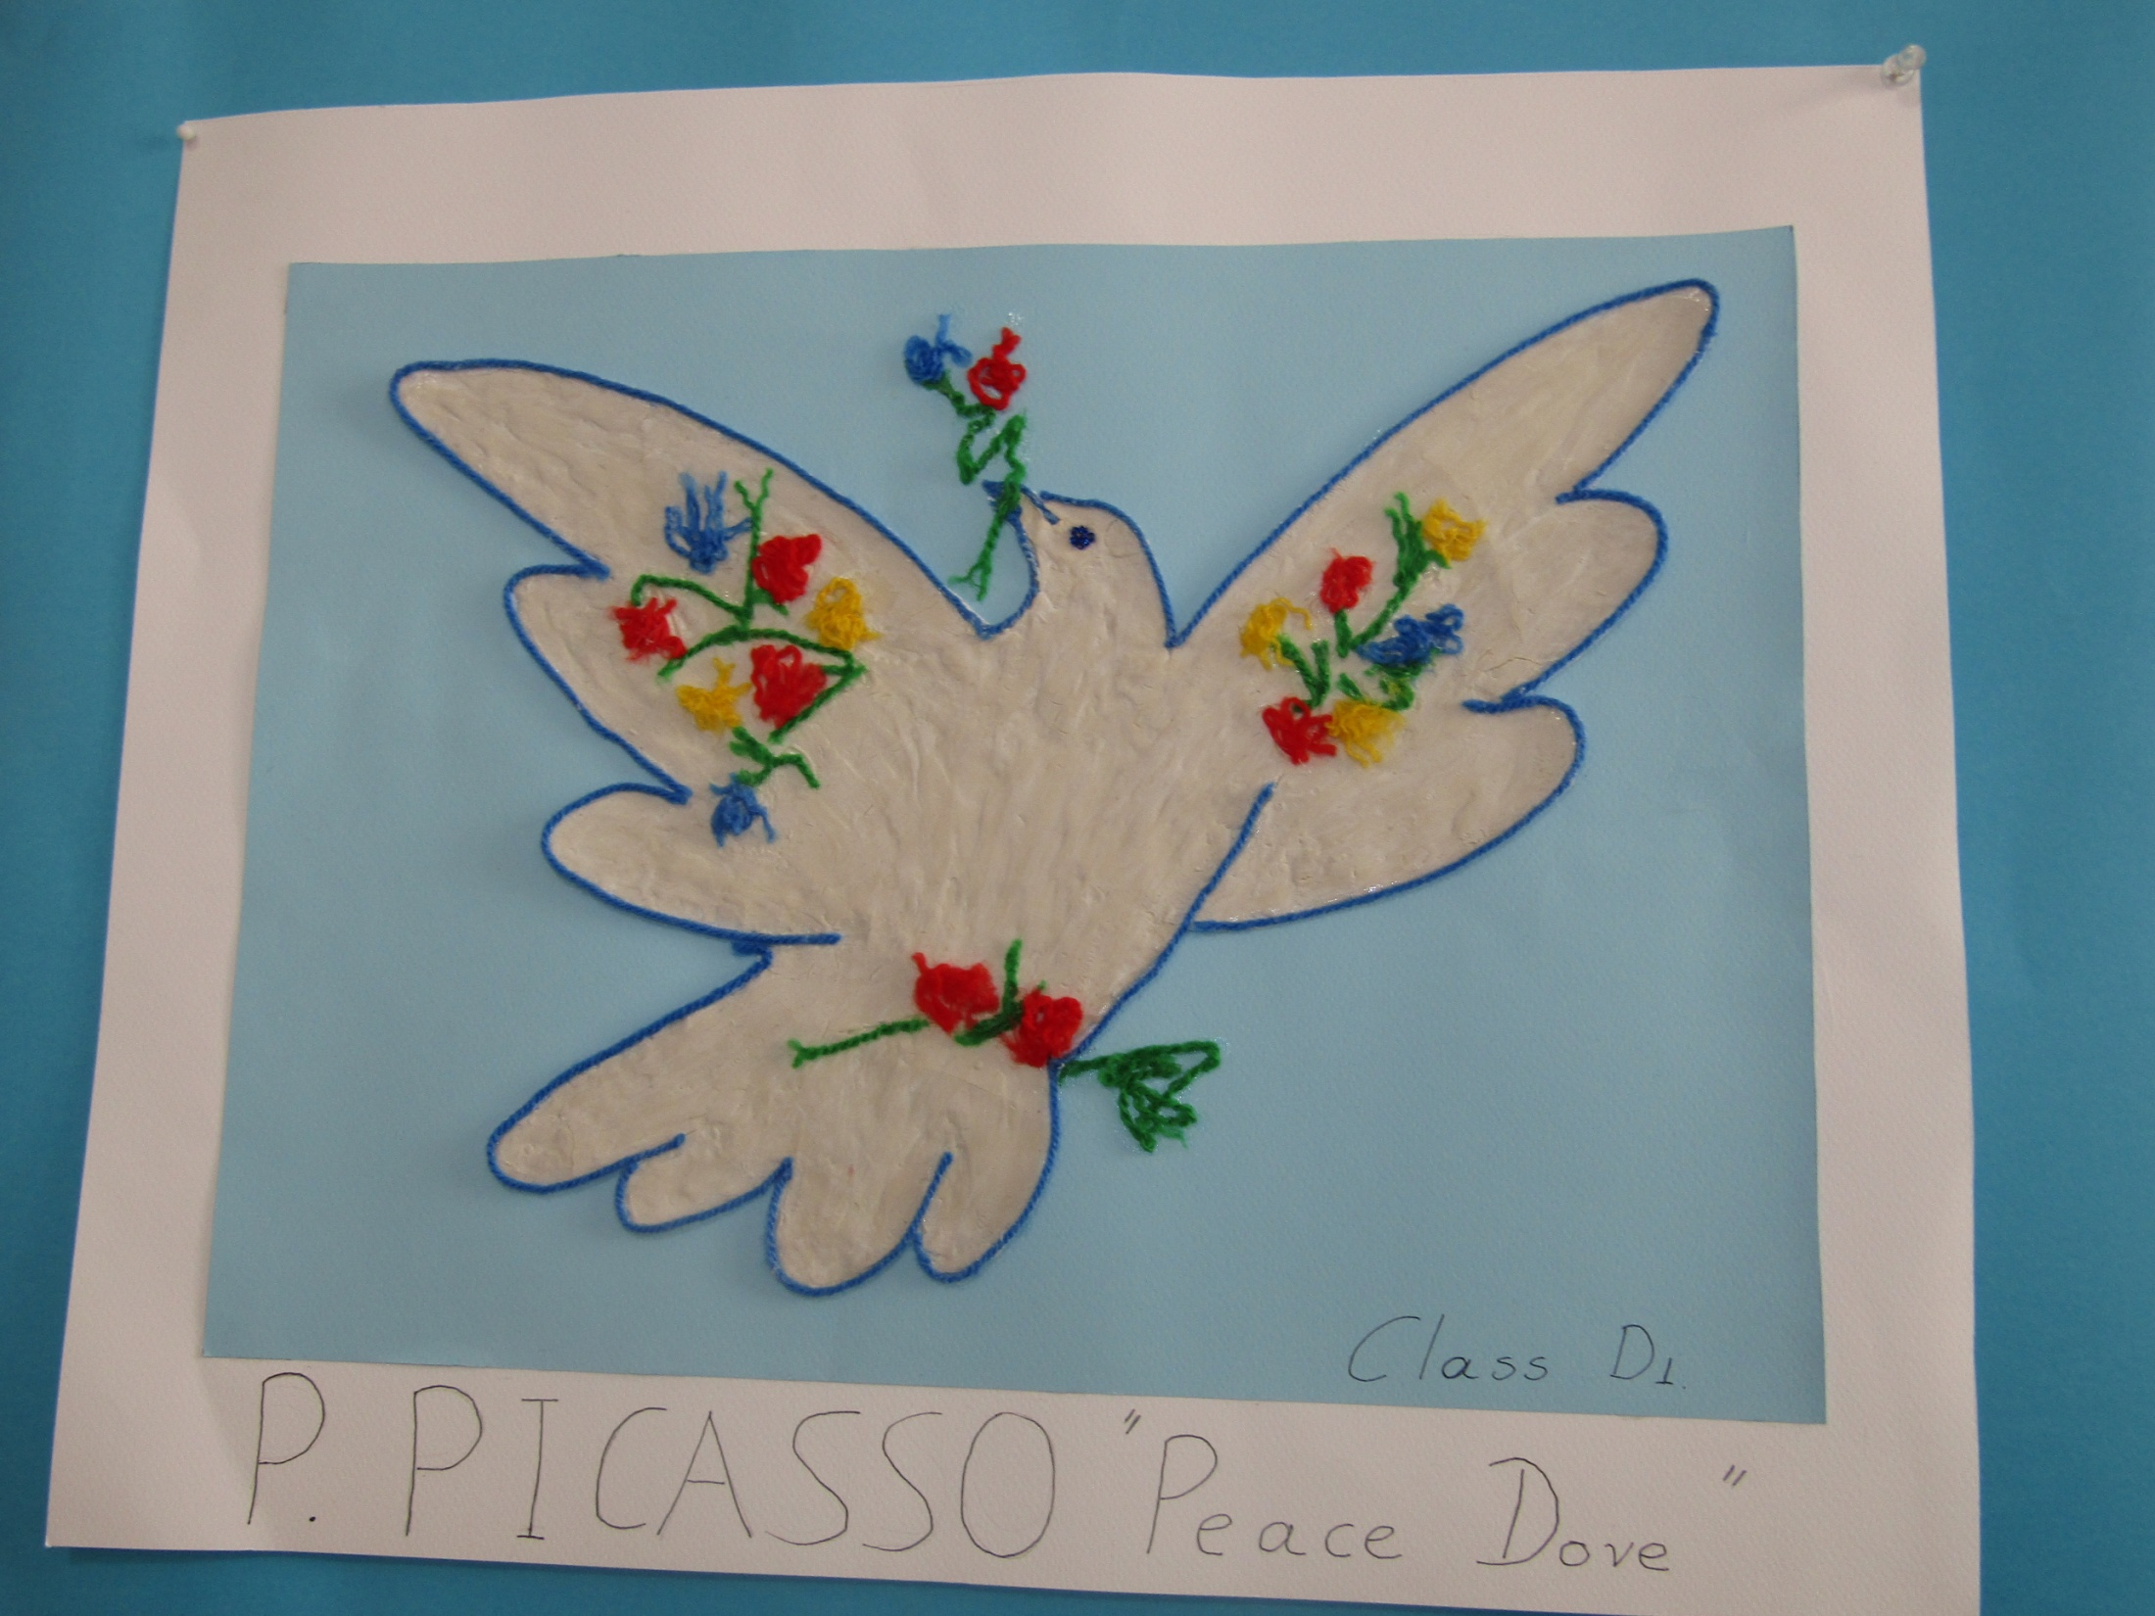

Slide 10
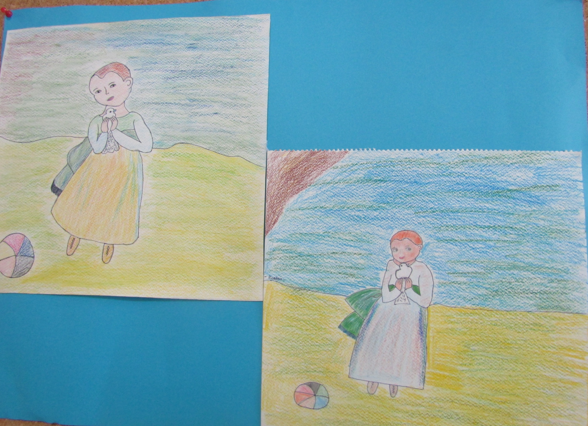
CHILD WITH A DOVE -PICASSO- SPAIN
CLASS D2

Slide 11
CLASS E1
RENE MAGRITTE
BELGIUM

Slide 12
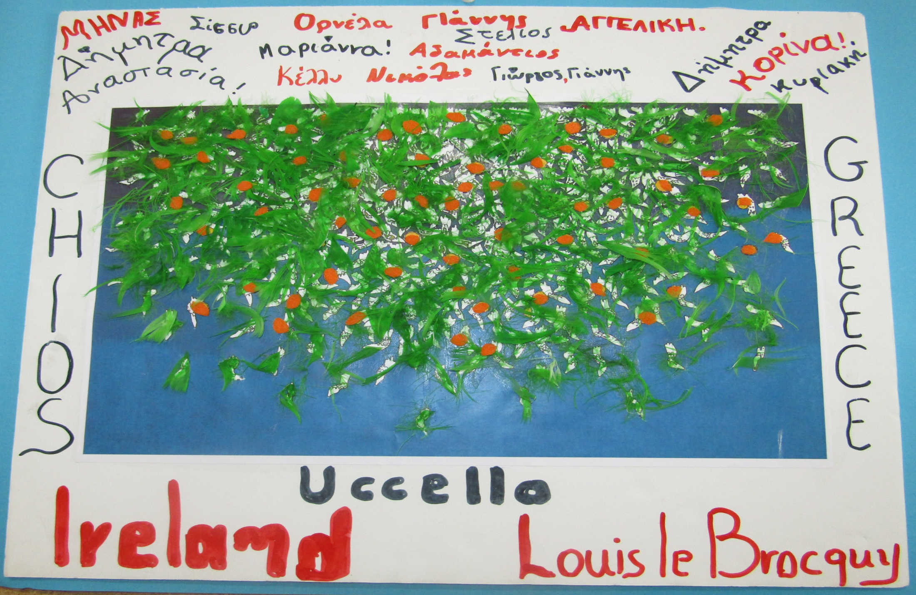
CLASS E2

Slide 13
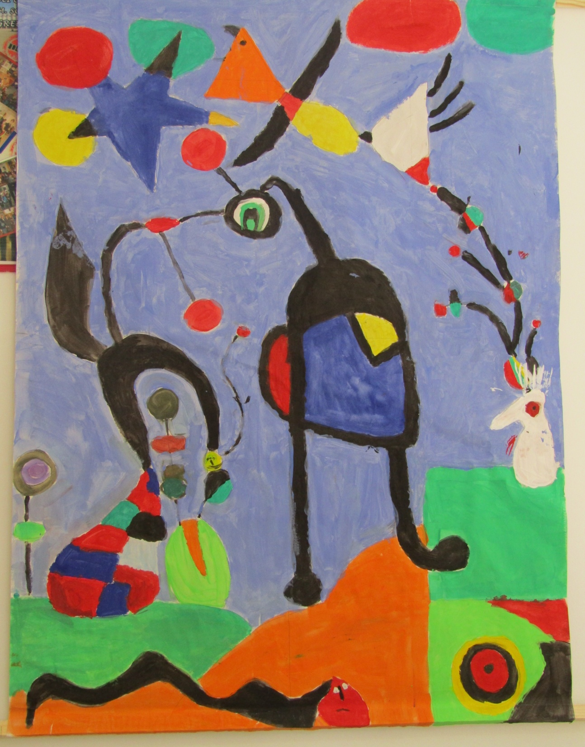
CLASS F
MIRO -SPAIN

Slide 14
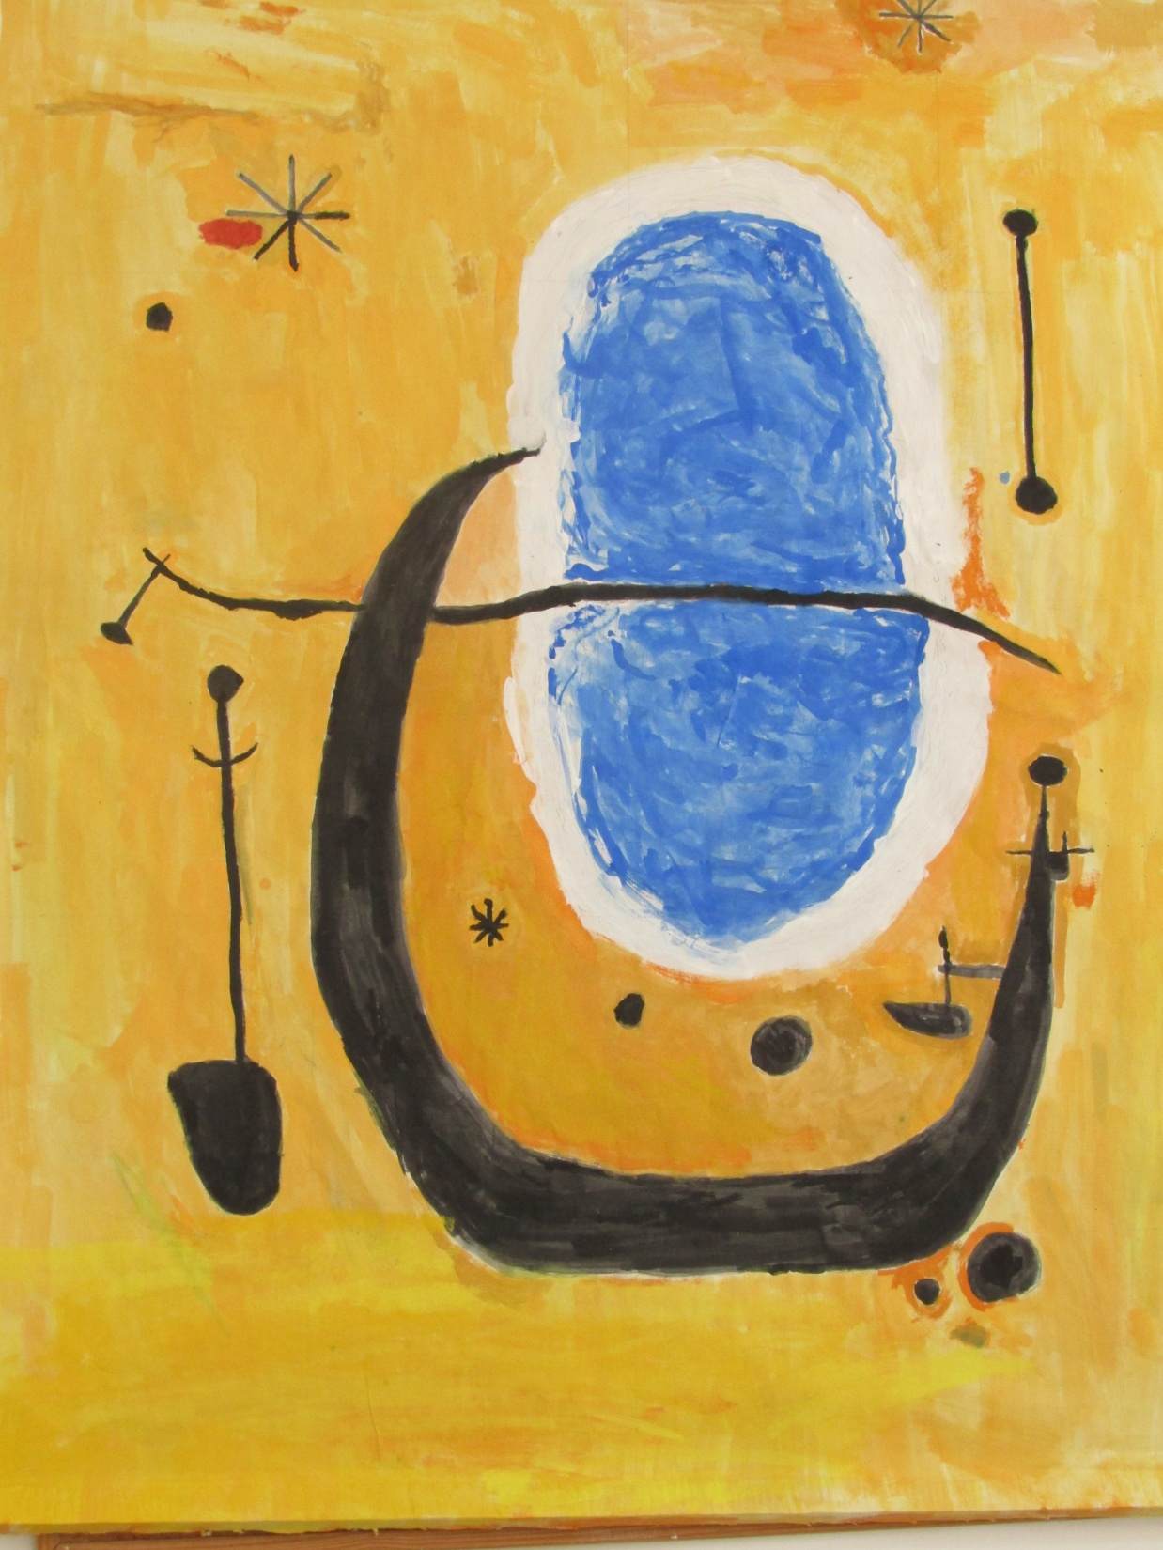
CLASS F MIRO- SPAIN

Slide 15
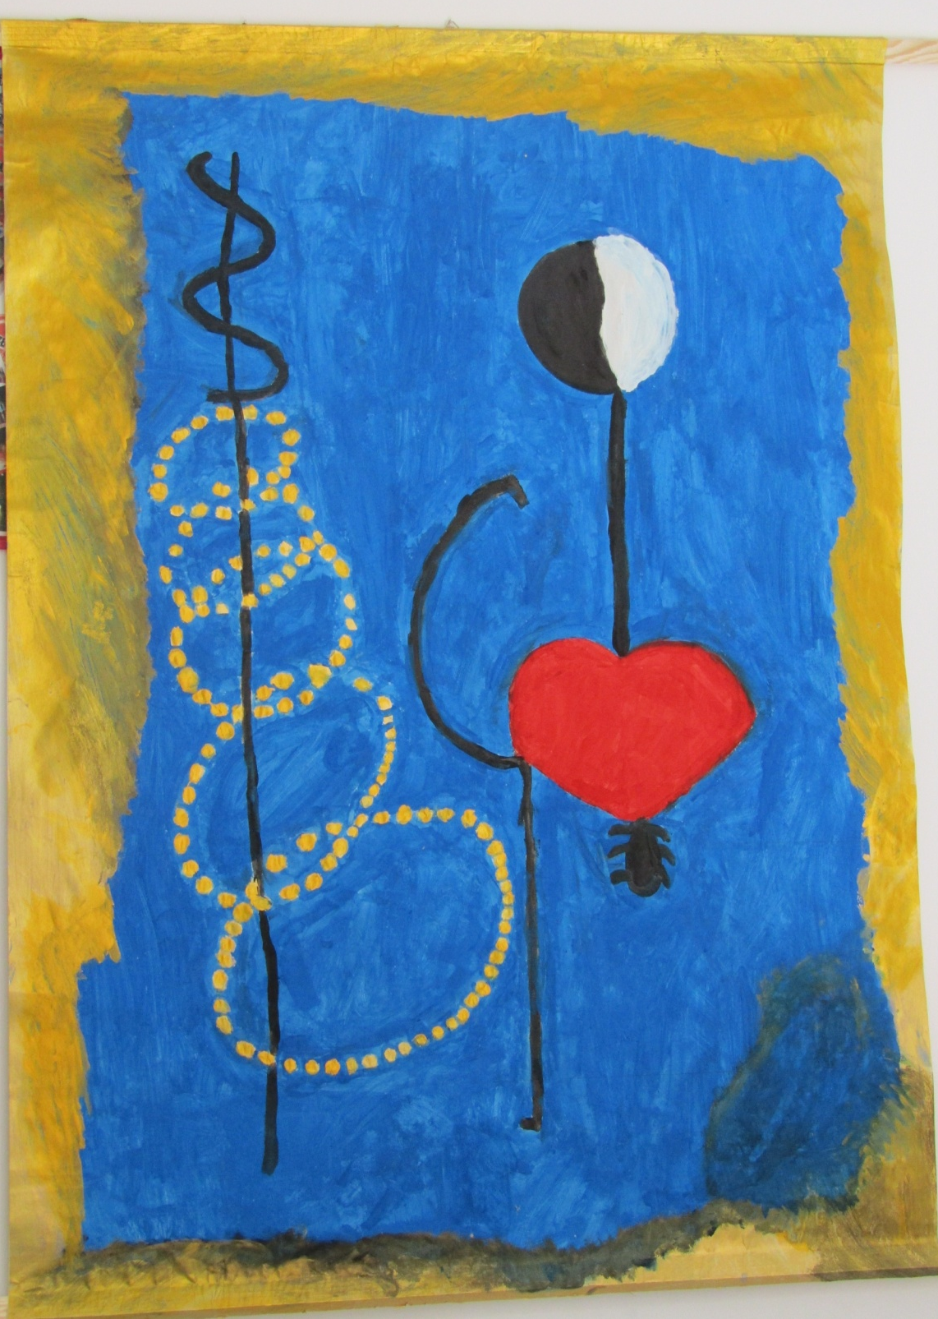
CLASS F
MIRO -SPAIN

Slide 16
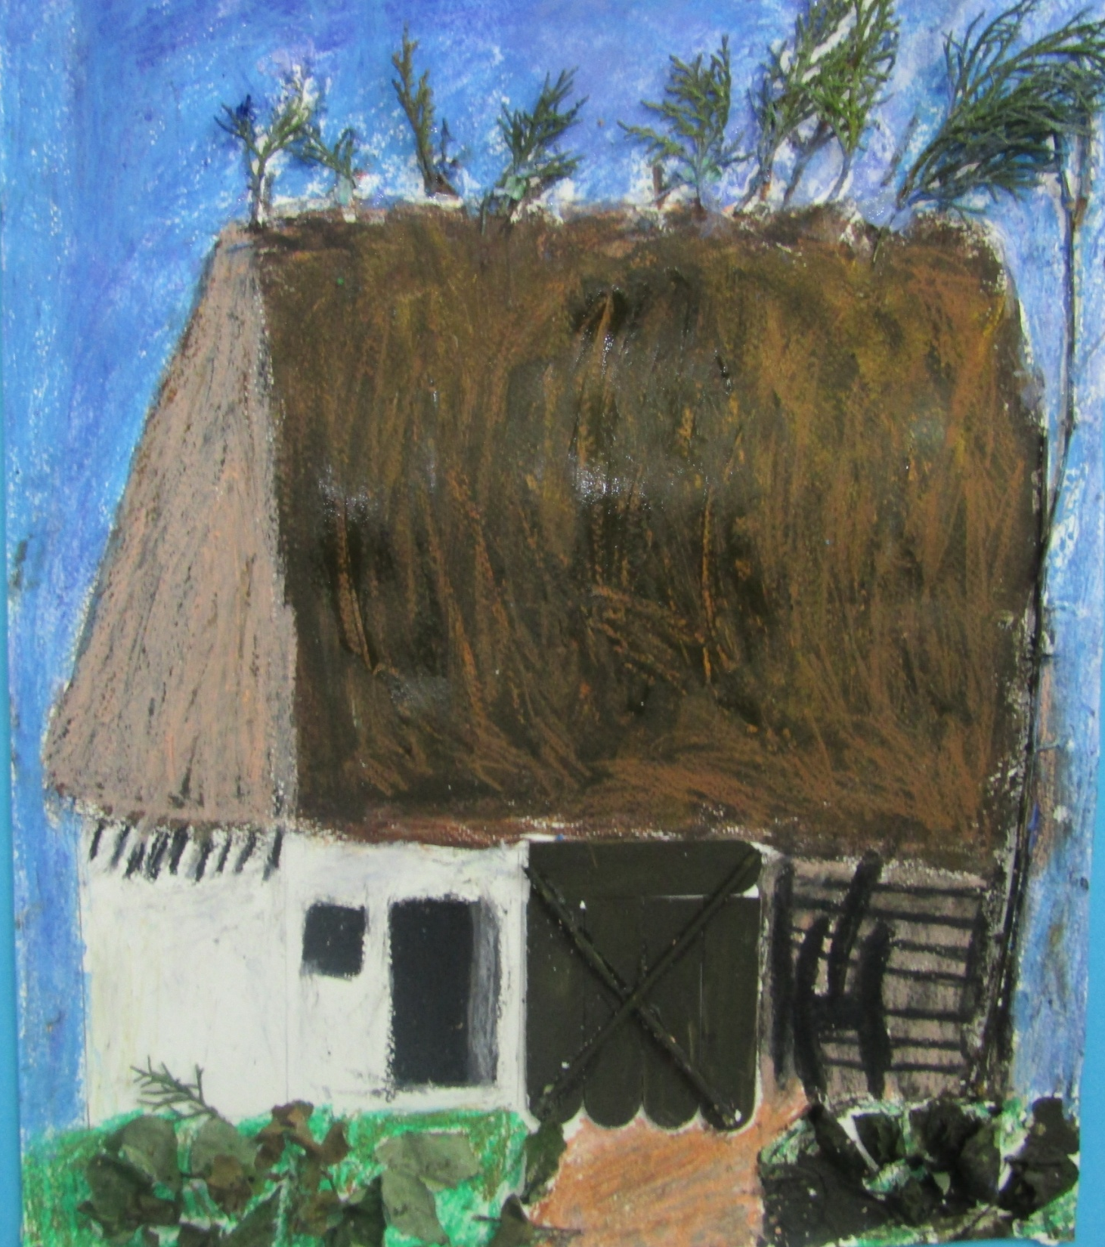
CLASS F- GROUP A
HOREA BERNEA
ROMANIA

Slide 17
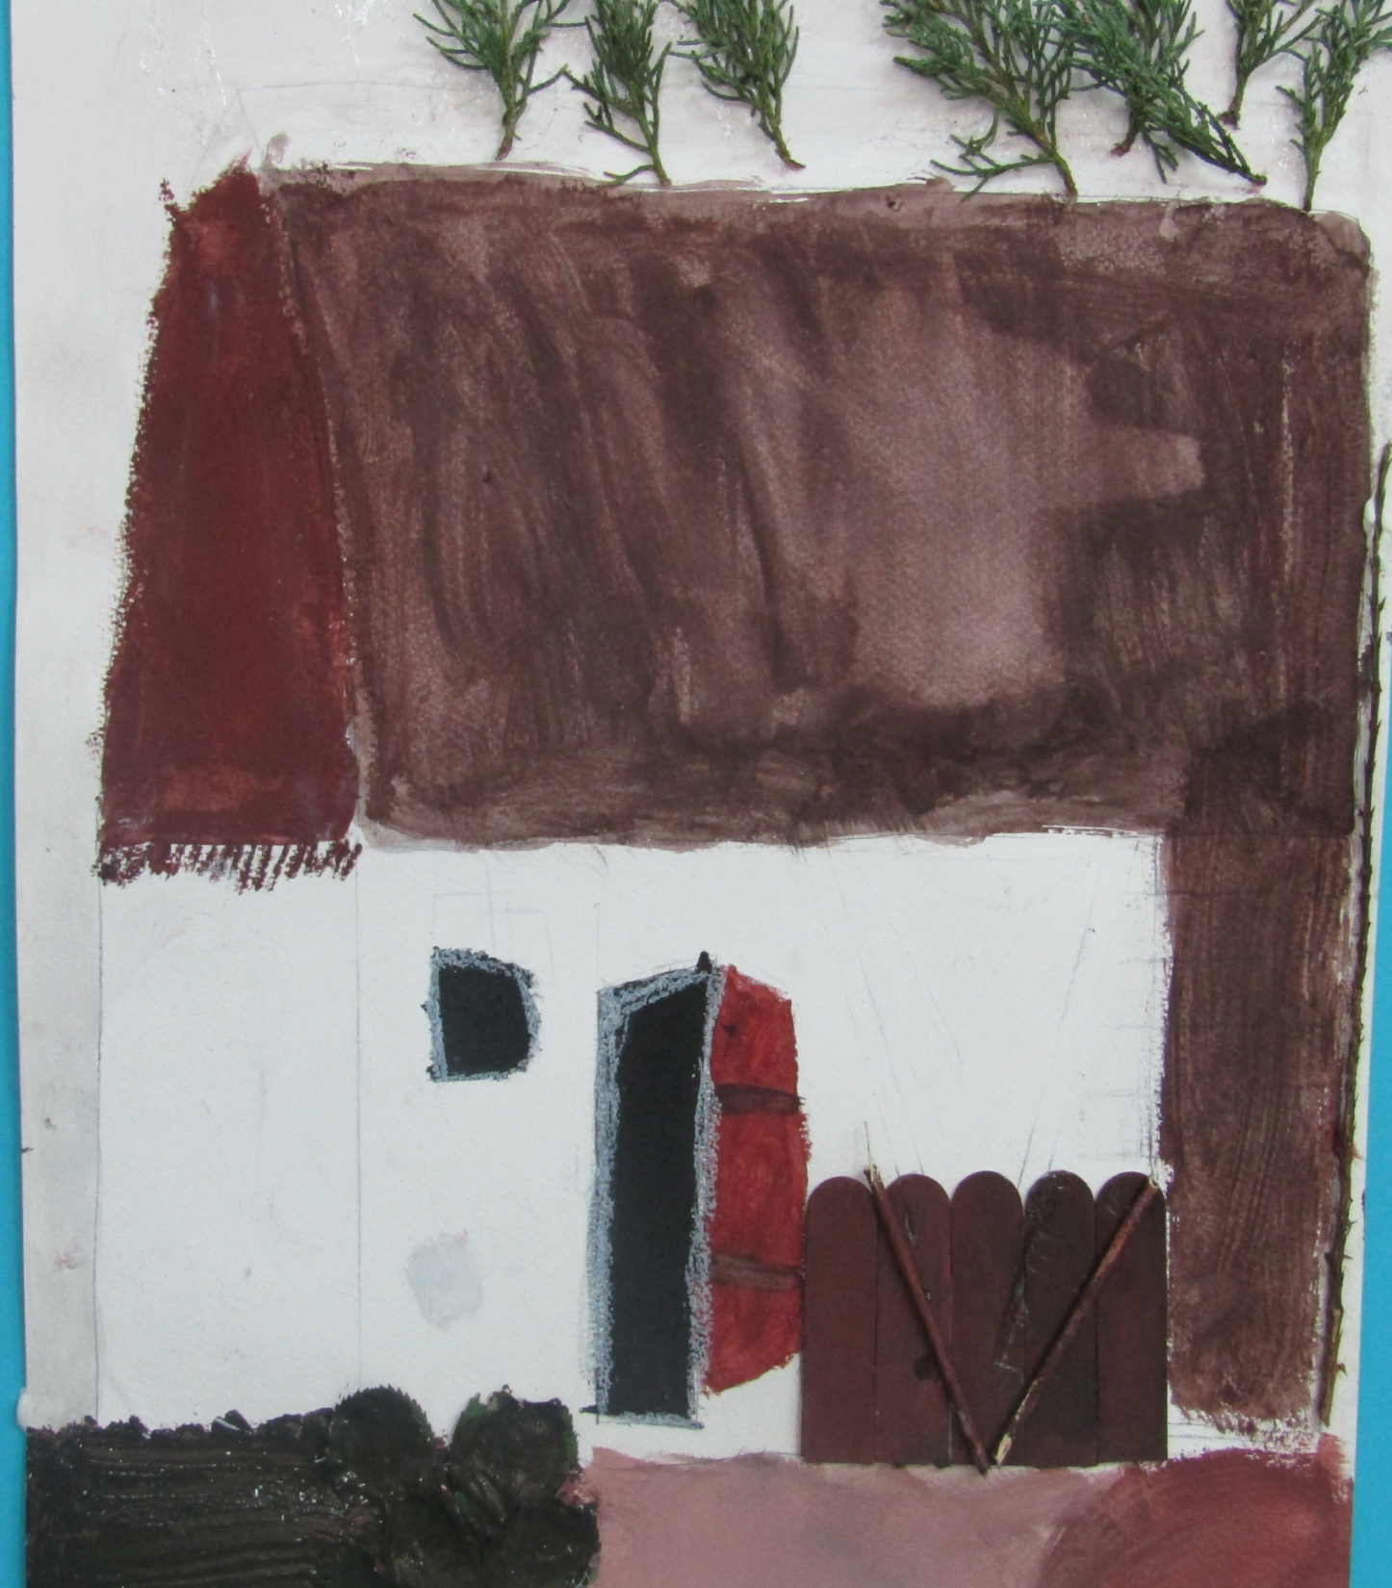
CLASS F – GROUP B
HOREA BERNEA
ROMANIA

Slide 18
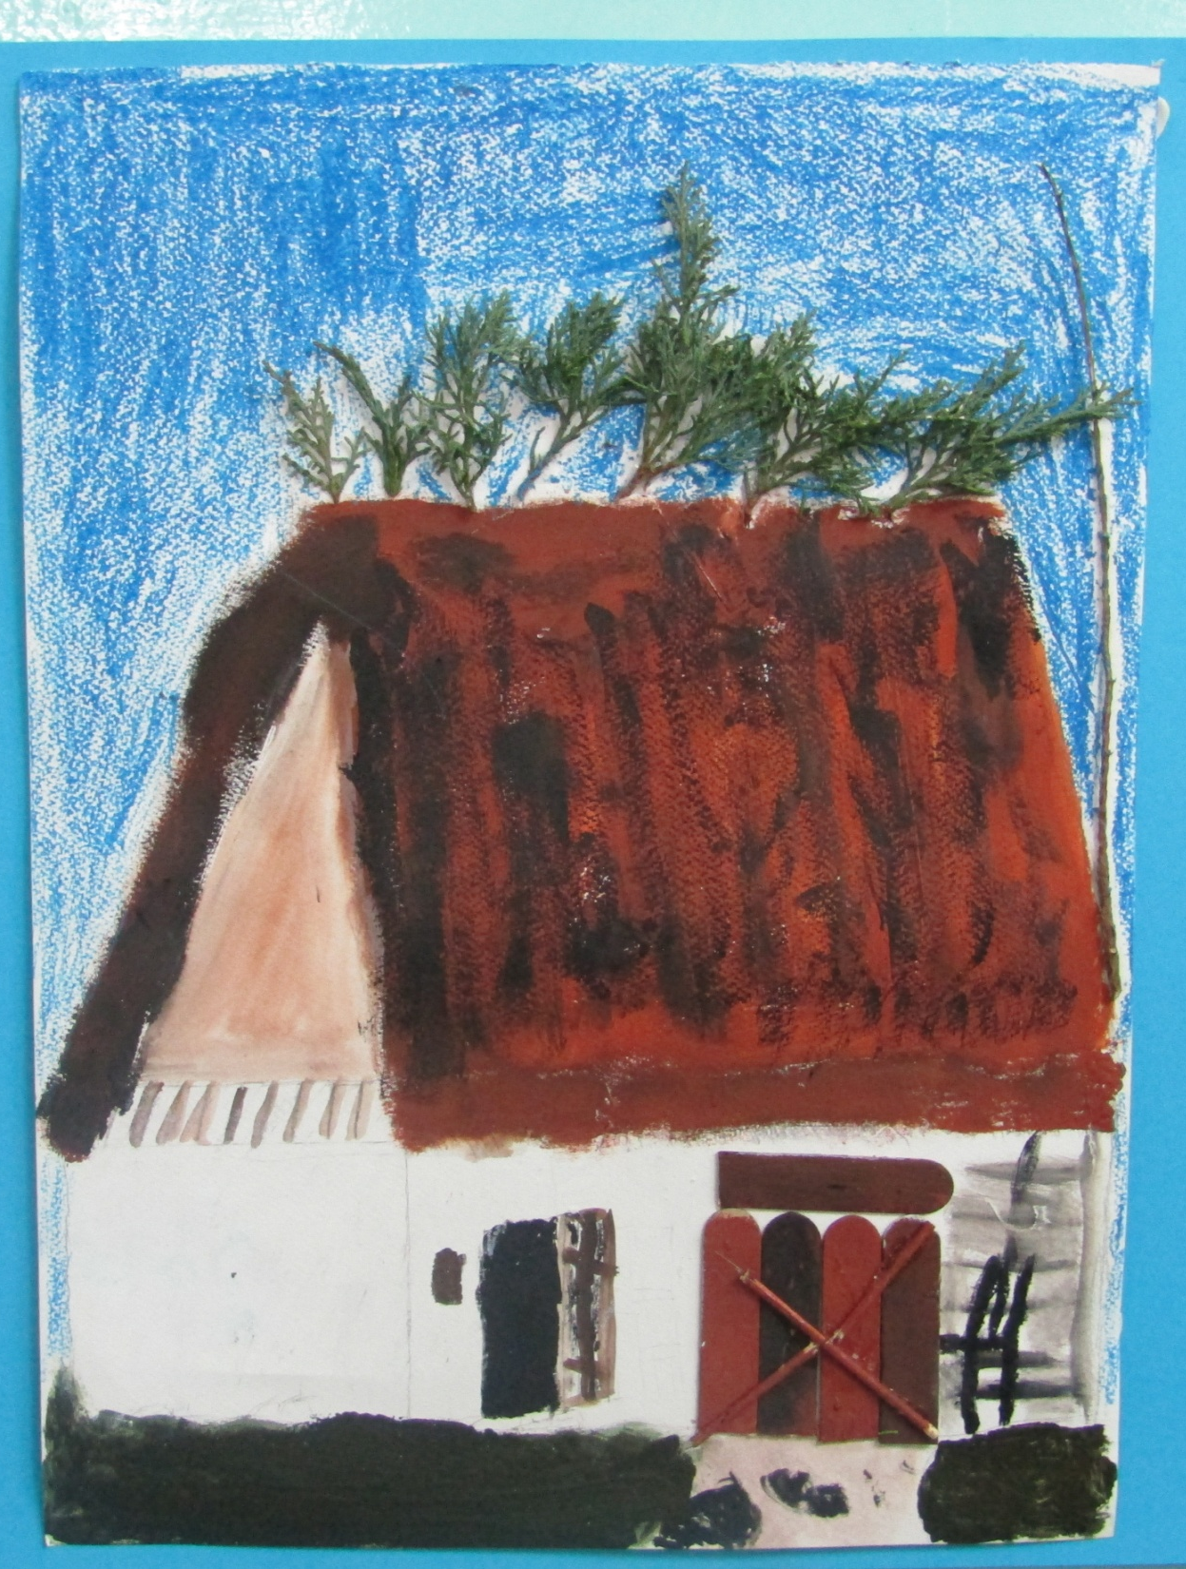
CLASS F- GROUP C
HOREA BERNEA
ROMANIA

