Slide 1
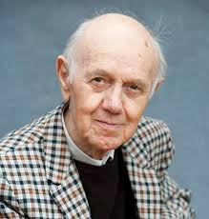
Roger Raveel (1921–2013)

Slide 2
Roger Raveel was born on15 juli 1921 in Machelen.
He died on 30 januari 2013 in Deinze.
He was Belgian.

Slide 3
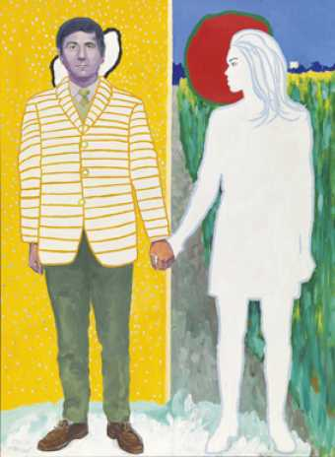
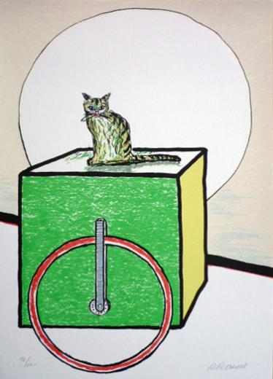
Zijn kunststijl
Stijlkenmerken:
Roger Raveel was a contemporary Flemish painter postexpressionistisch . Raveel style is characterized by a mix of abstract and figurative painting . In the image of a typical Flemish rural backyard with wax wire and concrete walls for example, displays a full white square ( often characterized by a painting of Raveel ) . These white areas set basically for voids or absence. Motion he again by painting spots, because a moving object can not be displayed with a sharp image of it. Integrated trimming often mirrors in his works , so that the area part of his work could be. He did so under more Trolley to transport Heaven (1968).

Slide 4
He was considered an important Belgian painter after WWII. He was inspired by his surroundings. He studied at the Academy of Deinze and the Royal Academy of Fine Arts in Ghent . Through his friend Hugo Claus , he learned in the early 50s painters of the Cobra Group as Karel Appel and Corneille know . He wants very different ways with his painting.
Click here
Filmpje over Roger Raveel.

Slide 5
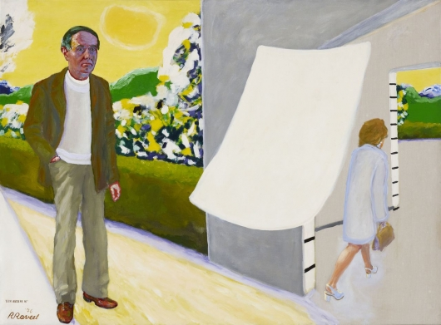
The painting:
Jabbeke

Slide 6
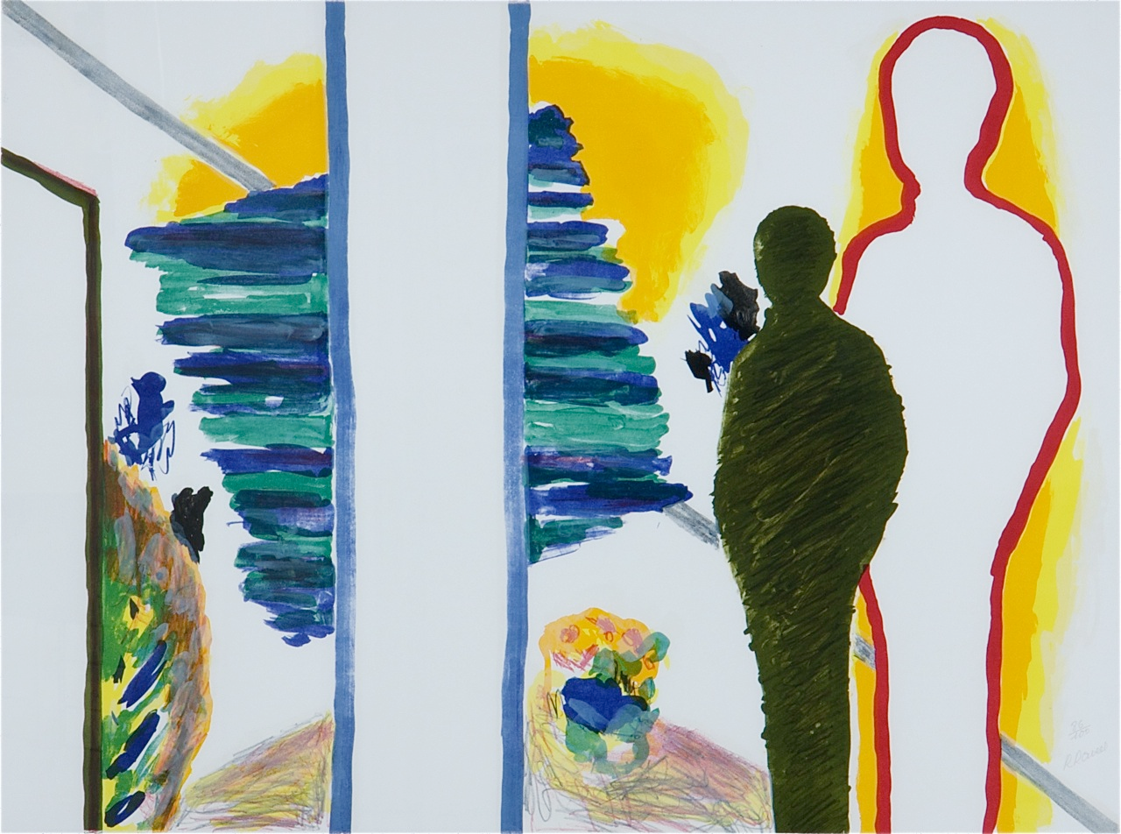
The painting:
In the light Théoule

Slide 7
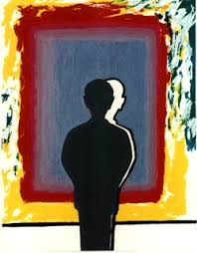
The painting:
Reflection at the reflection in saturated colors

Slide 8
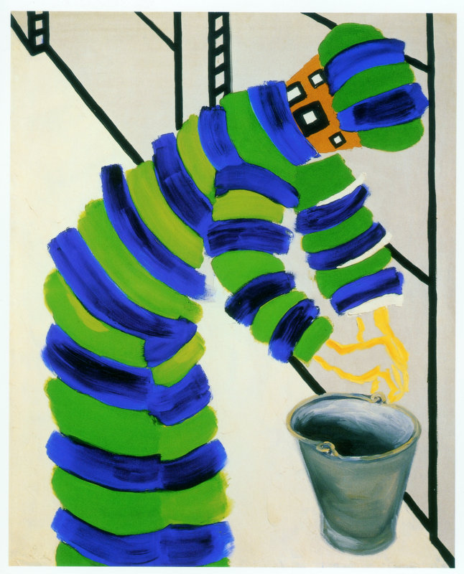
Het schilderij:
Man, emmer, enz. (1967)

Slide 9
Het schilderij:
Mensenpaar(1968)

Slide 10
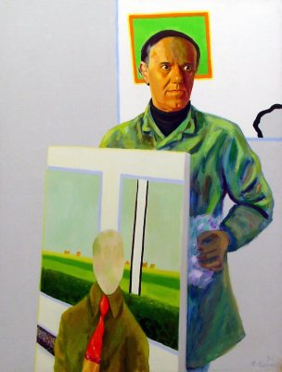
Het schilderij:
Zelfportret met schilderij (1974)

Slide 11
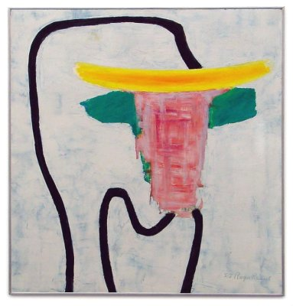
Het schilderij:
Stier(1958)

Slide 12
