Slide 1
Georgeta Năpăruș
Romanian painter 1930–1997
by Daria Ruxandra Bunghez

Slide 2
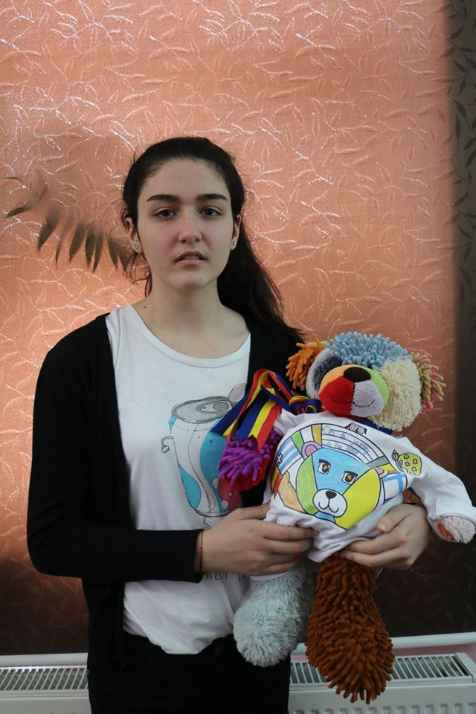
Georgeta Năpăruș
Hei, Jan! Today I’m going to tell you something about Georgeta Năpăruș, a well-known Romanian painter. I hope you will like it! Let’s begin!

Slide 3
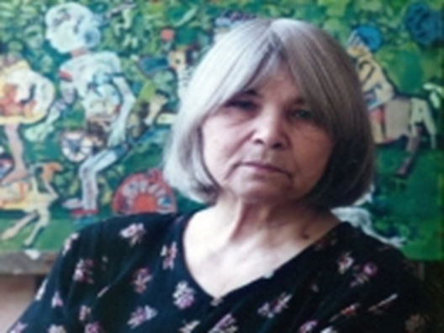
Georgeta Năpăruș
She is Georgeta Năpăruș: She was born in my town, Comarnic. Between 1951-1957, she studied at ,,Nicolae Grigorescu’’ Art School

Slide 4
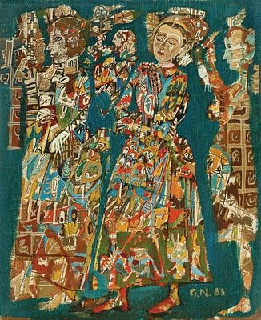
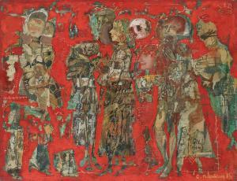
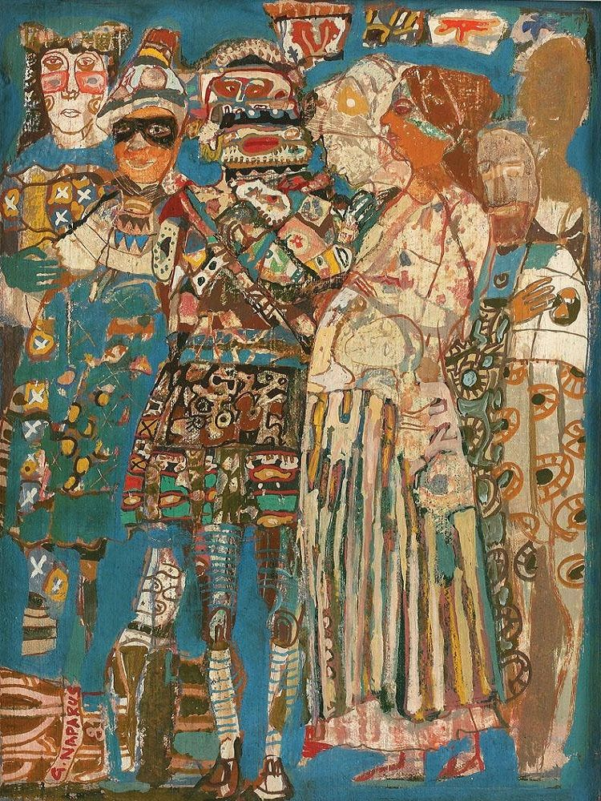
Georgeta Năpăruș
Her paintings were full of life and colorful. Here are some of her paintings:

Slide 5
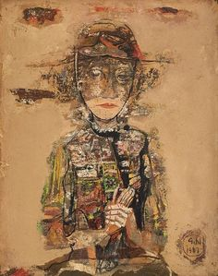
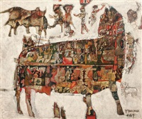
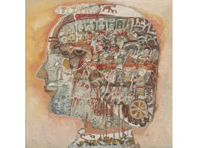
Georgeta Năpăruș
But in 1997, her last year of life, she became sick and sad. Her paintings were affected, too. They were painted in dark colors and became depressing, like these:

Slide 6
Georgeta Năpăruș
Georgeta Naparus was such a great painter. She had exhibitions all over the world: France, Germany, Hungary, Brazil, Canada, Finland, China, etc.
She was full of life, and her paintings were so deep. She died at the age of 67. I hope you like it and thank you for your attention!

