Slide 1
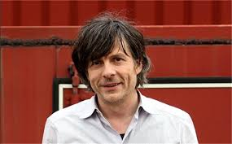
Kamagurka

Slide 2
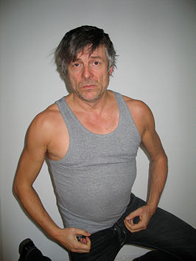
Kamagurka is born in Nieuwpoort (Belgium) on the 5th of May 1955.
His real name is Luc Charles Zeebroek.
He is living in Bruges.

Slide 3
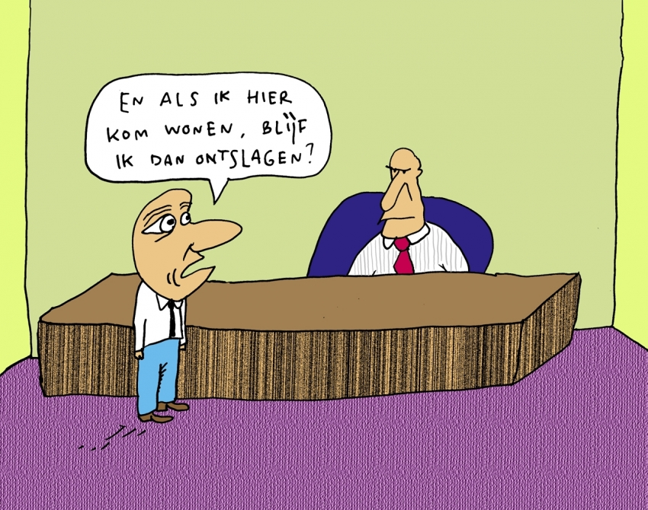
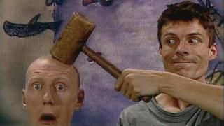
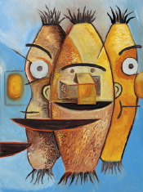
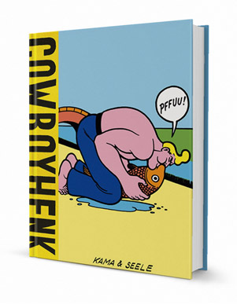
Kamagurka is a cartoonist. He also makes performances. He worked for radio en television.
Not so many people know that Kamagurka is a appreciated painter. You see: he is an all-round artist.. .

Slide 4
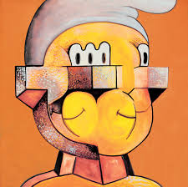
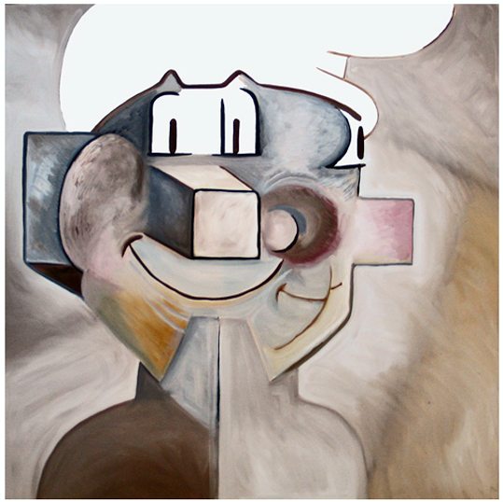
NEO-CUBISM
Cubistic smurf
Click on this link to see more paintings painted in the same style.
http://www.kamagurka.com/en/products/111/paintings/neo-cubism

Slide 5
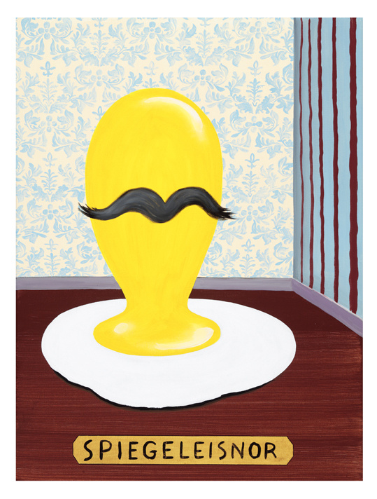
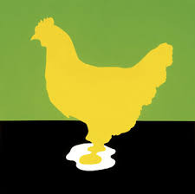
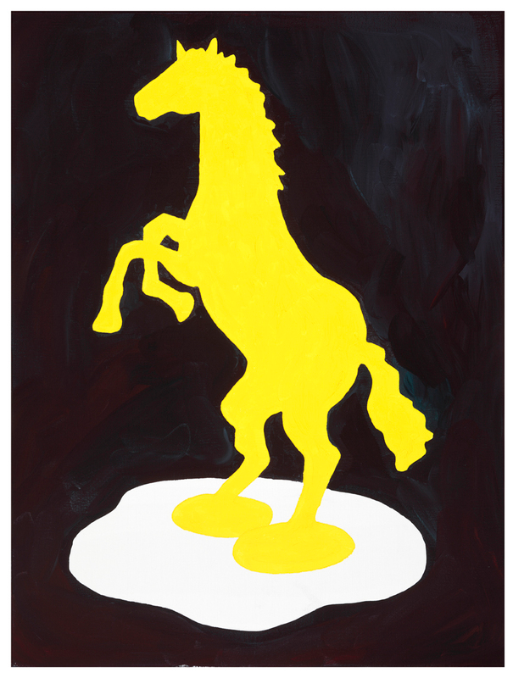
FRIED EGG PAINTINGS
Click on this link to see more paintings painted in the same style.
http://www.kamagurka.com/en/products/1215/paintings/fried-egg-paintings

Slide 6
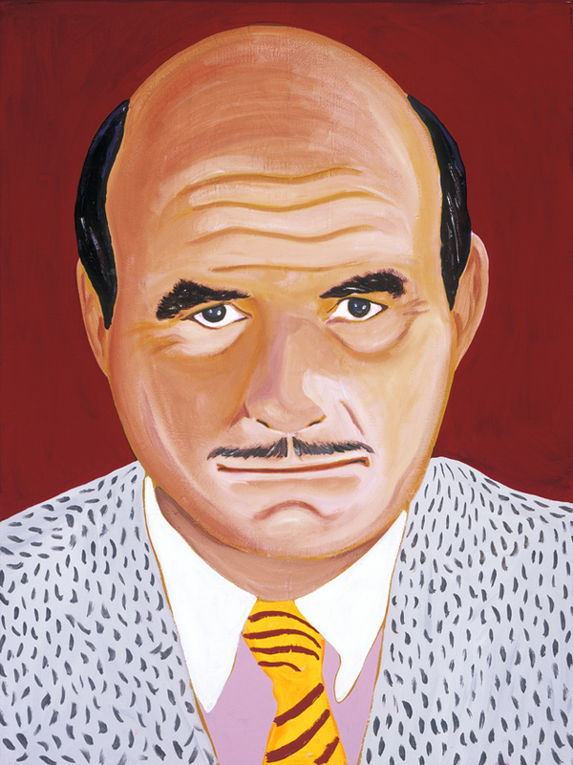
ACCIDENTALISM
Portrait of an unknown man.
Click on this link to see more paintings painted in the same style.
http://www.kamagurka.com/en/products/1214/paintings/accidentalism

Slide 7
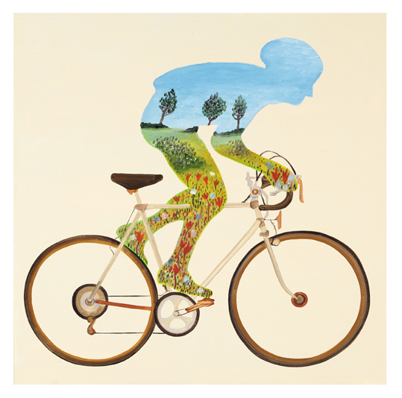
LAZY LANDSCAPES
Click on this link to see more paintings painted in the same style.
http://www.kamagurka.com/en/products/1218/paintings/lazy-landscapes

Slide 8
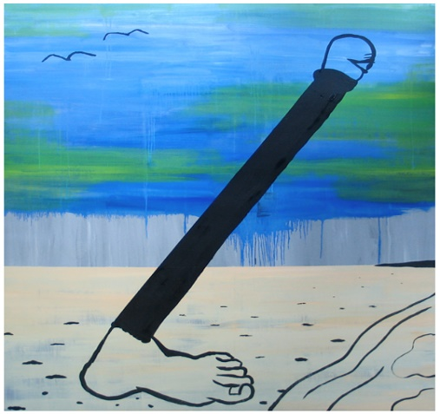
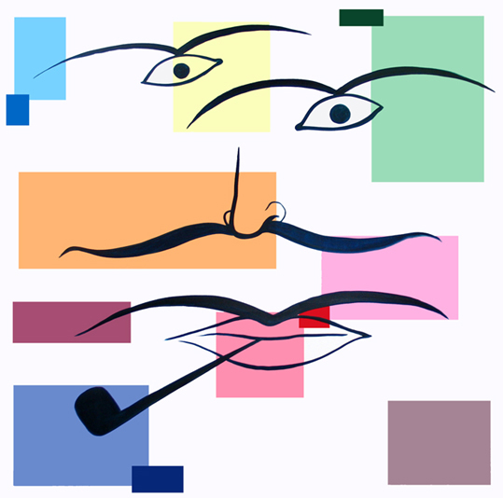
KAMALMANAK
Walking on the beach
2008
Kama boogie woogie with pipe
2008
Click on this link to see more paintings painted in the same style.
http://www.kamagurka.com/en/products/117/kamalmanak

Slide 9
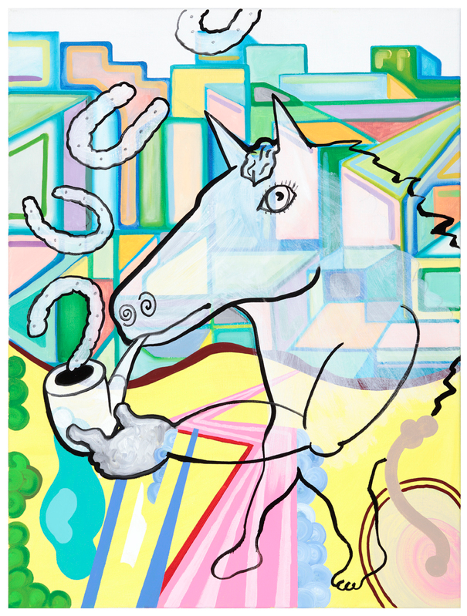
OTHER WORKS
Horse smoking
Click on this link to see more paintings painted in the same style.
http://www.kamagurka.com/en/products/1213/paintings/other-works

Slide 10
Here is a link to a video.
Click here to watch a video with paintings of Kamagurka..

Slide 11
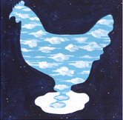
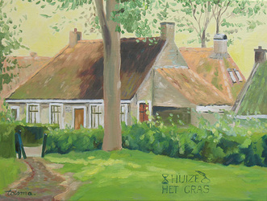
A SMALL QUIZ…
YOU KNOW KAMAGURKA WILL NOT THAT WE TAKE HIS PAINTINGS VERY SERIOUSLY.
WHICH PAINTING IS MADE BY KAMAGURKA?

