Slide 1
HELLO!
My name is INGRID and this is my friend JAN.
We like to present you a great Romanian painter:
STEFAN LUCHIAN

Slide 2
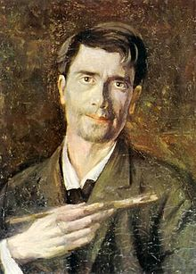
STEFAN LUCHIAN
Born - 1 February 1868 (in Ștefanesti, a village of Botosani Country)
Died - 28 June 1916
Nationality– Romanian
Famous for - lanscapes and still life

Slide 3
STEFAN LUCHIAN
In 1885, Luchian joined the painting class at the Fine Arts School;
Chrysanthemums

Slide 4
STEFAN LUCHIAN
In 1889 Luchian studied for two semesters at the Munich Fine Arts Academy;
The Mounted Red Hussar

Slide 5
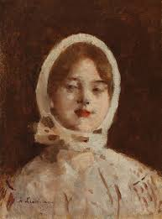
STEFAN LUCHIAN
After his return to Romania, he took part in the first exhibition of the Cercul Artistic art group;
Country girl

Slide 6
STEFAN LUCHIAN
In 1890, he left for Paris, where he studied at the Académie Julian;
Portrait of a Woman 1901

Slide 7
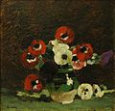
STEFAN LUCHIAN
Luchian's painting shows the influence of Impressionism, Post-impressionism and Symbolism;
Anemona Flowers, 1908

Slide 8
STEFAN LUCHIAN
In 1896, Stefan Luchian was one of the main founders of Bucharest's Salonul Independenţilor
The River Meadow at Poduri, 1909

Slide 9
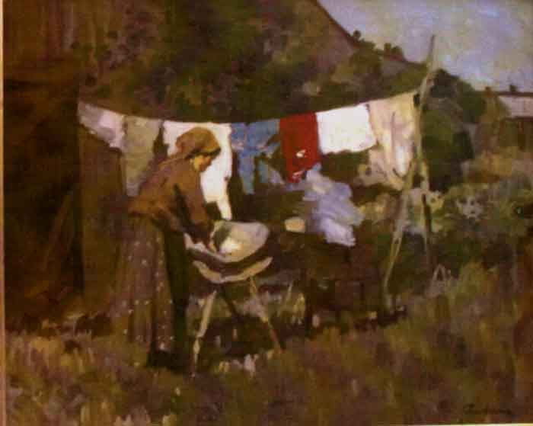
STEFAN LUCHIAN
In 1900, Luchian suffered the first symptoms of multiple sclerosis, the disease which, after some initial improvements, was to haunt him for the rest of his life.
The Laundress

Slide 10
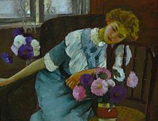
STEFAN LUCHIAN
Paralysed from 1909, he had to live the rest of his life in an armchair. He was no longer able to hold the painter's brush with his fingers, and was instead helped to tie it to his wrist in order to continue work.
Interior (Lorica), Luchian's last painting (1913)

Slide 11
THANK YOU!
Bye!

