Slide 1
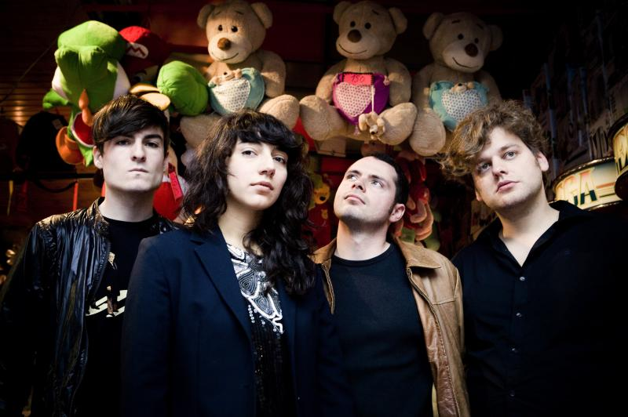
Intergalactic lovers

Slide 2
information
Stardet in 2008
1 gril & 3 boys
Brendan Corbey (drums)
Maarten Huygens (gitaar)
Raf De Mey (bas)
Lara Chedraoui (song)

Slide 3
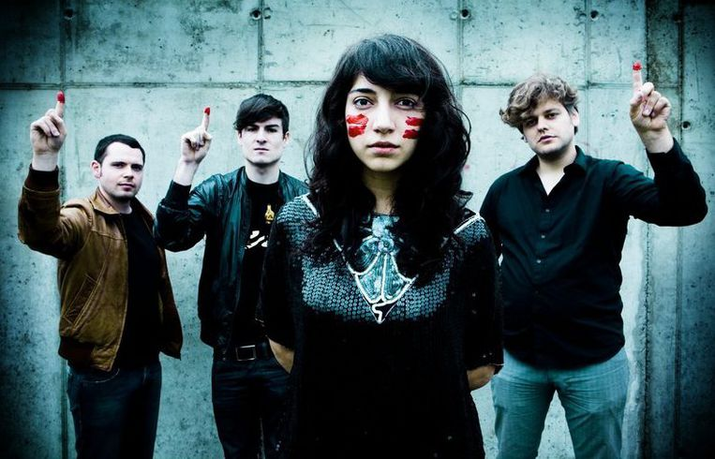
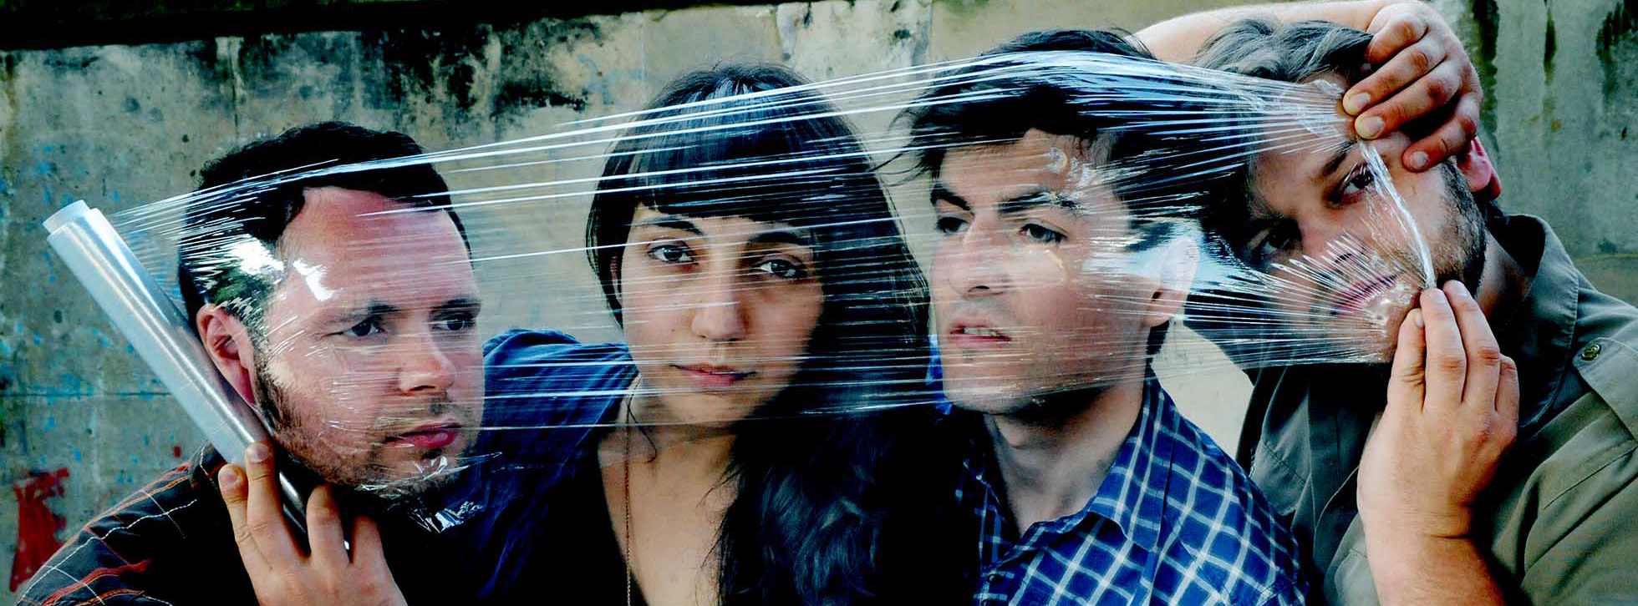
Click on th Photos to hear the Songs

